Slide 2
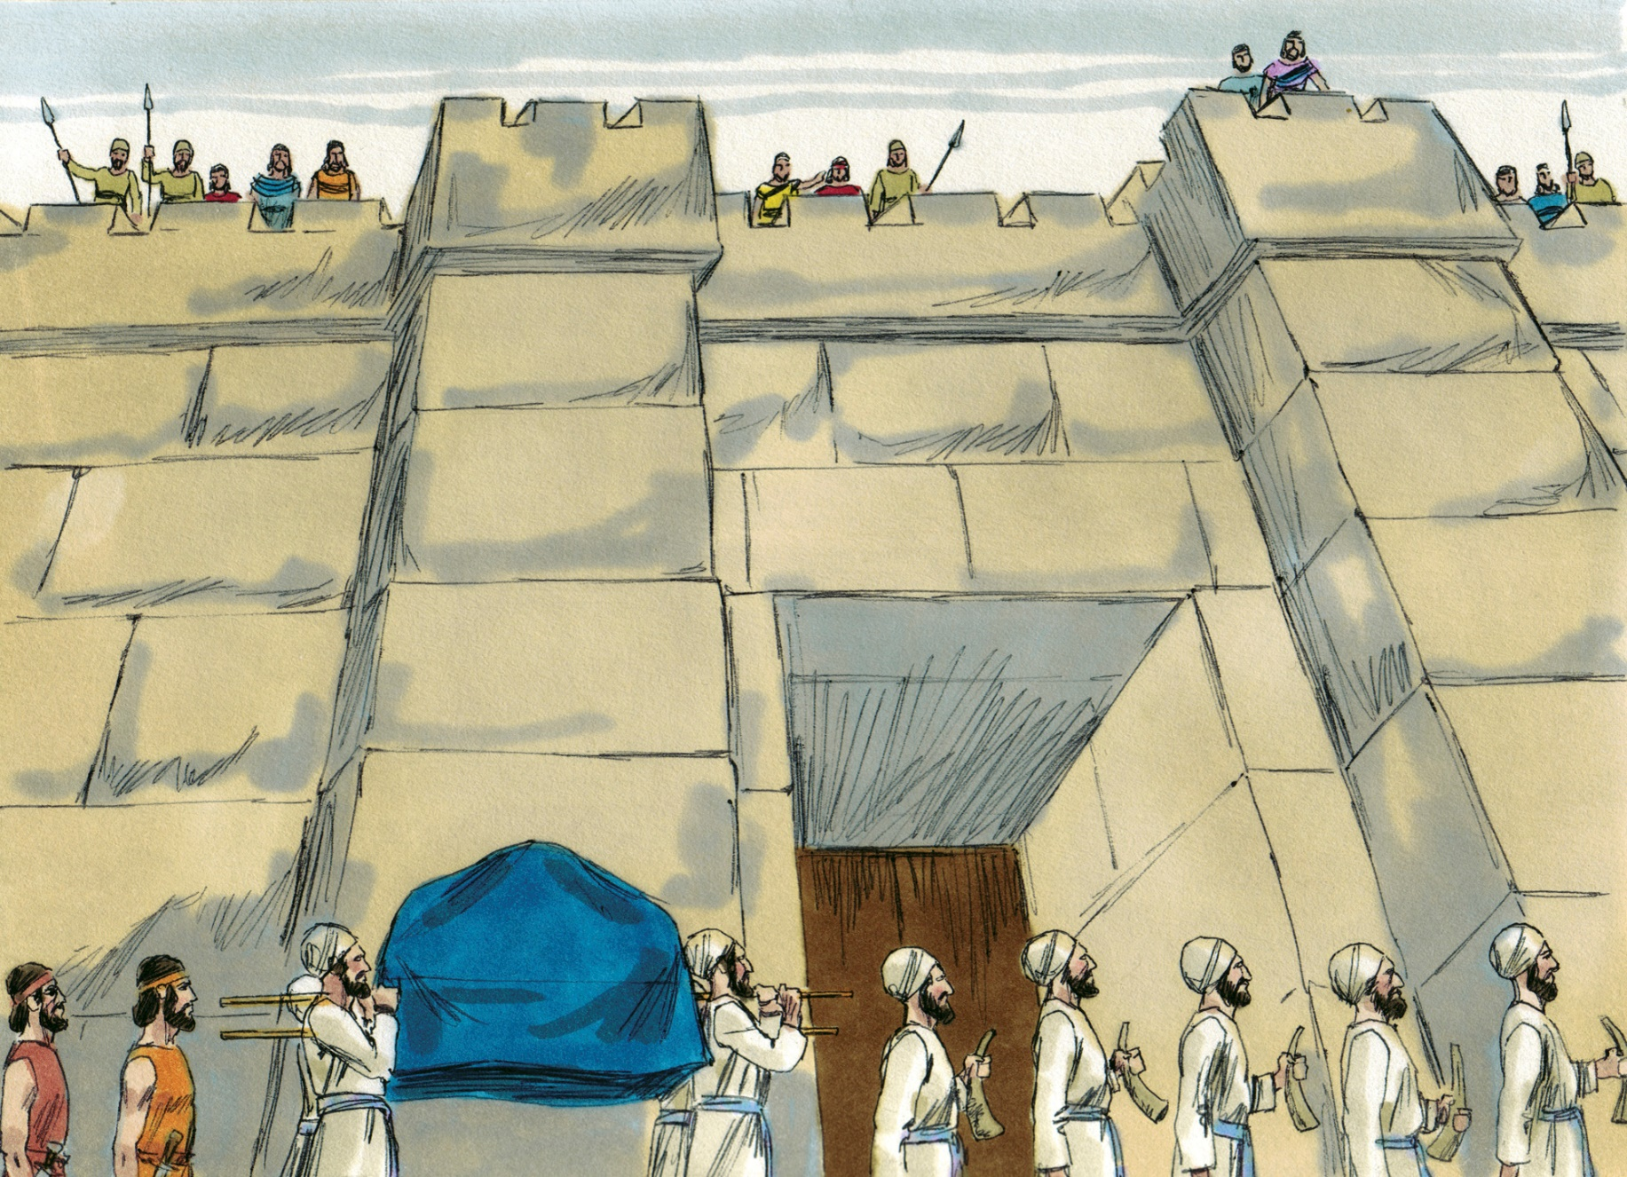

Slide 3
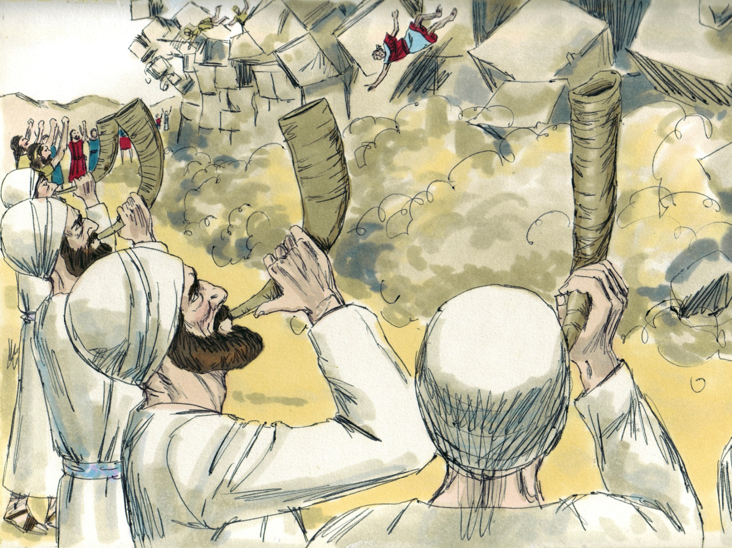

Slide 4
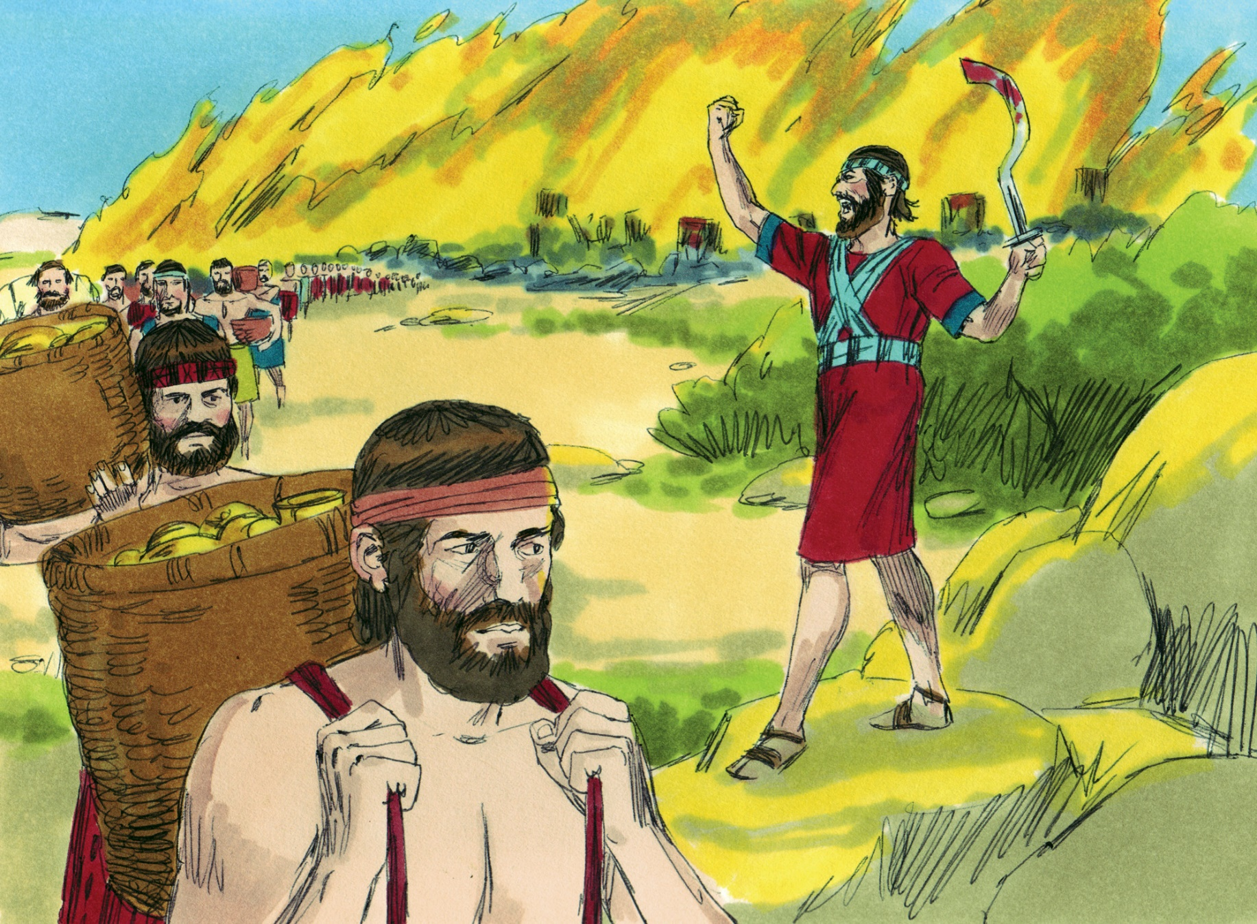

Slide 5
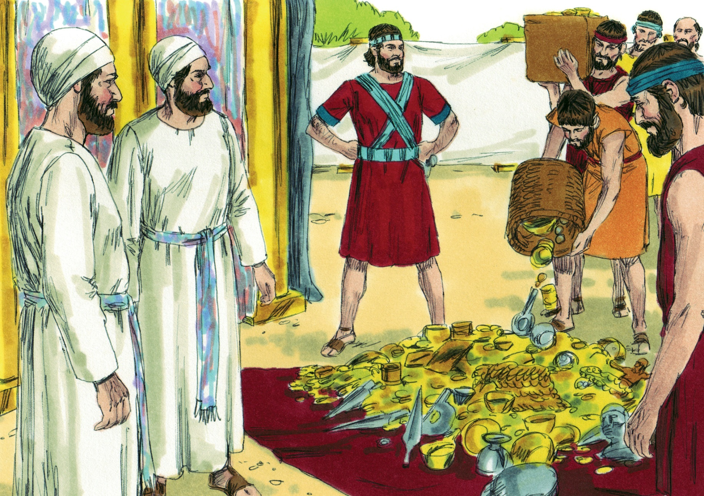

Slide 7
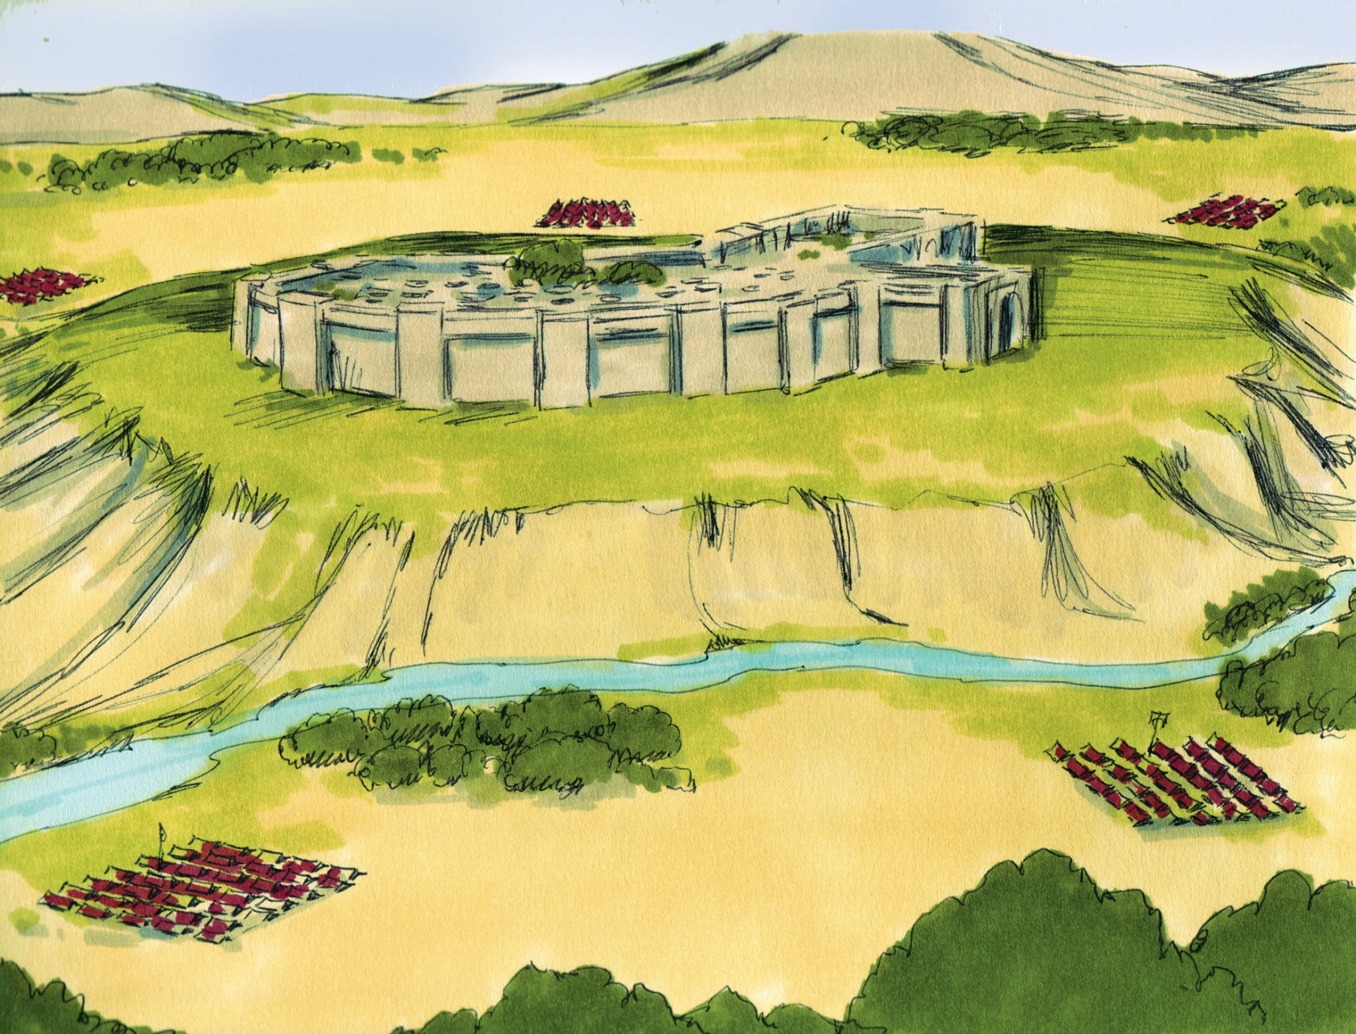

Slide 8
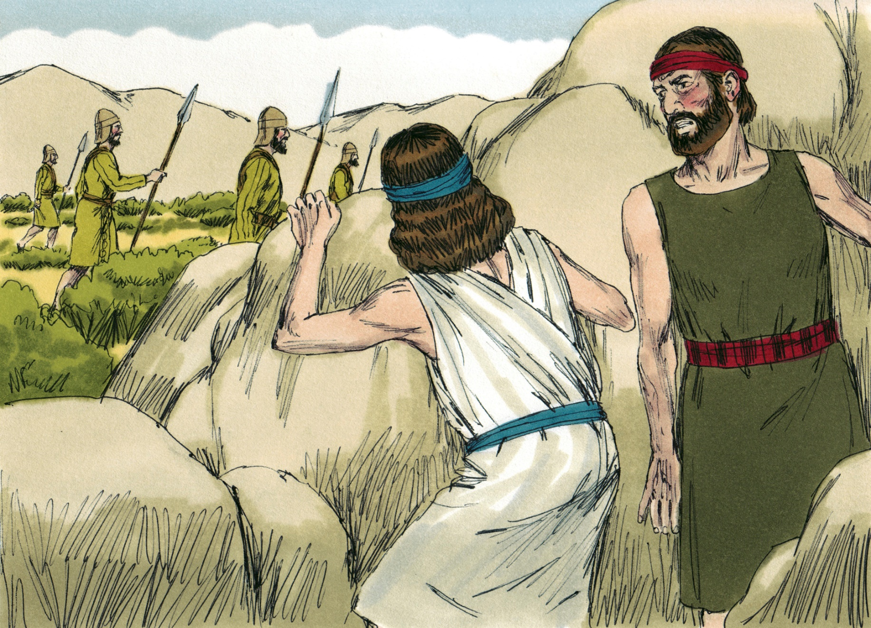

Slide 9
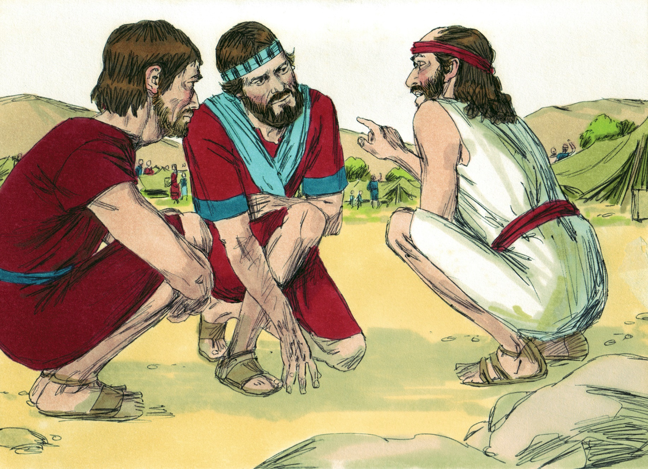

Slide 10
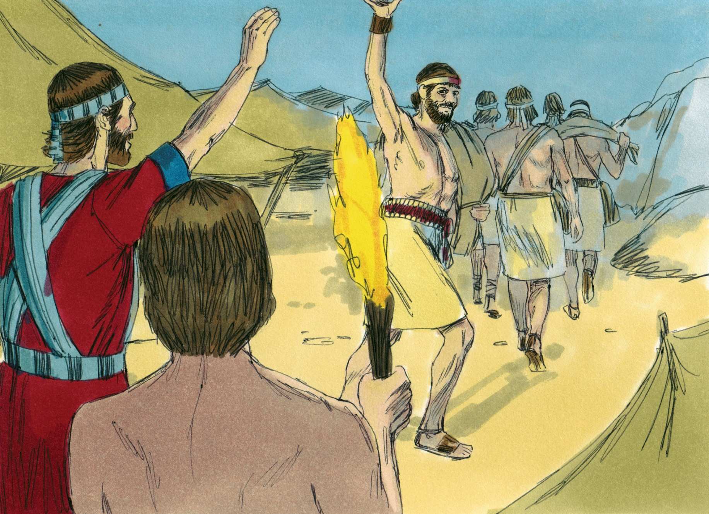

Slide 11
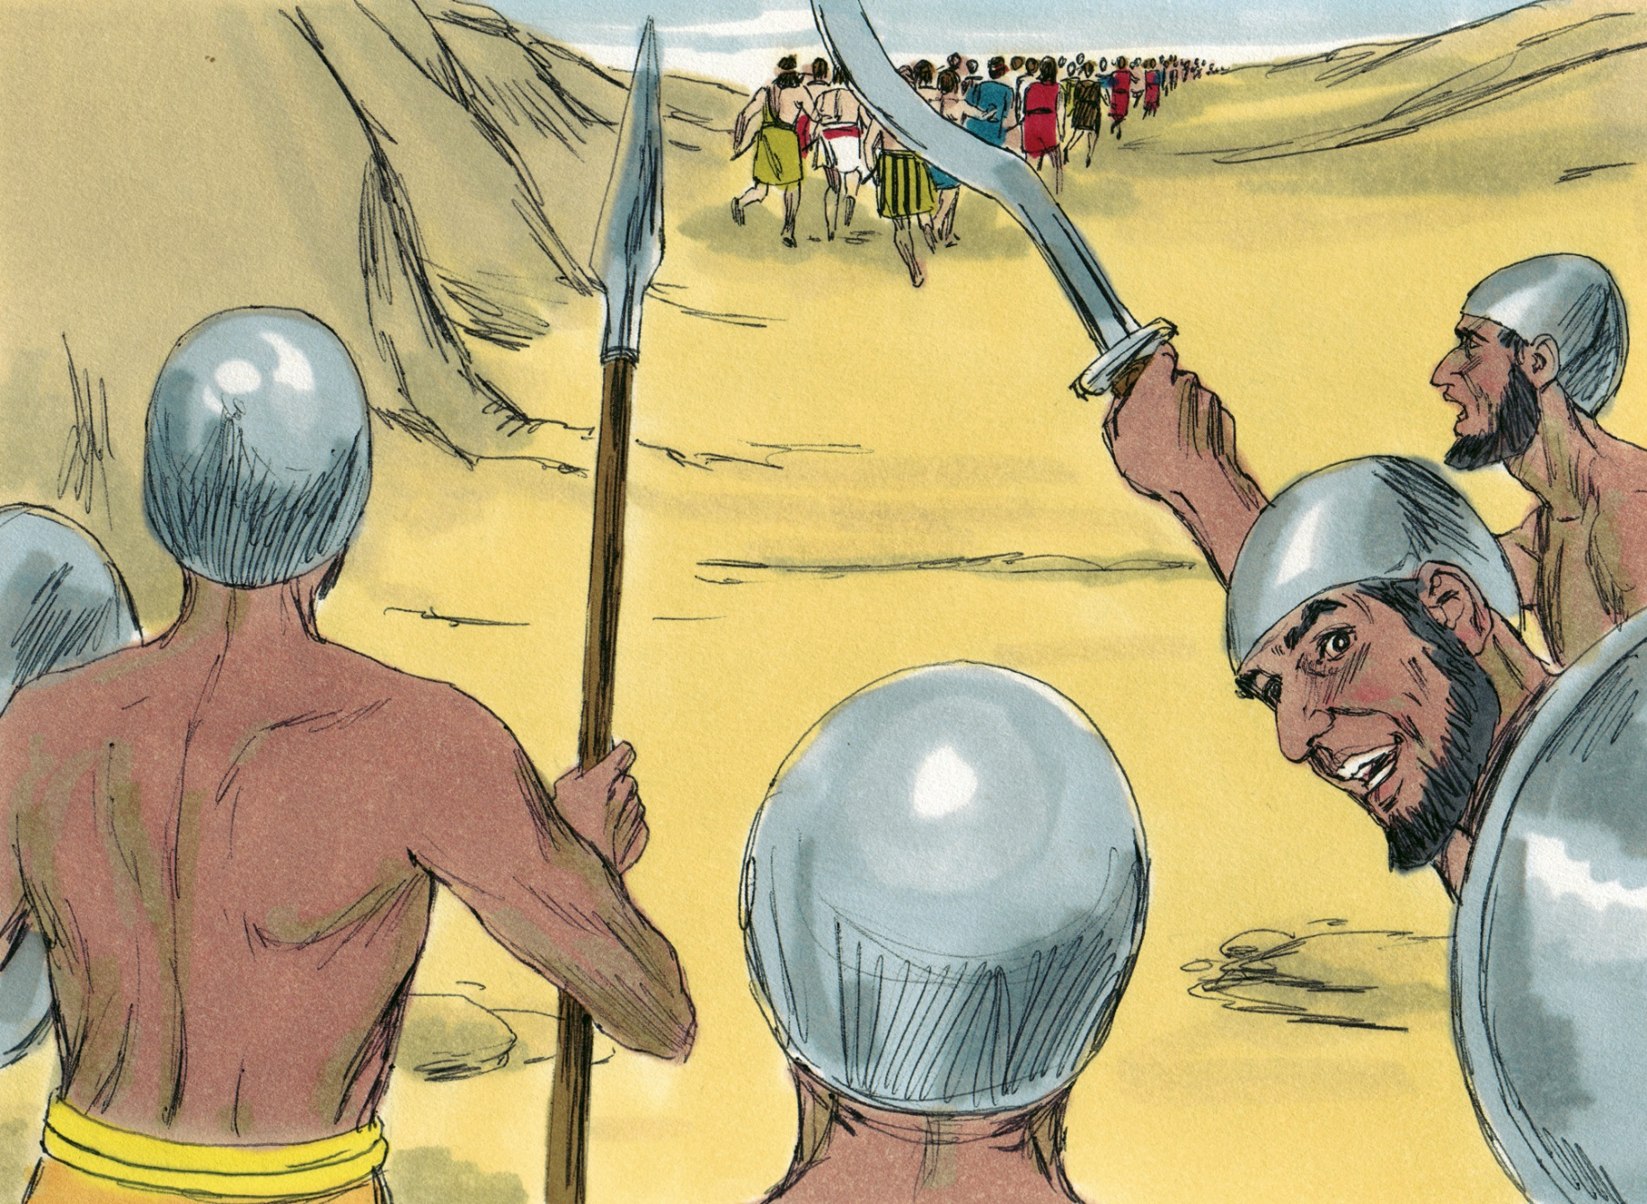

Slide 12
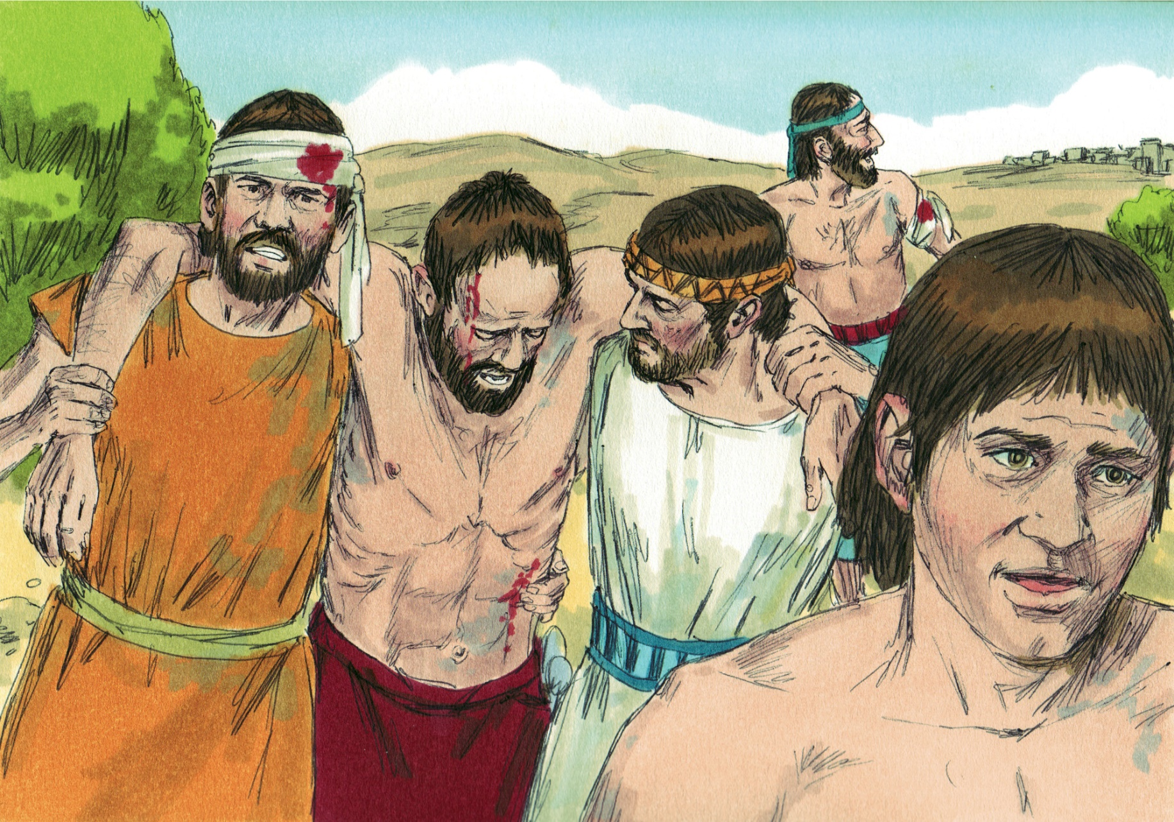

Slide 13
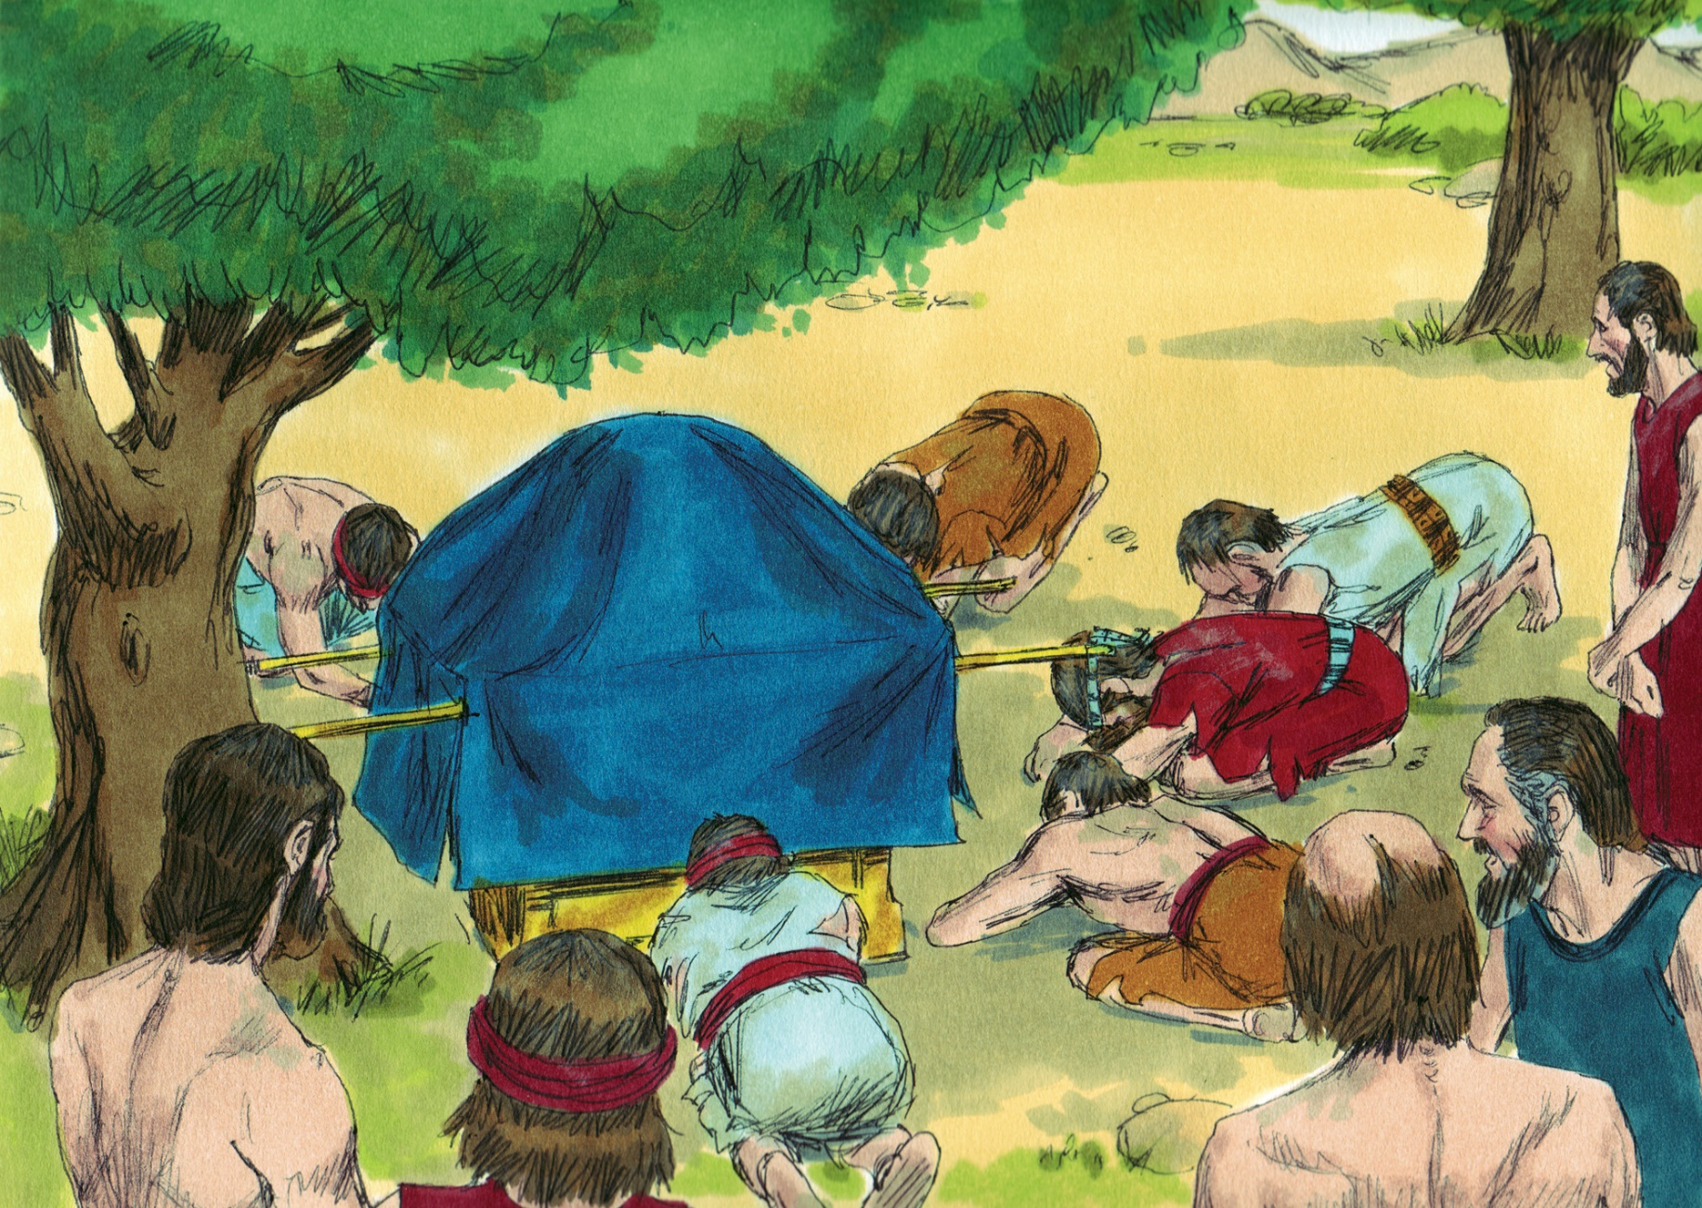

Slide 14
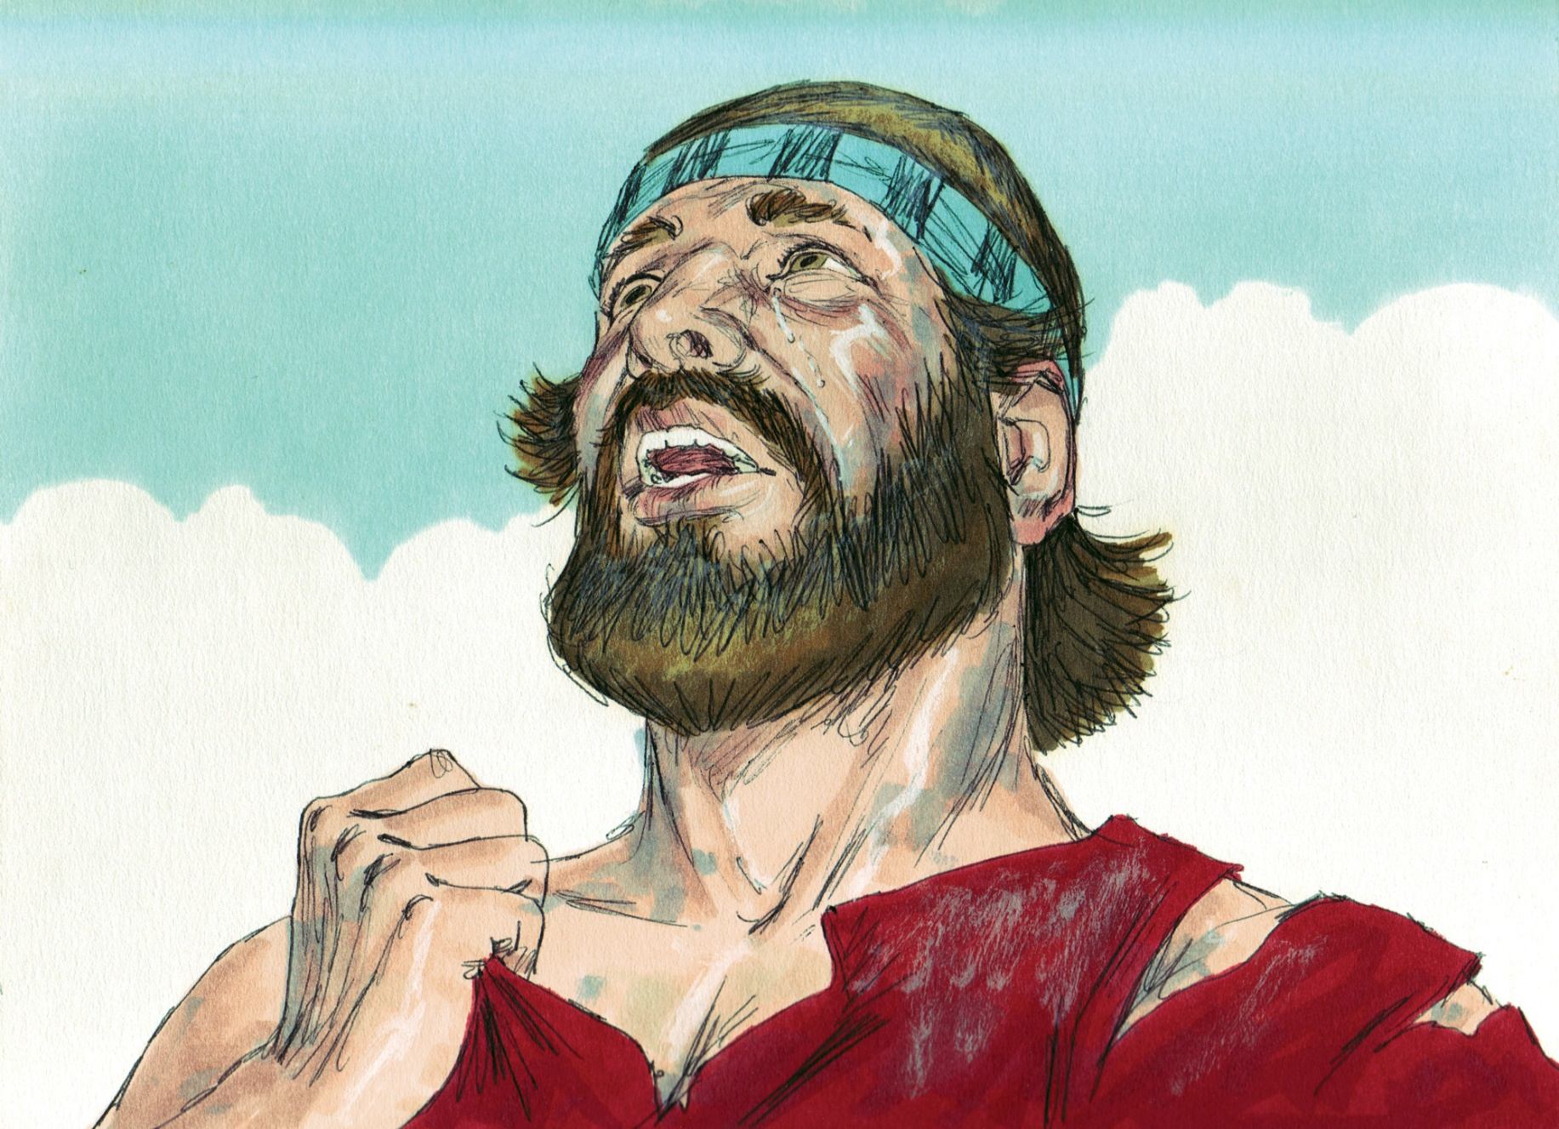

Slide 15
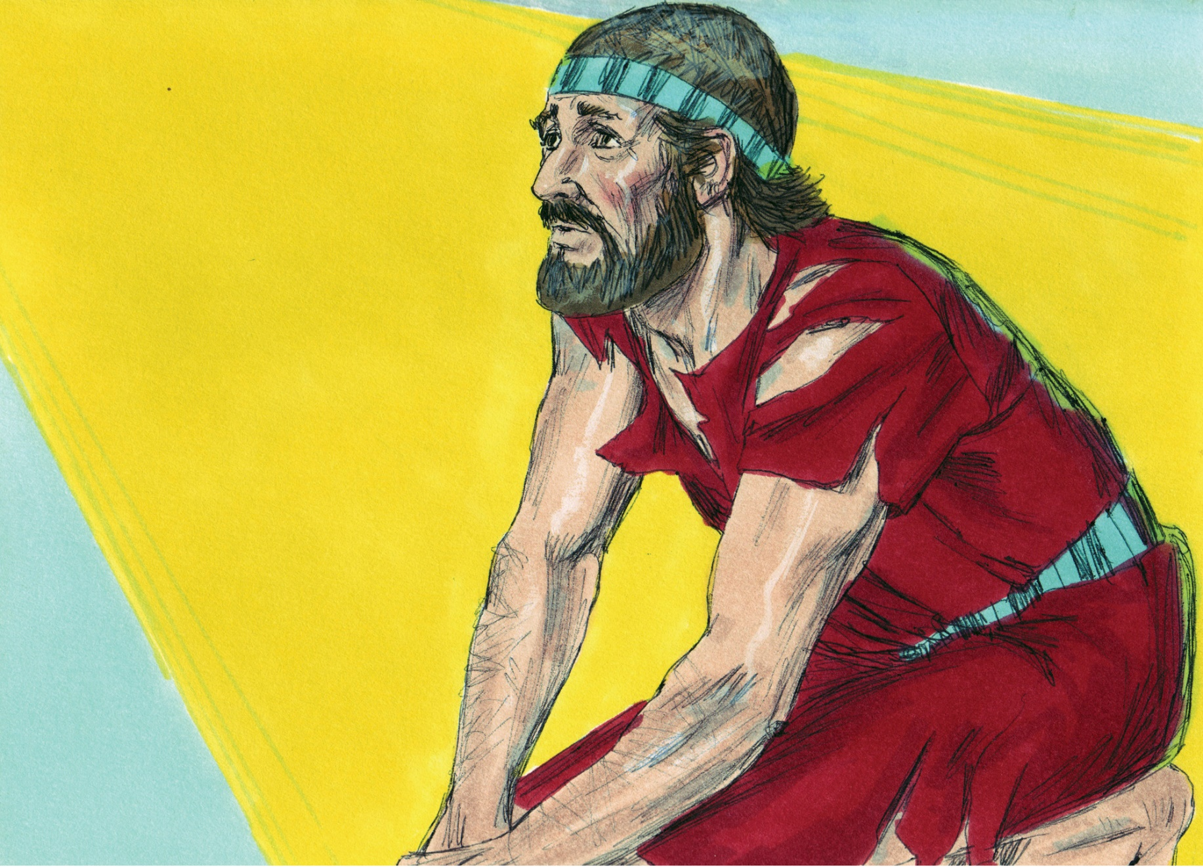

Slide 16
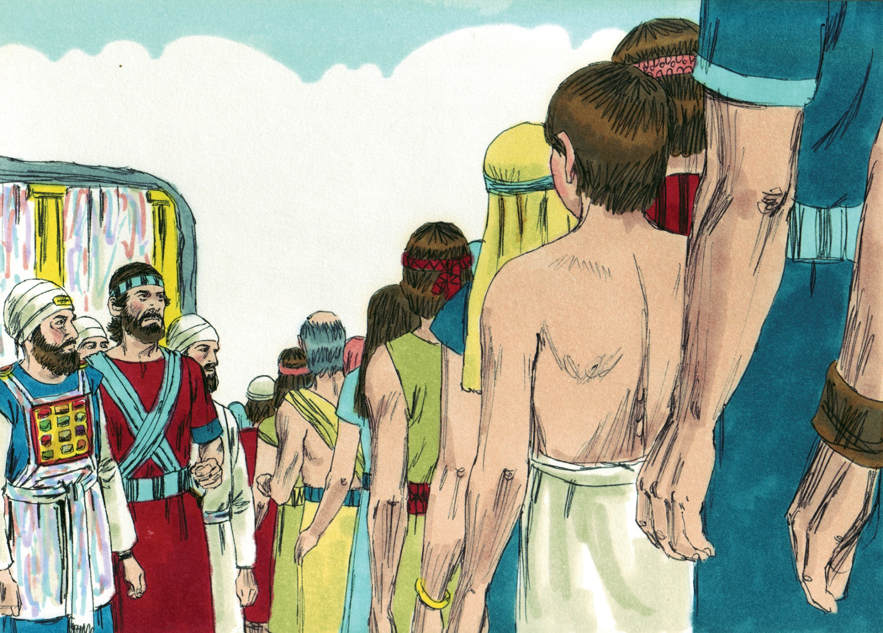

Slide 17
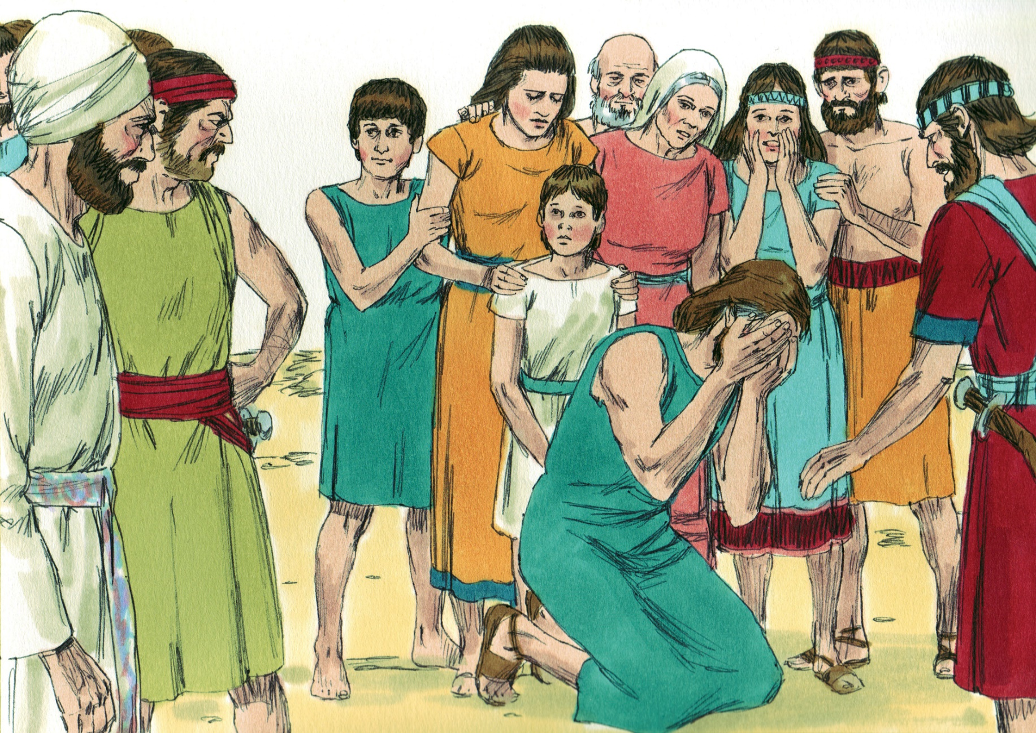

Slide 18
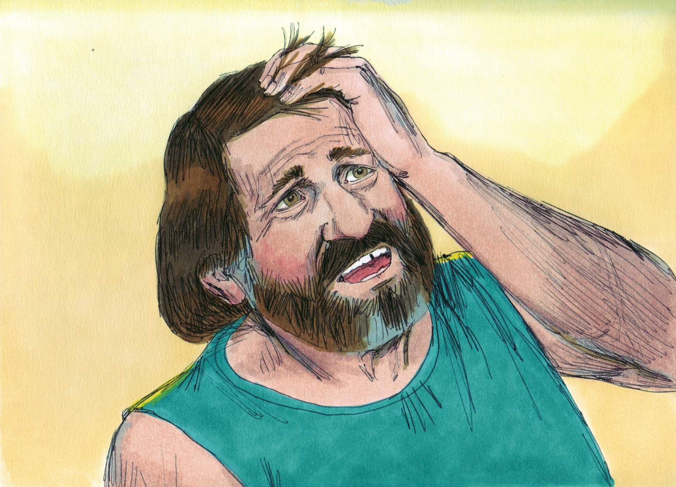

Slide 19
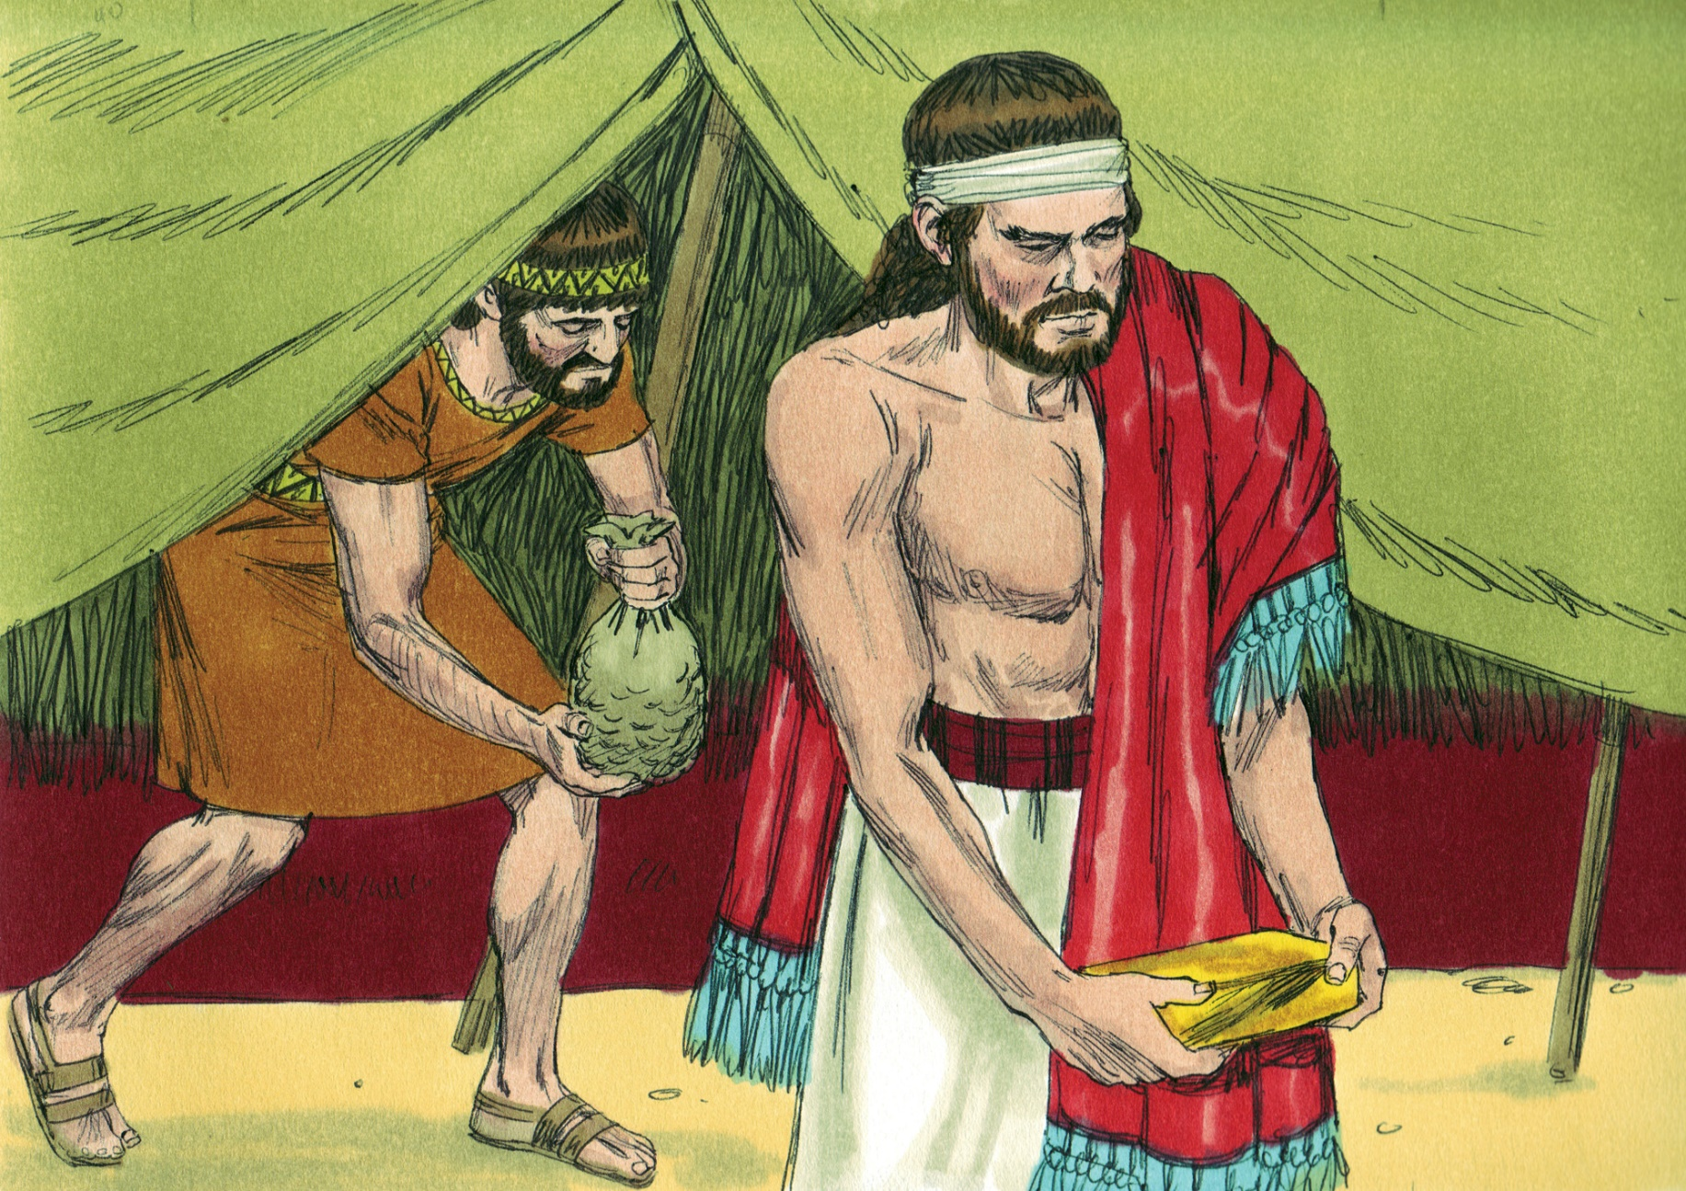

Slide 20
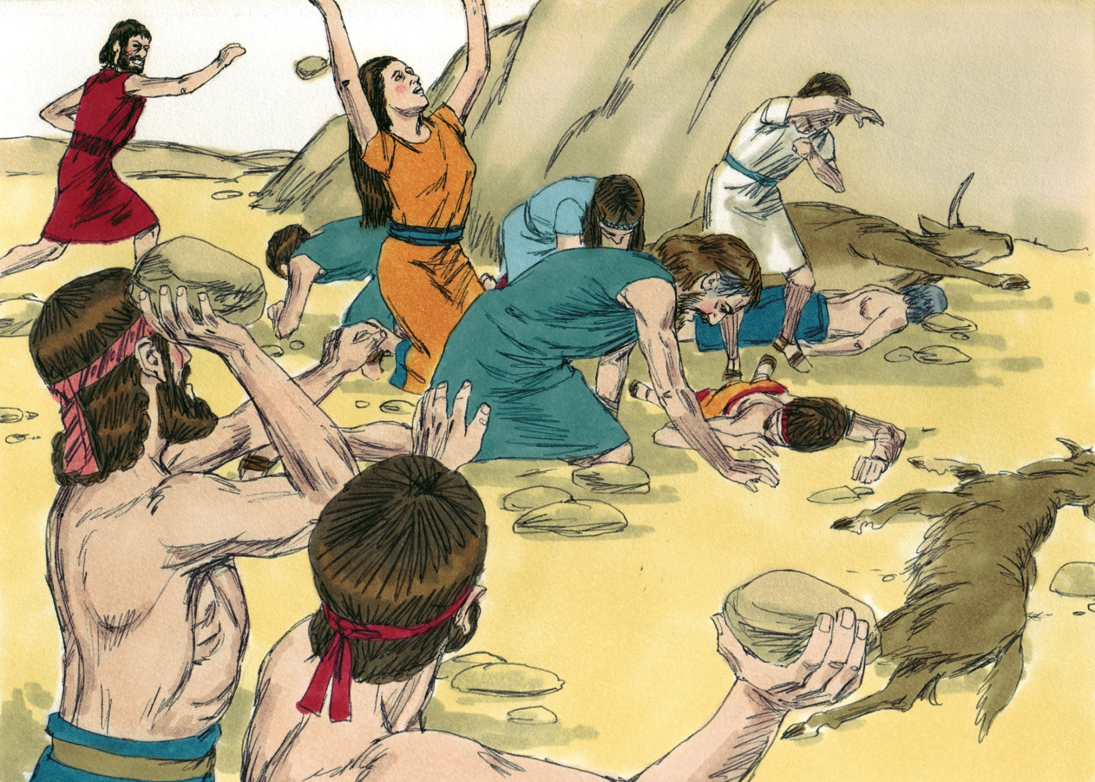

Slide 21
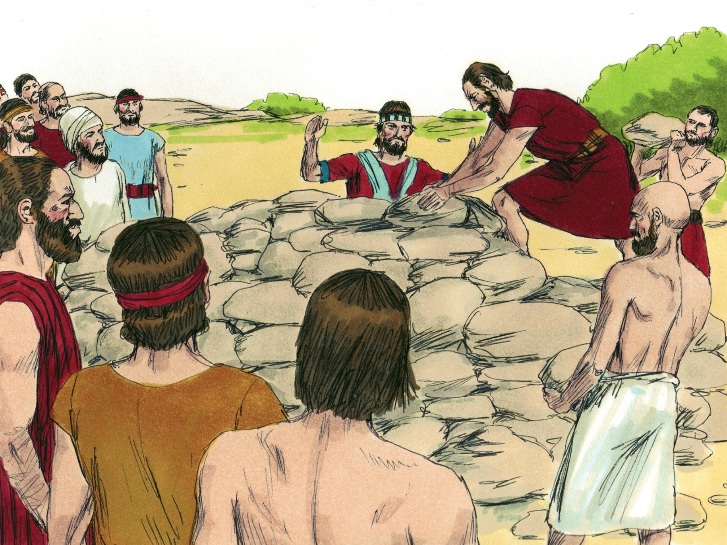

Slide 22
Sin!
God has simple rules and He tells us what they are (Josh. 6:17-19)
Disobeying God is to “act unfaithfully” (7:1)
Disobeying God is to “sin” = “miss the mark” (7:11)
Disobeying God is to “transgress” = “cross over the line” (7:11)

Slide 23
Serious!
Redefining God’s terms is serious (7:21~6:18-19; cf. Isa. 5:20)
Stealing what belongs to God is serious (7:11; cf. 1 Cor. 4:2; 6:20)
Hiding something from God is serious (7:21; cf. Heb. 4:13; Ecc. 12:14)
“Be sure your sin will find you out” (Num. 32:23)

Slide 24
Socially-Destructive!
The whole nation was affected by Achan’s sin (7:1, 5, 11-12)
Disobeying God hurts my brethren (7:2-5, 11-12; cf. 1 Cor. 5)
Disobeying God hurts my friends (7:5; cf. 1 Cor. 15:33; Ex. 23:2)
Disobeying God hurts my spiritual leaders (7:6-10; cf. Heb. 13:17)
Disobeying God hurts my family (7:24-26; cf. Heb. 12:15)

Slide 25
Self-Incriminating!
“Be sure your sin will find you out” (Num. 32:23)
Disobeying God arouses the Lord’s anger against me (7:1)
Disobeying God causes the Lord to not be with me anymore (7:12)
Disobeying God causes me to lose to the enemy and not be able to win (7:12)
Disobeying God will lead to spiritual and eternal death (7:15, 24-26)

Slide 26
Believe Jesus is God’s Son – John 20:30-31
Repent of your sins and turn to God – Acts 2:38
Confess your faith in Jesus – Romans 10:9-10
Be immersed into Christ – Galatians 3:27
God will forgive all of your sins – Acts 22:16
God will add you to His church – Acts 2:47
God will register you in heaven – Hebrews 12:23
Faithfully obey His will – Hebrews 5:9

