Slide 2
God’s People and Stones
Jacob at Bethel – Gen. 28:18-19
Jacob at Mizpah – Gen. 31:48-49
Joshua at Jordan – Josh. 4:20-24
Samuel at Ebenezer – 1 Sam. 7:12

Slide 3

Every dollar given on Mission Sunday
goes toward mission work.

Slide 4

12 Years of
Sacrificial Giving
2004 – 2015
Last Year’s Contribution $ 126,496.04
Average Contribution $ 117,541.63
Total Contribution $1,410,499.61

Slide 5
Some Local Efforts in Early Years
Daily Radio Program (2002-2007)
  Reaching a potential 2,000,000 People
Television Program (2005)
  Reaching a potential 300,000 Homes
TV Spot Ads (2006-2007)
  Reaching a potential 300,000 Homes
“Plan of Salvation” Mailout (2007)
  Reaching 50,000 Homes
Spanish Work at PBL (2003-2010)

Slide 6
Ongoing Local Efforts
House to House/Heart to Heart (12 Years)
  Mailing Out 980,000+ Pieces
Sr. High Mission Trips
  16 Congregations in 10 states with 50+ PBL teens
Outreach via I-95 (banners, sign, etc.)
  Reaching 500,000+ Travelers Daily
New Bible tracts and car magnets/plates

Slide 7
Specific Mission Points
13 Full-Time Missionaries in 26 Countries on 4 Continents
  Nnanna Aforji (Nigeria)
  Tamuka Arunashe (Zimbabwe)
  Josh Blackmer (Paraguay)
  Chris Fry (Paraguay)
  Junot Joseph (Miami)
  Ray Leonard (South Africa)
  Robert Martin (Pacific Islands)
Dozens of Mission Trips to 25+ Countries on 6 Continents
  Adult Groups from PBL to Bahamas, Paraguay, Peru, Trinidad
  College Student Mission Trips all over the globe
  Jason Quashie (Bahamas)
  Scott Shanahan (Pacific Isl)
  Surendra Singh (Trinidad)
  Troy Spradlin (Paraguay)
  Joey Treat (Pacific Islands)
  Mauricio Yegros (Miami)

Slide 8

Special Works to PBL
Apologetics Press in Montgomery, AL
  Professional Staff
    Four men (Dave Miller, Jeff Miller, Eric Lyons, Kyle Butt)
    Speak around the country & globe (100+ places annually)
  Publications
    Monthly Journals: Reason & Revelation and Discovery
    Books for adults & kids + Tracts for adults & kids
    Videos for adults & kids + eBooks for adults & kids
    Bible Class curriculum, VBS Materials, Study Courses, etc.
  Website (www.ApologeticsPress.org)
    19,000,000+ page hits from 230+ countries

Slide 9
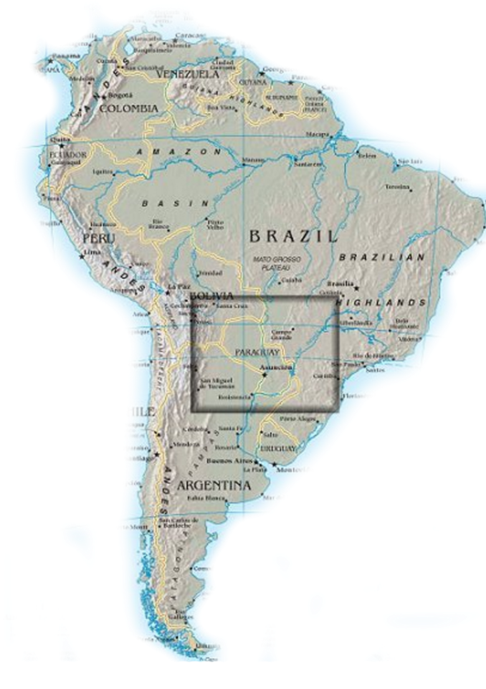
Special Works to PBL
Asuncion, Paraguay
  Chris & Vickie Fry
    First team went down in September 2003
    Chris & Vickie returned in February 2011
  Josh & Cara Blackmer (and Josiah & Vivian)
    Moved down in September 2009
    Labored for 5 years, returning to PBL in August 2014
  Troy & Andrea Spradlin
    Moved down in February 2010
    Still laboring with church and academy
    Plan to return to the States in 2017

Slide 10
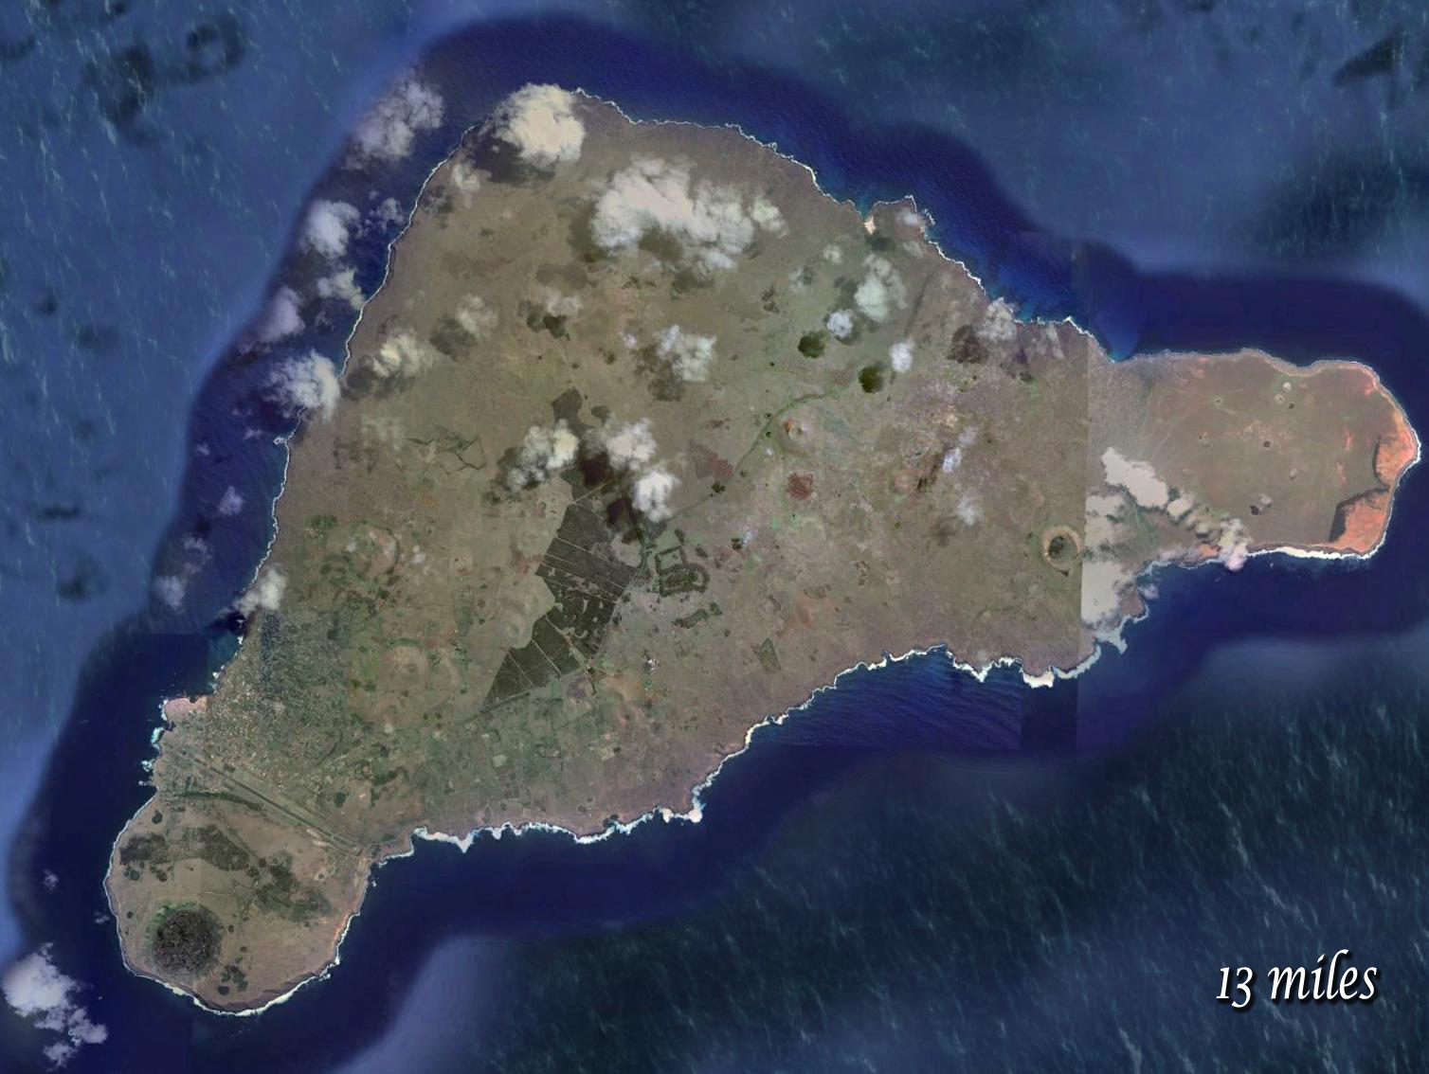
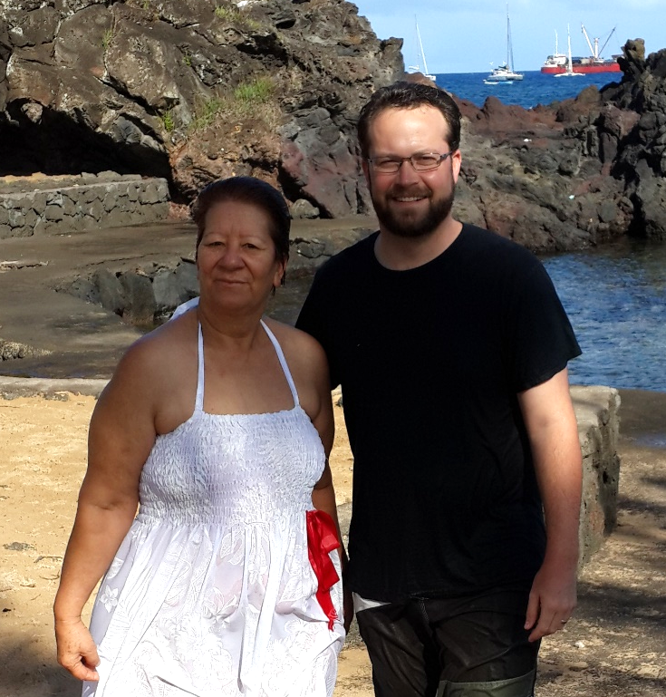
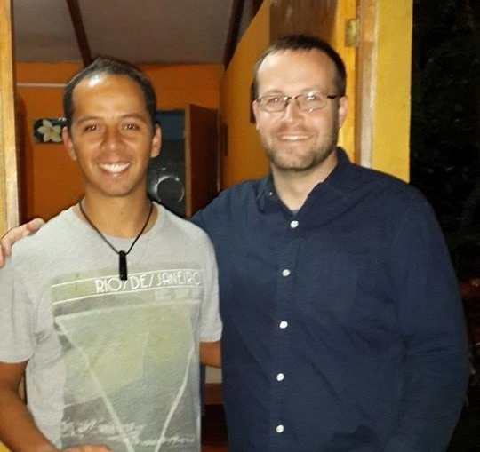
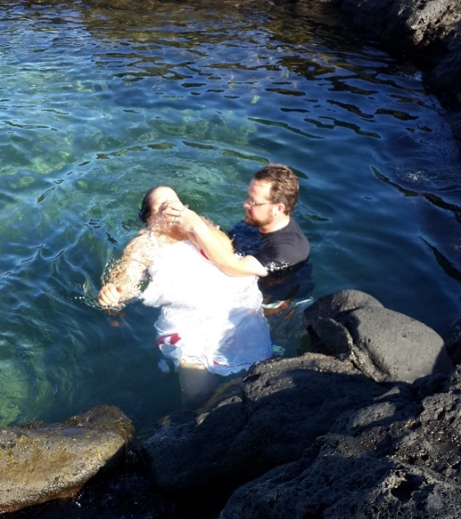
Special Works to PBL
Easter Island
  Josh made the first trip in November 2010
  First convert on the Island, Piki, in April 2014
  Piki’s adult son, Uri, converted in August 2014
  Josh has made 8 trips, continuing to preach and encourage

Slide 11
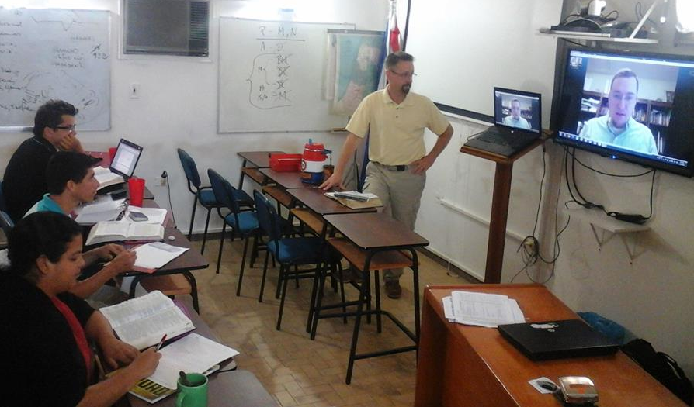
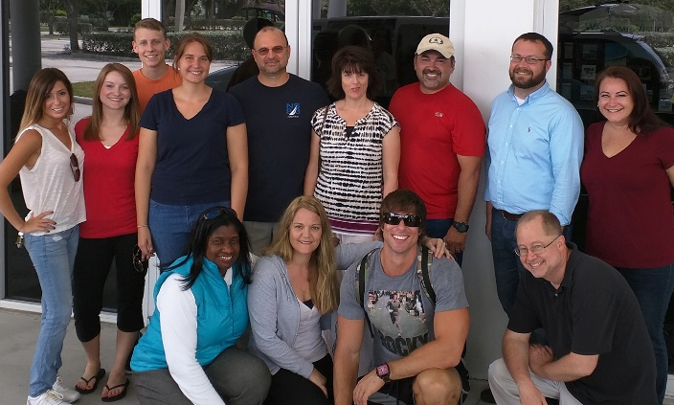
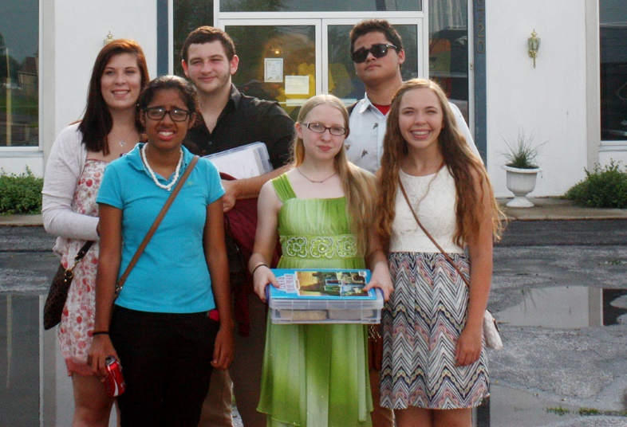
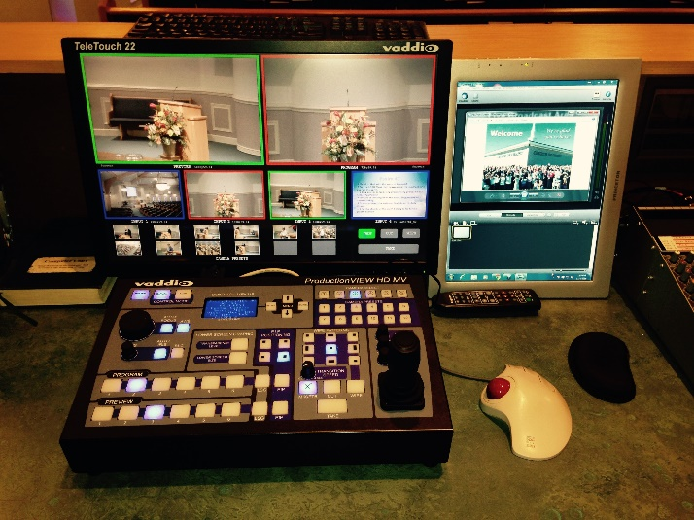
New Highlights in 2015
Asuncion Bible Academy
Adult Mission Trip to Paraguay
Sr. High Mission Trip to Indiana
HD Video Production Equipment

Slide 12
Today, Let Us Raise Our Ebenezer
Thus far the Lord has helped us!
Thus “far-ward” He will help us!

Slide 13
Believe in Jesus Christ John 3:16
Repent—decide to obey Acts 17:30
Confess Christ Rom. 10:9
Baptized to be saved Acts 22:16
Added to His kingdom, His church
Be faithful until death Rev. 2:10

