Slide 1
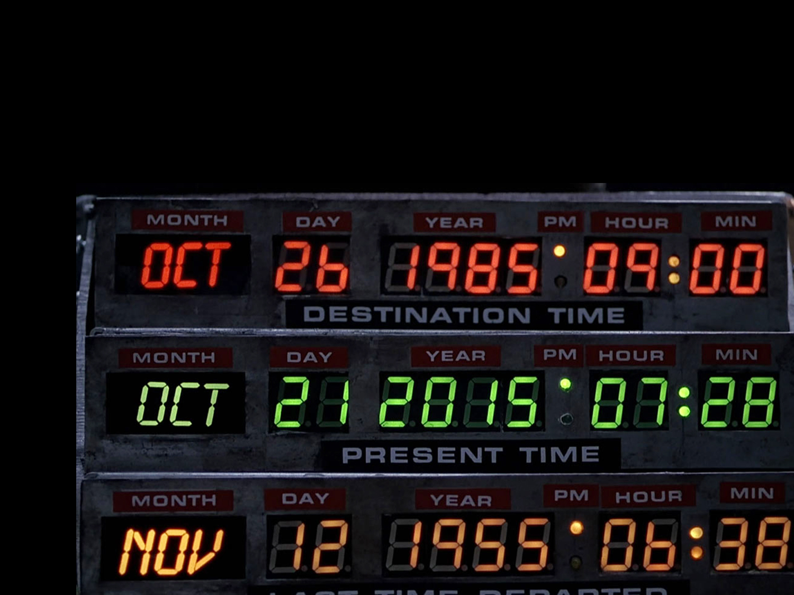

Slide 2
The WORD of the Lord Stands Forever
It is perpetual (Isa. 40:8; Psa. 119:89; 1 Pet. 1:23-25)
It is identifiable (1 Pet. 1:25; 2 Tim. 3:16-17)
It is restorable: Go back to the Word that God intended!

Slide 3
The PURPOSE of the Lord Stands Forever
It is perpetual (Psa. 33:11; Heb. 6:17)
It is identifiable (Matt. 7:21; Eph. 5:17; 2 Pet. 1:21)
It is restorable: Go back to the Purpose that God intended!

Slide 4
The TRUTH of the Lord Stands Forever
It is perpetual (Psa. 117:2; 2 John 2)
It is identifiable (John 8:32; 1 Tim. 2:4)
It is restorable (Jas. 5:19-20): Go back to the Truth that God intended!

Slide 5
The RIGHTEOUSNESS of the Lord Stands Forever
It is perpetual (Psa. 111:3; Heb. 1:8)
It is identifiable (Rom. 3:21-26; 2 Cor. 5:21)
It is restorable (Ezek. 18:21-32): Go back to the Righteousness that God intended!

Slide 6
The CHURCH of the Lord Stands Forever
It is perpetual (Dan. 2:44; Matt. 16:18)
It is identifiable
It was founded by Christ in Jerusalem on Pentecost (Acts 2)
It wears the name of its owner (Rom. 16:16)
It follows only New Testament law (Col. 3:17; Gal. 1:6-9)
It worships on Sunday (Acts 20:7)
It sings congregationally (Eph. 5:19)
It breaks bread every Sunday (1 Cor. 11:20)
It is overseen by elders (Acts 20:28)
It teaches the essentiality of baptism for salvation (Acts 2:38)
It is restorable: Go back to the Church that God intended!

Slide 7
The Plan of Salvation That God Intended
Believe Jesus is God’s Son – Acts 16:31
Repent of your sins and turn to God – Acts 17:30
Confess your faith in Jesus – Romans 10:9-10
Be immersed into Christ – Acts 22:16
God will forgive all your sins – Acts 2:38
God will add you to His church – Acts 2:47
God will register you in heaven – Hebrews 12:23
Live the faithful life that God intended – Revelation 2:10

