Slide 2
Laborers Who Have Gone Before Us: Those Who Served
Phoebe (Rom. 16:1-2)
“A servant”
“A helper”
John Mark (2 Tim. 4:11)
“Useful for ministering”
Let’s emulate those who served!
Am I a servant? A helper? Useful for ministering?

Slide 3
Laborers Who Have Gone Before Us: Those Who Gave Their Lives to Serving
Paul (Phil. 1:12-21)
“For to me, to live is Christ” (Phil. 1:21)
“Always…Christ will be magnified in my body” (Phil. 1:20)
“I am appointed for the defense of the gospel” (Phil. 1:16-17)
Stephanas’ family (1 Cor. 16:15)
“Addicted themselves to the ministry of the saints”
Let’s emulate those who gave their lives to serving!
Is Christ my life? Magnified in my life? The gospel my life? Am I addicted to serving?

Slide 4
Laborers Who Have Gone Before Us: Those Who Gave Their Lives While Serving
Stephen (Acts 7:1-60)
Preached “the Just One” and the Lord’s eternal plan
His opponents “could not withstand the wisdom” (Acts 6:10)
They became “enraged” and stoned him (7:54-60)
Polycarp (~70-156 A.D.)
Disciple of the apostle John, elder in the church of Smyrna
Burned at the stake for his unwavering devotion to Christ
Let’s emulate those who gave their lives while serving!
Do I stand up for Christ? The gospel? To my own detriment?

Slide 5
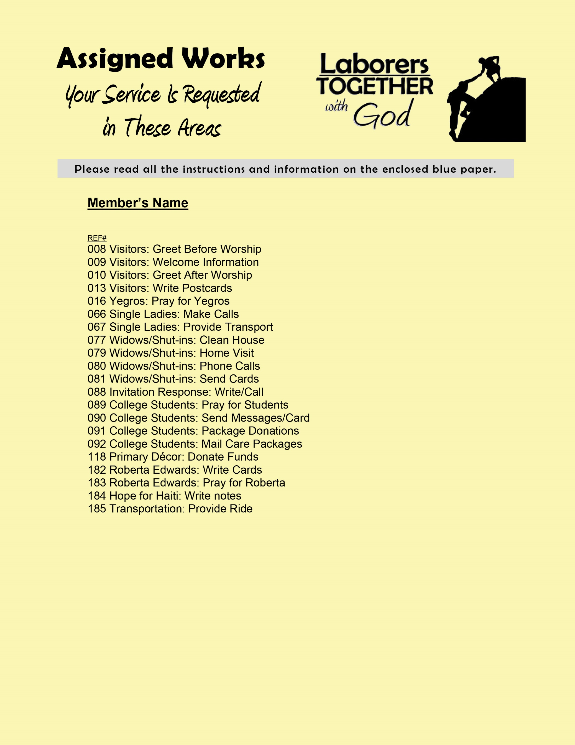
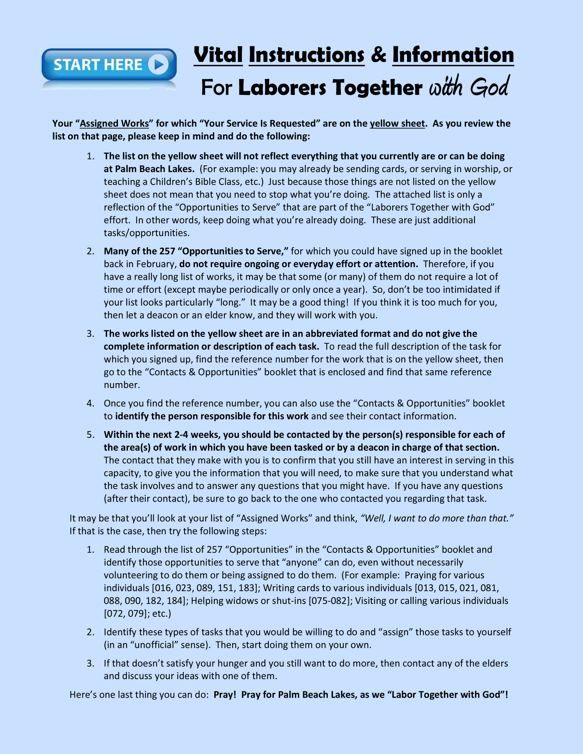
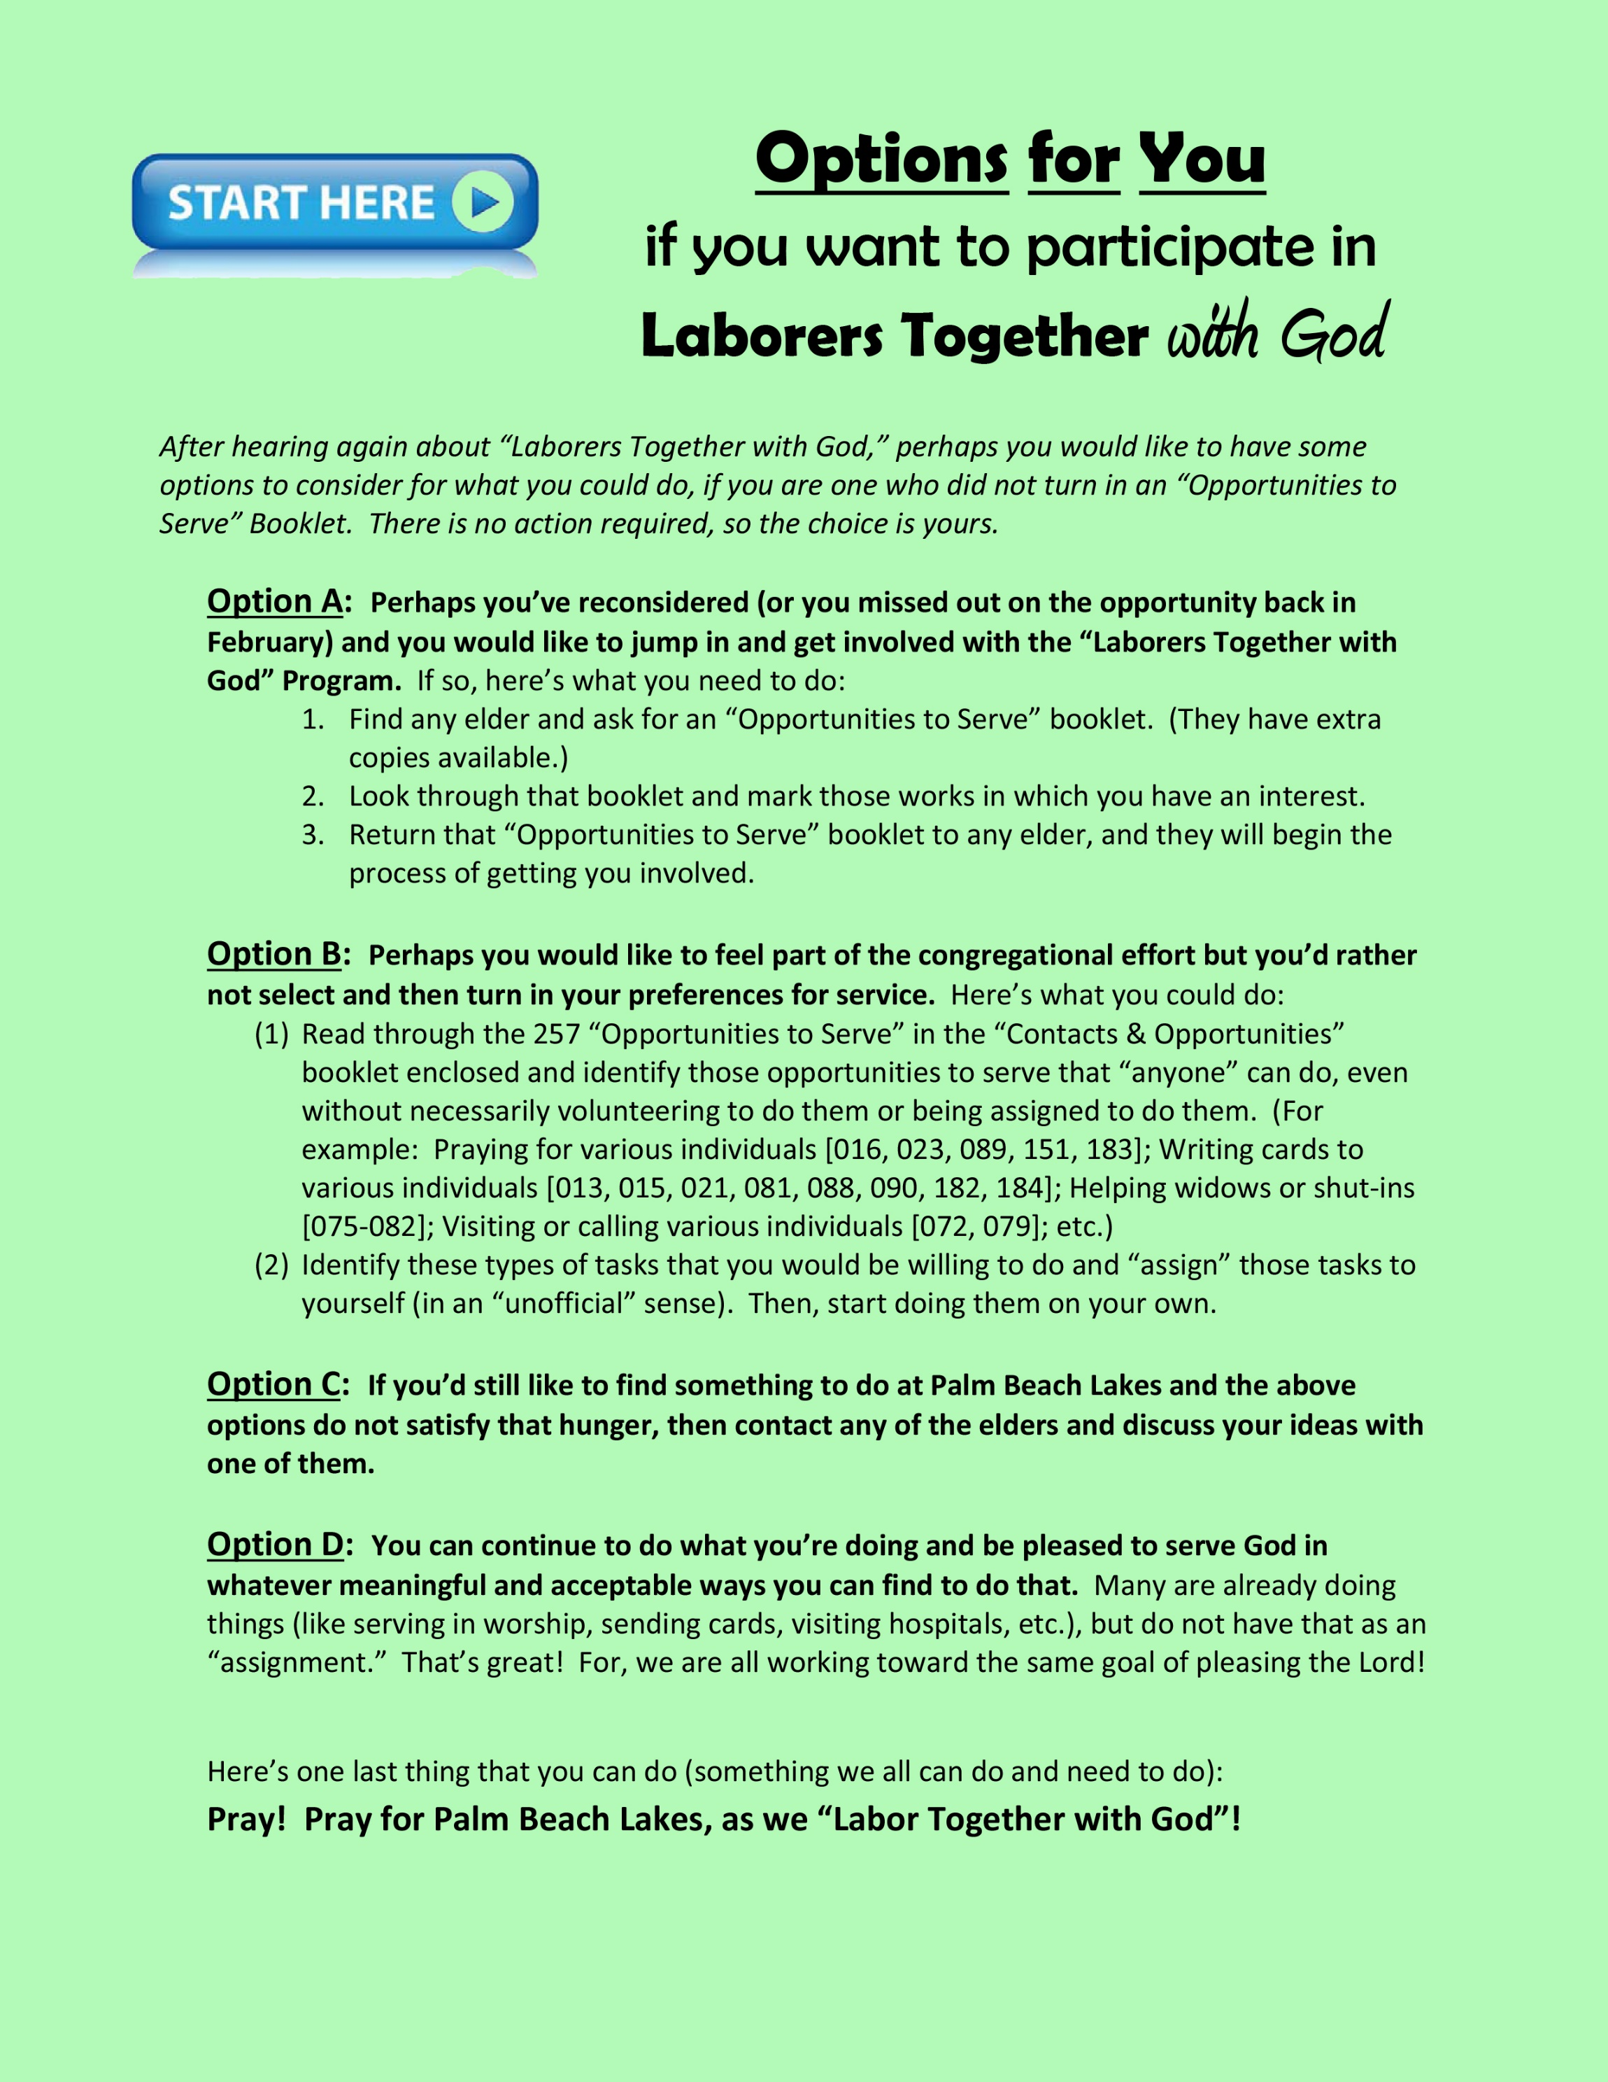
Let’s Get “In Step” as Laborers Together
The elders have written a letter to each member of PBL
Options for PBL members who did not turn in an “Opportunities to Serve” Booklet in February
Instructions for PBL members who did turn in an “Opportunities to Serve” Booklet in February
May we set an example of service for others to emulate!
What an awesome privilege to LABOR TOGETHER WITH GOD!
One last thing that we can all do: PRAY!

Slide 6
The work of God is to believe in Christ – John 6:29
Repent of your sins – Acts 3:19
Confess your faith in Jesus – Matthew 10:32
Be buried with Christ in baptism – Colossians 2:12
God will wash away your sins – Acts 22:16
God will add you to His church – Acts 2:47
God will write your name in heaven – Hebrews 12:23
Labor with God faithfully – 1 Corinthians 15:58

