Slide 1

1 Corinthians 3:5-9

Slide 2
We Are
Laborers Together with God!
The work of the Lord requires LABOR
  Servants (v. 5), Planters & Waterers (v. 6-8), Labor (v. 8)
  Being a Christian involves labor (Eph. 2:10; 1 Cor. 15:58)
The work of the Lord brings laborers TOGETHER
  The work we do is not alone, not in isolation
  “He who plants and he who waters are one” (v. 8)
  There is work for each member (Eph. 4:16; Phil. 1:27)
The work of the Lord is labor done together WITH GOD
  Christians are “God’s fellow workers” (v. 9)
  He gives us opportunities to labor (v. 5)
  He gives the increase/growth from our labor (v. 6-7)
  He gives the reward according to our labor (v. 8)
  It is HIS work – and we get to share in it!

Slide 3
The Early Church Sought
Opportunities to Serve
Taught in-home Bible studies (Acts 5:42; 9:10-18; 18:26)
Cared for the widows (6:1-6)
Took on undesirable tasks (8:2; 5:6, 10; 15:22)
Helped new members create bonds in the church (9:26-28)
Used personal skills to do good works for brethren (9:36)
Built up, commended & motivated brethren (11:23; 14:22-23)
Reached out to help others get involved (11:25-26)
Prayed for specific needs and people (12:5, 12; 20:36; 21:5)
Hosted brethren in their homes (12:12; 16:15, 40; 18:3; 21:4-8)
Greeted guests at the door (12:13)

Slide 4
The Early Church Sought
Opportunities to Serve
Encouraged and mentored young people (Acts 12:25; 16:1-3)
Took care of their missionaries (14:28; 9:25; 15:40; 17:10; 27:3)
Provided food for brethren (16:34; 20:11; 24:23)
Visited and supported brethren in need (24:23)
Greatly helped the brethren (18:27)
Prepared the Lord’s Supper (20:7)
Opened and closed the meeting place (20:8)
Supported the weak (20:35)

Slide 5
Opportunities to Serve at Palm Beach Lakes
The works of the church at PBL are divided into these Major Categories:
  Spreading the Gospel (Evangelism)
  Loving One Another (Edification)
  Equipping Adults & Youth (Education)
  Doing Good Unto All Men (Benevolence)
  Worship Decently & Orderly (Worship)
  Stewards of Possessions (Property Maintenance)

Slide 6

Opportunities to Serve at Palm Beach Lakes
A booklet has been created
  Contains 257 opportunities
  A wide variety of works
  Truly something for everyone!
We can truly:
  Labor
  Together
  With God!

Slide 7
Opportunities to Serve at Palm Beach Lakes
What you need to do:
  Read through the “Opportunities to Serve” booklet.
    See the opportunities available
  Pray!
    Ask the Lord to use you as you labor together with Him.
    Ask Him to help you choose the best opportunities for you.
  Decide what you are Zealous to do
  and what you are Willing to do.

Slide 8
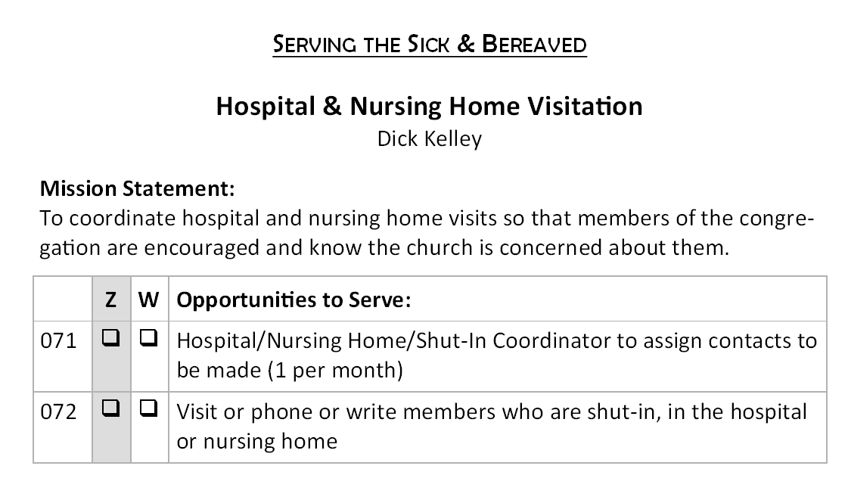
Opportunities to Serve at Palm Beach Lakes
✓
✓
✓

Slide 9
Opportunities to Serve at Palm Beach Lakes
What you need to do:
  Identify those opportunities you have a STRONG DESIRE to take on and “make happen.” Which opportunities to serve are you ZEALOUS to take and do?
    Check the box in the Z column for “Zealous.”
    Important Note: Limit 5 checks in the Z column.
  Identify those opportunities you are WILLING (if asked) to take on and “make happen.” Which opportunities to serve may not have your strongest zeal, but you would be WILLING to take and do?
    Check the box in the W column for “Willing.”
    Important Note: There is no limit to checks in the W column.

Slide 10
Opportunities to Serve at Palm Beach Lakes
What you need to do:
  If, perhaps, there is an area in which you would really like to serve but it is not listed in this booklet, write it out on Page 44 and the elders will take it into consideration.
  If, perhaps, there is a work in which you are presently serving and strongly want to continue, write it out on Page 45.
  If you want to know more about a particular opportunity, go and talk to the person assigned to that task for more information.
  Once you’ve completed the booklet, please deposit it in the box in the lobby by Sunday, February 22.

Slide 11
Opportunities to Serve at Palm Beach Lakes
Let’s all grow more fully to be:
  Laborers!
  Laborers Together!
  Laborers Together with God!
  Laborers Together with God at Palm Beach Lakes!

Slide 12
Become a Laborer Together with God Today!
Believe Jesus is God’s Son – Mark 16:16
Repent of your sins – 2 Peter 3:9
Confess your faith in Jesus – Romans 10:9-10
Be immersed into Christ – Acts 2:38
  God will wash away your sins – Acts 22:16
  God will add you to His church – Acts 2:47
  God will write your name in heaven – Hebrews 12:23
Labor with God faithfully – 1 Corinthians 15:58

