Slide 1
Now Tobiah the Ammonite was near him and he said, "Even what they are building--if a fox should jump on it, he would break their stone wall down!" Hear, O our God, how we are despised! Return their reproach on their own heads and give them up for plunder in a land of captivity. Do not forgive their iniquity and let not their sin be blotted out before You, for they have demoralized the builders. So we built the wall and the whole wall was joined together to half its height, for the people had a mind to work. Now when Sanballat, Tobiah, the Arabs, the Ammonites and the Ashdodites heard that the repair of the walls of Jerusalem went on, and that the breaches began to be closed, they were very angry.
Nehemiah 4:3-7

Slide 2
“for the people
had a mind to work”
Nehemiah 4:6

Slide 3
The Story
Nehemiah was cup bearer to king Artaxerxes king of Persia and he received word that the walls of Jerusalem were in shambles and that the city was in distress. So he prayed.
Nehemiah was asked why he was so sad by the king so he prayed and responded. The king asked what he could do to help and Nehemiah unfolds the plan that he had prepared.
He returns to Jerusalem with permission to rebuild the walls.

Slide 4
Nehemiah 2:17-20
Then I said to them, "You see the bad situation we are in, that Jerusalem is desolate and its gates burned by fire. Come, let us rebuild the wall of Jerusalem so that we will no longer be a reproach." I told them how the hand of my God had been favorable to me and also about the king's words which he had spoken to me. Then they said, "Let us arise and build." So they put their hands to the good work. But when Sanballat the Horonite and Tobiah the Ammonite official, and Geshem the Arab heard it, they mocked us and despised us and said, "What is this thing you are doing? Are you rebelling against the king?" So I answered them and said to them, "The God of heaven will give us success; therefore we His servants will arise and build, but you have no portion, right or memorial in Jerusalem."

Slide 5
The Opposition
Now when Sanballat, Tobiah, the Arabs, the Ammonites and the Ashdodites heard that the repair of the walls of Jerusalem went on, and that the breaches began to be closed, they were very angry. All of them conspired together to come and fight against Jerusalem and to cause a disturbance in it. But we prayed to our God, and because of them we set up a guard against them day and night.
Nehemiah 4:7-9

Slide 6
Nehemiah 4:12-14
When the Jews who lived near them came and told us ten times, "They will come up against us from every place where you may turn," then I stationed men in the lowest parts of the space behind the wall, the exposed places, and I stationed the people in families with their swords, spears and bows. When I saw their fear, I rose and spoke to the nobles, the officials and the rest of the people: "Do not be afraid of them; remember the Lord who is great and awesome, and fight for your brothers, your sons, your daughters, your wives and your houses."

Slide 7
The Completion
So the wall was completed on the twenty-fifth of the month Elul, in fifty-two days. When all our enemies heard of it, and all the nations surrounding us saw it, they lost their confidence; for they recognized that this work had been accomplished with the help of our God.
Nehemiah 6:15-16

Slide 8
The Wall
The length of the wall is 2.5 miles, their average height is 40 feet and the average thickness is 8 feet. The walls contain 34 watchtowers and 8 gates.

Slide 9
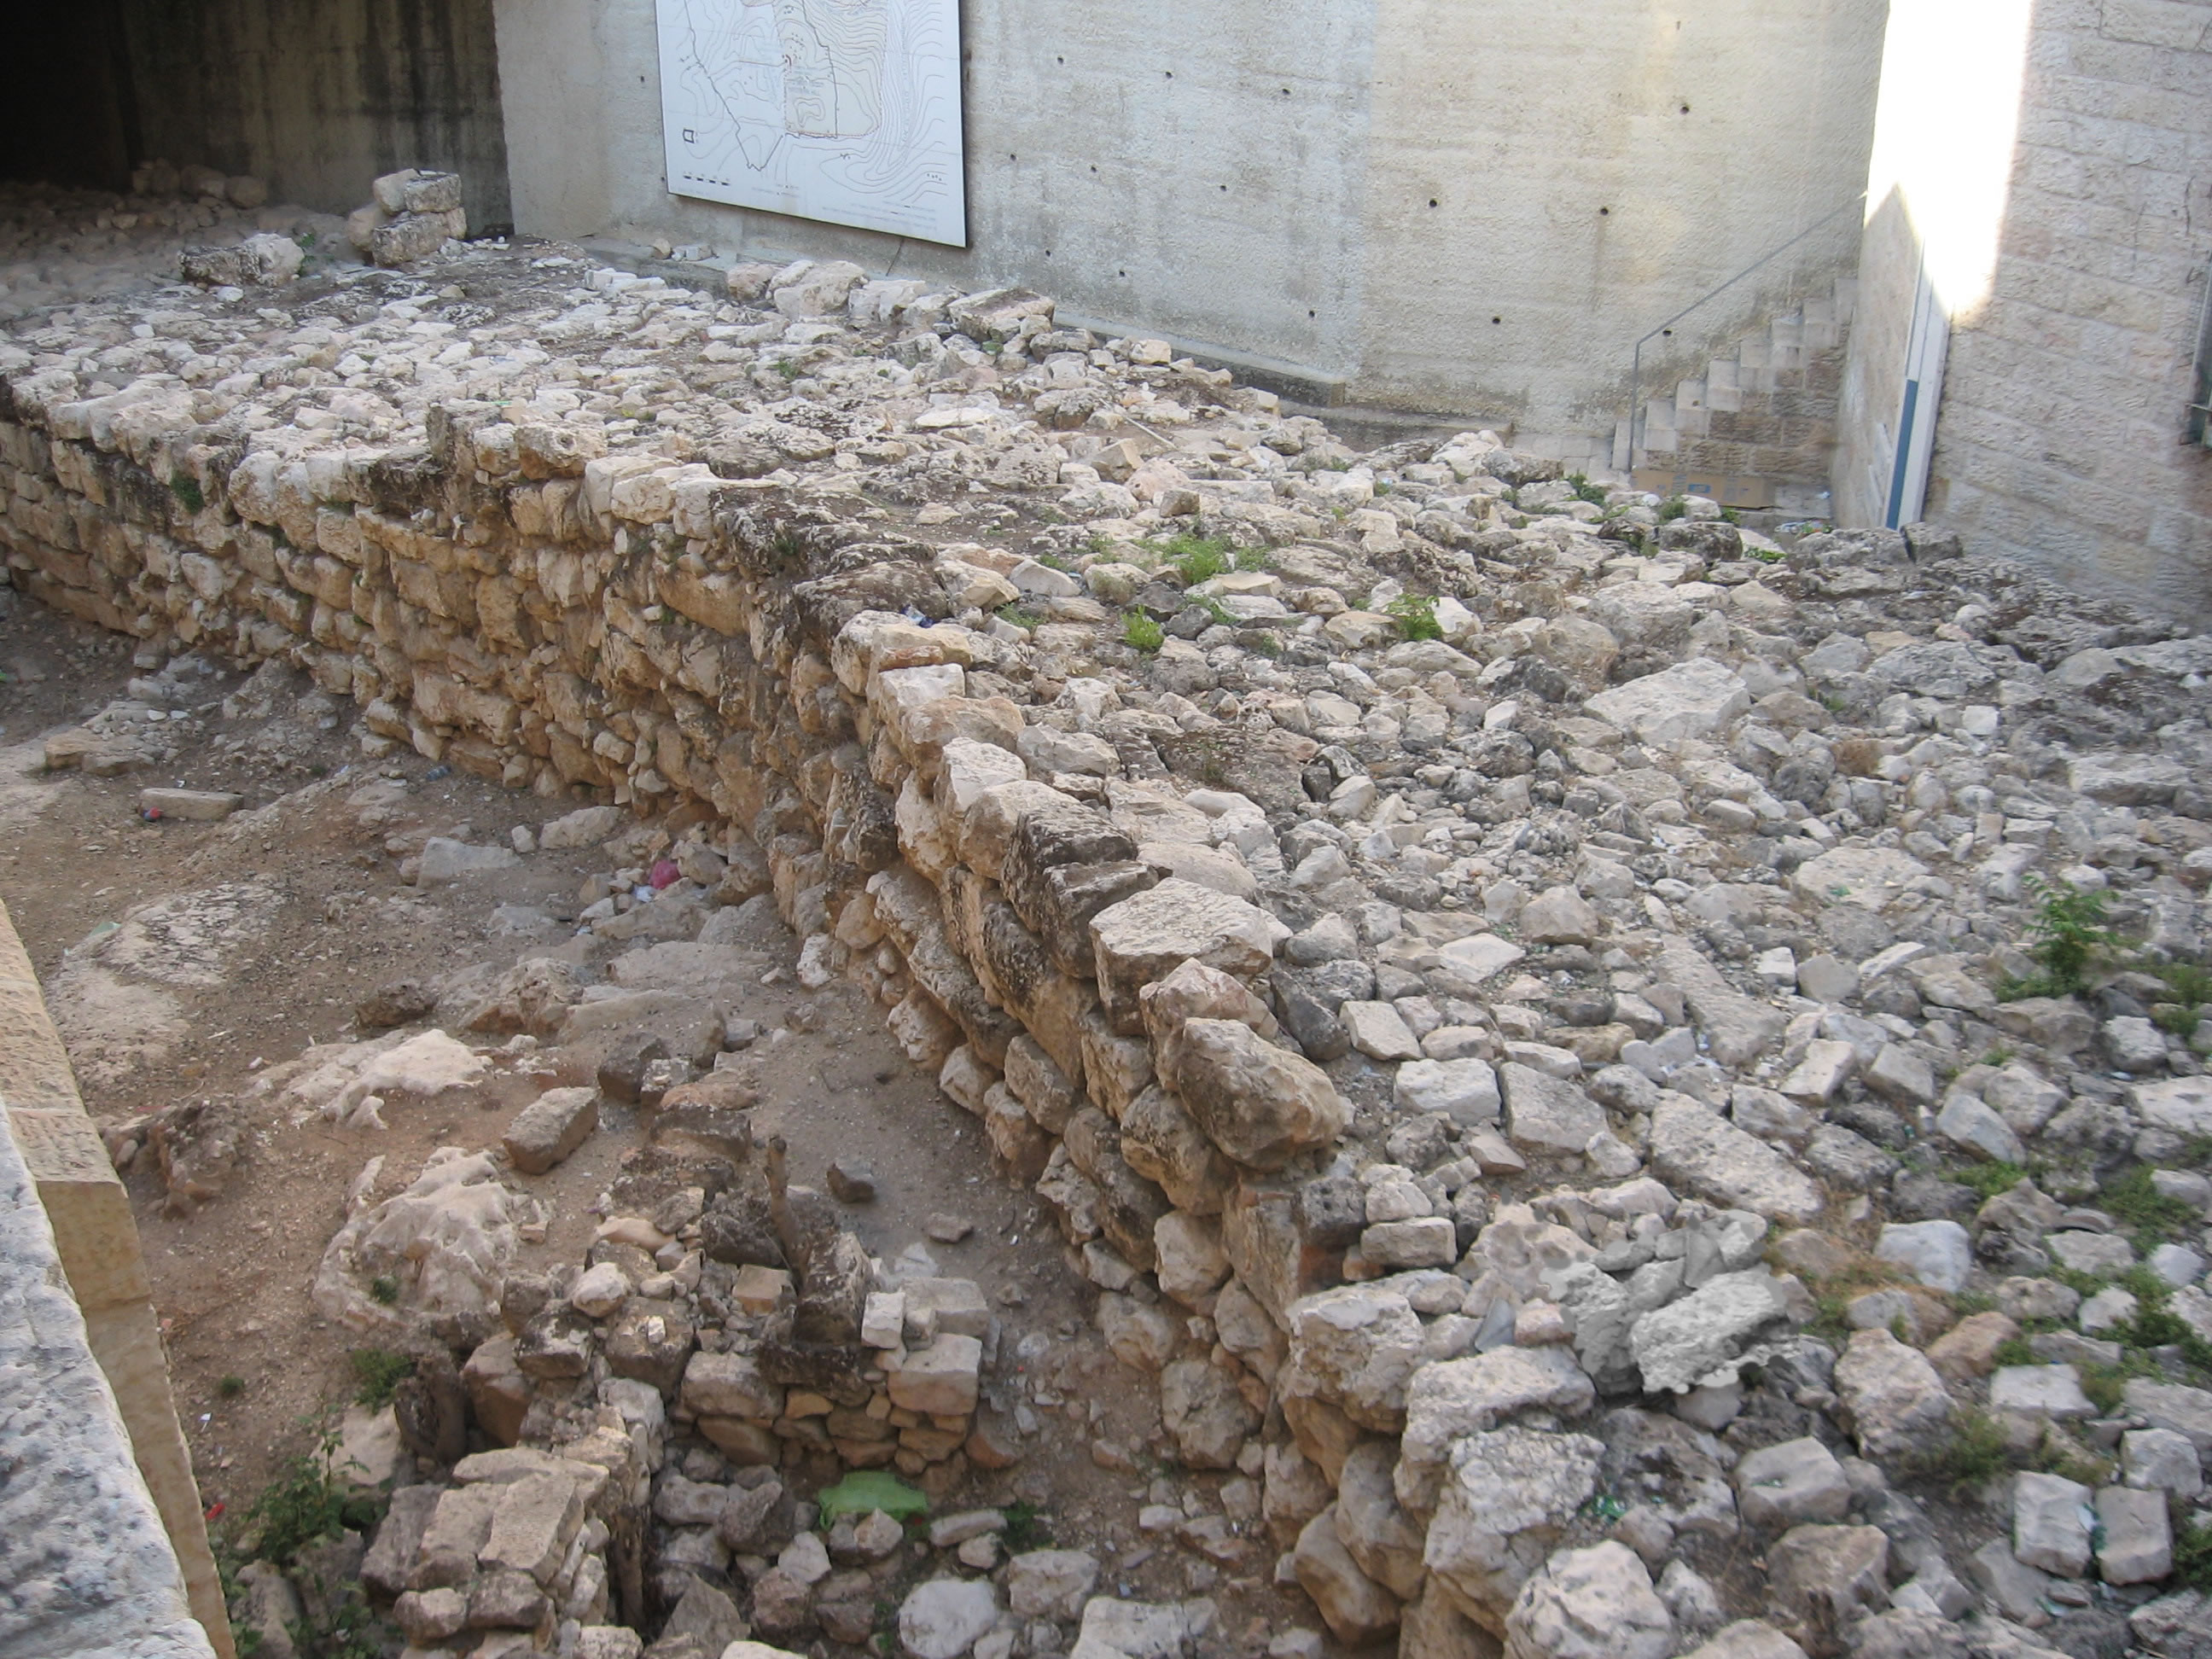

Slide 10
Keys to the Success
They had a mind to work (Nehemiah 4:6)
Whatever you do, do your work heartily, as for the Lord rather than for men, knowing that from the Lord you will receive the reward of the inheritance. It is the Lord Christ whom you serve.
Colossians 3:23-24

Slide 11
Keys to the Success
They knew God was working (Nehemiah 2:20)
So then, my beloved, just as you have always obeyed, not as in my presence only, but now much more in my absence, work out your salvation with fear and trembling; for it is God who is at work in you, both to will and to work for His good pleasure.
Philippians 2:12,13

Slide 12
Keys to the Success
They knew God was working (Nehemiah 2:20)
equip you in every good thing to do His will, working in us that which is pleasing in His sight, through Jesus Christ, to whom be the glory forever and ever. Amen.
Hebrews 13:21

Slide 13
Keys to the Success
They knew God was working (Nehemiah 2:20)
What then shall we say to these things? If God is for us, who is against us?
Romans 8:31

Slide 14
Keys to the Success
They knew prayer worked (Nehemiah 4:9)
Therefore, confess your sins to one another, and pray for one another so that you may be healed. The effective prayer of a righteous man can accomplish much.
James 5:16

Slide 15
Keys to the Success
They knew prayer worked (Nehemiah 4:9)
Finally, brethren, pray for us that the word of the Lord will spread rapidly and be glorified, just as it did also with you;
2 Thessalonians 3:1

Slide 16
Keys to the Success
They knew prayer worked (Nehemiah 4:9)
And when he realized this, he went to the house of Mary, the mother of John who was also called Mark, where many were gathered together and were praying. (13) When he knocked at the door of the gate, a servant-girl named Rhoda came to answer. (14) When she recognized Peter's voice, because of her joy she did not open the gate, but ran in and announced that Peter was standing in front of the gate. (15) They said to her, "You are out of your mind!" But she kept insisting that it was so. They kept saying, "It is his angel." (16) But Peter continued knocking; and when they had opened the door, they saw him and were amazed. Acts 12:12-16

Slide 17
How to be a servant
Believe: John 3:16
Repent: Acts 2:38
Confess: Romans 10:9-10
Be Baptized: 1 Peter 3:21

