Slide 2
January 25
Every dollar given on Mission Sunday
goes toward mission work.

Slide 3
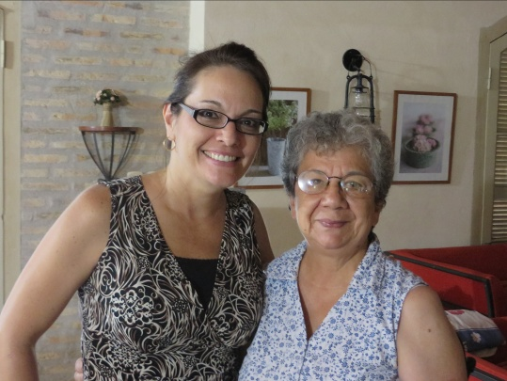
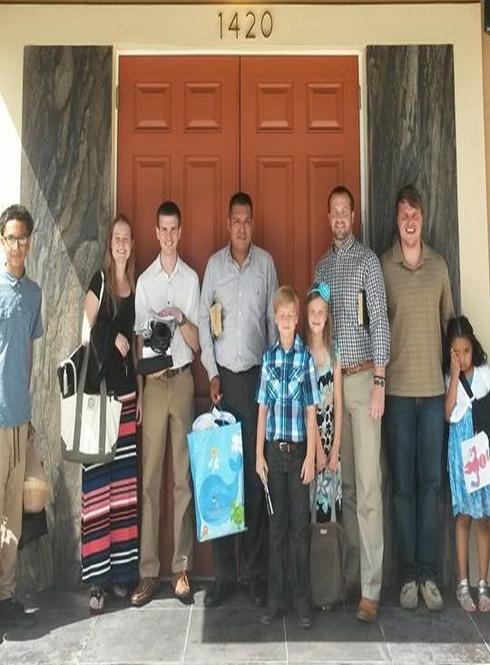
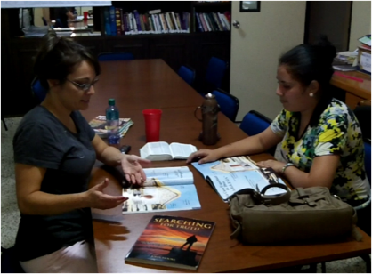
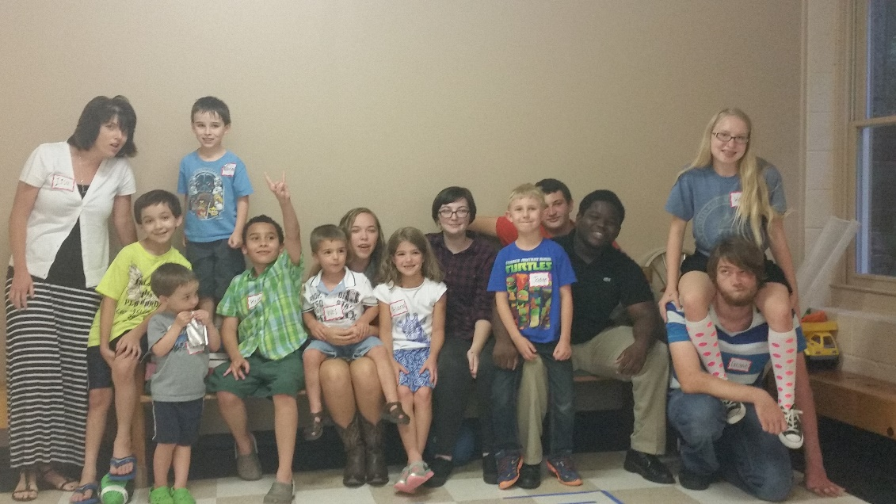
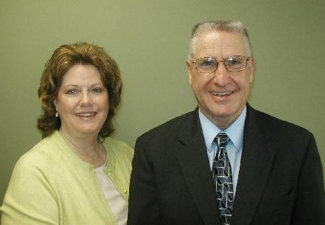
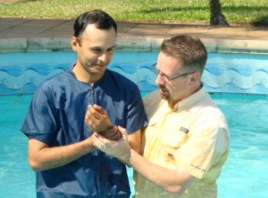
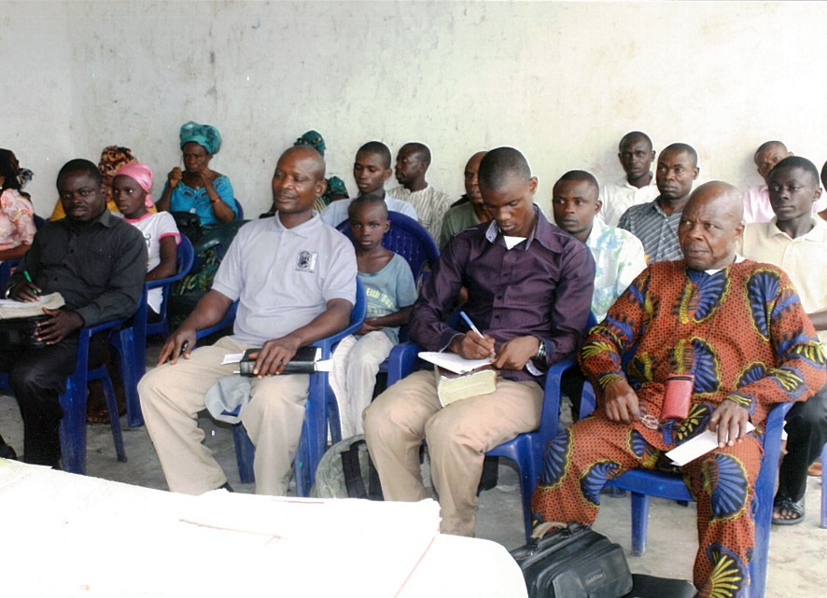
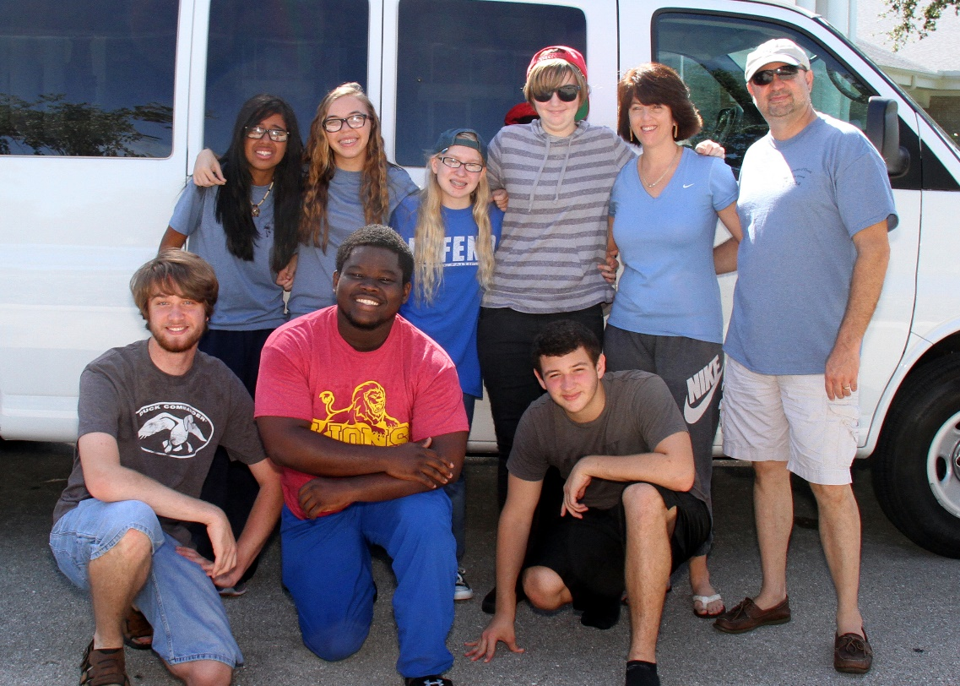
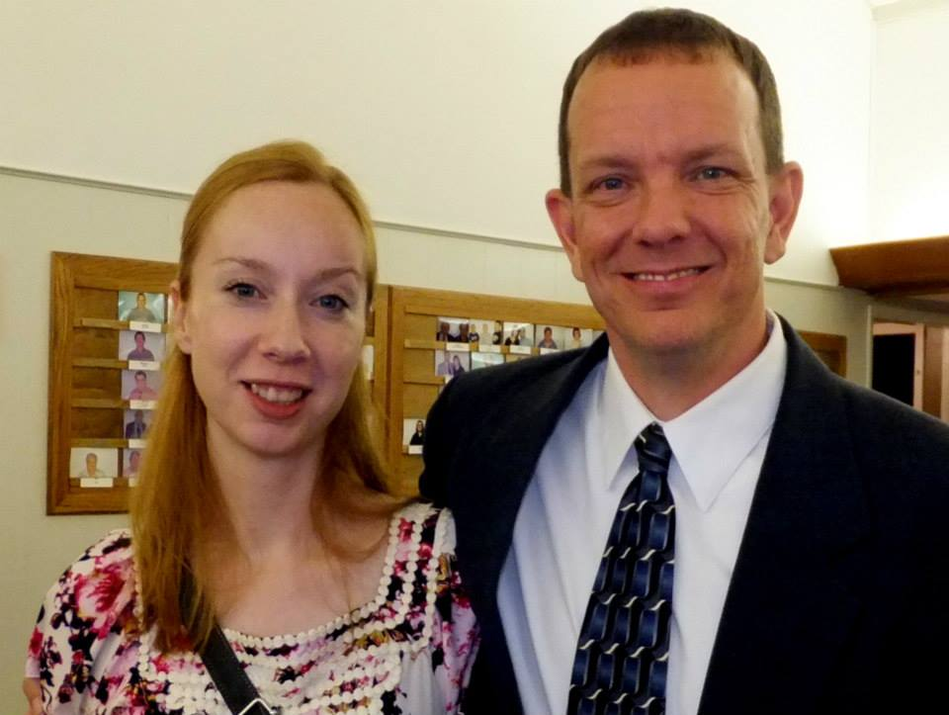
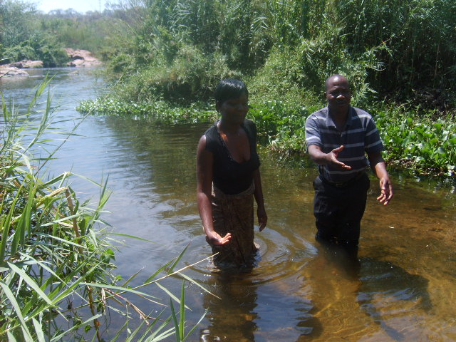
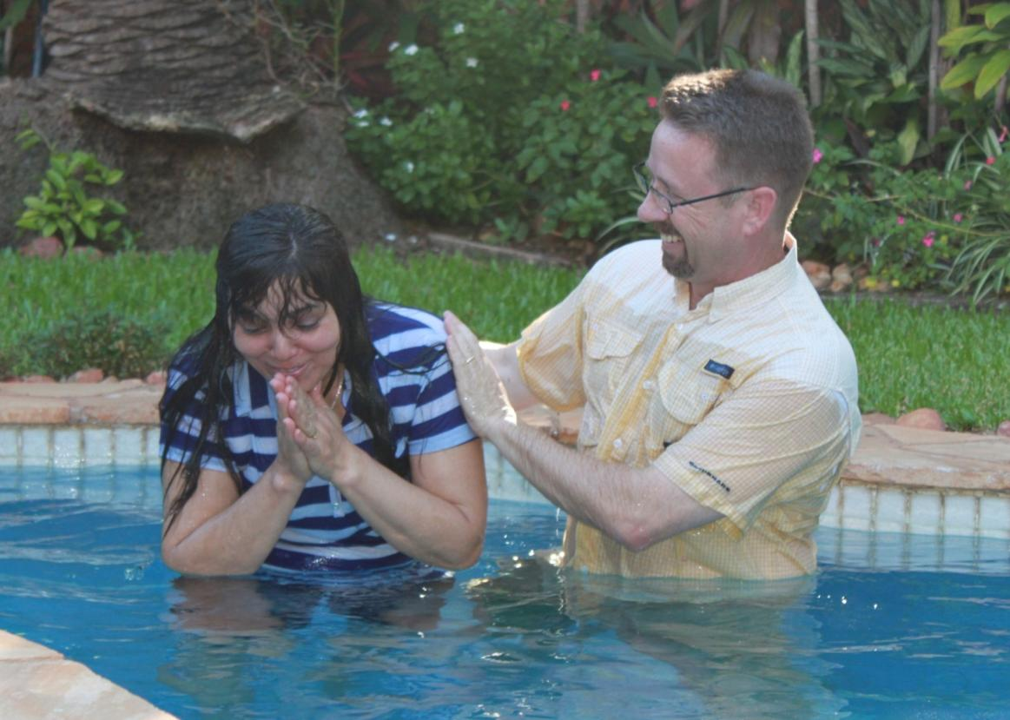
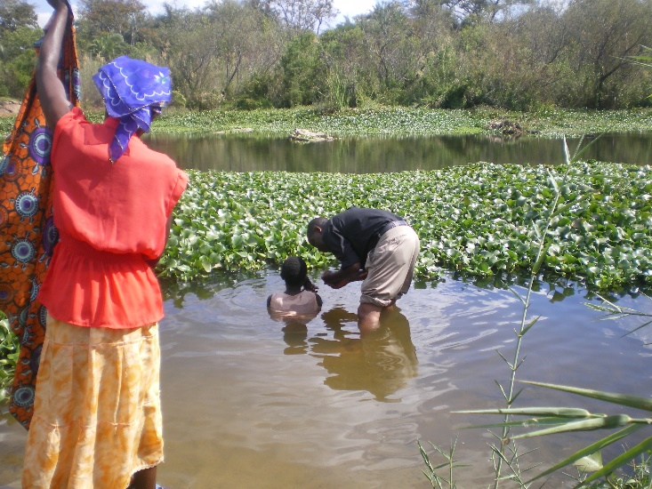
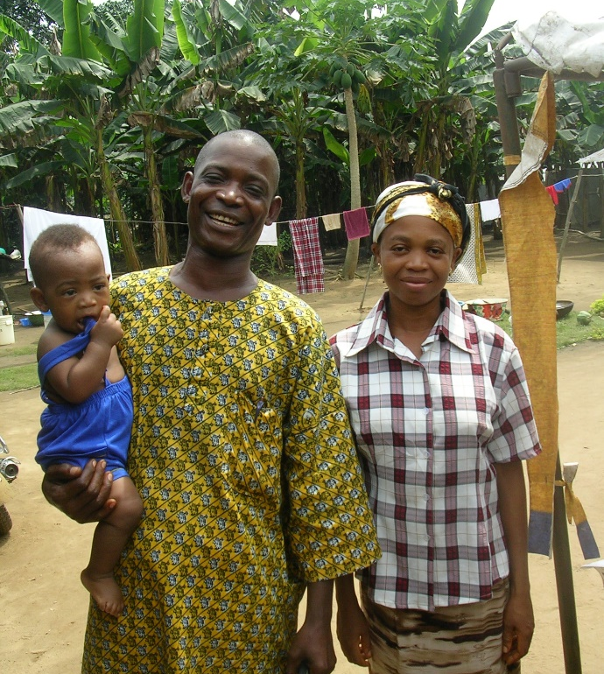
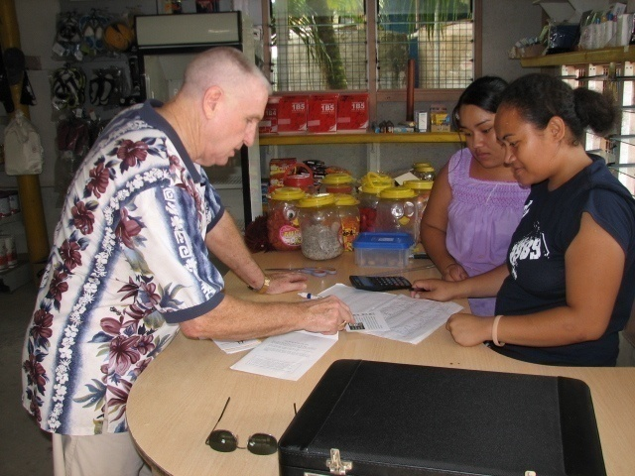
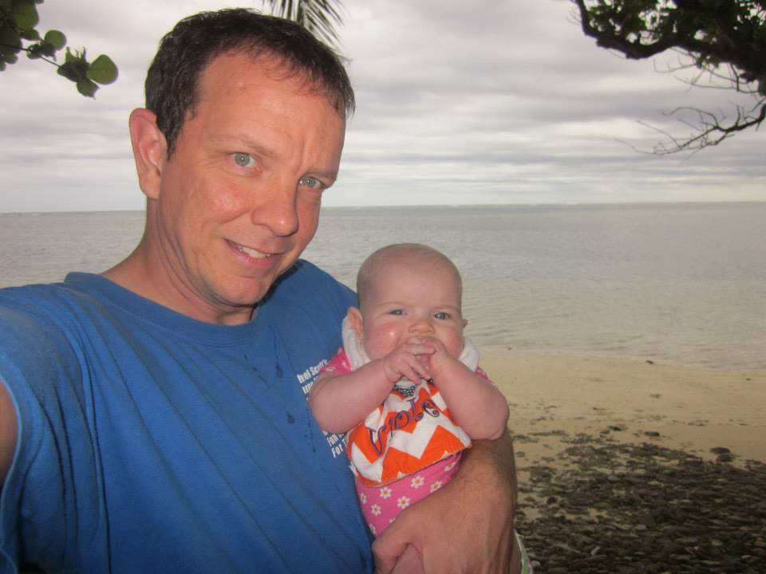
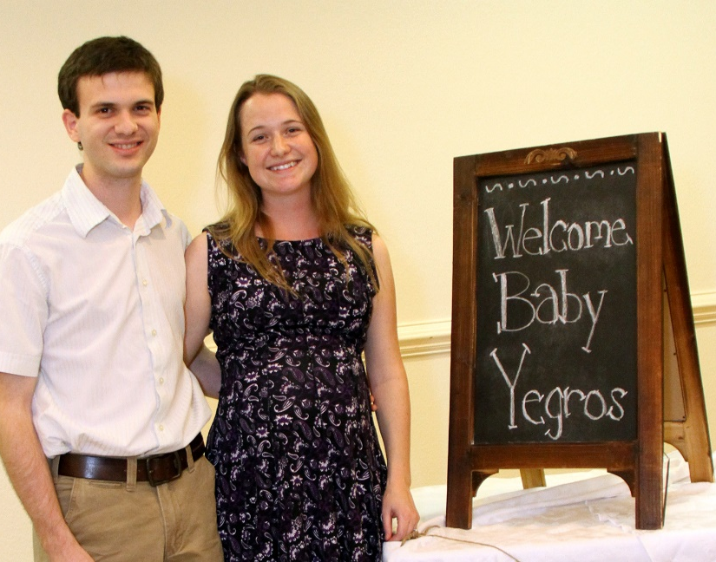
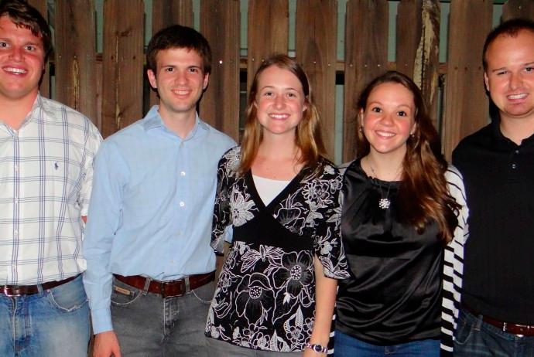
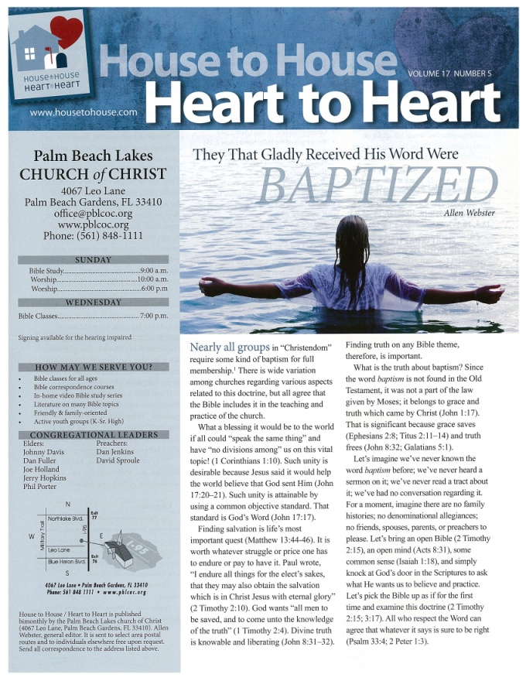
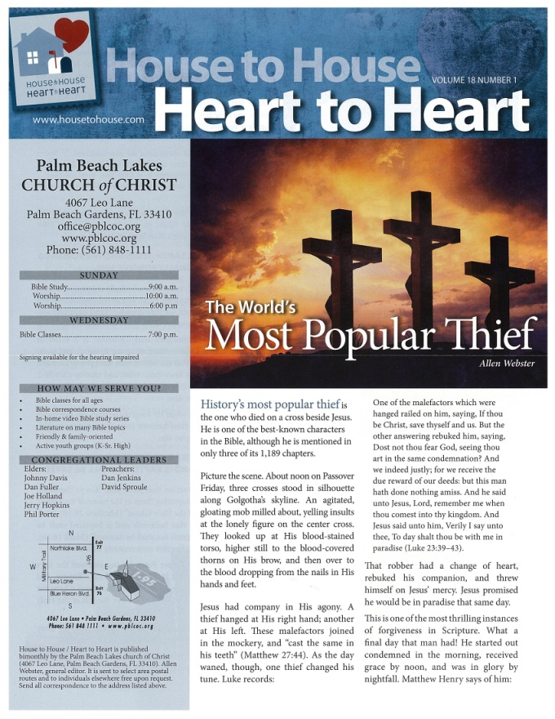
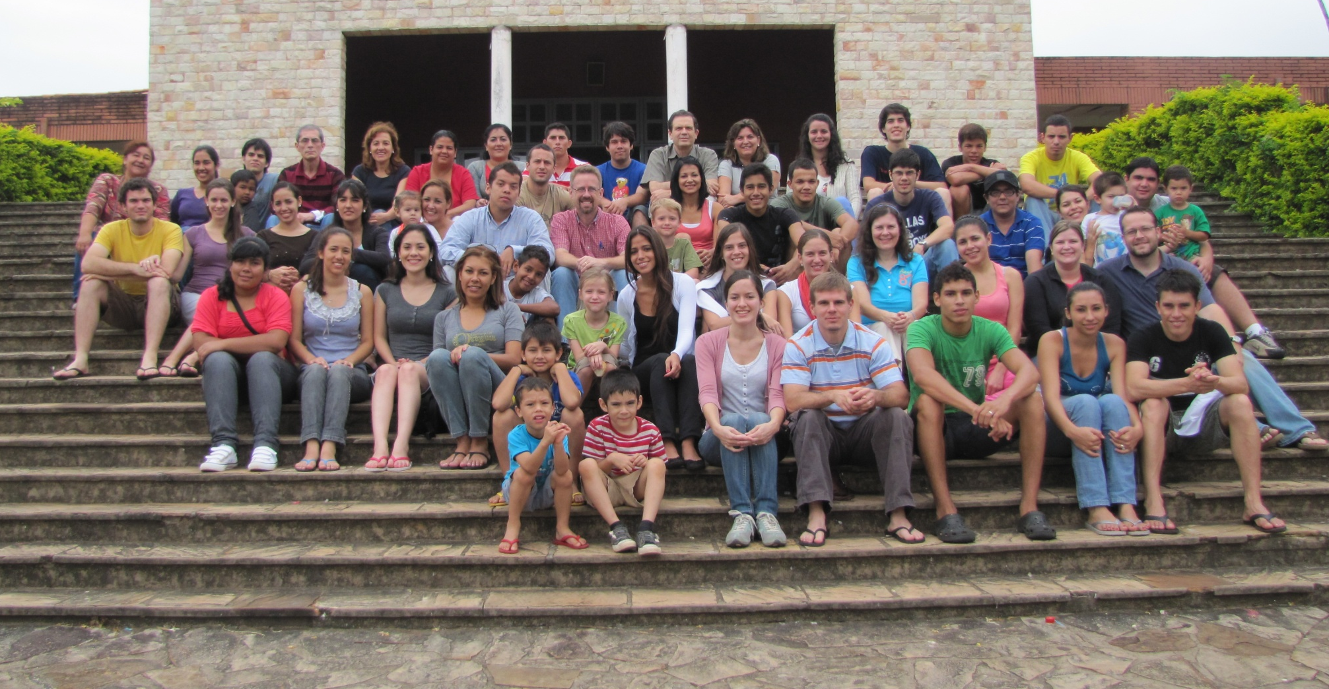
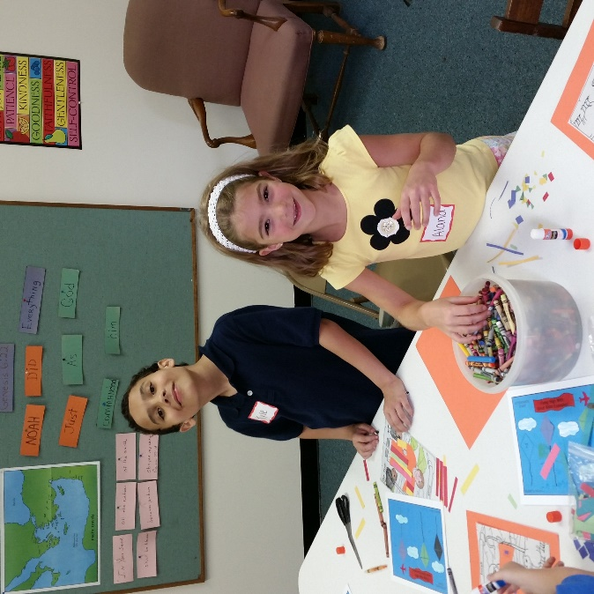
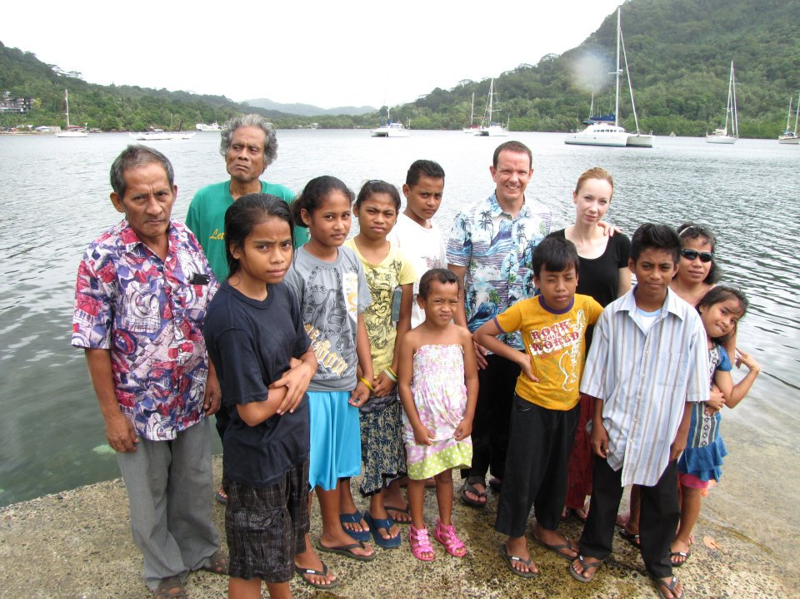
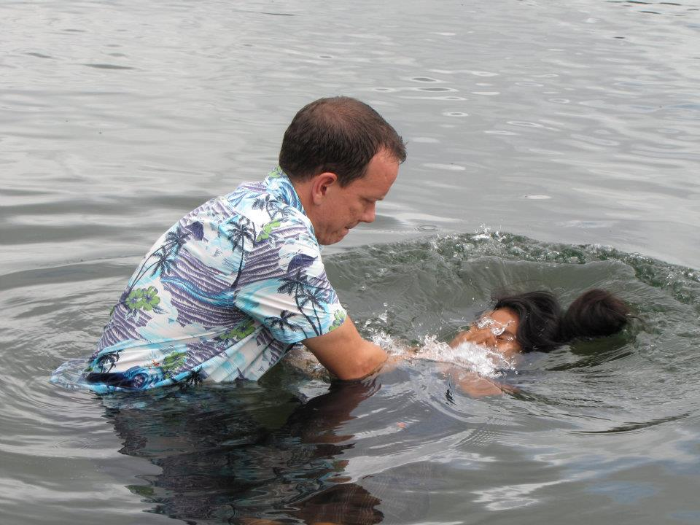
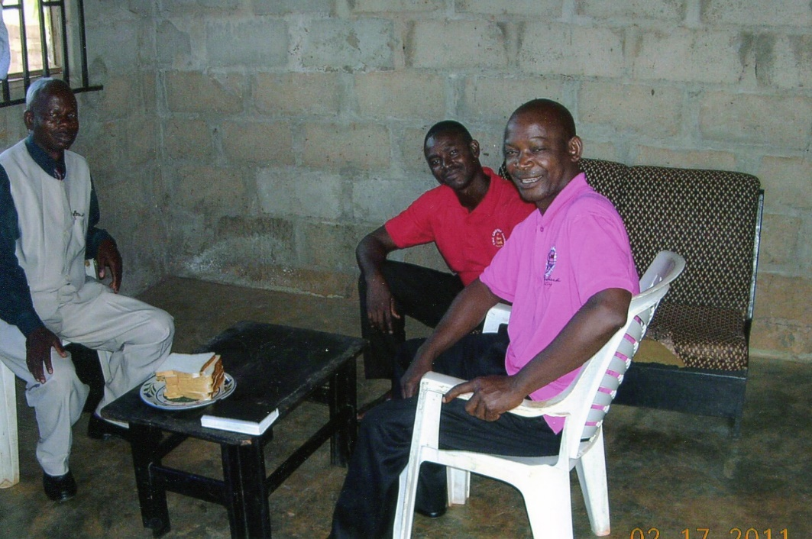
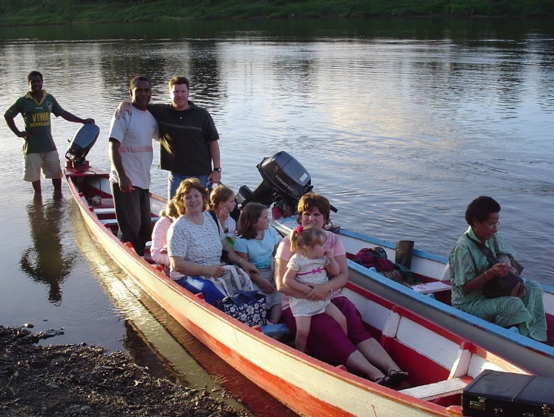
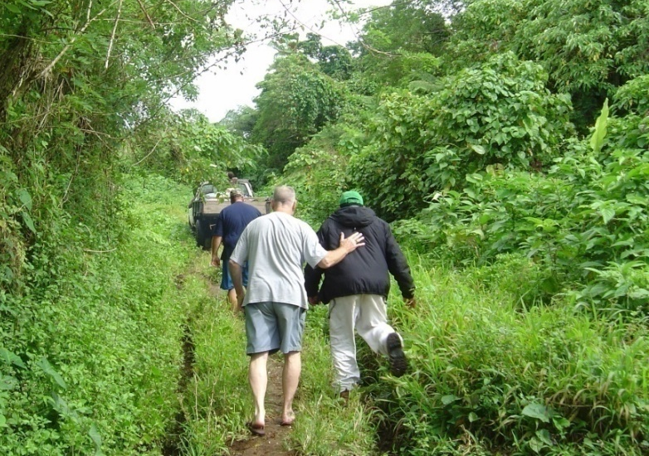
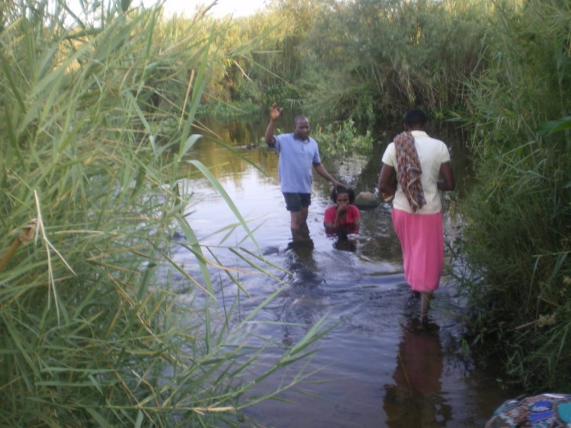
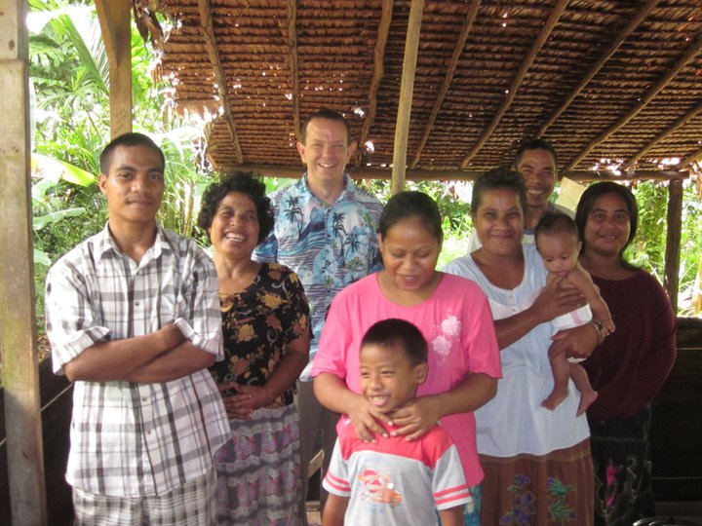
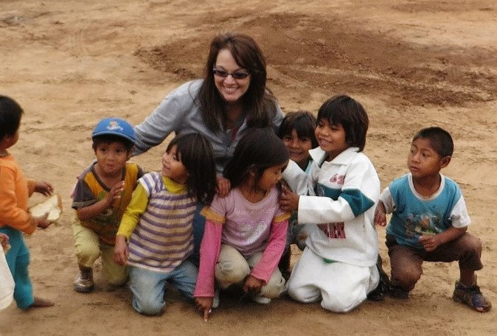
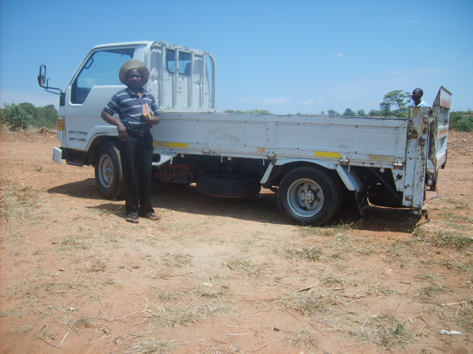
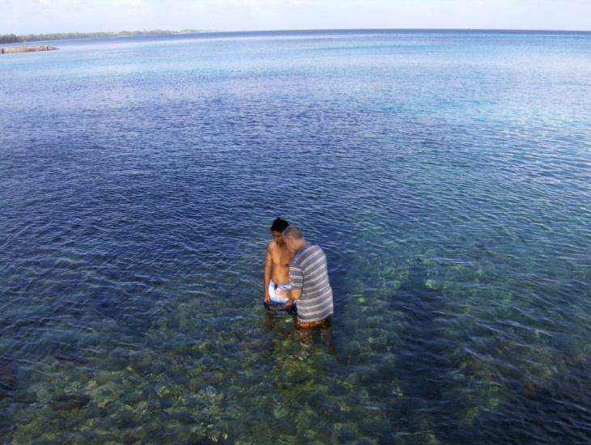
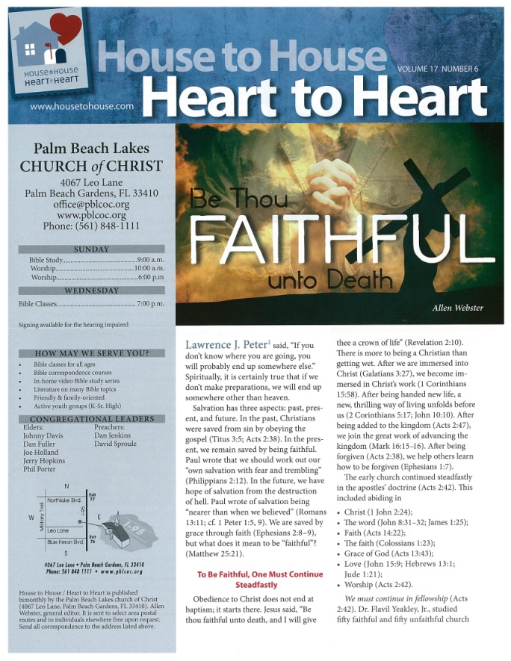
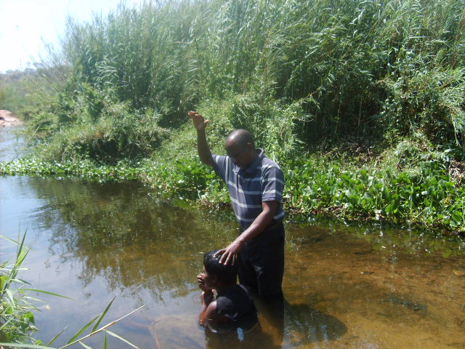
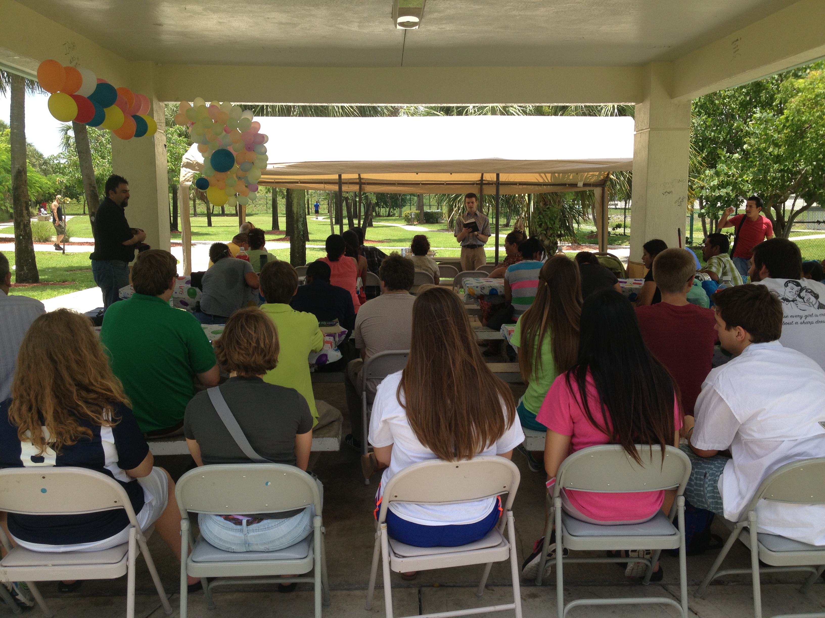
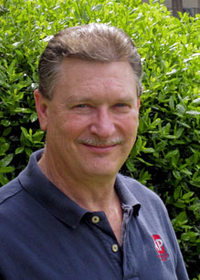
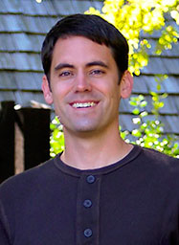
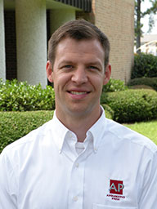
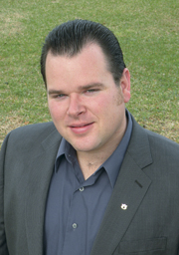
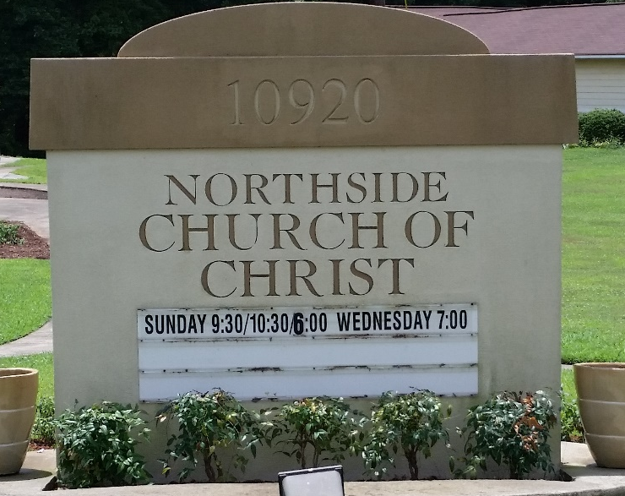
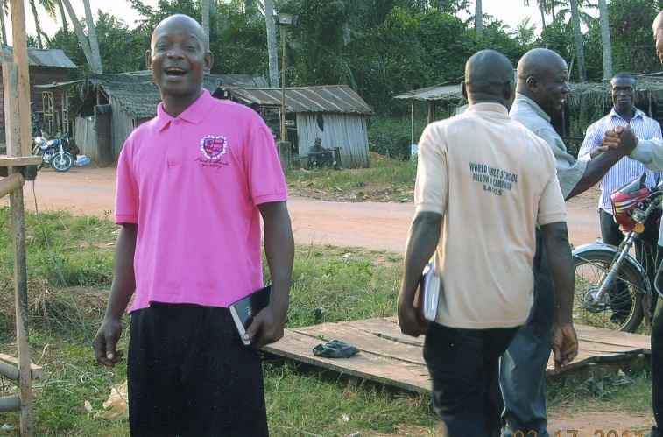
8,000 homes
6 x’s a year
House to House/Heart to Heart (to 8,000 local homes)
Sr. High Summer Mission Trip
Troy Spradlin (Paraguay)
Apologetics Press
$64,600
Robert Martin (Pacific)
Mauricio Yegros (Coral Springs)
Scott Shanahan (Pacific)
Joey Treat (Pacific)
Nnanna Aforji (Nigeria)
Tamuka Arunashe (Zimbabwe)

Slide 4
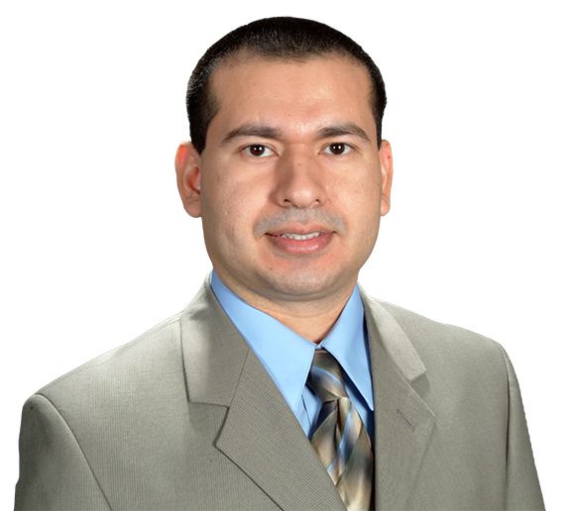
$77,400
Special Requests
for Mission Trips
Douglas Alvarenga
(Spanish Work in L.W.)
House to House/Heart to Heart (to 8,000 local homes)
Sr. High Summer Mission Trip
Troy Spradlin (Paraguay)
Apologetics Press
$64,600
Robert Martin (Pacific)
Mauricio Yegros (Coral Springs)
Scott Shanahan (Pacific)
Joey Treat (Pacific)
Nnanna Aforji (Nigeria)
Tamuka Arunashe (Zimbabwe)

Slide 5
$93,500
Student in Asuncion
Bible Academy
$77,400
Special Requests
for Mission Trips
Douglas Alvarenga
(Spanish Work in L.W.)
House to House/Heart to Heart (to 8,000 local homes)
Sr. High Summer Mission Trip
Troy Spradlin (Paraguay)
Apologetics Press
$82,000
Robert Martin (Pacific)
Mauricio Yegros (Coral Springs)
Scott Shanahan (Pacific)
Joey Treat (Pacific)
Nnanna Aforji (Nigeria)
Tamuka Arunashe (Zimbabwe)

Slide 6
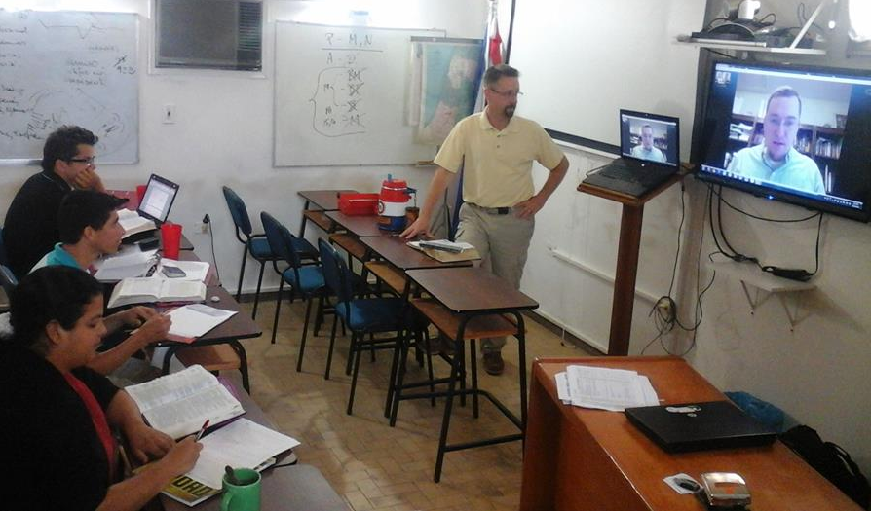
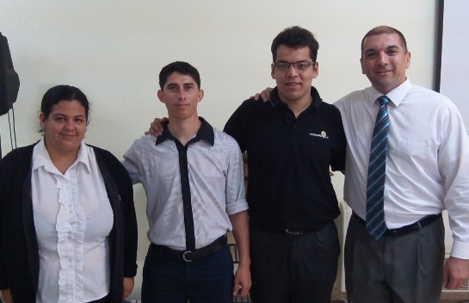
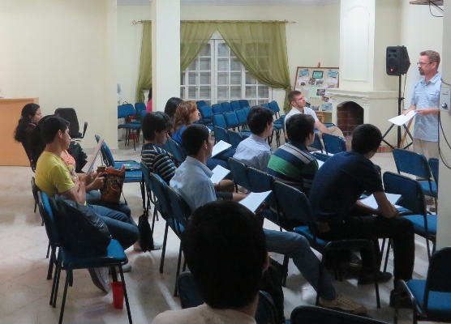
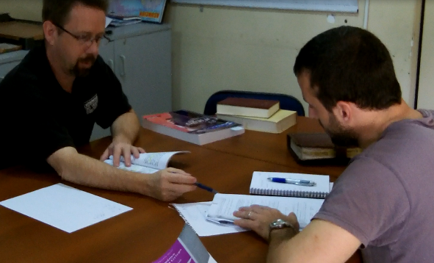
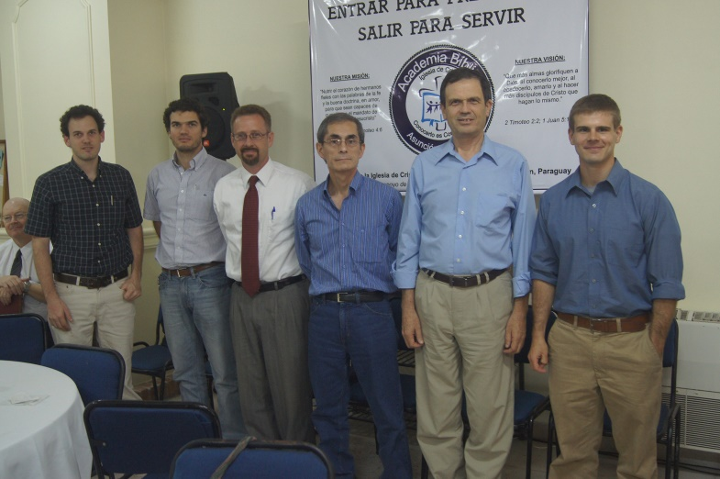

Slide 7
$93,500
Student in Asuncion
Bible Academy
Easter Island Trips
to Build the Church
$77,400
Special Requests
for Mission Trips
Douglas Alvarenga
(Spanish Work in L.W.)
House to House/Heart to Heart (to 8,000 local homes)
Sr. High Summer Mission Trip
Troy Spradlin (Paraguay)
Apologetics Press
$64,600
Robert Martin (Pacific)
Mauricio Yegros (Coral Springs)
Scott Shanahan (Pacific)
Joey Treat (Pacific)
Nnanna Aforji (Nigeria)
Tamuka Arunashe (Zimbabwe)

Slide 8
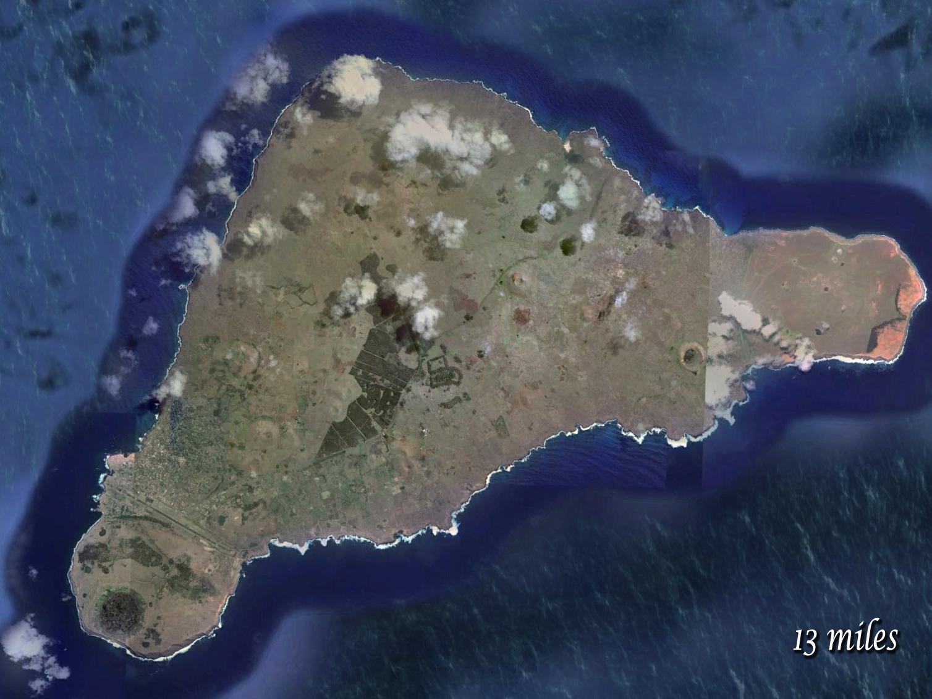
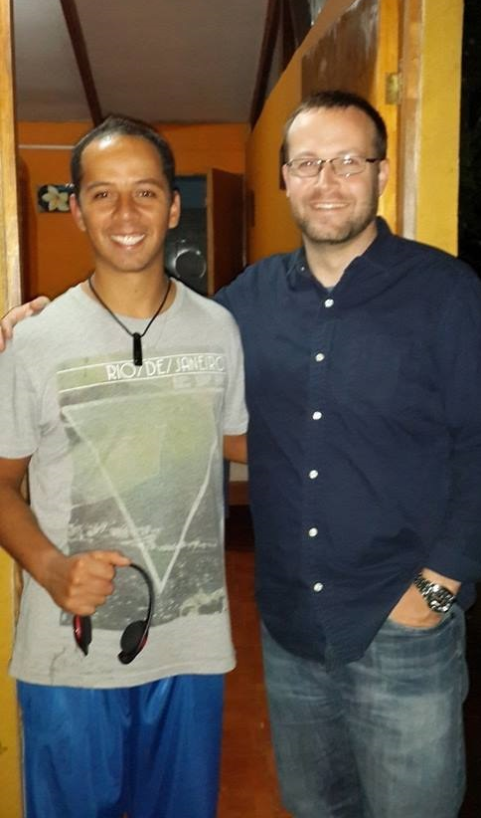
Send Josh Twice in 2015
to continue preaching and building up the church
Easter Island
Piki
Uri

Slide 9
Adult
Mission Trip to Paraguay
HD Video
Production
System
$123,500
$93,500
Student in Asuncion
Bible Academy
Easter Island Trips
to Build the Church
$77,400
Special Requests
for Mission Trips
Douglas Alvarenga
(Spanish Work in L.W.)
House to House/Heart to Heart (to 8,000 local homes)
Sr. High Summer Mission Trip
Troy Spradlin (Paraguay)
Apologetics Press
$64,600
Robert Martin (Pacific)
Mauricio Yegros (Coral Springs)
Scott Shanahan (Pacific)
Joey Treat (Pacific)
Nnanna Aforji (Nigeria)
Tamuka Arunashe (Zimbabwe)

Slide 10
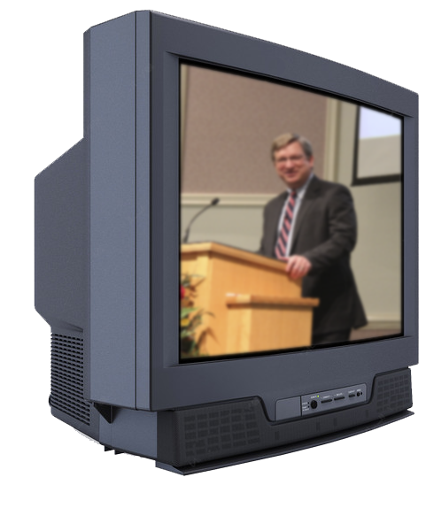
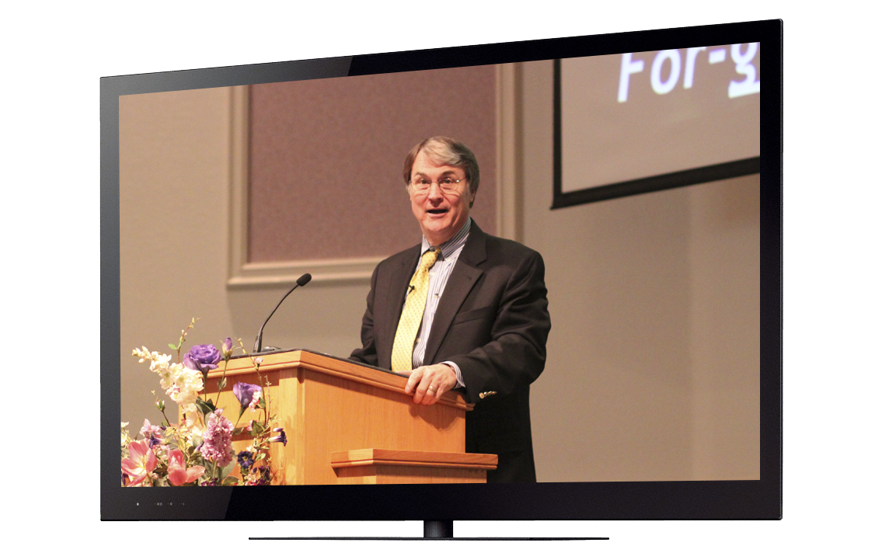

Slide 13
$+++,+++
I
95
Sign
Adult
Mission Trip to Paraguay
HD Video
Production
System
$123,500
$93,500
Student in Asuncion
Bible Academy
Easter Island Trips
to Build the Church
$77,400
Special Requests
for Mission Trips
Douglas Alvarenga
(Spanish Work in L.W.)
House to House/Heart to Heart (to 8,000 local homes)
Sr. High Summer Mission Trip
Troy Spradlin (Paraguay)
Apologetics Press
$64,600
Robert Martin (Pacific)
Mauricio Yegros (Coral Springs)
Scott Shanahan (Pacific)
Joey Treat (Pacific)
Nnanna Aforji (Nigeria)
Tamuka Arunashe (Zimbabwe)

Slide 15
The Purpose of
Mission Sunday
The Purpose of
The Gospel
is to
Save
Souls!
Are you
Saved?
Believe Jesus is God’s Son John 8:24
Repent/Turn from your sins Acts 2:38
Confess your faith Romans 10:9
Be baptized Mark 16:16
Live faithfully Revelation 2:10

