Slide 2
God’s plan has always been to use “the few”
Using “the few” always brings glory to Him
We are “the few”
“With GOD We Can”
To God be the glory!

Slide 3
Every dollar given on Mission Sunday
goes toward mission work.

Slide 4
11 Years of
Sacrificial Giving
2004 – 2014
Average Contribution $ 116,727.60
Total Contribution $1,284,003.57

Slide 5
House to House/Heart to Heart (11 Yrs) 940,000+ Pieces
Daily Radio Program (2002-2007) 2,000,000 People
Television Program (2005) 300,000 Homes
TV Spot Ads (2006-2007) 300,000 Homes
“Plan of Salvation” Mailout (2007) 50,000 Homes
Sr. High Mission Trips 15 Cong. in 9 states with 45+ teens
Spanish Work at PBL (2003-2010)
New Bible tracts and car magnets/plates (2012)
Outreach via I-95 (banners, sign, etc.) 500,000 Daily

Slide 6
13 Full-Time Missionaries in 26 Countries on 4 Continents
Nnanna Aforji (Nigeria)
Tamuka Arunashe (Zimbabwe)
Josh Blackmer (Paraguay)
Chris Fry (Paraguay)
Junot Joseph (Miami)
Ray Leonard (South Africa)
Robert Martin (Pacific Islands)
Dozens of Mission Trips to 25+ Countries on 6 Continents
Adult Groups from PBL to Bahamas, Paraguay, Peru, Trinidad
College Student Mission Trips all over the globe
Jason Quashie (Bahamas)
Scott Shanahan (Pac Isl)
Surendra Singh (Trinidad)
Troy Spradlin (Paraguay)
Joey Treat (Pacific Islands)
Mauricio Yegros (Miami)

Slide 7
Apologetics Press in Montgomery, AL
Professional Staff
Four men (Dave Miller, Jeff Miller, Eric Lyons, Kyle Butt)
Speak around the country & globe (100+ places annually)
Publications
Monthly Journals: Reason & Revelation and Discovery
Books for adults & kids + Tracts for adults & kids
Videos for adults & kids + eBooks for adults & kids
Bible Class curriculum, VBS Materials, Study Courses, etc.
Website (www.ApologeticsPress.org)
8,000,000+ page hits annually from 175+ countries

Slide 8
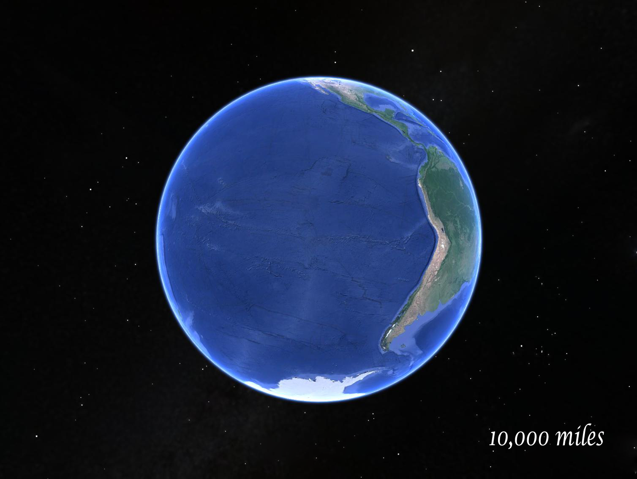

Slide 9
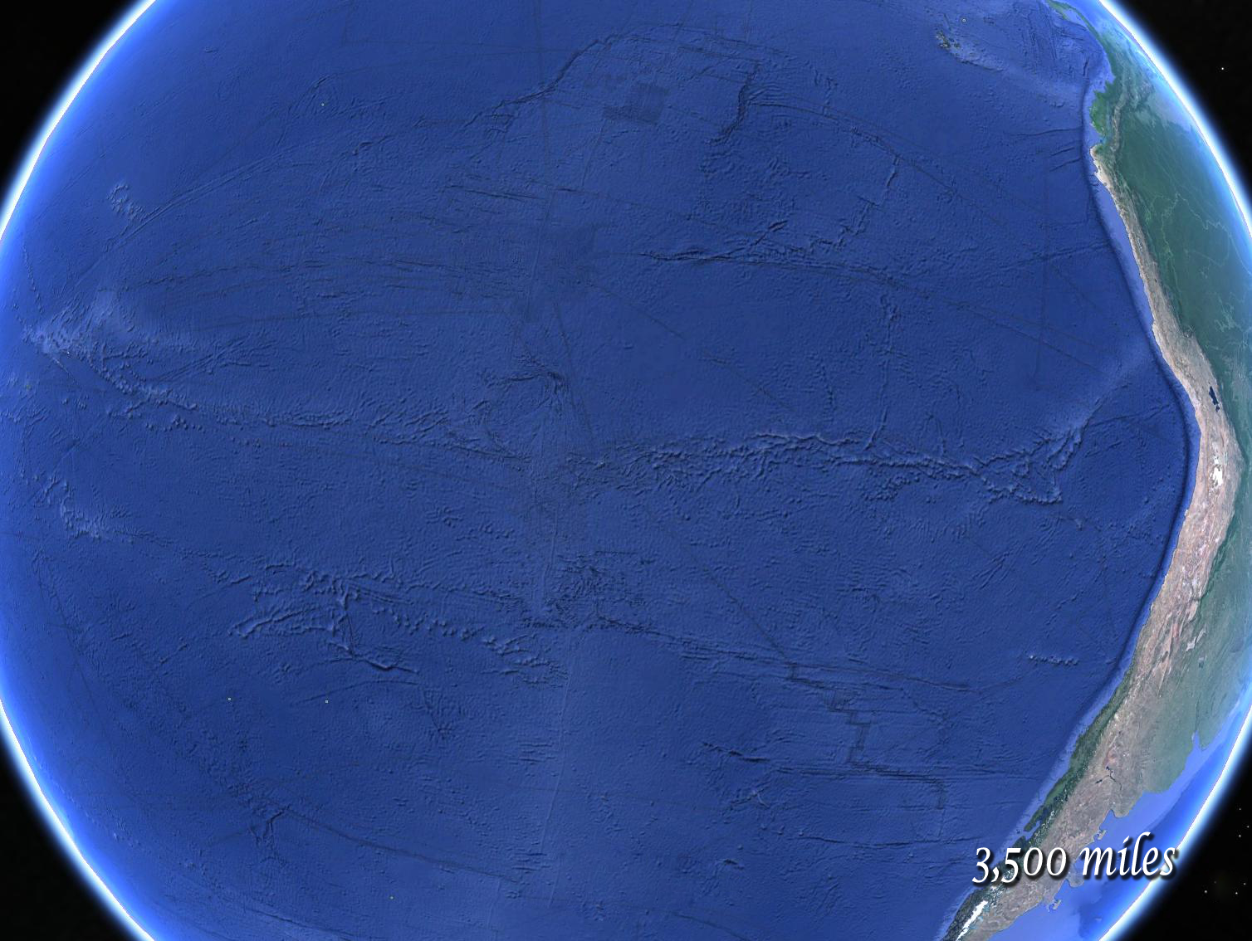

Slide 10
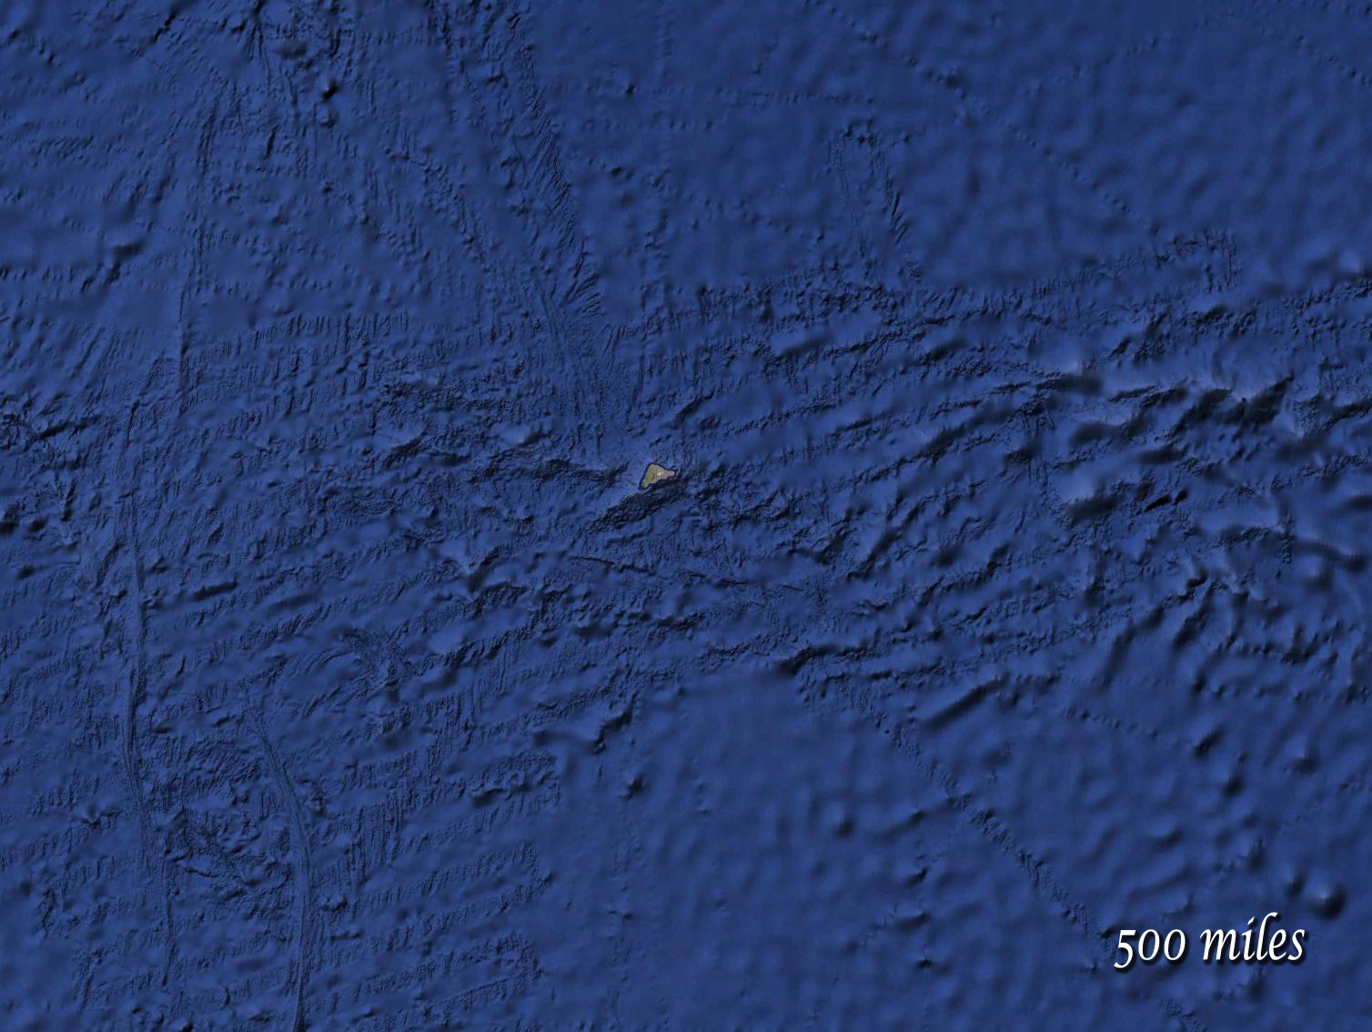

Slide 11
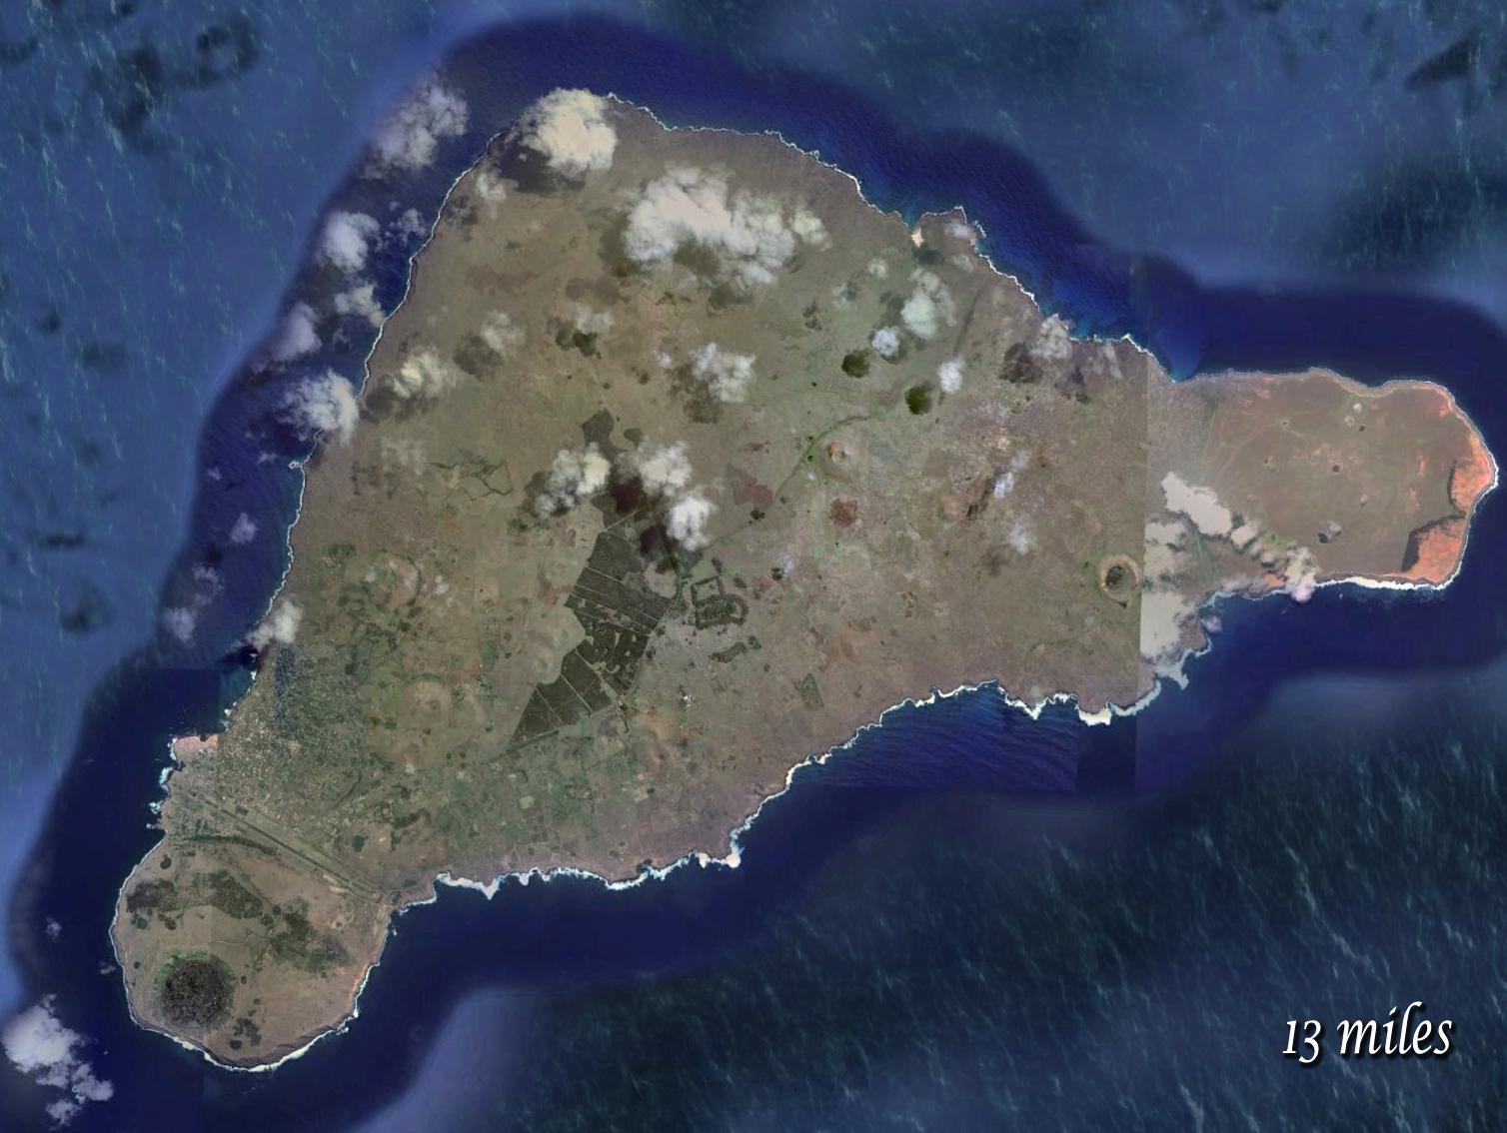
63 square miles
PBC is 2,400 mi²
~Size of PBG + RB
~35 miles of coastline
Easter Island
2,500 miles east of Tahiti
2,200 miles west of Chile
Population: 5,700
(PBG+RB=83,000)

Slide 12
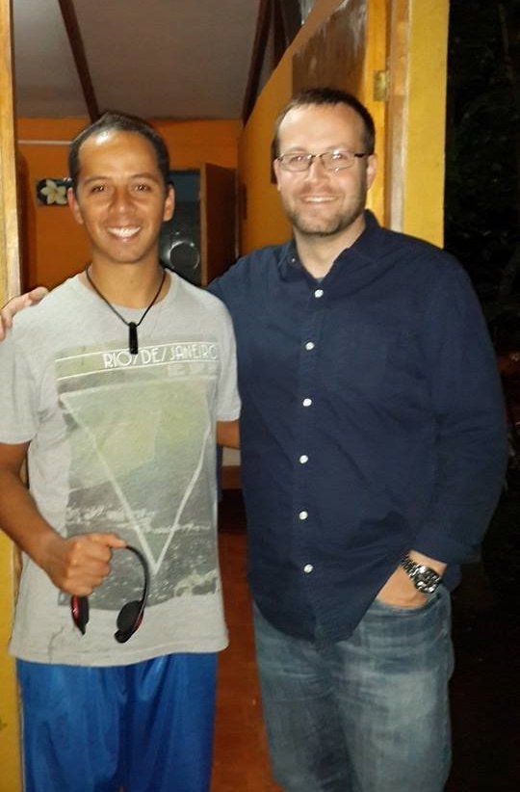
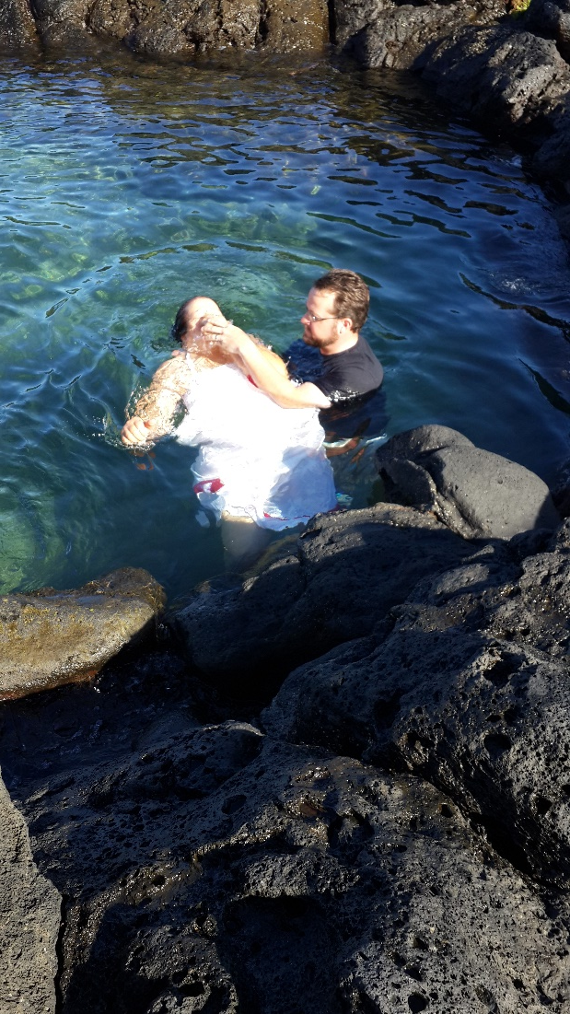
First New Testament Christians on Easter Island
Easter Island
Piki
Uri

Slide 13
One small congregation
Taking the seed of Jesus’ gospel
To the uttermost parts of the earth
For absolutely no glory of our own
Because we love Jesus & His cross!

Slide 14
Jesus Wants to Save You!
Him Glory
To
Be
Believe in Jesus Christ John 3:16
Repent—decide to obey Acts 17:30
Confess Christ Rom. 10:9
Baptized to be saved Acts 22:16
Added to His kingdom, His church
Be faithful until death Rev. 2:10

