Slide 1

@Palm Beach Lakes church of Christ
Family Youth Ministry

Slide 2

Questions

Slide 3

I got this!

Slide 4
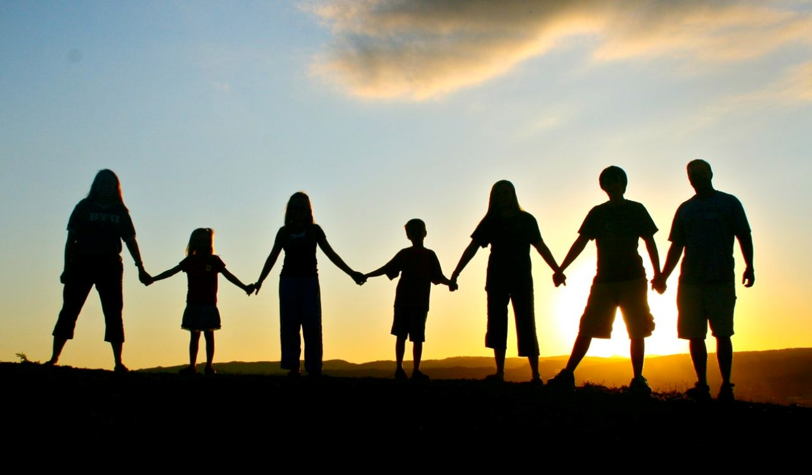
3 Biblical Concepts

Slide 5

The Church is the Family of God

Slide 6

The Church is the Family of God
but in case I am delayed, I write so that you will know how one ought to conduct himself in the household of God, which is the church of the living God, the pillar and support of the truth.
1Timothy 3:15

Slide 7
The Church is the Family of God
Let us not lose heart in doing good, for in due time we will reap if we do not grow weary. So then, while we have opportunity, let us do good to all people, and especially to those who are of the household of the faith.
Galatians 6:9-10

Slide 8
The Church is the Family of God
So then you are no longer strangers and aliens, but you are fellow citizens with the saints, and are of God's household, having been built on the foundation of the apostles and prophets, Christ Jesus Himself being the corner stone, in whom the whole building, being fitted together, is growing into a holy temple in the Lord, in whom you also are being built together into a dwelling of God in the Spirit.
Ephesians 2:19-22

Slide 9
The Church is the Family of God
But Jesus answered the one who was telling Him and said, "Who is My mother and who are My brothers?" And stretching out His hand toward His disciples, He said, "Behold My mother and My brothers! "For whoever does the will of My Father who is in heaven, he is My brother and sister and mother."
Matthew 12:48-50

Slide 10
The Church is the Family of God
And everyone who has left houses or brothers or sisters or father or mother or children or farms for My name's sake, will receive many times as much, and will inherit eternal life.
Matthew 19:29

Slide 11
The Church is the Family of God
When Jesus then saw His mother, and the disciple whom He loved standing nearby, He said to His mother, "Woman, behold, your son!" Then He said to the disciple, "Behold, your mother!" From that hour the disciple took her into his own household.
John 19:26-27

Slide 12

The Church Labors Together

Slide 13

The Church Labors Together
Therefore, my beloved brothers, be steadfast, immovable, always abounding in the work of the Lord, knowing that in the Lord your labor is not in vain.
1 Corinthians 15:58

Slide 14
The Church Labors Together
For we are God's fellow workers. You are God's field, God's building.
1 Corinthians 3:9

Slide 15
The Church Labors Together
Only let your manner of life be worthy of the gospel of Christ, so that whether I come and see you or am absent, I may hear of you that you are standing firm in one spirit, with one mind striving side by side for the faith of the gospel, and not frightened in anything by your opponents. This is a clear sign to them of their destruction, but of your salvation, and that from God.
Philippians 1:27-28

Slide 16
The Church Labors Together
So we built the wall. And all the wall was joined together to half its height, for the people had a mind to work.
Nehemiah 4:6

Slide 17
The Church Labors Together
And I looked and arose and said to the nobles and to the officials and to the rest of the people, "Do not be afraid of them. Remember the Lord, who is great and awesome, and fight for your brothers, your sons, your daughters, your wives, and your homes."
Nehemiah 4:14

Slide 18
The Church Labors Together
So the wall was finished on the twenty-fifth day of the month Elul, in fifty-two days. And when all our enemies heard of it, all the nations around us were afraid and fell greatly in their own esteem, for they perceived that this work had been accomplished with the help of our God.
Nehemiah 6:15-16

Slide 19

The Church Helps Prepare Youth

Slide 20

The Church Helps Prepare Youth
Fathers, do not provoke your children to anger, but bring them up in the discipline and instruction of the Lord.
Ephesians 6:4

Slide 21
The Church Helps Prepare Youth
And these words that I command you today shall be on your heart. You shall teach them diligently to your children, and shall talk of them when you sit in your house, and when you walk by the way, and when you lie down, and when you rise. You shall bind them as a sign on your hand, and they shall be as frontlets between your eyes. You shall write them on the doorposts of your house and on your gates.
Deuteronomy 6:6-9

Slide 22
The Church Helps Prepare Youth
Older men are to be sober-minded, dignified, self-controlled, sound in faith, in love, and in steadfastness. Older women likewise are to be reverent in behavior, not slanderers or slaves to much wine. They are to teach what is good, and so train the young women to love their husbands and children, to be self-controlled, pure, working at home, kind, and submissive to their own husbands, that the word of God may not be reviled. Likewise, urge the younger men to be self-controlled.
Titus 2:2-6

Slide 23
The Church Helps Prepare Youth
Do not rebuke an older man but encourage him as you would a father, younger men as brothers, older women as mothers, younger women as sisters, in all purity.
1Timothy 5:1-2

Slide 24
How does this work @
Palm Beach Lakes?

Slide 25

Palm Beach Lakes Vision Statement
To be the faithful church that Jesus established by actively taking the gospel to lost souls, actively building each other up, actively participating in personal spiritual growth, actively serving the spiritual and physical needs of this congregation and the community, according to the scriptures.

Slide 26
Family Youth Ministry Vision Statement
At Palm Beach Lakes the family of God is actively involved in the faith building of the youth, strengthening of the family unit and the edification of the body. We seek to achieve this through bible education, congregational involvement and providing opportunities for spiritual development.

Slide 27
3 Biblical Concepts
The Church is the Family of God
The Church Labors Together
The Church Helps Prepare Youth

Slide 28
Are you in the family of God?
Hear: Romans 10:17
Believe: John 3:16
Repent: Acts 2:38
Confess: Romans 10:9-10
Be Baptized: 1 Peter 3:21
Live Faithfully: Revelation 2:10

