Slide 1
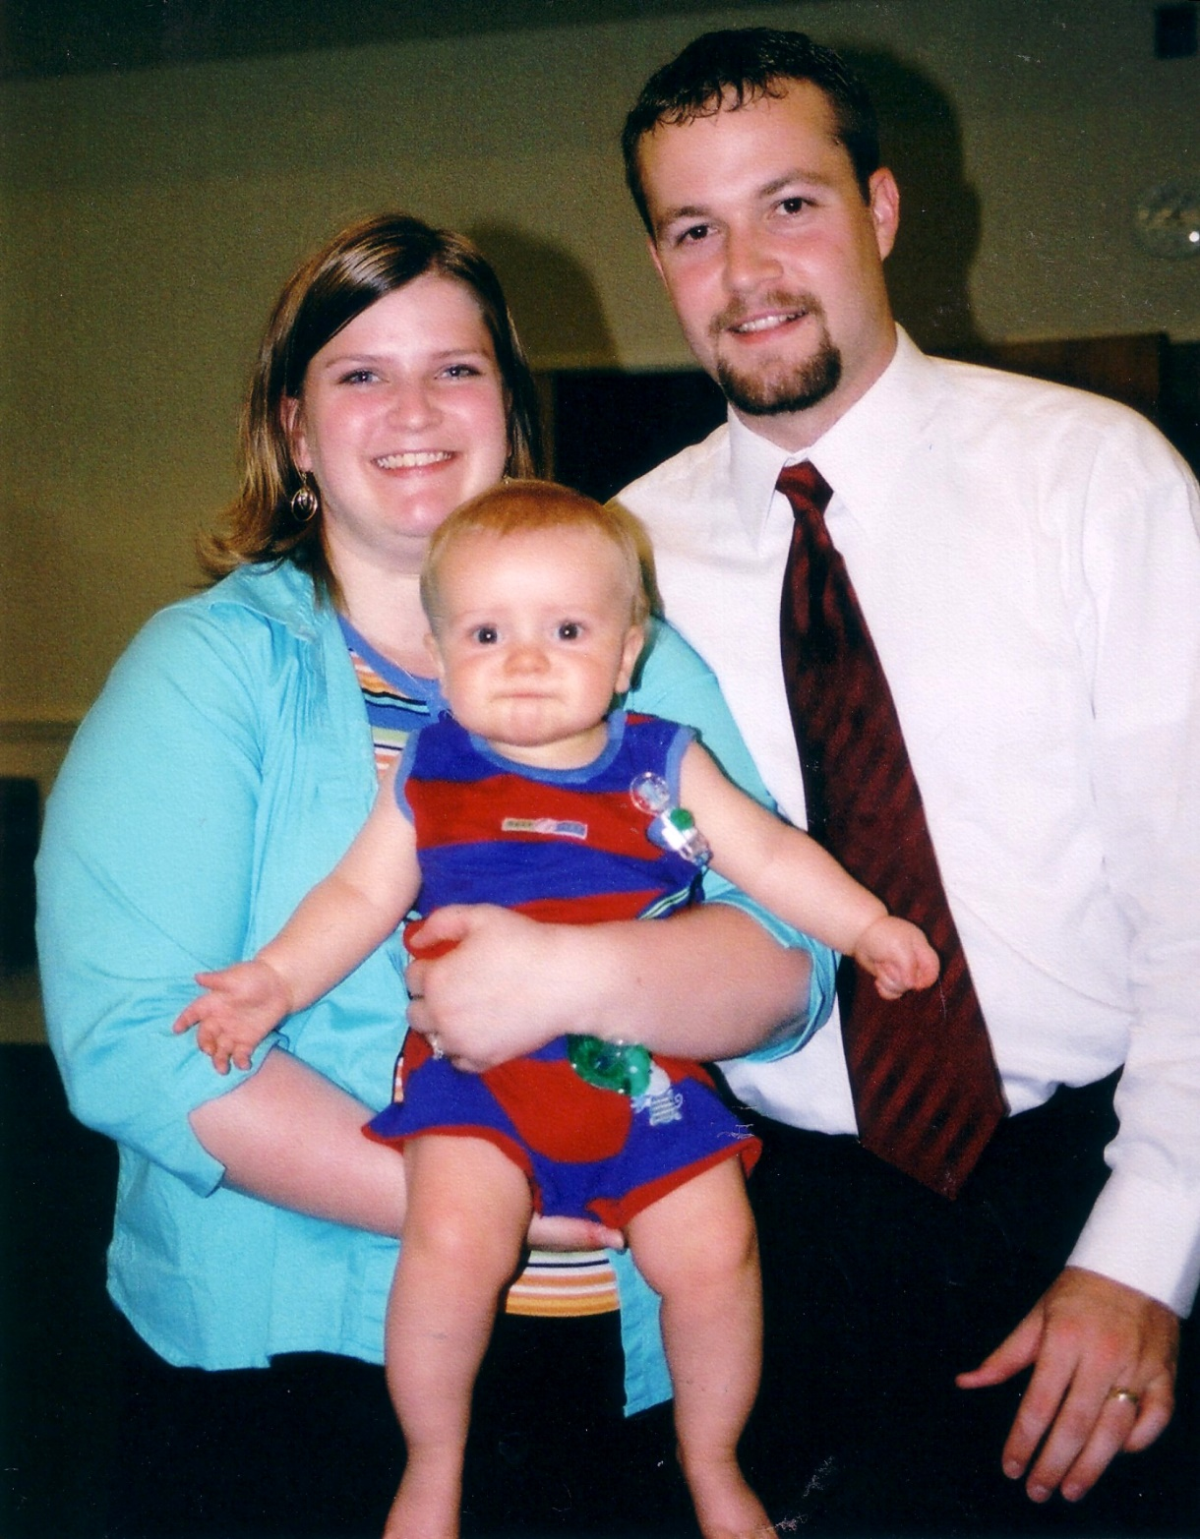

Slide 2
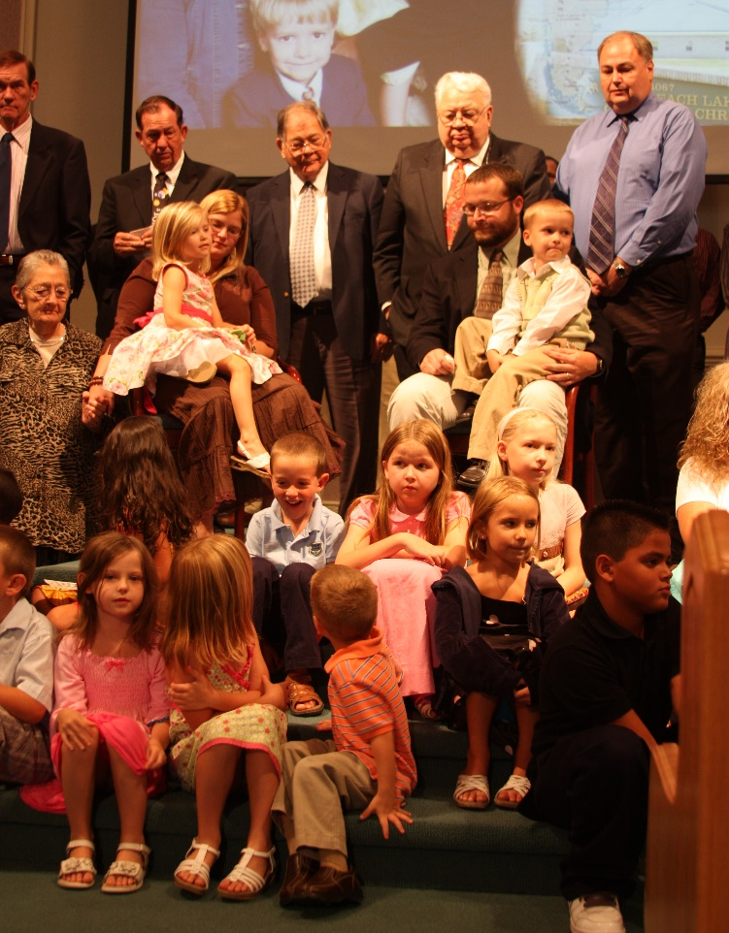
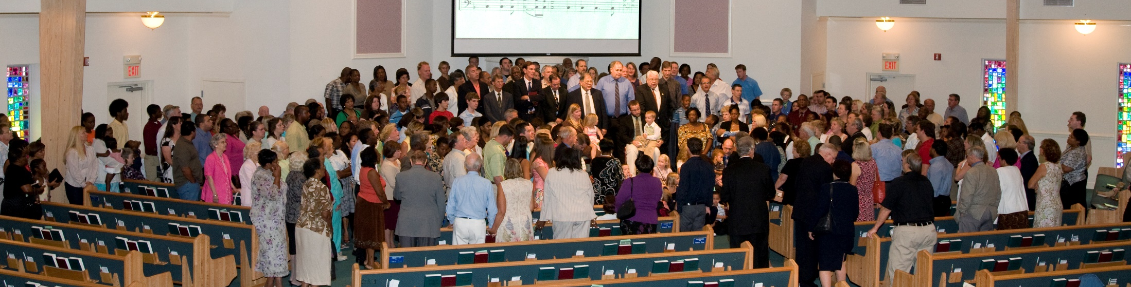
The Missionary Family Returned
Acts
14:26
Where They Had Been Commended
Set apart (13:2)
Prayed for (13:3)
Hands laid on (13:3)
Sent with a blessing (13:3)
When They Had Completed the Work

Slide 3
The Missionary Family Reported
Acts
14:27
“Reported all that God had done with them” (14:27; 15:4; 21:19)
They preached the gospel (14:21, 25)
They made many disciples (14:21)
They strengthened the brethren (14:22)
They prepared for appointing elders (14:23)

Slide 4
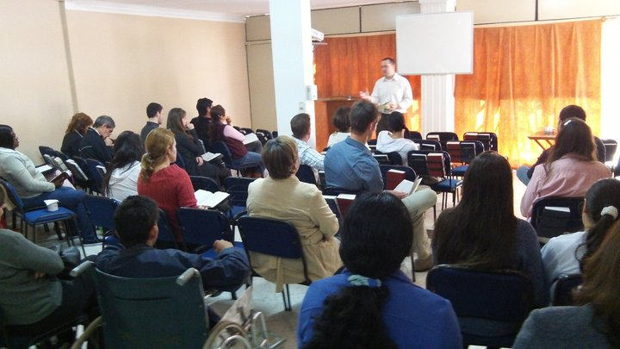
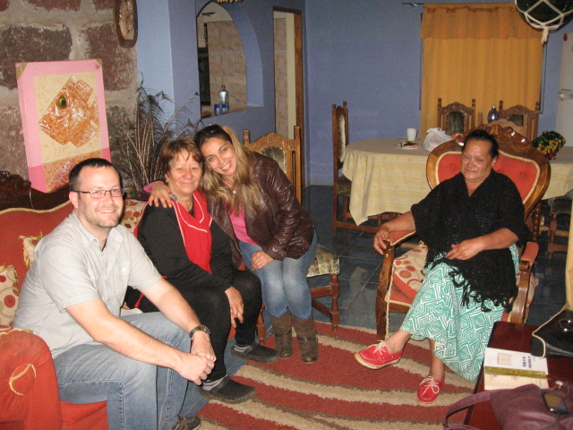
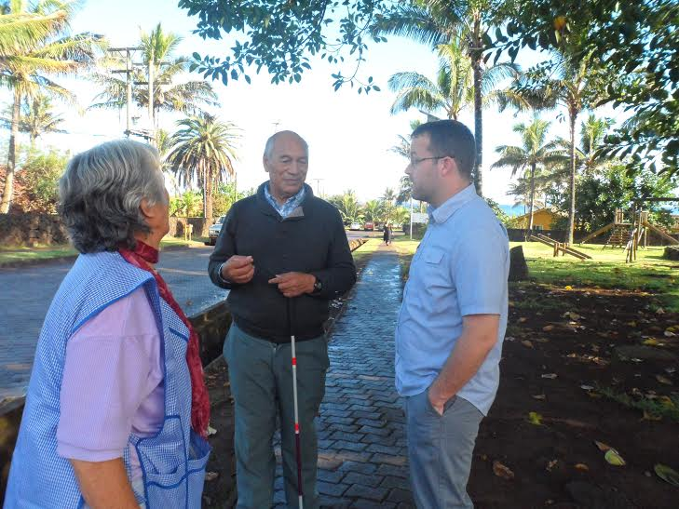
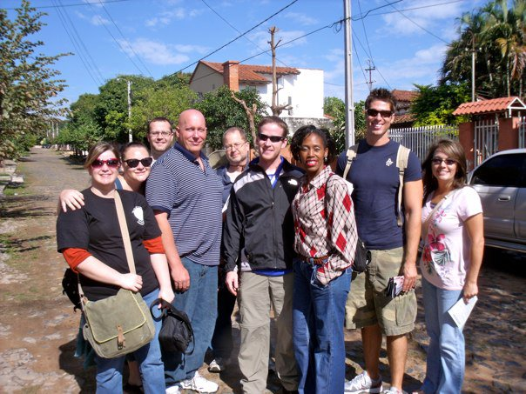
Preached the Gospel

Slide 5
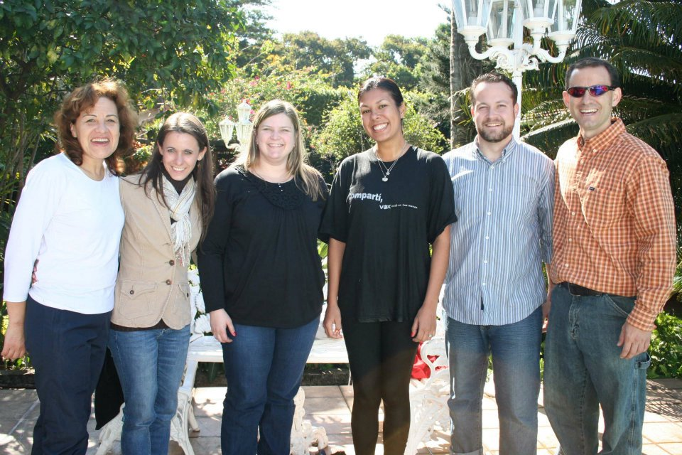
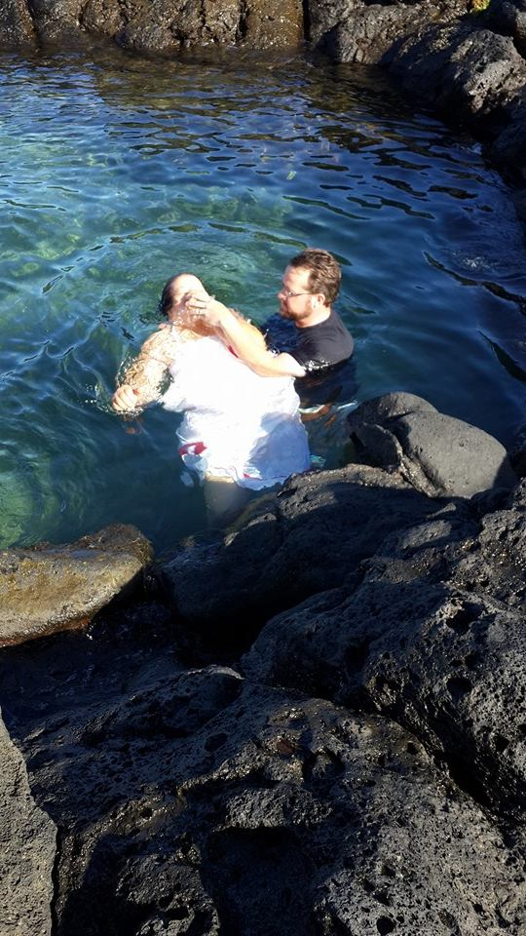
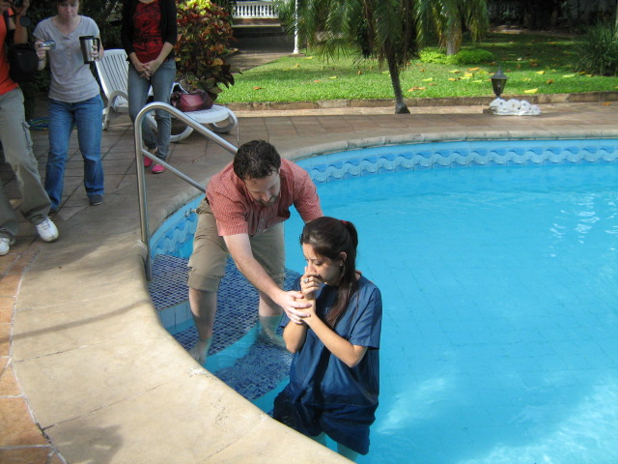
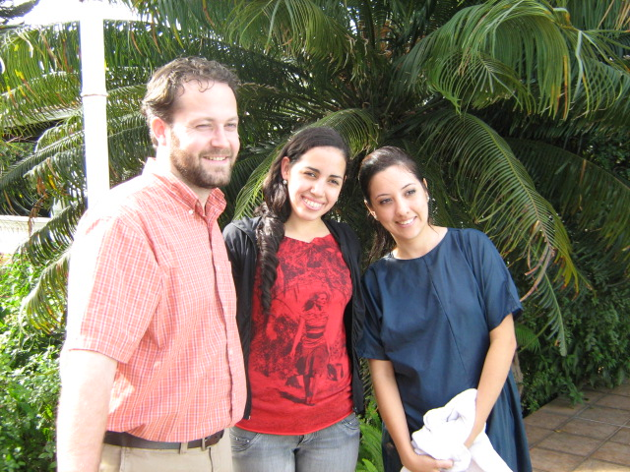
Made Many Disciples

Slide 6
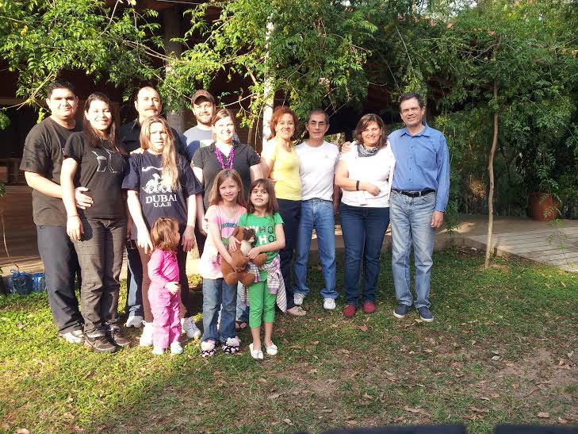
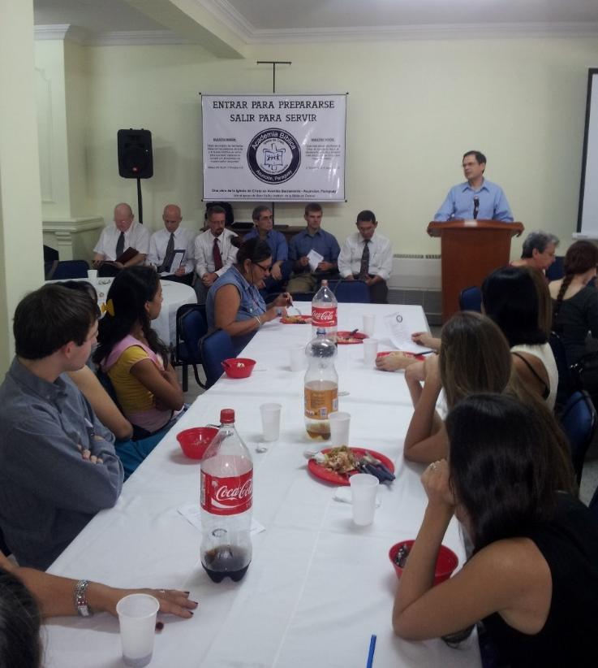
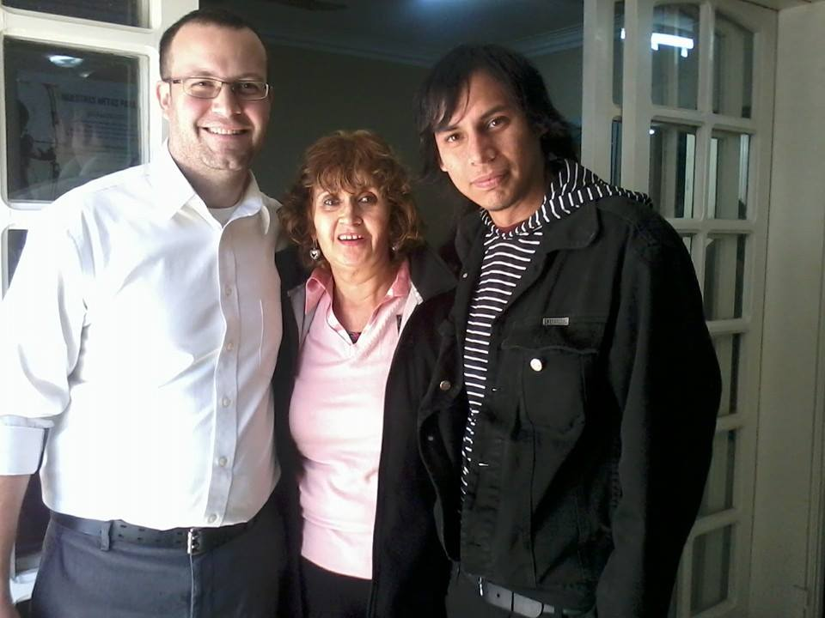
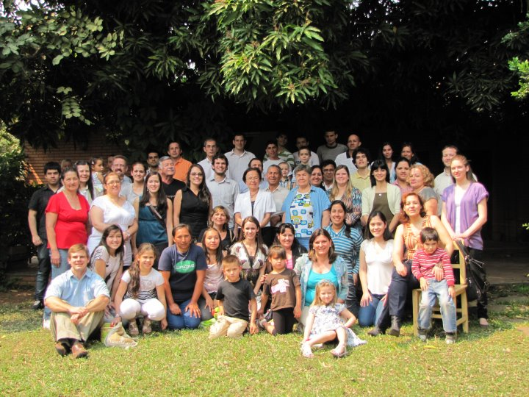
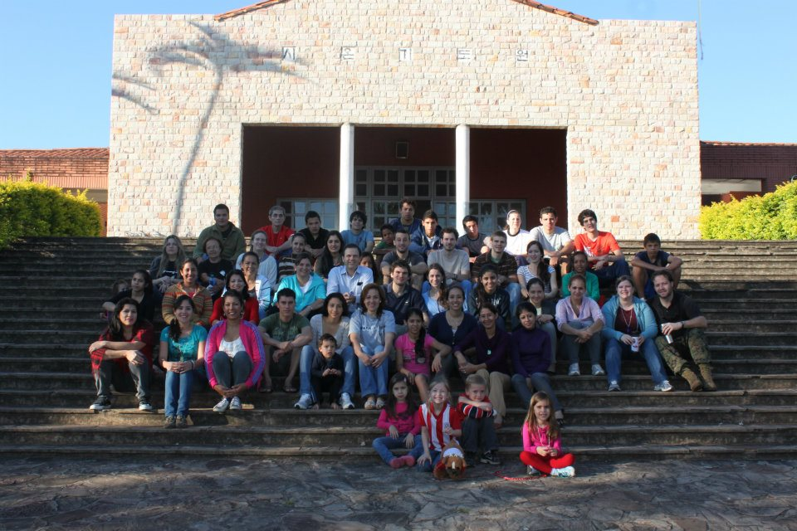
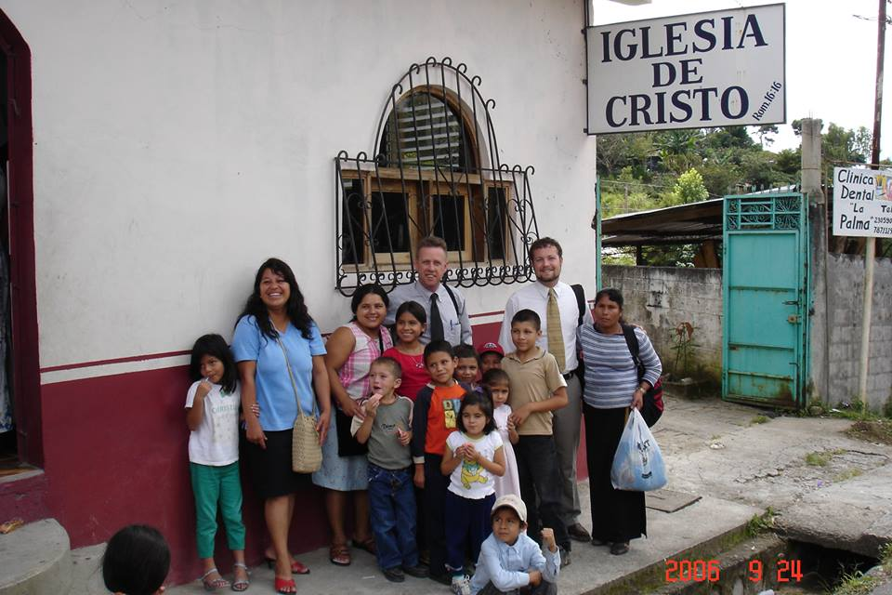
Strengthened the Brethren

Slide 7
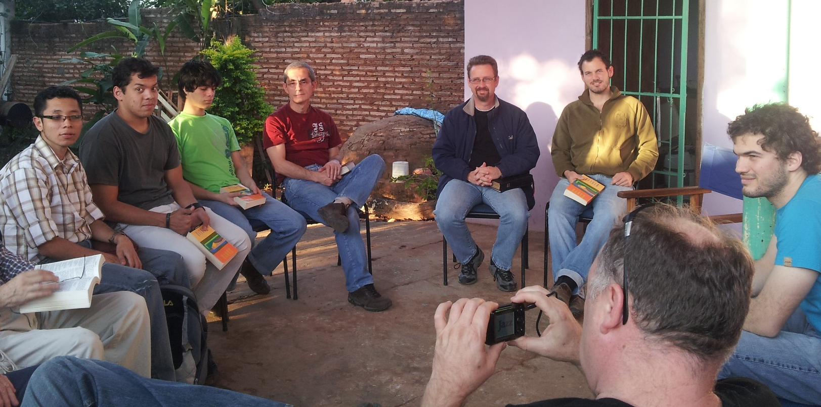
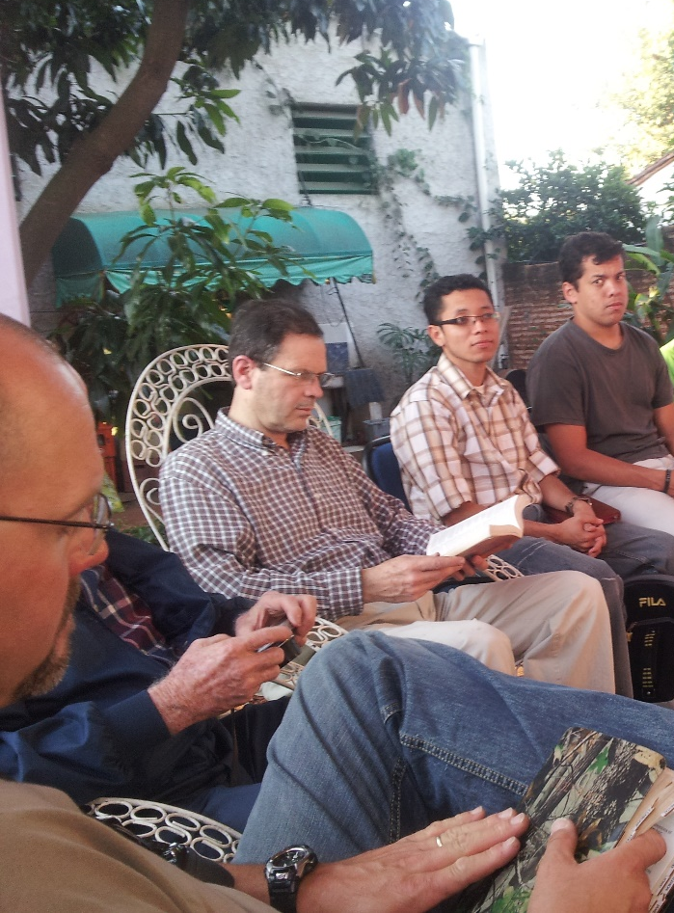
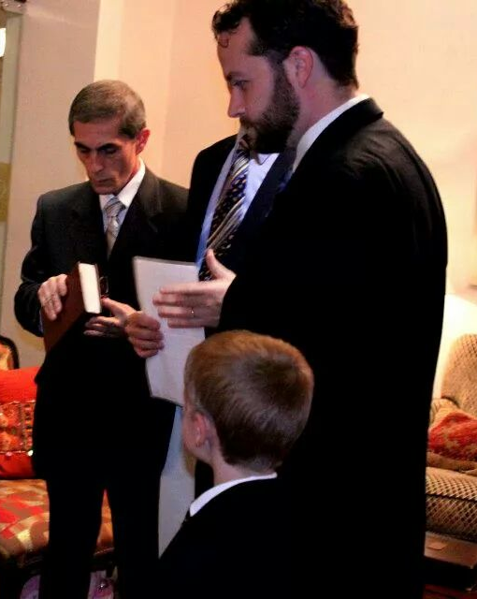
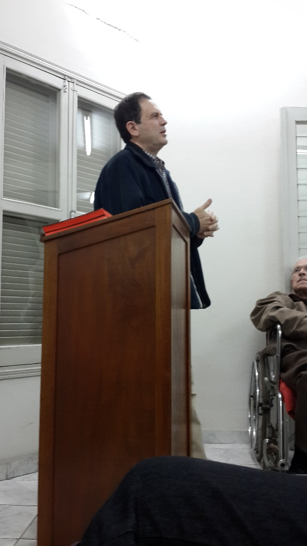
Prepared for Appointing Elders

Slide 8
The Church Family Rejoiced
Acts
15:3
To know of their safety & sacrifices
To be reunited with special friends
To have shared in the work (Phil. 4:14-19)
In the challenges (4:14)
In the finances (4:15)
In the needs (4:16)
In the fruit (4:17)
In the blessings from God (4:18-19)
To have the opportunity to work together again

Slide 9
The Missionary Family Remained with the Church Family
Acts
14:28
“Stayed there a long time” (NKJV)
“Remained no little time” (ESV)

Slide 10
You Can Be
in God’s Family
Believe that Jesus is God’s Son – John 8:24
Repent of your sins – 2 Peter 3:9
Confess your faith in Jesus – Matthew 10:32
Be immersed into Christ – Romans 6:3-4
God will save you from your sins – Acts 2:38
God will add you to His church – Acts 2:47
God will enroll you in heaven’s registry – Heb. 12:23
Serve Him faithfully in His family – 1 Cor. 15:58

