Slide 2
Reach Out – Luke 15:4, “Go”
Reassure – 2 Thess. 3:15
Words of greeting
Words of hope
Words of encouragement

Slide 3
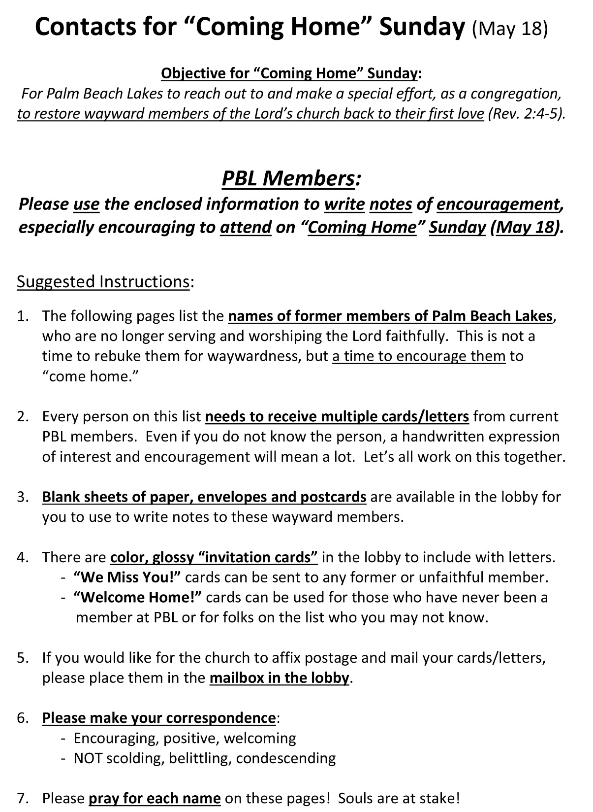

Slide 4
Reach Out – Luke 15:4, “Go”
Reassure – 2 Thess. 3:15
Words of greeting
Words of hope
Words of encouragement
Restore – Gal. 6:1
Help turn them back – Jas. 5:19-20
Help reset them – 2 Cor. 2:7-8

Slide 5
Rescue – Away from Sin
SAVE a soul from death – Jas. 5:20
COVER sins – cf. Rom. 4:6-8
Reconcile – Back to God
2 Cor. 5:17-21; Col. 1:19-22
Redirect – Coursed for Heaven
Heb. 12:1-2; 2 Tim. 4:7-8; 1 Jn. 1:7

Slide 6
Put your faith in Jesus – Jn. 20:31
Repent of your sins – Luke 13:3
Confess your faith – Matt. 10:32
Be immersed into Christ – Jn. 3:5
Sins washed away – Acts 22:16
Added to His church – Acts 2:47
Registered in heaven – Heb. 12:23
Stay faithful to Him – 1 John 1:7

