Slide 2
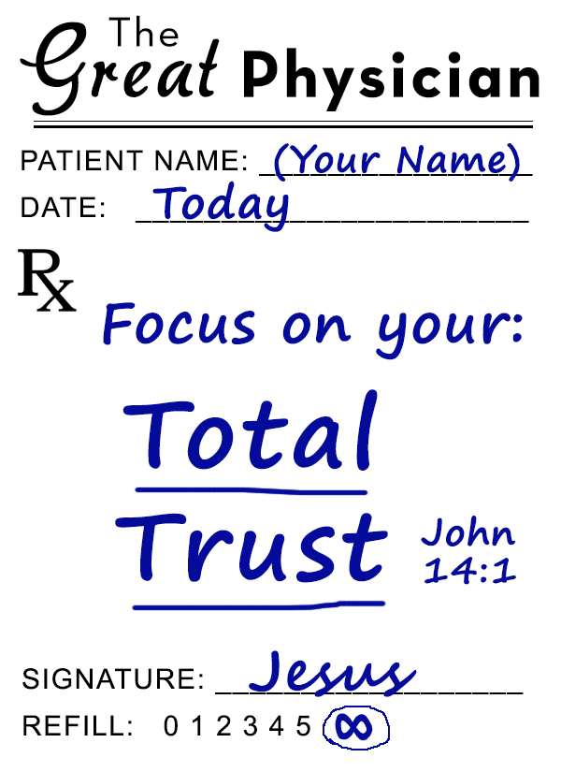
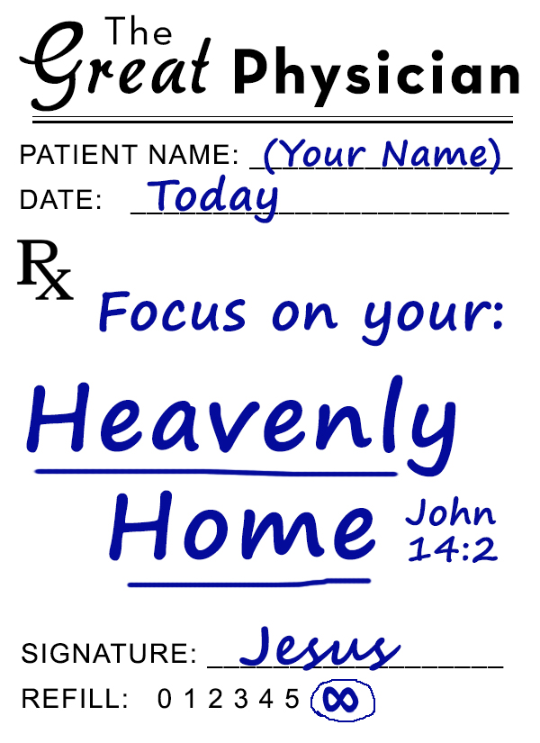
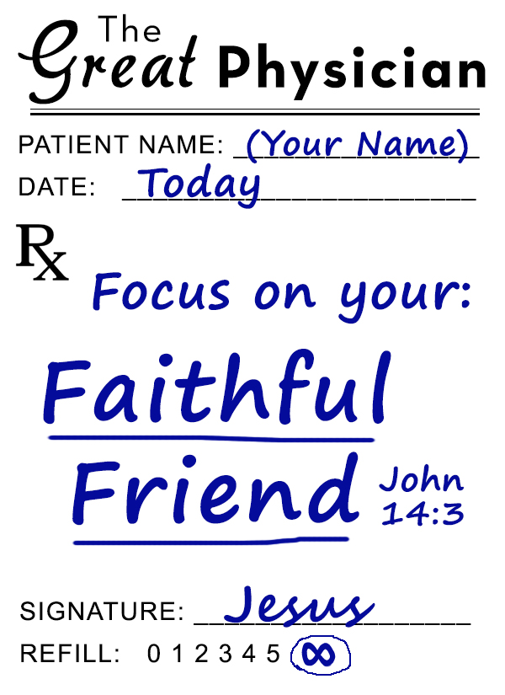
Phil. 4:4-7
2 Tim. 4:5-8
2 Cor. 1:3-4, 9-10
2 Tim. 4:14-18
Rom. 8:16-18
Matt. 28:18-20
1 Peter 5:6-7
Rev. 2:9-10
Heb. 13:5-6

Slide 3
Believe on the Lord & seek Him today – Hebrews 11:6
Turn away from sin & toward Him today – Acts 3:19
Make known your faith in Him today – Matthew 10:32
Be immersed into Him today – Galatians 3:27
The Lord will wash away your sins – Acts 22:16
The Lord will add you to His church – Acts 2:47
The Lord will enroll you in heaven – Hebrews 12:23
Keep trusting & faithfully living for heaven – 2 Tim. 4:8

