Slide 1
Galatians 3:26-29

Slide 2
The Background of this Lesson
Last week, God’s wisdom in the family
Last week, God’s wisdom in the FAMILY
Last week, the “one another” verses

Slide 3
The “One Another” Verses
Members of one another—Rom. 12:5
Kindly affectionate to one another—Rom. 12:10
Giving preference to one another—Rom. 12:10
Have same mind toward one another—Rom. 12:16
Like minded toward one another—Rom. 15:5
Receive one another—Rom. 15:7
Admonish one another—Rom. 15:14
Greet one another with holy kiss—Rom. 16:16
Eat Lord’s supper, wait for one another—1 Cor. 11:33

Slide 4
The “One Another” Verses
Care for one another—1 Cor. 12:25
Serve one another through love—Gal. 5:13
Bear one another’s burden—Gal. 6:2
Bearing with one another—Eph. 4:2
Be kind to one another—Eph. 4:32
Forgiving one another—Eph. 4:32
Speaking to one another in song—Eph. 5:19
Submitting to one another—Eph. 5:21
Bearing with one another—Col. 3:13

Slide 5
The “One Another” Verses
Teaching/admonishing one another in song—Col. 3:16
Abound in love to one another—1 Thess. 3:12
Comfort one another—1 Thess. 4:18
Edify one another—1 Thess. 5:11
Exhort one another daily—Heb. 3:13
Consider another—Heb. 10:24
Pray for one another—James 5:16
Love one another with a pure heart—1 Pet. 1:22
Have compassion for one another—1 Pet. 3:8

Slide 6
The “One Another” Verses
Have fervent love for one another—1 Pet. 4:8
Be hospitable to one another—1 Pet. 4:5
Minister to one another—1 Pet. 4:10
Be submissive to one another in humility—1 Pet. 5:5
Have fellowship with one another—1 John 1:7
Love another—John 13:34-35; 15:12, 17; 1 Thess. 3:12; 4:9; 1 Pet. 1:22; 1 Pet. 4:8; 1 John 3:23; 4:7, 11; 12, 2 John 1:5

Slide 7
The Background of this Lesson
Last week, God’s wisdom in the family
Last week, God’s wisdom in the FAMILY
Last week, the “one another” verses
Concluded by asking, “How does it happen?”
The answer is found by seeing, “How did it happen?”

Slide 8
The Diversity in the Early Church
Acts 2:9-11; Colossians 3:11; Galatians 3:28
Parthians and Medes and Elamites, those dwelling in Mesopotamia, Judea and Cappadocia, Pontus and Asia, Phrygia and Pamphylia, Egypt and the parts of Libya adjoining Cyrene, visitors from Rome, both Jews and proselytes, Cretans and Arabs… (Acts 2:9-11).
Where there is neither Greek nor Jew, circumcised nor uncircumcised, barbarian, Scythian, slave nor free, but Christ is all and in all (Col. 3:11).
There is neither Jew nor Greek, there is neither slave nor free, there is neither male nor female; for you are all one in Christ Jesus (Gal. 3:28).

Slide 9
The Diversity at Palm Beach Lakes
PBL = a miniature United Nations
Many groups at Palm Beach Lakes
Youth
Young adults
Couples
Families
Unmarried
We consciously retain our identity but give up our identity
Empty nesters
Elderly
Widows
“Gators” and “Seminoles”

Slide 10
Free
Slave
Egypt
Etc.
His FAMILY,
The Church
Greek
Etc.
Etc.
Jew
Etc.
Etc.

Slide 11
NOT THIS
His FAMILY,
The Church

Slide 12
NOT EVEN THIS

Slide 13
No more, “I”, but “we”
No more, “they,” but we/us
We work together, caring for “one another”
Invest in the outcome of being one in Him
Cannot be content with status quo
Love, the bond of perfection
His FAMILY,
The Church

Slide 14
Becoming Part of the FAMILY of God
Must have faith John 3:16
Must repent Luke 13:3
Must confess Rom. 10:9
Must be baptized Acts 2:38
Added to His FAMILY, the church
Then live faithfully Rev. 2:10

Slide 15
What is a FAMILY/Youth emphasis?
Does not apply just to young people
Does not apply just to parents of young children
Does not apply just to young families
It involves the whole FAMILY

Slide 16
Purpose statement of FAMILY/youth at PBL
The FAMILY actively involved
Building faith of the youth
Strengthening the family unit
Edifying the entire FAMILY
Using Bible education in all forms
Congregational involvement
Providing opportunities for FAMILY growth

Slide 17
It involves every member/section of PBL
In its implementation
In its growth
In its success
In the rewards

Slide 18
We have been working toward a Family/Youth program for over a year.
We have two deacons and a large group of adults who have already been involved in the lives of our young people.

Slide 19
The elders know that having someone to organize and lead an effort like this is essential.
A man to edify the congregation and its young people.
A man who is a family man.
A man who loves the lord and the church.
A man who is evangelistic.
A man who is devoted to the truth of God’s word.
A man who is an effective teacher of old and young alike.
A man who PBL can love, respect and encourage.

Slide 20
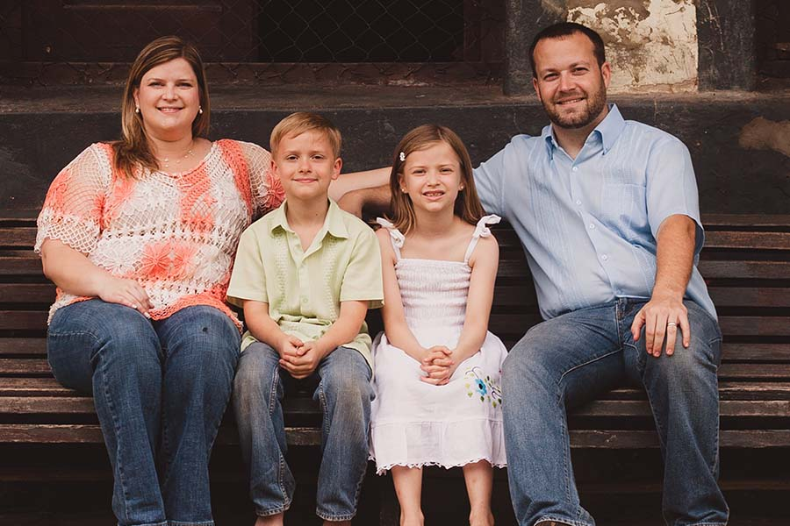
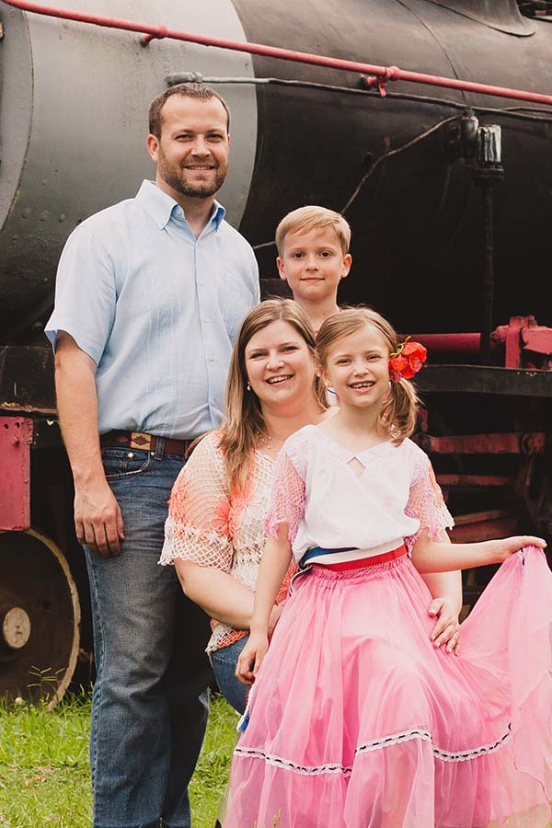
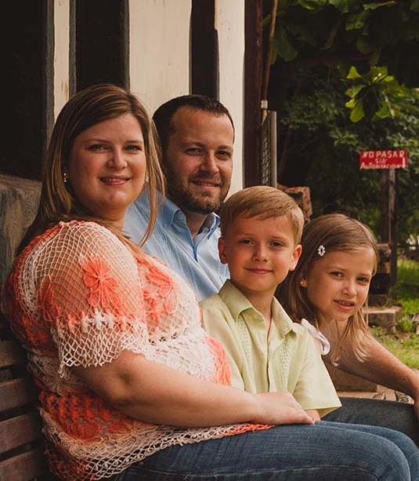
Our New
FAMILY/Youth Evangelist
Josh Blackmer
& Cara, Josiah & Vivian

Slide 21
These are exciting times at Palm Beach Lakes!
There will be more information coming over the next several weeks and month.
Remember and recognize that this is something that INVOLVES and IMPACTS ALL of us!

