Slide 1

The Family That
Pleases God

Slide 2

Ephesians 4:22-5:2
That ye put off concerning the former conversation the old man, which is corrupt according to the deceitful lusts; (23) And be renewed in the spirit of your mind; (24) And that ye put on the new man, which after God is created in righteousness and true holiness. (25) Wherefore putting away lying, speak every man truth with his neighbour: for we are members one of another. (26) Be ye angry, and sin not: let not the sun go down upon your wrath: (27) Neither give place to the devil. (28) Let him that stole steal no more: but rather let him labour, working with his hands the thing which is good, that he may have to give to him that needeth. (29) Let no corrupt communication proceed out of your mouth, but that which is good to the use of edifying, that it may minister grace unto the hearers. (30) And grieve not the holy Spirit of God, whereby ye are sealed unto the day of redemption. (31) Let all bitterness, and wrath, and anger, and clamour, and evil speaking, be put away from you, with all malice: (32) And be ye kind one to another, tenderhearted, forgiving one another, even as God for Christ's sake hath forgiven you. 5 (1) Be ye therefore followers of God, as dear children; (2) And walk in love, as Christ also hath loved us, and hath given himself for us an offering and a sacrifice to God for a sweetsmelling savour.

Slide 3
Colossians 3:5-15
Mortify therefore your members which are upon the earth; fornication, uncleanness, inordinate affection, evil concupiscence, and covetousness, which is idolatry: (6) For which things' sake the wrath of God cometh on the children of disobedience: (7) In the which ye also walked some time, when ye lived in them. (8) But now ye also put off all these; anger, wrath, malice, blasphemy, filthy communication out of your mouth. (9) Lie not one to another, seeing that ye have put off the old man with his deeds; (10) And have put on the new man, which is renewed in knowledge after the image of him that created him: (11) Where there is neither Greek nor Jew, circumcision nor uncircumcision, Barbarian, Scythian, bond nor free: but Christ is all, and in all. (12) Put on therefore, as the elect of God, holy and beloved, bowels of mercies, kindness, humbleness of mind, meekness, longsuffering; (13) Forbearing one another, and forgiving one another, if any man have a quarrel against any: even as Christ forgave you, so also do ye. (14) And above all these things put on charity, which is the bond of perfectness. (15) And let the peace of God rule in your hearts, to the which also ye are called in one body; and be ye thankful.

Slide 4

Wives

Slide 5

Wives
Ephesians 5:21-23, 33
Submitting yourselves one to another in the fear of God. (22) Wives, submit yourselves unto your own husbands, as unto the Lord. (23) For the husband is the head of the wife, even as Christ is the head of the church: and he is the saviour of the body…(33) Nevertheless let every one of you in particular so love his wife even as himself; and the wife see that she reverence her husband.
Colossians 3:18
Wives, submit yourselves unto your own husbands, as it is fit in the Lord.

Slide 6

Husbands

Slide 7

Husbands
Ephesians 5:25-29, 33
Husbands, love your wives, even as Christ also loved the church, and gave himself for it; (26) That he might sanctify and cleanse it with the washing of water by the word, (27) That he might present it to himself a glorious church, not having spot, or wrinkle, or any such thing; but that it should be holy and without blemish. (28) So ought men to love their wives as their own bodies. He that loveth his wife loveth himself. (29) For no man ever yet hated his own flesh; but nourisheth and cherisheth it, even as the Lord the church…(33) Nevertheless let every one of you in particular so love his wife even as himself; and the wife see that she reverence her husband.
Colossians 3:19
Husbands, love your wives, and be not bitter against them.

Slide 8

Children

Slide 9

Children
Ephesians 6:1-3
Children, obey your parents in the Lord: for this is right. (2) Honour thy father and mother; (which is the first commandment with promise;) (3) That it may be well with thee, and thou mayest live long on the earth.
Colossians 3:20
Children, obey your parents in all things: for this is well pleasing unto the Lord.

Slide 10
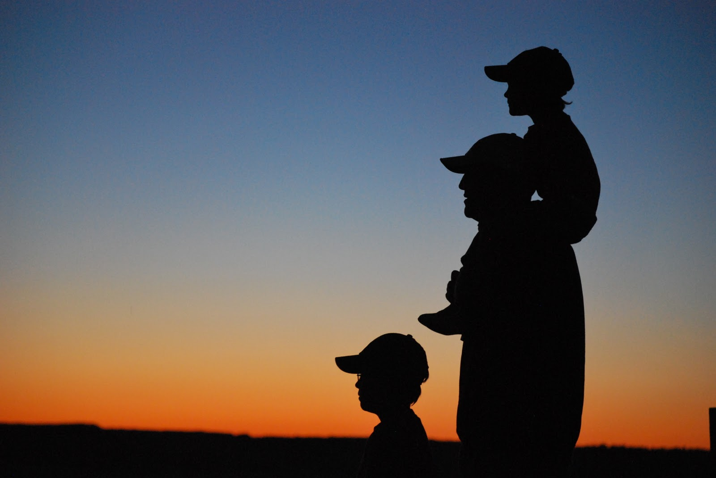
Fathers

Slide 11

Fathers
Ephesians 6:4
And, ye fathers, provoke not your children to wrath: but bring them up in the nurture and admonition of the Lord.
Colossians 3:21
Fathers, provoke not your children to anger, lest they be discouraged.

Slide 12
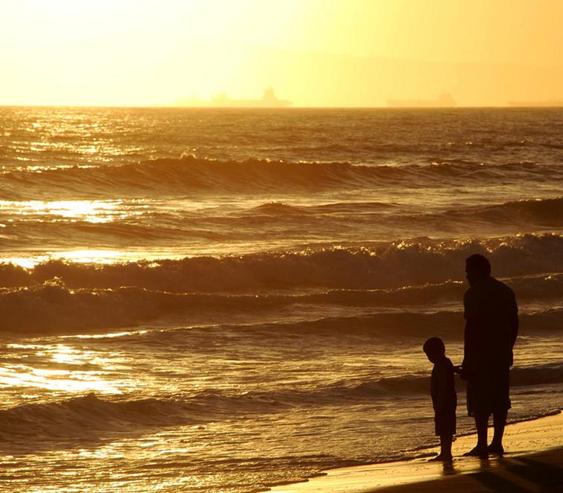
Matthew 6:26
Behold the fowls of the air: for they sow not, neither do they reap, nor gather into barns; yet your heavenly Father feedeth them. Are ye not much better than they?
Ephesians 5:1-2
Be ye therefore followers of God, as dear children; (2) And walk in love, as Christ also hath loved us, and hath given himself for us an offering and a sacrifice to God for a sweetsmelling savour.

