Slide 1
PHILIPPIANS
4:2-3

Slide 2
Starts with the Right Mindset (4:2)
“Be of the same mind”
Live in harmony, agreement, complete unity (Amos 3:3)
“Be of the same mind…IN THE LORD”
Must all possess the “one mind” (2:2)
Must all possess “humility of mind” (2:3)
Must all possess “the mind of Christ” (2:5)
Getting IN SYNC…starts when we realize and accept:
The Mindset is all about THE LORD!

Slide 3
Strides with the Right Mission (4:3)
“Labor together”
Greek word sun-athleo = “to strive/contend together”
“Side-by-side” (cf. 1:27) like athletes
“Labor together…IN THE GOSPEL”
Must all share common mission/cause of the gospel (1:27)
Then all share common ground, message, doctrine & practice
Getting IN SYNC…strides when we realize and accept:
The Mission is all about THE GOSPEL!

Slide 4
Succeeds with the Right Motivation (4:3)
“Whose names are”
To man: Specific names, Nicknames, Generic names
To God: Each individual is an individual…with individual name
“Whose names are…IN THE BOOK of life”
Reflects genealogical record (1 Jn. 3:1-2; Ro. 8:14-17; Ga 3:26)
Reflects citizenship enrollment now (Phil. 3:20-21; Lk. 10:20)
Reflects eternal reward based individually (Rev. 21:27)
Getting IN SYNC…succeeds when we realize and accept:
The Motivation is all about THE BOOK!

Slide 5
Brief History of “Laborers Together with God”
July 2011 – elders started evaluating our works
May 2012 – elders met with deacons & presented LTWG
Aug 2012 – 7 deacons appointed to increase laboring potential
Oct 2012 – deacons submitted new works & opp to serve
Feb 2013 – members presented with 329 opportunities to serve
April-May 2013 – elders & deacons finalized works for all mbrs
May 26, 2013 – members presented with assignments (IN SYNC)

Slide 6
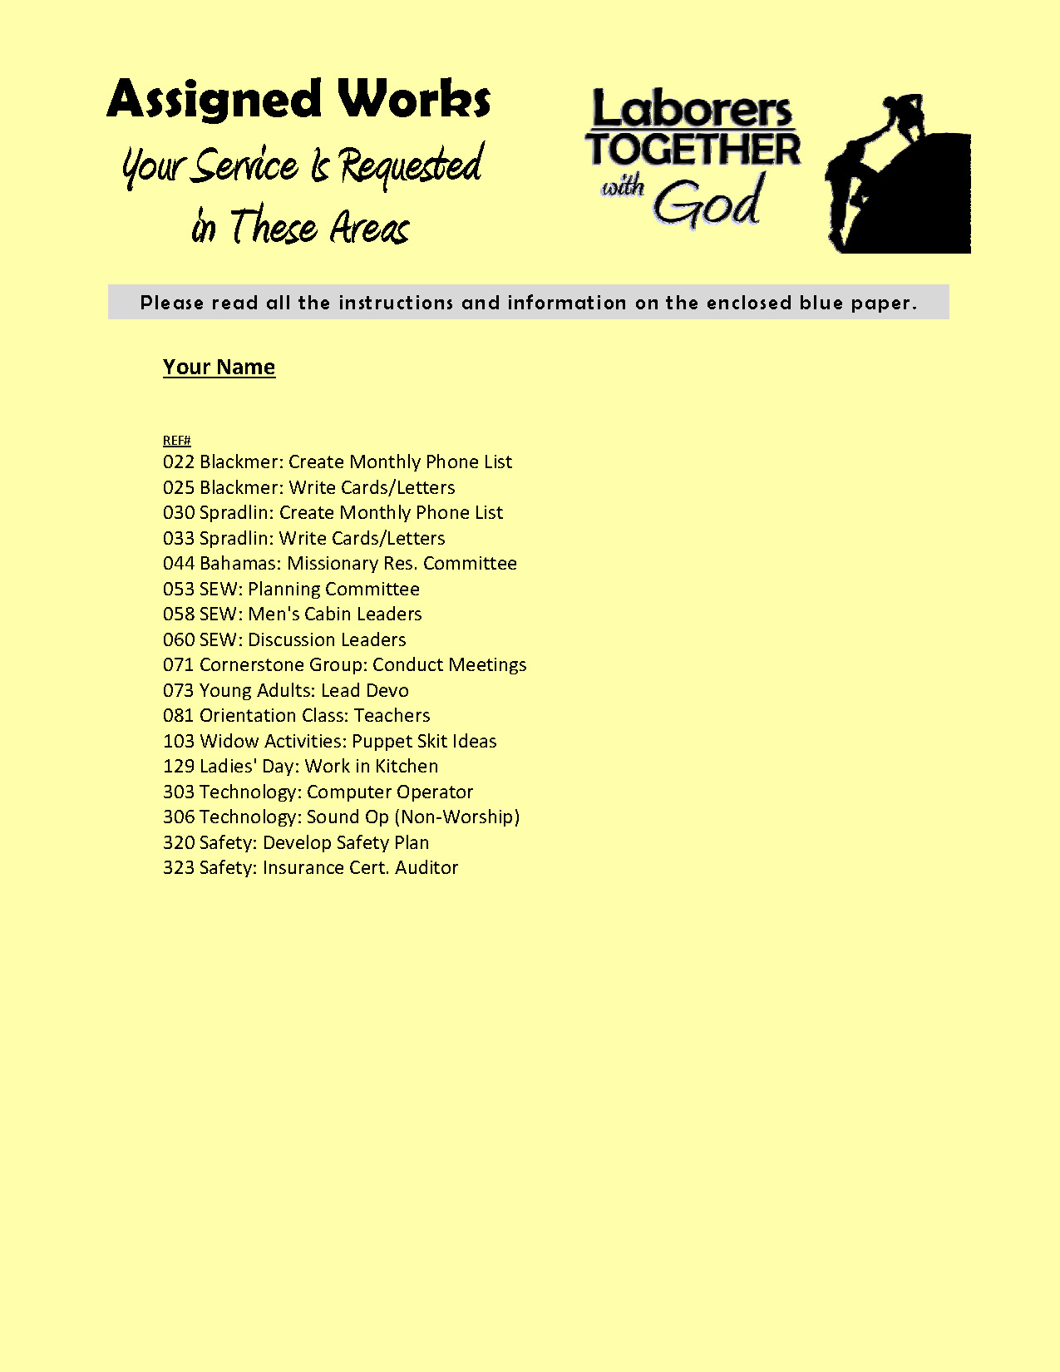
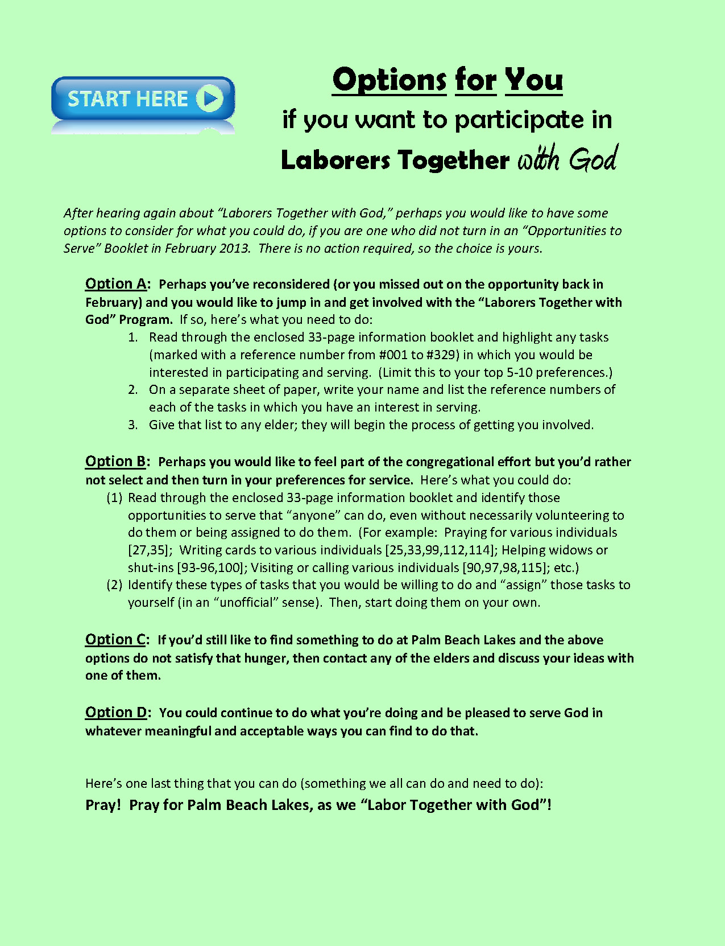
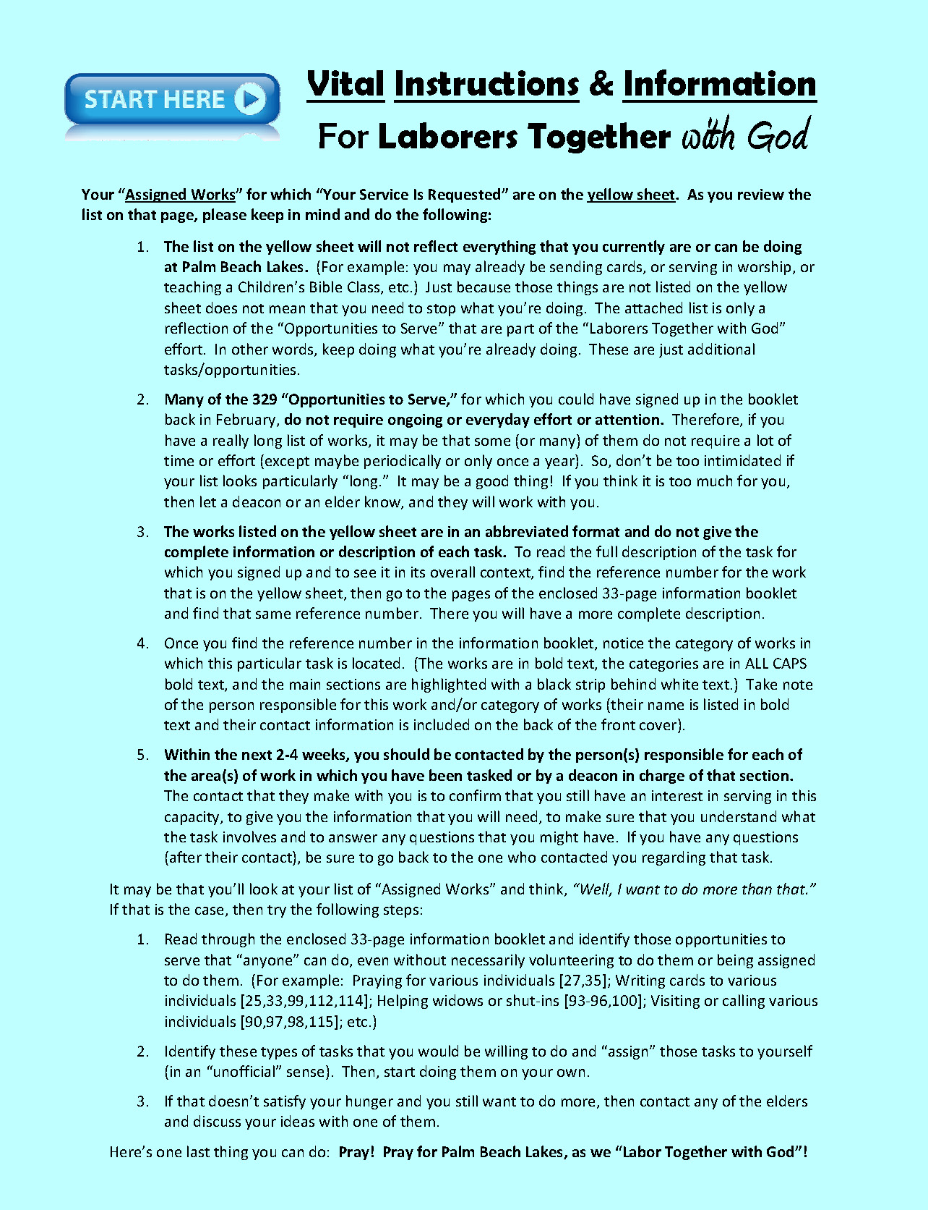
Let’s Get “IN SYNC” as Laborers Together
The elders have written a letter to each member of PBL
Options for PBL members who did not turn in an “Opportunities to Serve” Booklet in February
Instructions for PBL members who did turn in an “Opportunities to Serve” Booklet in February
Reminder: This effort will only matter & only succeed if we are IN SYNC – IN THE LORD, IN THE GOSPEL, IN THE BOOK!
What an awesome privilege to LABOR TOGETHER WITH GOD!
One last thing that we can all do: PRAY!

Slide 7
The work of God is to believe in Christ – John 6:29
Repent of your sins – Acts 3:19
Confess your faith in Jesus – Matthew 10:32
Be buried with Christ in baptism – Colossians 2:12
God will wash away your sins – Acts 22:16
God will add you to His church – Acts 2:47
God will write your name in heaven – Hebrews 12:23
Labor with God faithfully – Philippians 4:3; 1 John 1:7

