Slide 1
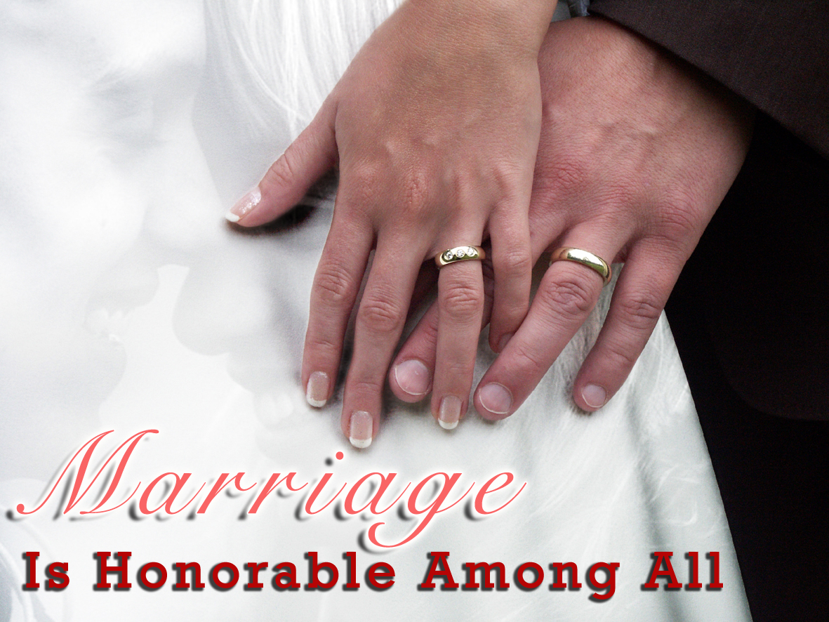
Genesis
2:18-24

Slide 2
God Ordained Marriage (not man)
“He brought” (Gen. 2:22)
First institution He created (Mark 10:6)
God said, “…not good that man should be alone…”
God made the woman for the man
Marriage is done in the sight of God (Matt. 19:6)

Slide 3
God Defined Marriage (not man)
“He brought her to the man” (Gen. 2:22)
“male and female He created them” (Gen. 1:27)
“comparable to him” (Gen. 2:18)
“He made (lit. built) into a woman” (Gen. 2:22)
“man…cling to his wife” (Gen. 2:24)
ONE HER to the ONE MAN
NO other combination is acceptable to God

Slide 4
God Regulates Marriage (not man)
He made it exclusive
“a man shall leave his father and mother…” (Gen. 2:24)
Marriage is an exclusive relationship
No earthly relationship is more important
Requires fidelity & loyalty to your mate
Takes precedence over every other human relationship

Slide 5
God Regulates Marriage (not man)
He made it exclusive
He made it permanent
“…and be joined to his wife…” (Gen. 2:24)
Marriage is a permanent relationship
Cleave, cling, be glued, “stick together no matter what”
Requires commitment & faithfulness at all costs
Jesus said, “Let not man separate” (Matt. 19:6)
Permanent, life-long, “until death” (cf. Rom. 7:1-3)
The Lord gave only one exception (Matt. 19:9)

Slide 6
God Regulates Marriage (not man)
He made it exclusive
He made it permanent
He made it intimate
“…they shall become one flesh” (Gen. 2:24)
Married couples share intimate oneness on all levels
Only possible with a man & a woman
Become one physically (incl. sexually), spiritually, socially, emotionally, intellectually
Mirror God’s image – “Let Us make man in Our image…” (Gen. 1:26)

Slide 7
God Imposes His Marriage Laws (not man)
He made it exclusive
“have his own wife…have her own husband” (1 Cor. 7:2)
“You shall not commit adultery” (Ex. 20:14; Matt. 5:27)
He made it permanent
God hates divorce (Mal. 2:16)
“remain unmarried or be reconciled” (1 Cor. 7:11)
He made it intimate
The marriage bed is undefiled (Heb. 13:4)
God will judge fornicators & adulterers (Heb. 13:4)

Slide 8
God Gives Purpose to Marriage (not man)
To provide self-completion/companionship
“The Lord God said, ‘It is not good that man should be alone; I will make him a helper comparable to him’” (Gen. 2:18).
Each is incomplete without the other.
Each needs one “comparable” – one suited, a complement
“This is now bone of my bone and flesh of my flesh…” (Gen. 2:23)

Slide 9
God Gives Purpose to Marriage (not man)
To provide self-completion/companionship
To propagate the human race
“Be fruitful and multiply” (Gen. 1:28)
More than that – multiply a godly legacy (cf. Mal. 2:15)
“teach them diligently” (Deut. 6:7)
“in the nurture and admonition of the Lord” (Eph. 6:4)
All society began and was to be built on the strength of godly marriages – “as go marriages, so goes society”

Slide 10
God Gives Purpose to Marriage (not man)
To provide self-completion/companionship
To propagate the human race
To enjoy intimacy ONLY with each other
“male & female…become one flesh”
God created sex and placed it exclusively within marriage
The only “safe sex” is in marriage (Heb. 13:4)
Only Scripturally married “avoid fornication” (1 Cor. 7:2-4)

Slide 11
God Gives Purpose to Marriage (not man)
To provide self-completion/companionship
To propagate the human race
To enjoy intimacy ONLY with each other
To help each other go to heaven
Created by God
Completed by God
Saved by God (cf. 1 Cor. 7:14, 16; 1 Pet. 3:1)
In order that they might return to God (1 Pet. 3:7)

Slide 12
God Gives Purpose to Marriage (not man)
To provide self-completion/companionship
To propagate the human race
To enjoy intimacy ONLY with each other
To help each other go to heaven
To give us a picture of the relationship between Christ and His church
Ephesians 5:22-33

Slide 13
God Ordained Marriage
God Defined Marriage
God Regulates Marriage
God Imposes His Marriage Laws
God Gives Purpose to Marriage

