Slide 1

1 Corinthians 3:5-9

Slide 2
We Are
Laborers!
The work of the Lord is the greatest work in the world
  It deals with the Wonderful = Jesus (Isa. 9:6; John 3:16)
  It deals with the eternal = heaven (2 Cor. 4:17-5:4)
  It deals with the spiritual = souls (Matt. 16:26; 10:28)
  It deals with eternal salvation of souls (Jas. 1:21; 5:20)
The work of the Lord demands hard work by hard workers
  The Lord saved us in Christ to work (Eph. 2:10)
  The Lord requires us to work to stay saved (Jas. 2:14-26)
  The Lord expects us to abound in His work (1 Co. 15:58)

Slide 3
We Are
Laborers Together!
The work of the Lord brings Christians together (Phil. 1:27)
  One plants, another waters (1 Cor. 3:6-7)
  All Christians are responsible to be laborers (1 Cor. 15:58)
The work of the Lord is easier done together (1 Cor. 12:12-27)
  “The effective working by which every part does its share” (Eph. 4:16)
The work of the Lord fosters:
  Unity (1 Cor. 1:10)
  Love (1 Pet. 3:8-9)
  Fruit (John 15:1-8)

Slide 4
We Are
Laborers Together with God!
The work of the Lord is NOT my work! (1 Cor. 3:5, 7, 23)
  It is the Lord’s work!
The work of the Lord affords me an exclusive opportunity and beautiful relationship: to labor together WITH God! (2 Cor. 6:1)
  When I labor in the work of the Lord:
    “It is God who works in [me]…mightily…what is well pleasing in His sight” (Phil. 2:13; Col. 1:29; Heb. 13:21)
  I get to work WITH God while He works IN me!
    I belong to God!
    My work belongs to God!

Slide 5
Faithful Laborers Enjoy Special Blessings
“Fellowship with God” (1 John 1:6)
“Favor with God” (Luke 2:52)
Heavenly “home with God” (2 Cor. 5:8)
  “Your labor is not in vain in the Lord” (1 Cor. 15:58)
  “Each one will receive his own reward according to his own labor” (1 Cor. 3:8)

Slide 6
Laborers Together with God at Palm Beach Lakes
The elders, deacons & preachers have been working for over a year-and-a-half on:
  Restructuring how they work together
  Identifying new works for the church
  Identifying new deacon assignments
  Creating opportunities to serve for every PBL member

Slide 7
Laborers Together with God at Palm Beach Lakes
The works of the church are divided into these Major Categories:
  Spreading the Gospel (Evangelism)
  Loving One Another (Edification)
  Equipping Adults & Youth (Education)
  Doing Good Unto All Men (Benevolence)
  Worship Decently & Orderly (Worship)
  Stewards of Possessions (Property Maintenance)

Slide 8

Laborers Together with God at Palm Beach Lakes
A booklet has been created
  Contains 326 opportunities
  A wide variety of works
  Truly something for everyone!
Like never before we can and will:
  Labor
  Together
  With God!

Slide 9
Laborers Together with God at Palm Beach Lakes
What you need to do:
  Complete the new “Member Information Card”
    Last name first; make sure to complete both sides
  Write your name on the front of your booklet
    First and last; please print
  Read through the “Opportunities to Serve” booklet.
    See the opportunities available for the next 2 yrs (2013-2014)
  Pray!
    Ask the Lord to use you as you labor together with Him.
    Ask Him to help you choose the best opportunities for you.
  Decide what you are Zealous to do
  and what you are Willing to do.

Slide 10
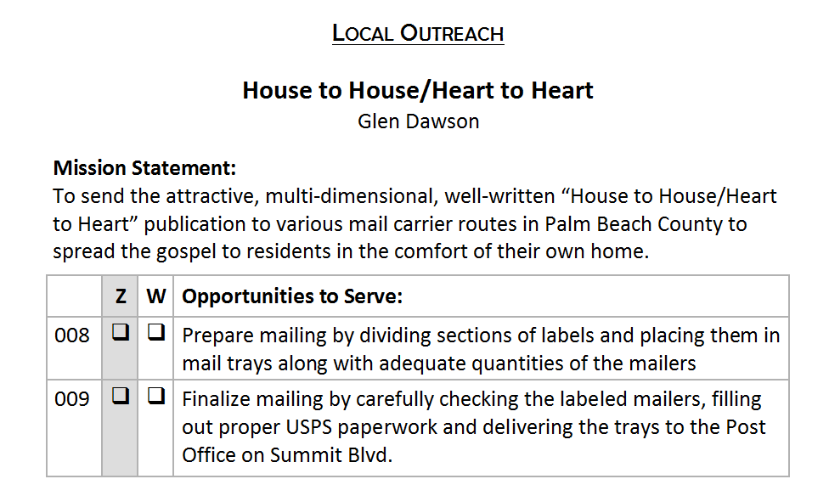
Laborers Together with God at Palm Beach Lakes
✓
✓
✓

Slide 11
Laborers Together with God at Palm Beach Lakes
What you need to do:
  Identify those opportunities you have a STRONG DESIRE to take on and “make happen” in 2013-2014. Which opportunities to serve are you ZEALOUS to take and do?
    Check the box in the Z column for “Zealous.”
    Important Note: Limit 5 checks in the Z column.
  Identify those opportunities you are WILLING (if asked) to take on and “make happen” in 2013-2014. Which opportunities to serve may not have your strongest zeal, but you would be WILLING to take and do?
    Check the box in the W column for “Willing.”
    Important Note: There is no limit to checks in the W column.

Slide 12
Laborers Together with God at Palm Beach Lakes
What you need to do:
  If, perhaps, there is an area in which you would really like to serve but it is not listed in this booklet, write it out on Page 47 and the elders will take it into consideration.
  If you want to know more about a particular opportunity, go and talk to the person assigned to that task for more information.
  Once you’ve completed the booklet, please deposit it in the box in the lobby by Sunday, February 24.

Slide 13
Laborers Together with God at Palm Beach Lakes
Let’s all grow more fully to be:
  Laborers!
  Laborers Together!
  Laborers Together with God!
  Laborers Together with God at Palm Beach Lakes!

Slide 14
Become a Laborer Together with God Today!
Believe Jesus is God’s Son – Mark 16:16
Repent of your sins – 2 Peter 3:9
Confess your faith in Jesus – Romans 10:9-10
Be immersed into Christ – Acts 2:38
  God will wash away your sins – Acts 22:16
  God will add you to His church – Acts 2:47
  God will write your name in heaven – Hebrews 12:23
Labor with God faithfully – 1 Corinthians 15:58

