Slide 1
As God’s Fellow Workers
All Things Are Possible
1 Corinthians 3:5-11

Slide 2
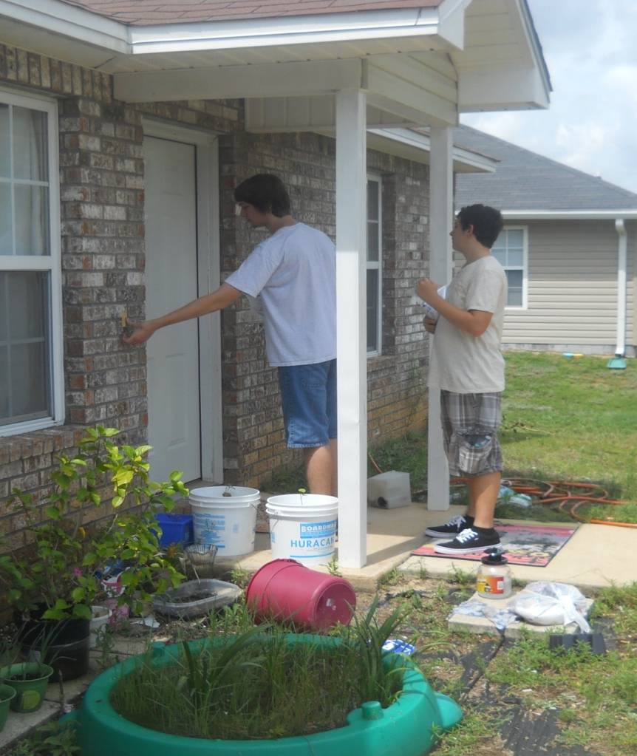
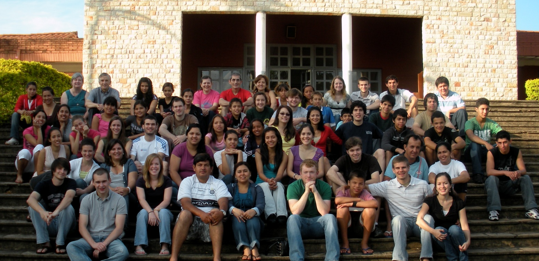
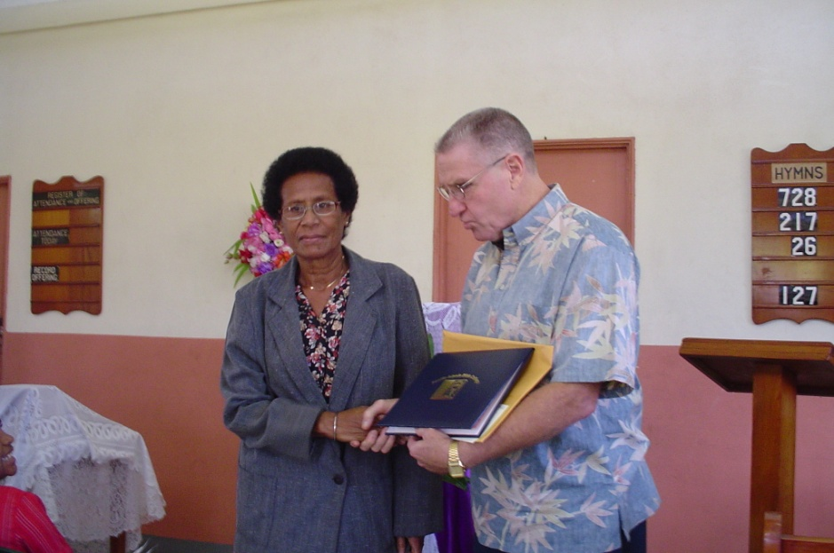
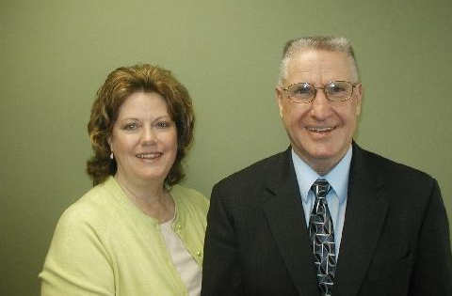
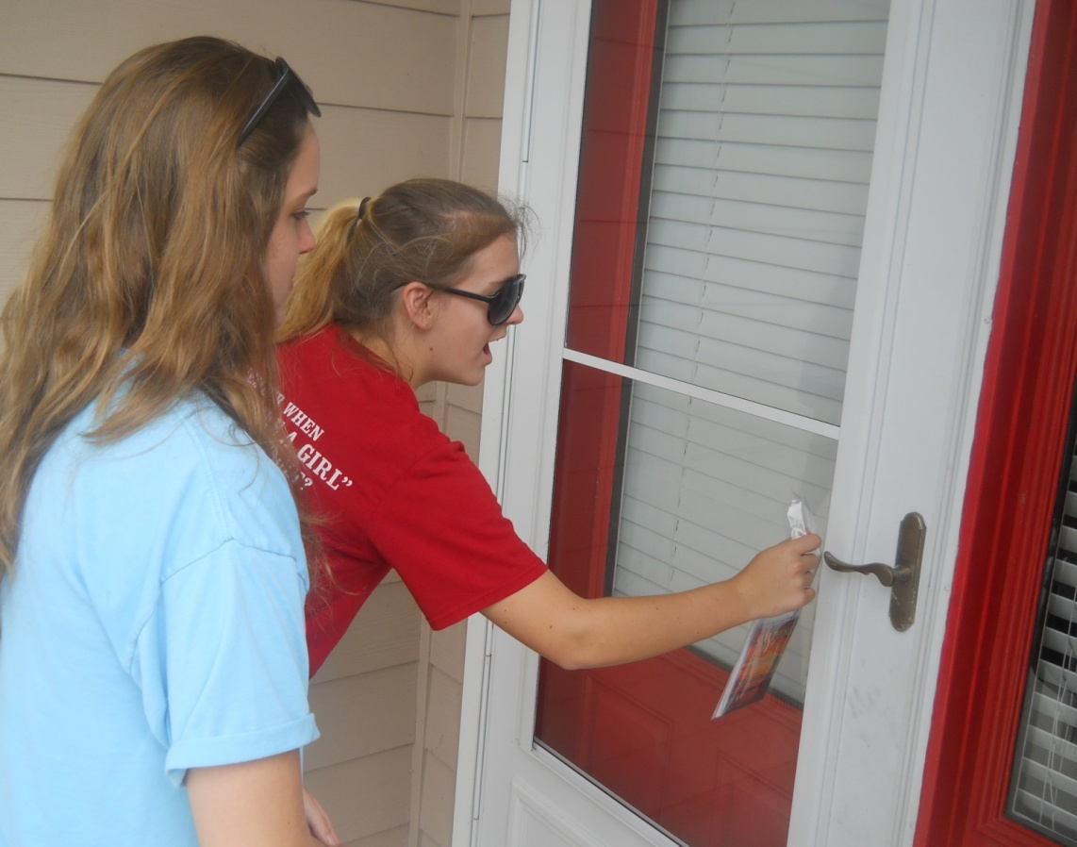
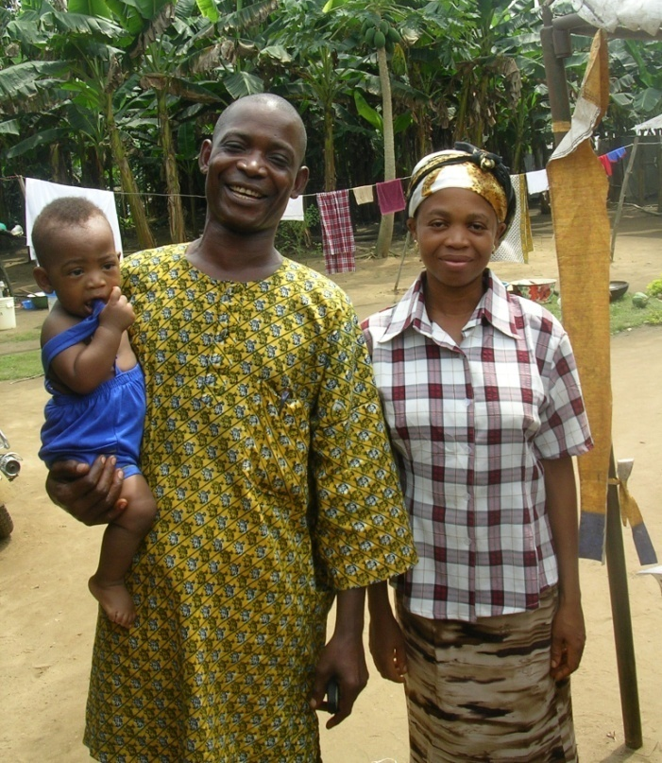
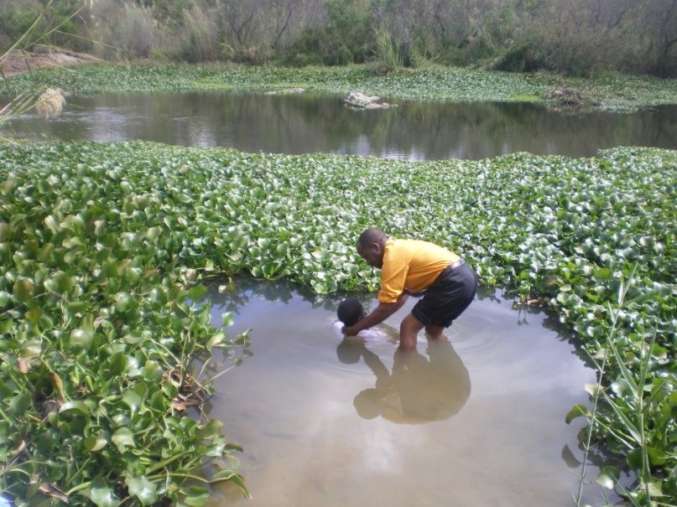
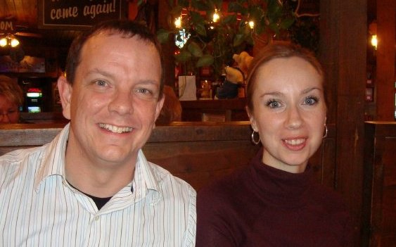
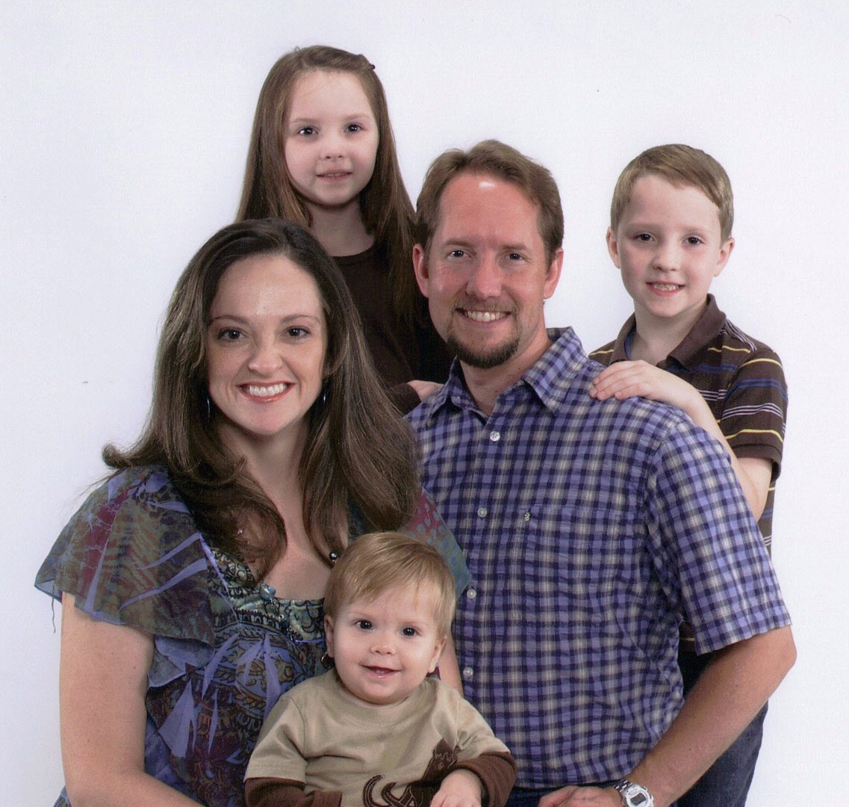
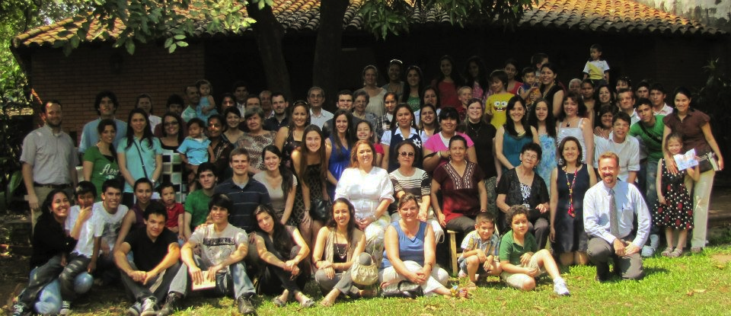
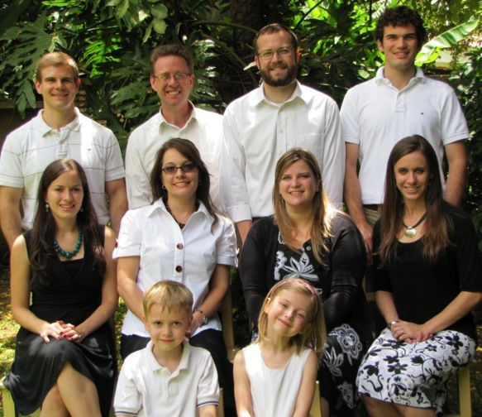
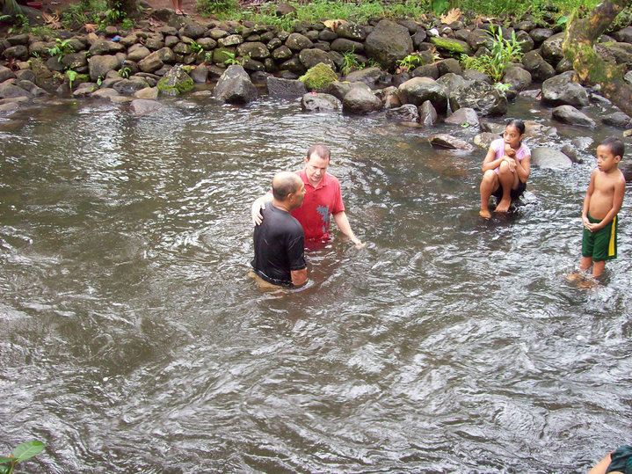
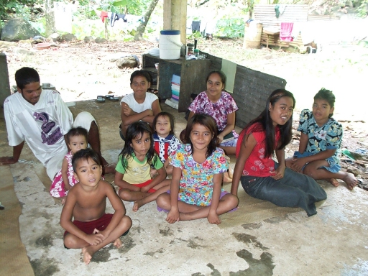
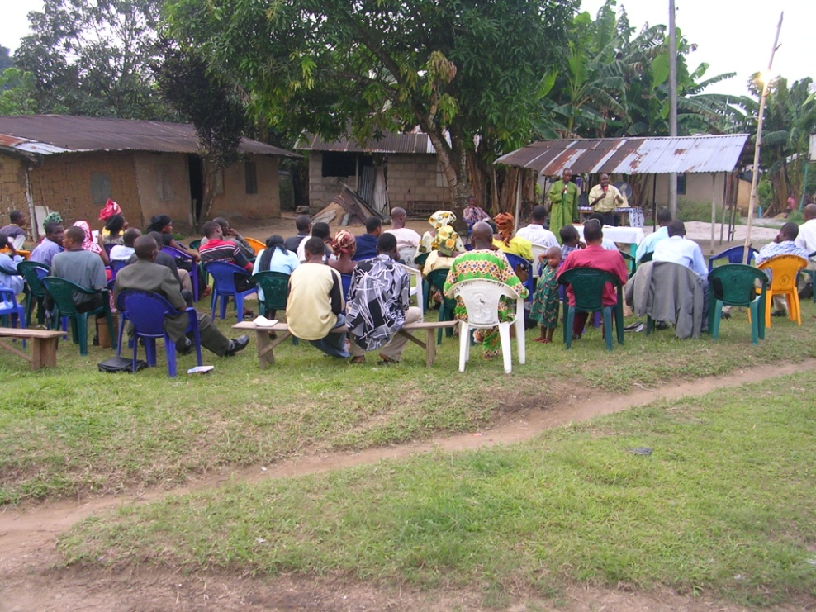
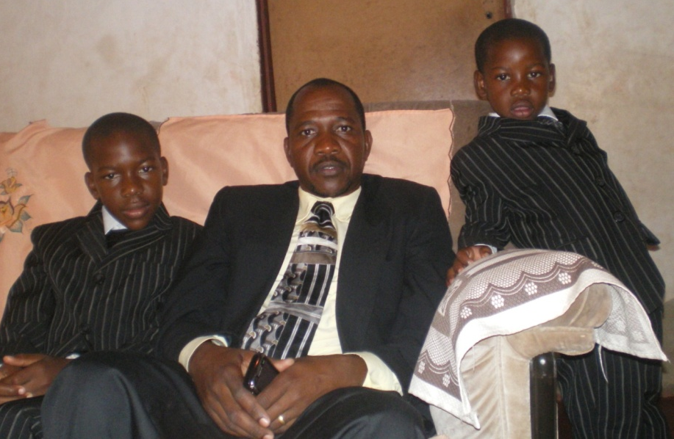
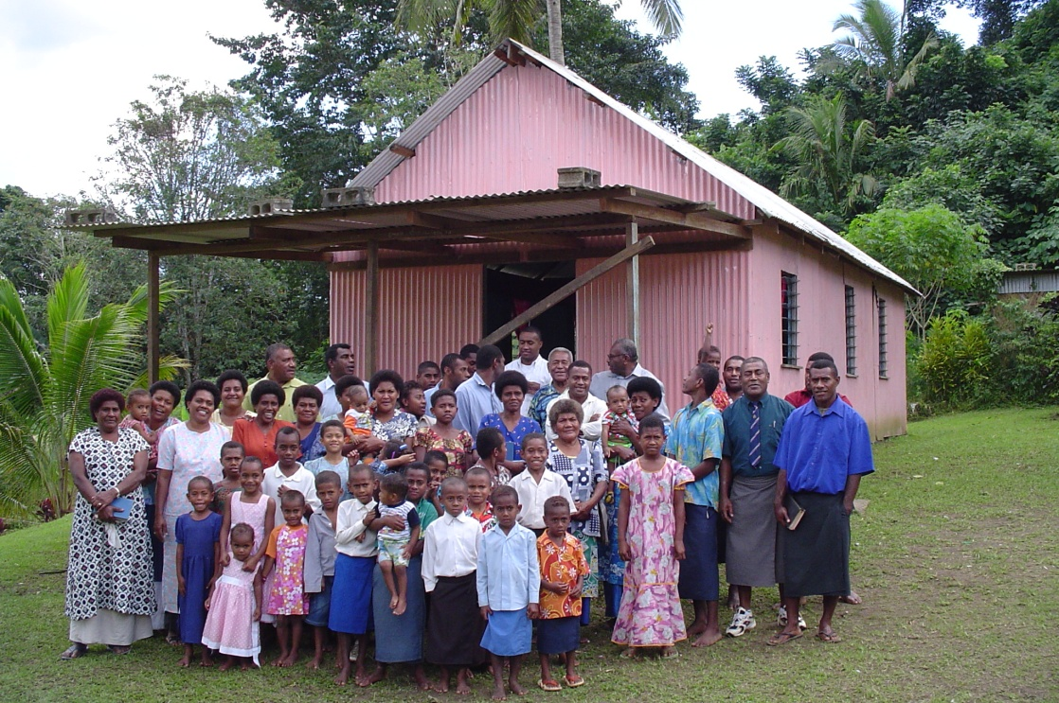
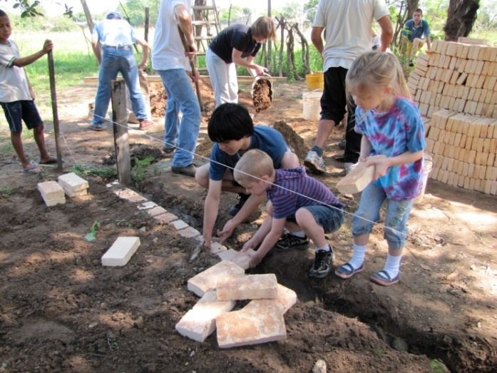
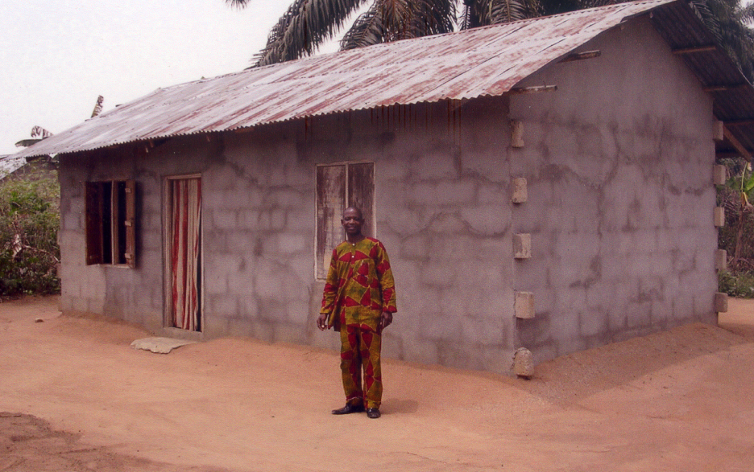
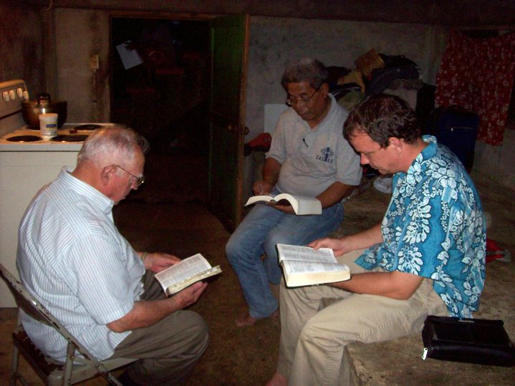
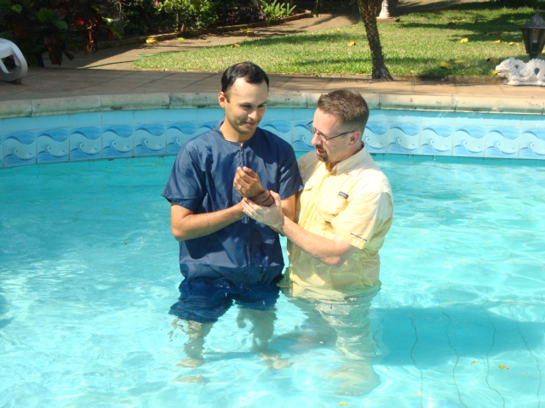
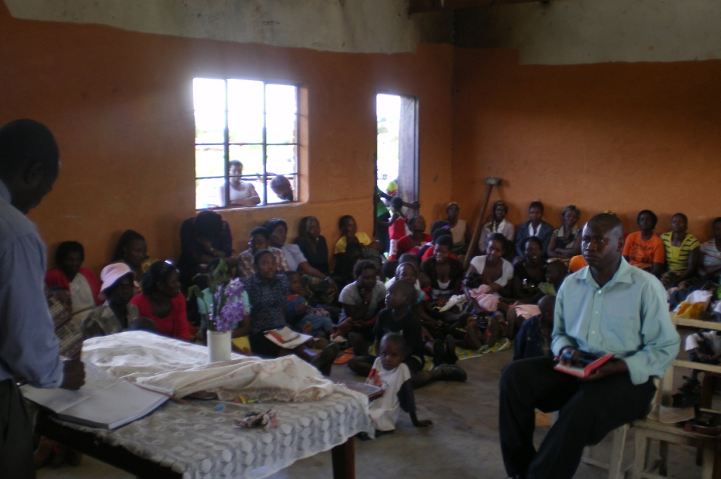
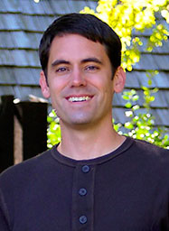
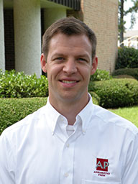
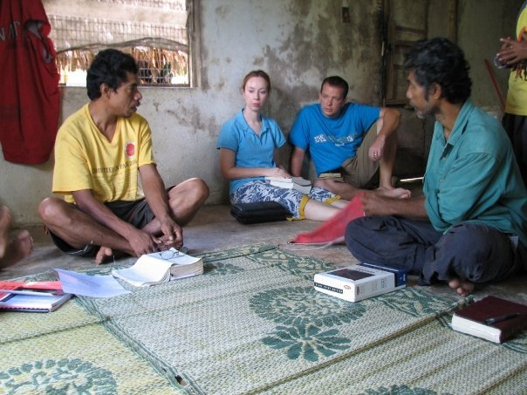
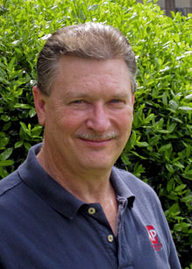
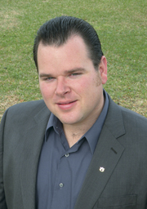
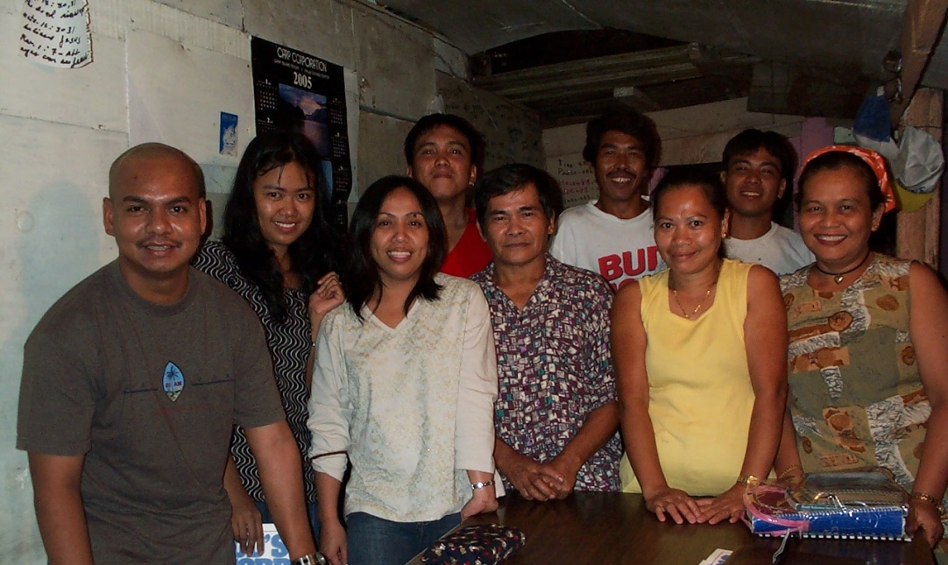
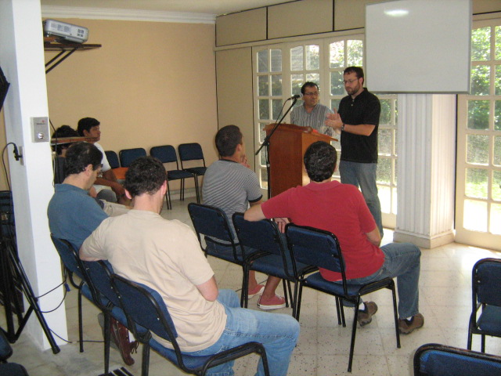
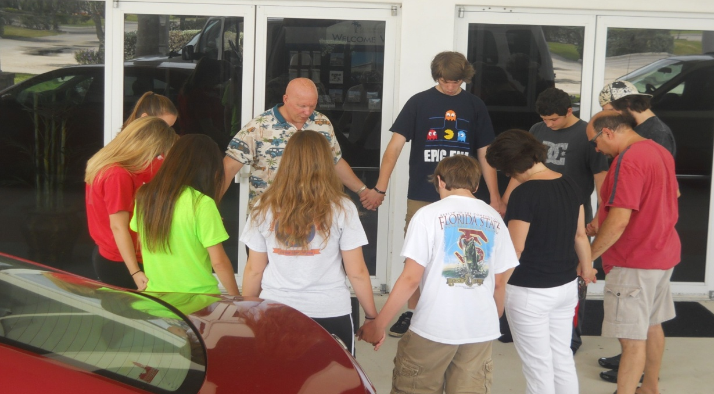
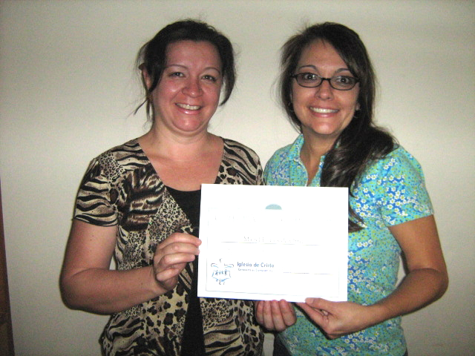
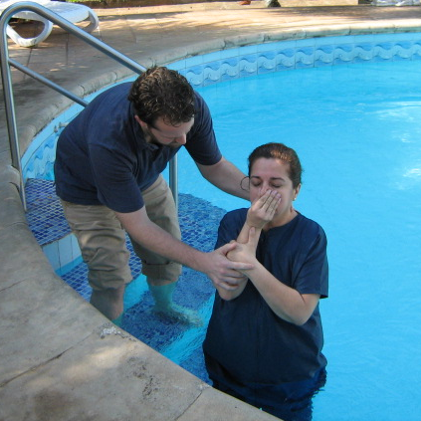
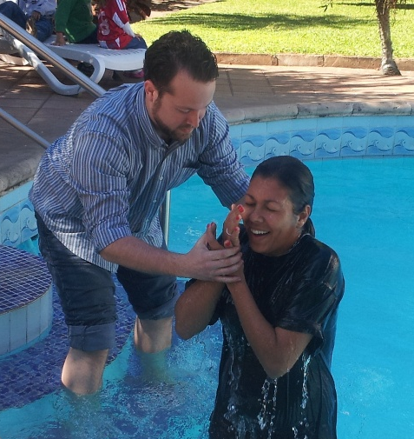
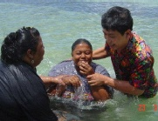
Josh, Cara, Josiah & Vivian Blackmer (Paraguay)
Troy Spradlin (Paraguay)
Apologetics Press
$58,650
Robert Martin (Pacific)
Teen Mission Trip
Scott Shanahan (Pacific)
Joey Treat (Pacific)
Nnanna Aforji (Nigeria)
Tamuka Arunashe (Zimbabwe)

Slide 3
This will NOT be projected
Must have $58,650 to cover our base/committed works
Nnanna Aforji (Nigeria) – supported him since 1994
Tamuka Arunashe (Zimbabwe) – since 1994
Scott Shanahan (Pacific) – since 2012
Joey Treat (Pacific) – since 2004
Own TV network (1 of 3 on the island); increasing support
Robert Martin (Pacific) – since 1989
Apologetics Press – since 1986 (oversight since 2004)
Teen Mission Trip
Troy Spradlin (Paraguay)
Josh Blackmer (Paraguay)

Slide 4
$72,150
Special Requests
for Mission Trips
Josh, Cara, Josiah & Vivian Blackmer (Paraguay)
Troy Spradlin (Paraguay)
Apologetics Press
$58,650
Robert Martin (Pacific)
Teen Mission Trip
Scott Shanahan (Pacific)
Joey Treat (Pacific)
Nnanna Aforji (Nigeria)
Tamuka Arunashe (Zimbabwe)

Slide 5
This will NOT be projected
If we give $72,150
Special Requests for Mission Trips
PLUS, Pursuing Sign on I-95

Slide 6
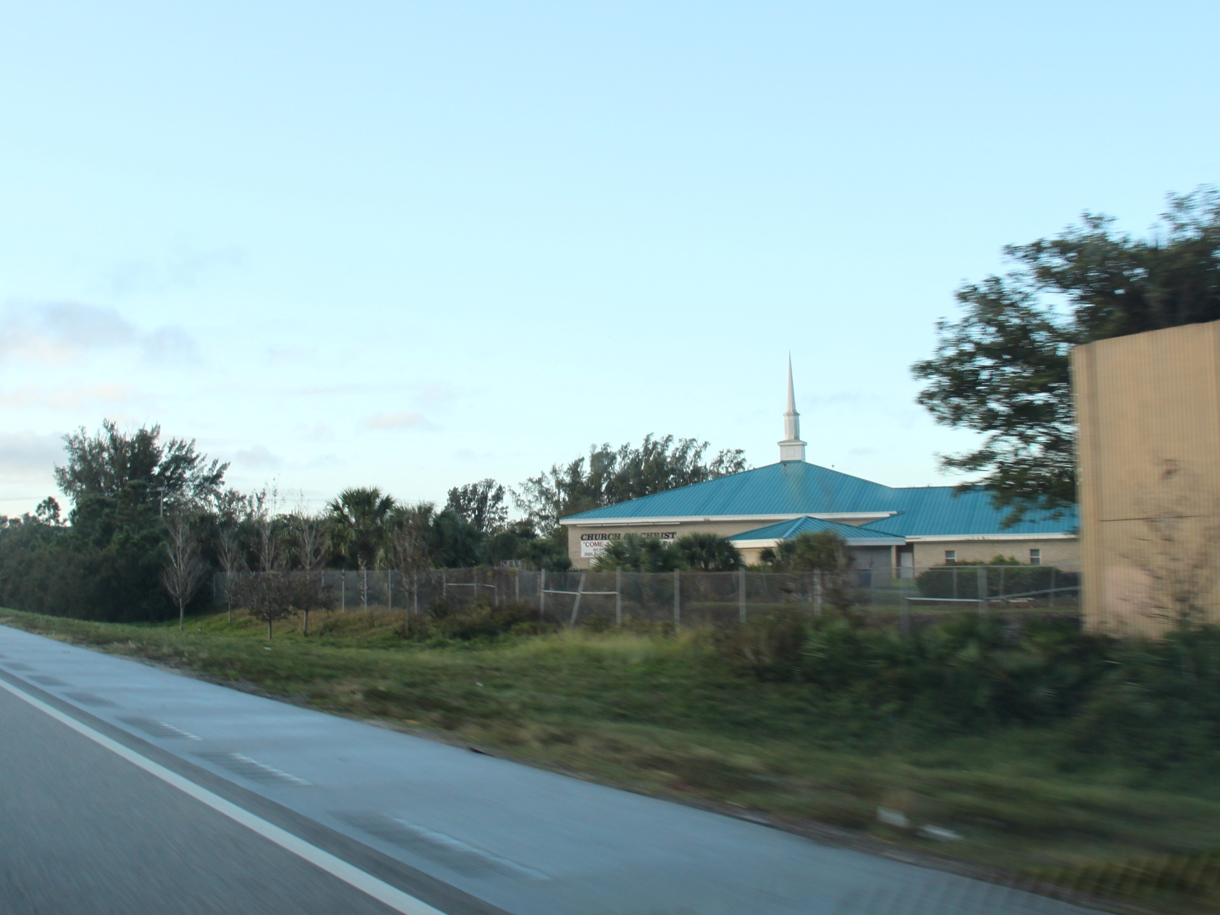

Slide 7
$81,150
Paraguay Mission Trip
for PBL Members
$72,150
Special Requests
for Mission Trips
Pursuing
Sign on I-95
Josh, Cara, Josiah & Vivian Blackmer (Paraguay)
Troy Spradlin (Paraguay)
Apologetics Press
$58,650
Robert Martin (Pacific)
Teen Mission Trip
Scott Shanahan (Pacific)
Joey Treat (Pacific)
Nnanna Aforji (Nigeria)
Tamuka Arunashe (Zimbabwe)

Slide 8
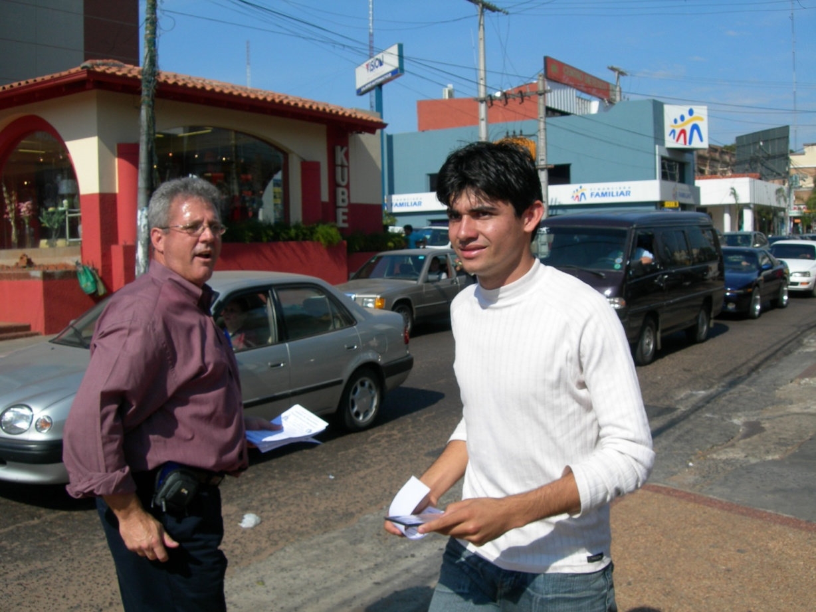
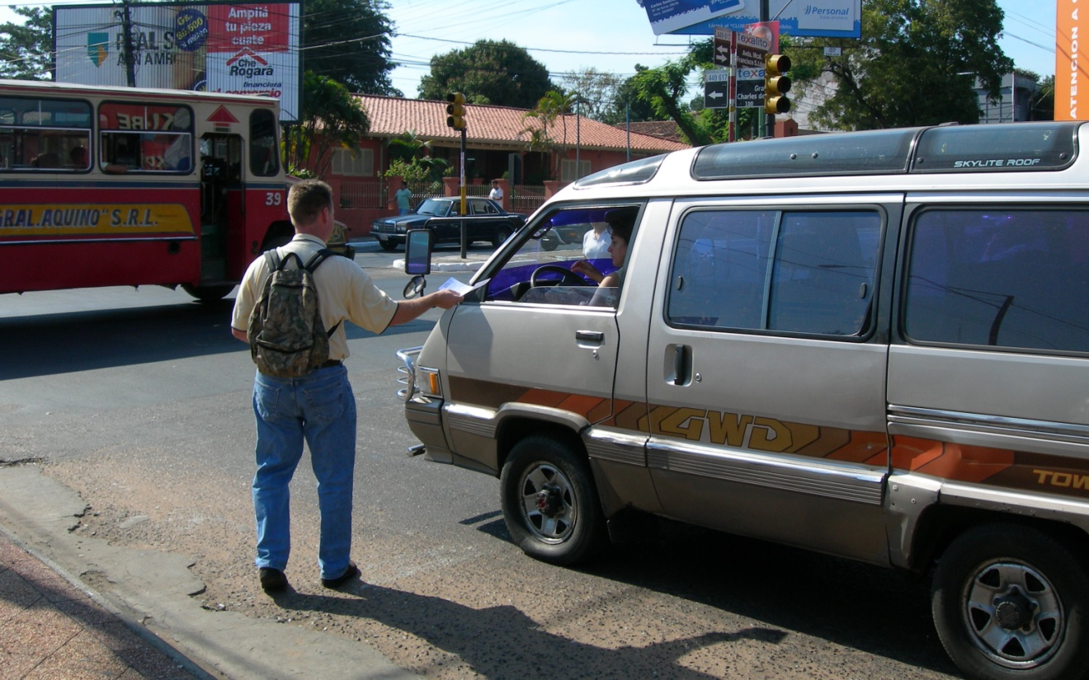
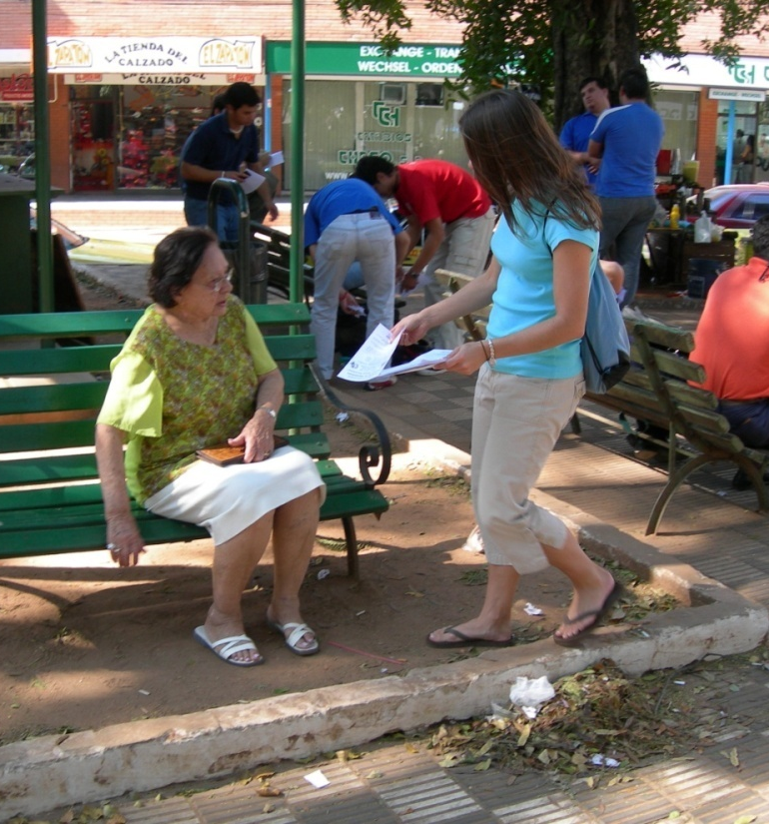

Slide 9
This will NOT be projected
If we give $81,150
Adult Mission Trip to Paraguay
PLUS, Mauricio Yegros with Mission Team to Miami

Slide 10
$81,150
Paraguay Mission Trip
for PBL Members
Mauricio Yegros
Mission Team in Miami
$72,150
Special Requests
for Mission Trips
Pursuing
Sign on I-95
Josh, Cara, Josiah & Vivian Blackmer (Paraguay)
Troy Spradlin (Paraguay)
Apologetics Press
$58,650
Robert Martin (Pacific)
Teen Mission Trip
Scott Shanahan (Pacific)
Joey Treat (Pacific)
Nnanna Aforji (Nigeria)
Tamuka Arunashe (Zimbabwe)

Slide 11
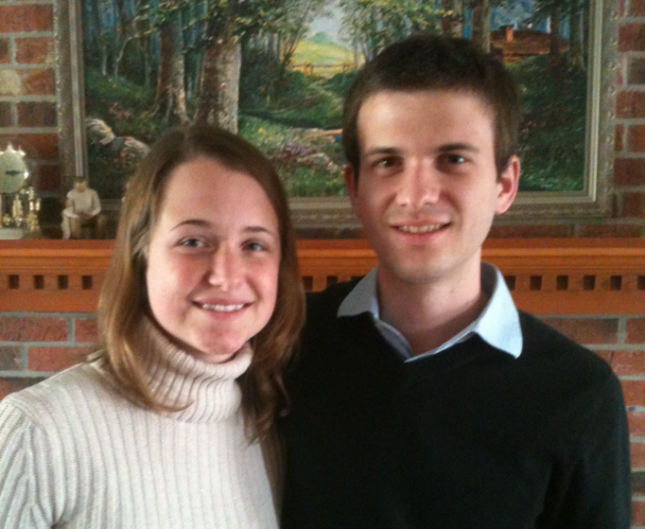
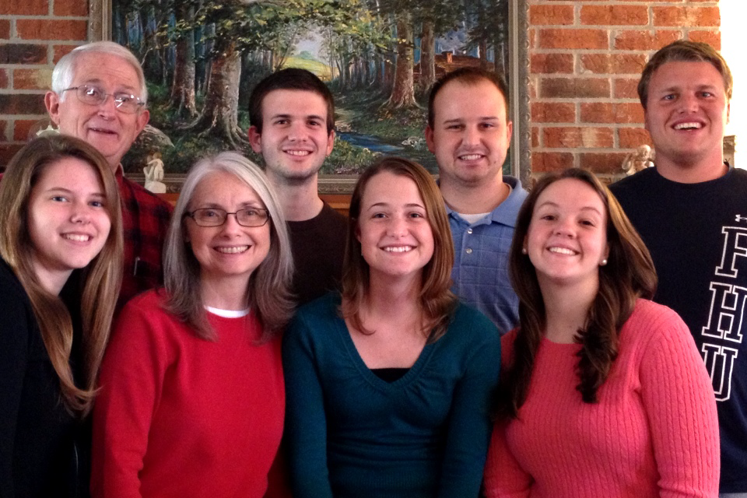
PBL Connection
Mauricio Yegros (wife: Kayla) is from Asuncion, Paraguay
Latin
American
Mission
Project
8 Member Mission Team
- Led by Glen & Kathy Henton
(Long-time missionaries to Argentina &
Bible Professor at FHU)
5.6 million in Metro Miami
- 65% is Hispanic (3.6 mil)
- 5 Latino cong, 5 bilingual

Slide 12
$98,150
+1 issue of H2H
to PBL Neighbors
$81,150
Paraguay Mission Trip
for PBL Members
Mauricio Yegros
Mission Team in Miami
$72,150
Special Requests
for Mission Trips
Pursuing
Sign on I-95
Josh, Cara, Josiah & Vivian Blackmer (Paraguay)
Troy Spradlin (Paraguay)
Apologetics Press
$58,650
Robert Martin (Pacific)
Teen Mission Trip
Scott Shanahan (Pacific)
Joey Treat (Pacific)
Nnanna Aforji (Nigeria)
Tamuka Arunashe (Zimbabwe)

Slide 13
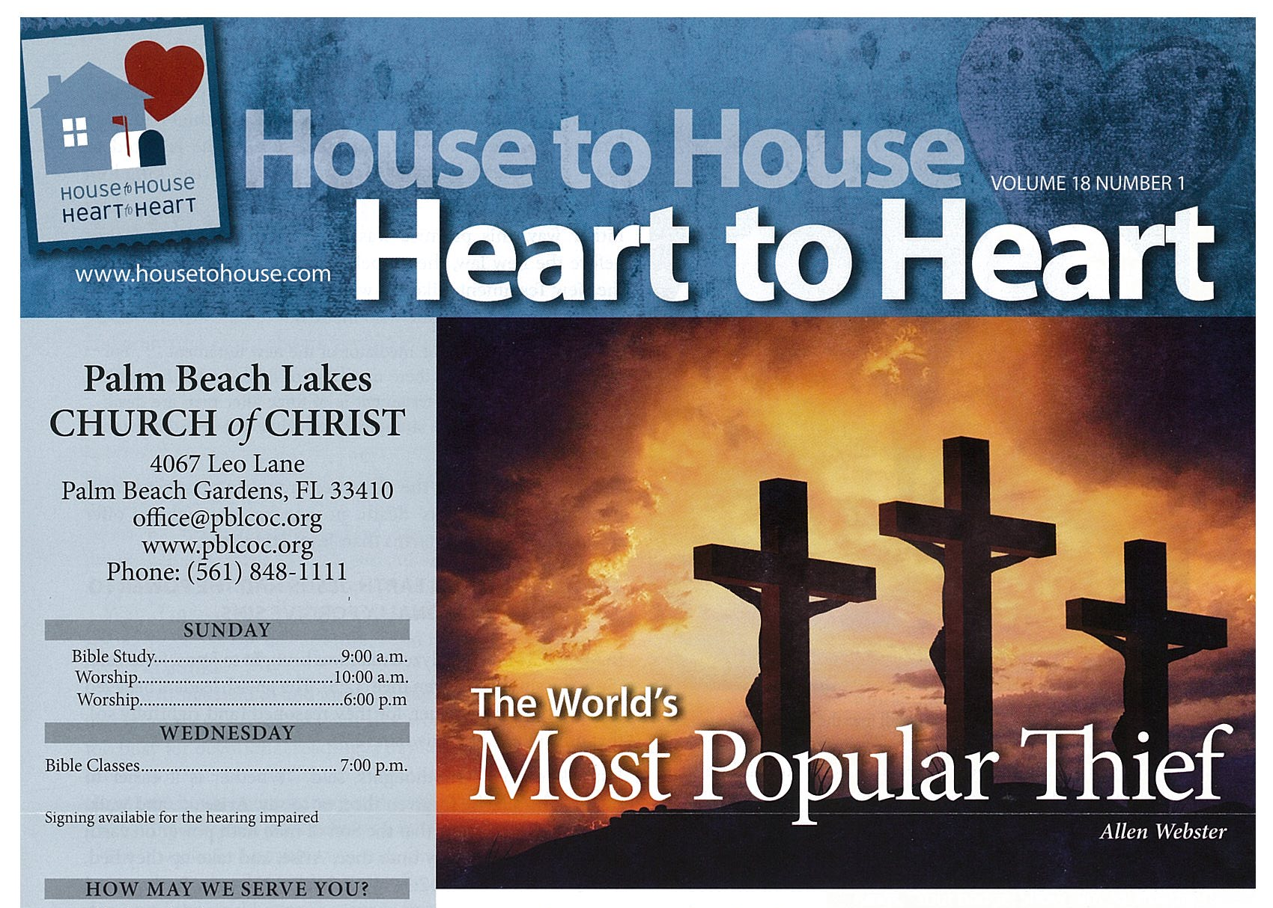
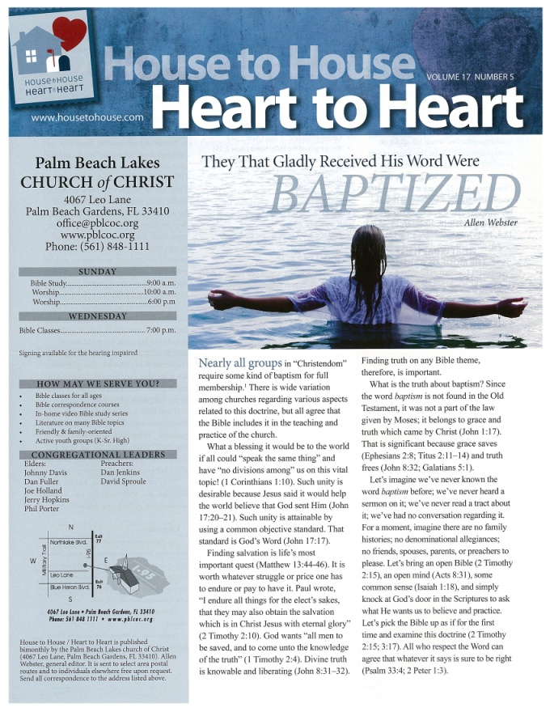
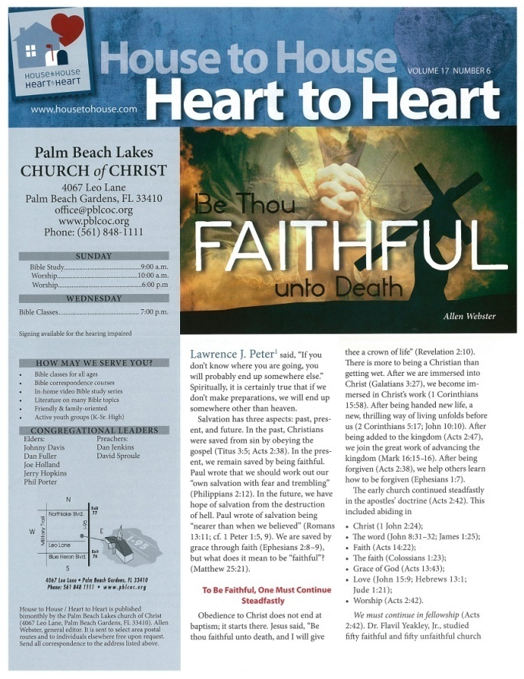
100,000
copies
One More Issue
March 2013
(Saturation is key!)
100,000
copies
100,000
copies
100,000
copies
Sept. ‘12
Nov. ‘12
Jan. ‘13

Slide 14
Just info - This will NOT be projected
House to House began in 1994 with the idea of having churches of Christ throughout the world cooperating to seek and save the lost through direct mail.
HTH is a bi-monthly publication that has grown to a circulation of over 3 million.
It is distributed by over 1,100 congregations in 48 states and 8 foreign countries, and has been translated into four different languages.
It has surpassed the circulation of the New York Times, the Wall Street Journal, and the USA Today.
With just 130 issues since 1994, it has distributed more than 175 million copies over the course of 18 years.
House to House costs less to print and mail than a postage stamp.

Slide 15
Just info - This will NOT be projected
PBL currently has ~475 members
Living in ~170 mail carrier routes
With ~100,000 homes on those routes
In Sept. 2012, we began sending H2H to:
Every home in our “neighborhoods”
One issue at a time
With a goal to send at least 3 issues, up to 6 issues
SATURATION in advertising is KEY!
We have mailed 3 ISSUES!
We want to do at least one more – in MARCH.

Slide 16
$98,150
+1 issue of H2H
to PBL Neighbors
Marsh Harbour Mission Trips
$81,150
Paraguay Mission Trip
for PBL Members
Mauricio Yegros
Mission Team in Miami
$72,150
Special Requests
for Mission Trips
Pursuing
Sign on I-95
Josh, Cara, Josiah & Vivian Blackmer (Paraguay)
Troy Spradlin (Paraguay)
Apologetics Press
$58,650
Scott Shanahan (Pacific)
Teen Mission Trip
Robert Martin (Pacific)
Joey Treat (Pacific)
Nnanna Aforji (Nigeria)
Tamuka Arunashe (Zimbabwe)

Slide 17
Just info - This will NOT be projected
In 2012, Alex (onion farmer) home destroyed by hurricane (home = shipping container)
We were able to help him get it fixed
He was sleeping in his car
We can make other trips to help the church
Dan, you might look at Jeff’s 2013-2014 proposal in Laborers Together with God worksheets

Slide 18
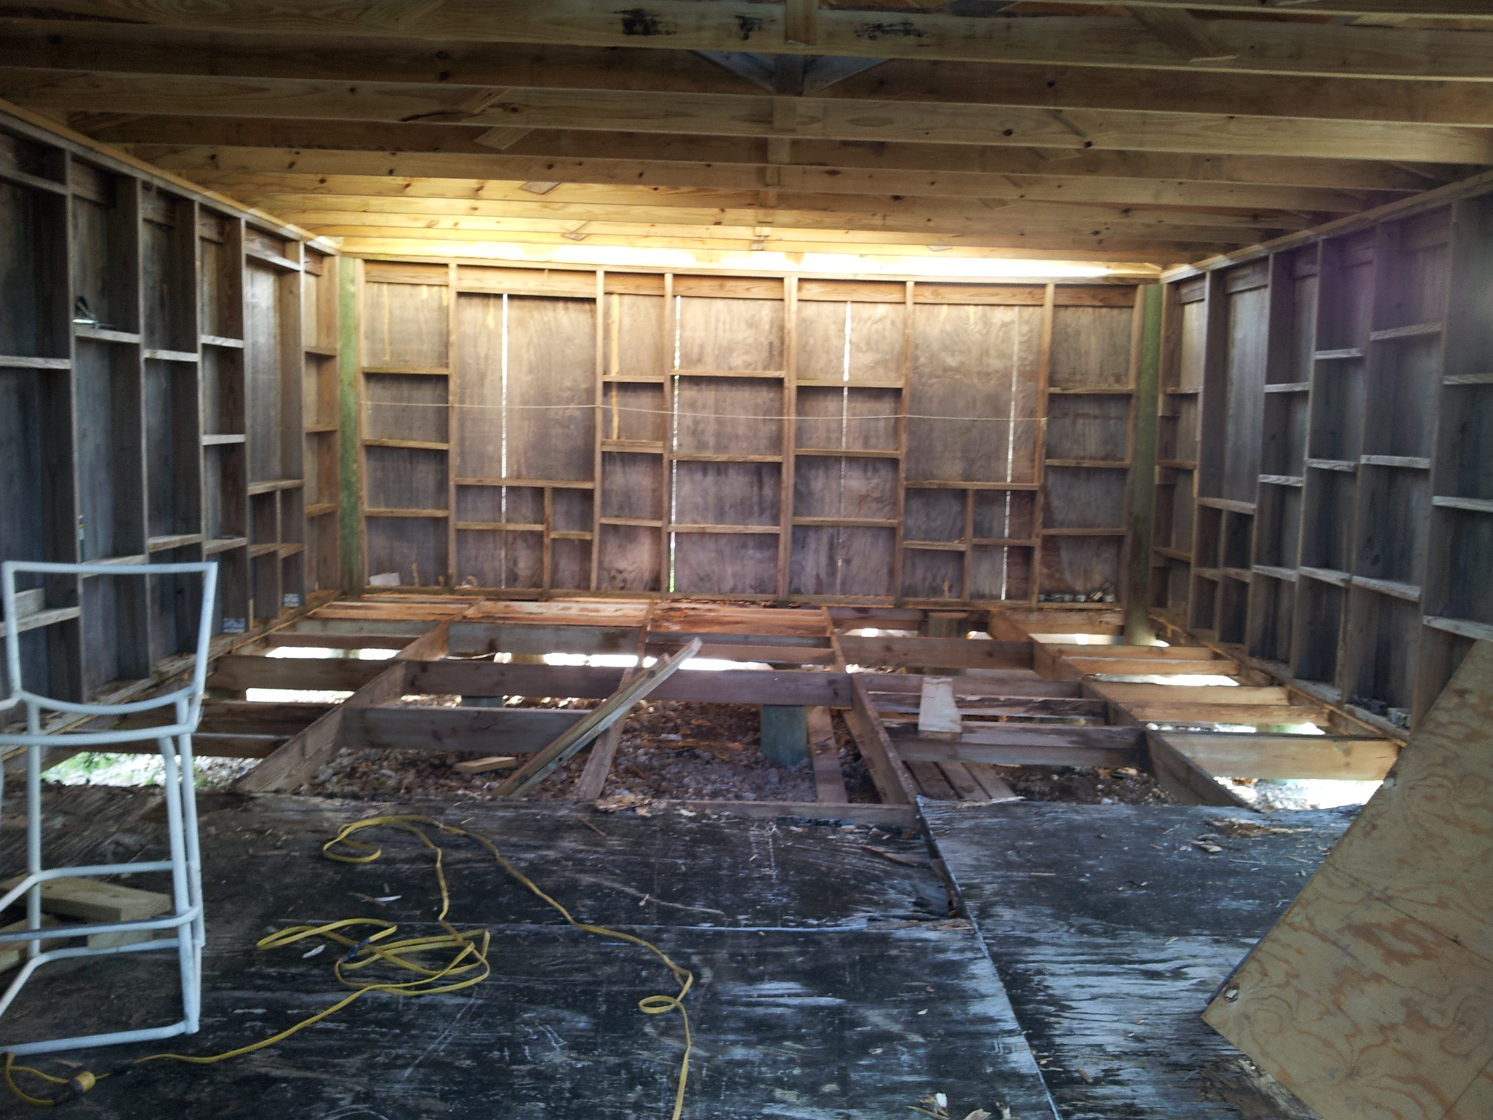
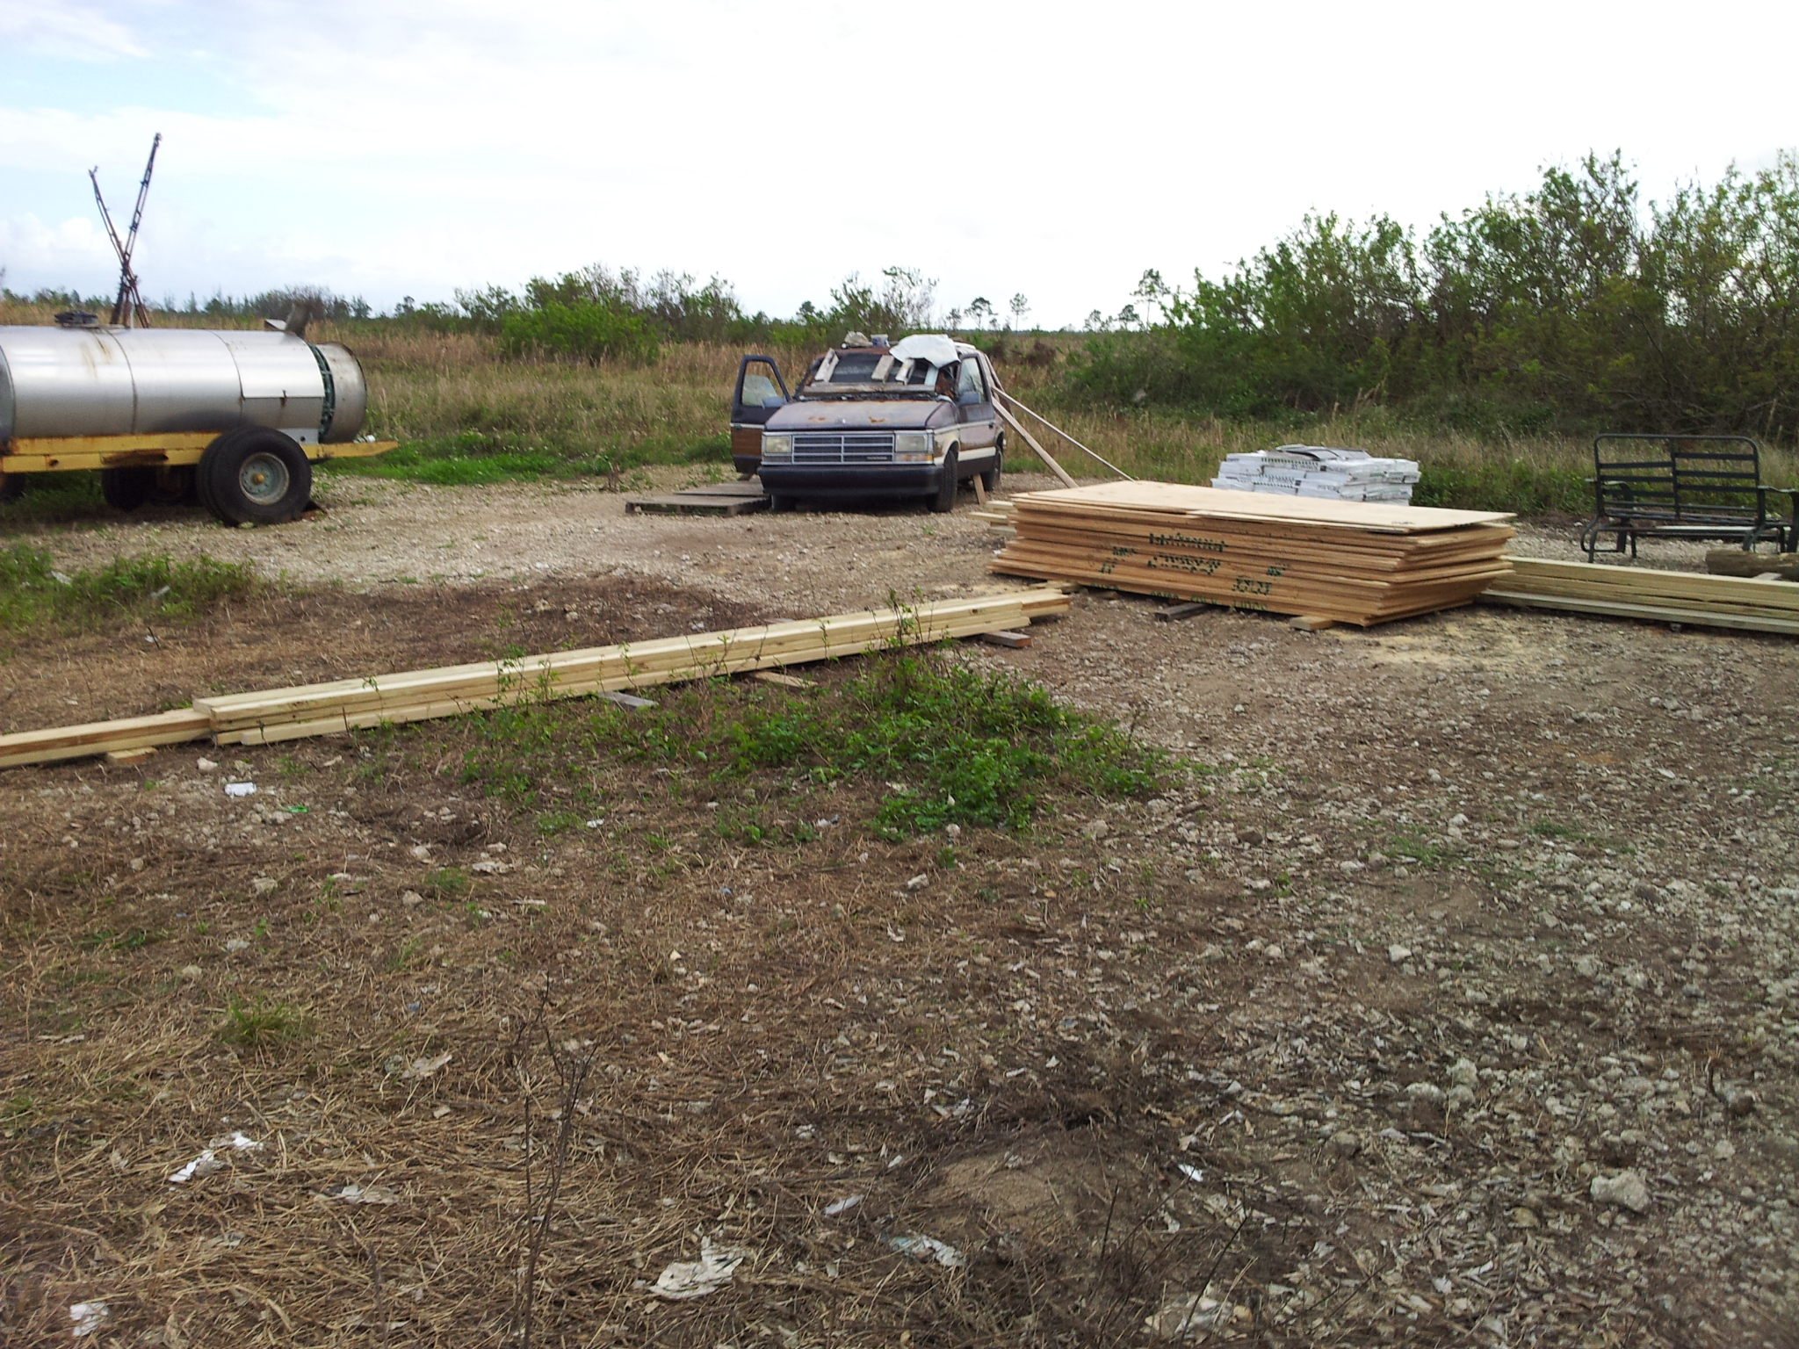
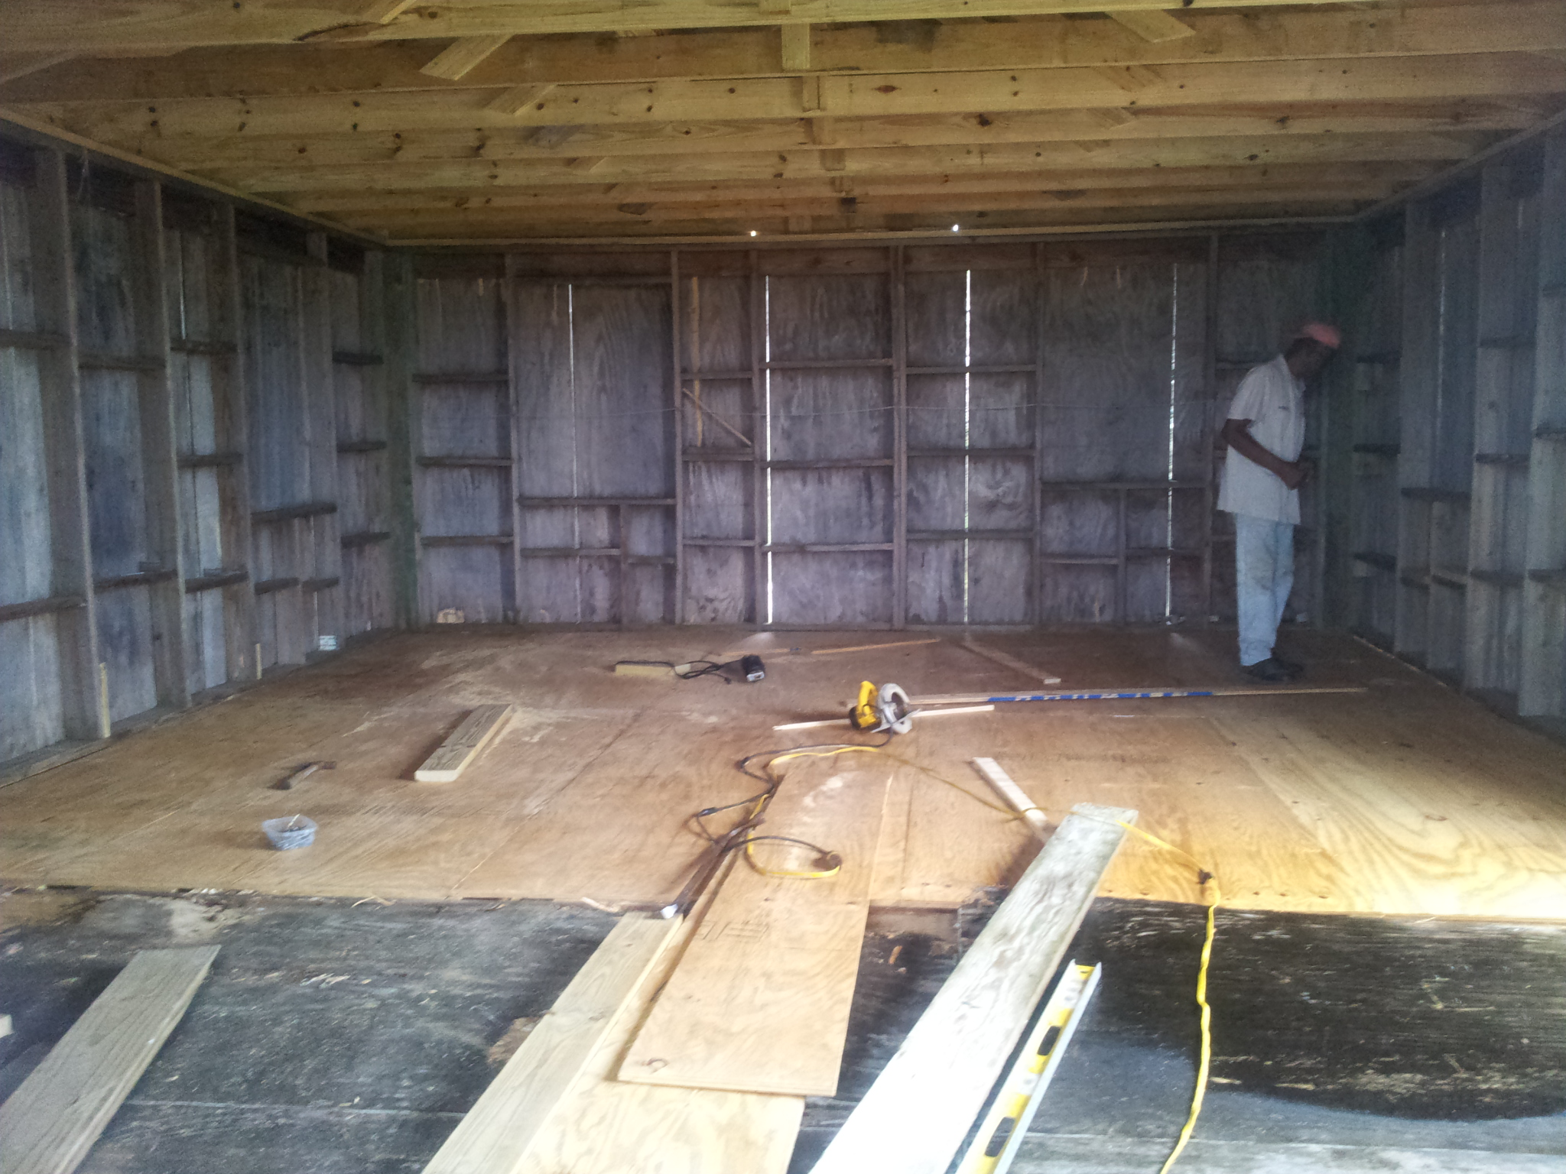
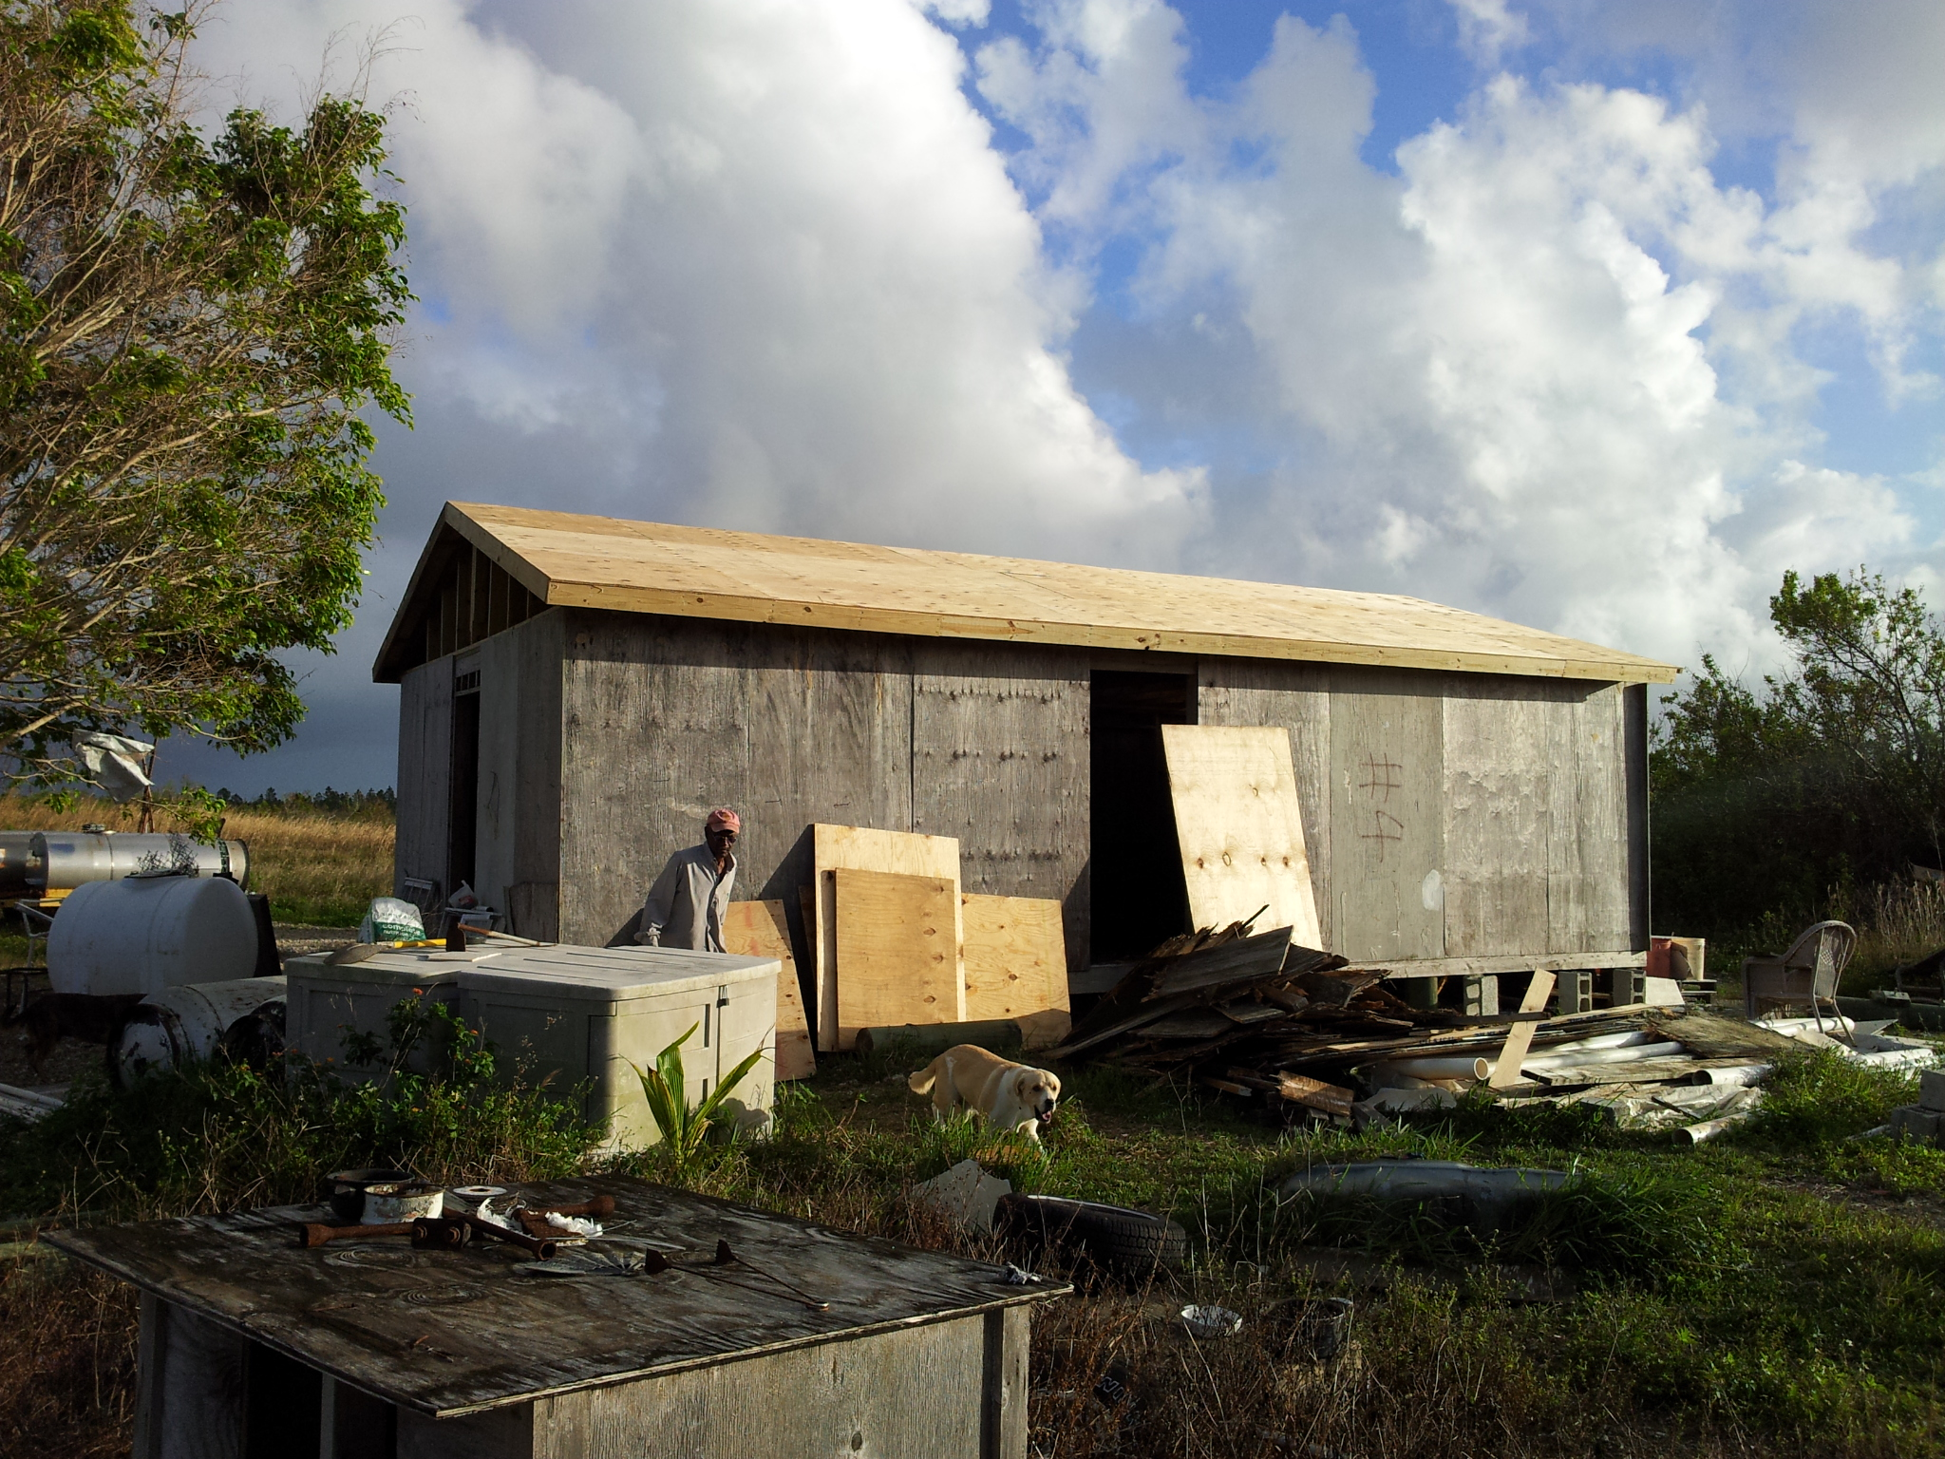
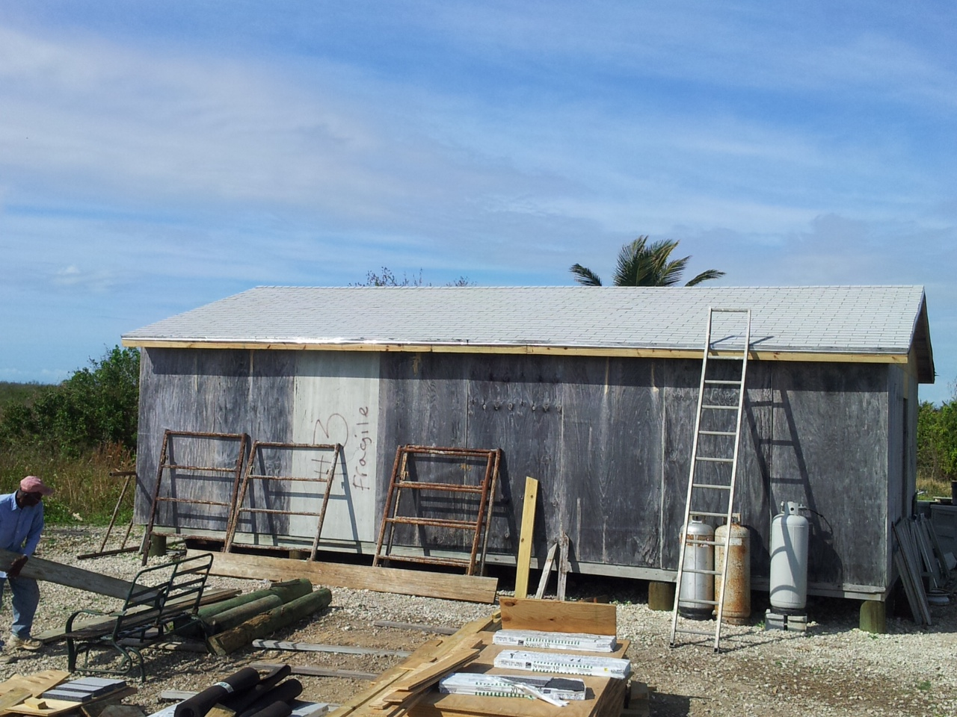

Slide 19
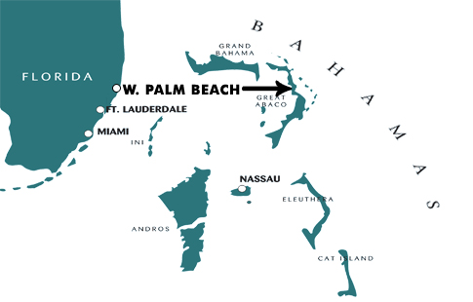
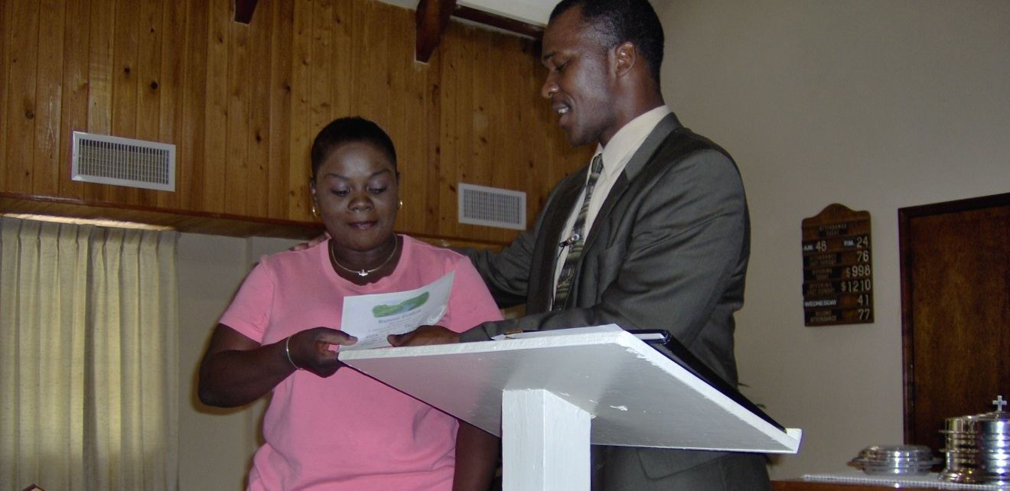
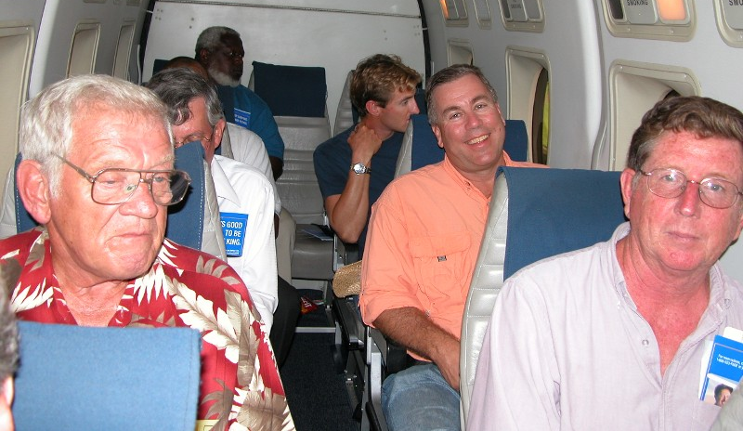

Slide 20
$111,150
+1 issue of H2H
to PBL Neighbors
$98,150
+1 issue of H2H
to PBL Neighbors
Marsh Harbour Mission Trips
$81,150
Paraguay Mission Trip
for PBL Members
Mauricio Yegros
Mission Team in Miami
$72,150
Special Requests
for Mission Trips
Pursuing
Sign on I-95
Josh, Cara, Josiah & Vivian Blackmer (Paraguay)
Troy Spradlin (Paraguay)
Apologetics Press
$58,650
Scott Shanahan (Pacific)
Teen Mission Trip
Robert Martin (Pacific)
Joey Treat (Pacific)
Nnanna Aforji (Nigeria)
Tamuka Arunashe (Zimbabwe)

Slide 21
One Last Issue
May 2013
(Saturation is key!)
100,000
copies
100,000
copies
100,000
copies
100,000
copies
Sept. ‘12
Nov. ‘12
100,000
copies
One More Issue
March 2013
Jan. ‘13

Slide 22
$+++,+++
+
Sign
$111,150
+1 issue of H2H
to PBL Neighbors
$98,150
+1 issue of H2H
to PBL Neighbors
Marsh Harbour Mission Trips
$81,150
Paraguay Mission Trip
for PBL Members
Mauricio Yegros
Mission Team in Miami
$72,150
Special Requests
for Mission Trips
Pursuing
Sign on I-95
Josh, Cara, Josiah & Vivian Blackmer (Paraguay)
Troy Spradlin (Paraguay)
Apologetics Press
$58,650
Robert Martin (Pacific)
Teen Mission Trip
Scott Shanahan (Pacific)
Joey Treat (Pacific)
Nnanna Aforji (Nigeria)
Tamuka Arunashe (Zimbabwe)

Slide 23
When We Follow God’s Plan
Salvation Is Possible
Believe Jesus is God’s Son John 8:24
Repent/Turn from your sins Acts 2:38
Confess your faith Romans 10:9
Be baptized Mark 16:16
Live faithfully Revelation 2:10

