Slide 1
Luke 2:40-52

Slide 2
Luke 2:40-52
Single-Minded Parents
Trained Jesus at Home (Luke 2:40)
Traveled to Jerusalem every year at Passover (2:41)
Took Jesus with them to the feast in Jerusalem (2:42)

Slide 3
Luke 2:40-52
Single-Minded Parents
Tenderhearted Teachers
They sat in the midst of the students (Luke 2:46)
They set forth the great truths of God
They shared info & answers from their studies
They showed an interest in their students (2:47)
They submerged themselves in the setting & the study

Slide 4
Luke 2:40-52
Single-Minded Parents
Tenderhearted Teachers
Engaged “Church”-Family
Jesus stayed behind in Jerusalem alone (Luke 2:43)
Jesus separated from parents for two nights (2:44-46)
Where did Jesus stay/sleep for those three days?
Where/How did Jesus eat for those three days?
Kind, loving “extended family” took care of His needs

Slide 5
Luke 2:40-52
Single-Minded Parents
Tenderhearted Teachers
Engaged “Church”-Family
Personal Inner-Drive
Decided on His own to stay in Jerusalem (Luke 2:43)
Desired to learn all that He could (2:46)
Deliberated with teachers through Q&A (2:46-47)
Devoted Himself to His Father & His Mission (2:49)

Slide 6
Luke 2:40-52
Single-Minded Parents
Tenderhearted Teachers
Engaged “Church”-Family
Personal Inner-Drive

Slide 7
Children’s
Bible Education & Experience
at Palm Beach Lakes church of Christ

Slide 8
PBL has always had a tremendous Bible class program
PBL has always placed a strong emphasis on teaching
PBL places utmost importance on fortifying faith
PBL has uniquely talented members
PBL’s teachers are second to none
PBL’s Media Center is first-class and unparalleled
Combine all of this into a new Bible Class Program:
Stepping into the Bible!
(Written & Published by PBL for PBL Families)

Slide 9
A program designed to:
Develop and strengthen a living faith
in the hearts of our children
by walking them into
the settings, narratives and truths
of the living messages of God’s Word!

Slide 10
Overview of the “Experience”
Designed to immerse the kids into the Bible stories
Walk through Bible scenes (some 3-D) in the hallway
Step into classrooms transformed into individual stories
Children will learn the Bible while immersed in it
Children will learn the Bible while experiencing it
Children will experience the Bible while learning it
The emphasis will be placed on the learning
The “experience” is to help the learning to “stick”
Kids learn in different ways; we want all kids to learn!

Slide 11
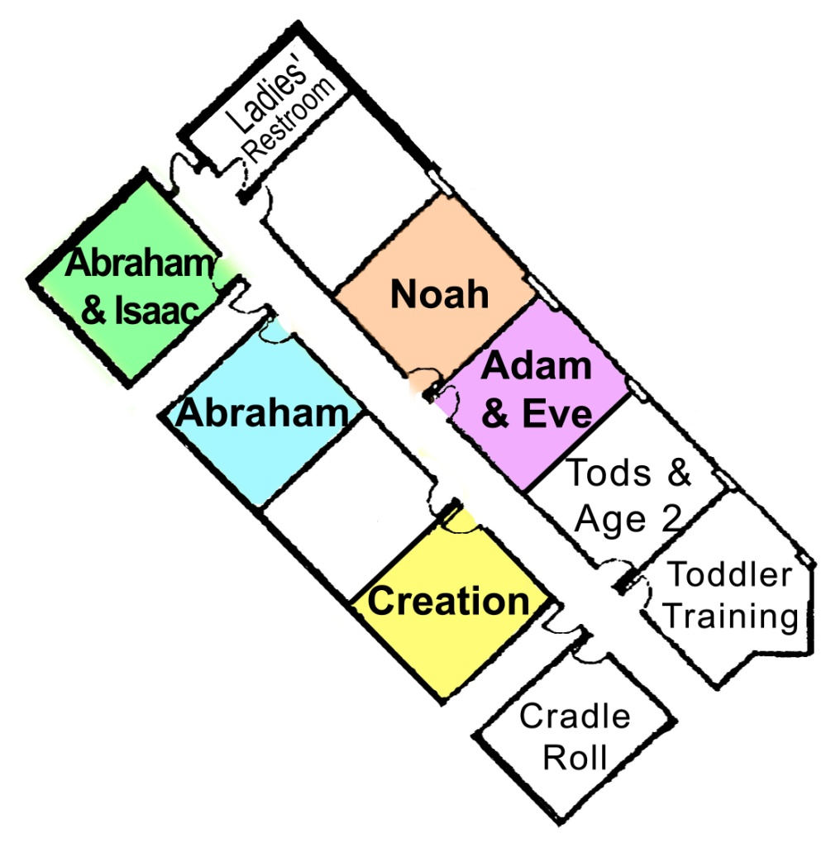
Overview of the Age & Classroom Rotation
For children, Age 3 thru Grade 5
Five age levels using five classrooms
Ages 3-4
Kindergarten
Grade 1
Grades 2-3
Grades 4-5
Each age level will be taught in each of the five classrooms, rotating every four weeks
Teachers will teach same age level for 8 weeks or 12 weeks, rotating with them

Slide 12
Overview of the Curriculum Structure
Does not follow traditional “13-Week Quarter” system
Covers the entire Bible in approximately 6 ¾ years
Every 4 weeks (“Session”), age levels rotate to next setting
20 wks (“Semester”) for each age to be taught in each room
After each Semester will be a 2-week Mini-Session
All children will be taught in other rooms in South hall
Classroom settings will be changed for the next Semester

Slide 13
Semester 1
Session 1: Creation (4 weeks)
Session 2: Adam & Eve (4 weeks)
Session 3: Noah (4 weeks)
Session 4: Abraham (4 weeks)
Session 5: Abraham & Isaac (4 weeks)
20 weeks in classrooms
(4 weeks in each room)
+ 2 weeks in review
January 6 –
June 5, 2013
Ages 3-4
Kindergarten
Grade 1
Grades 2-3
Grades 4-5

Slide 14
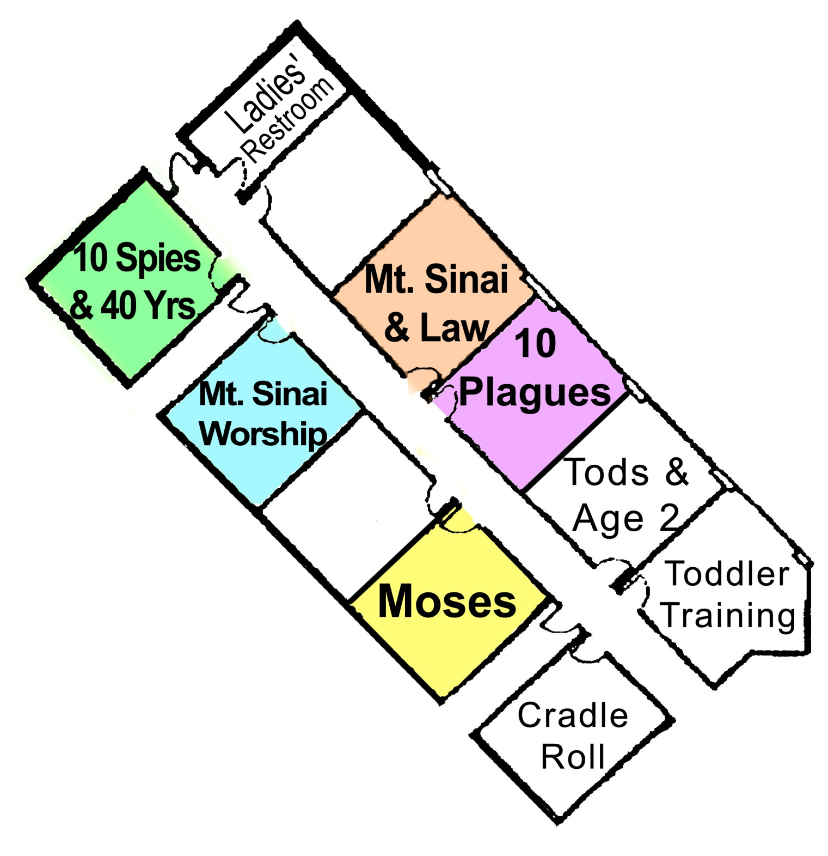
Semester 3
Session 1: Moses (4 weeks)
Session 2: 10 Plagues & Red Sea (4 weeks)
Session 3: Mt. Sinai—The Law (4 weeks)
Session 4: Mt. Sinai—Worship (4 weeks)
Session 5: Spies & Wilderness (4 weeks)
20 weeks in classrooms
(4 weeks in each room)
+ 2 weeks in review
Oct. 6, 2013 – Feb. 26, 2014
Ages 3-4
Kindergarten
Grade 1
Grades 2-3
Grades 4-5

Slide 15
Overview of the Lesson Plans
Each Session has a Teacher’s Binder that contains everything the teachers need for that Session and it universally applies that Session to all ages.
The Lesson Plans provide a wide range of instructional methods and applicable reinforcement systems that include visual, audible and hands-on learning.
Every Lesson Plan has a built-in “Take Home Review Sheet” for children to take home and for families to review.
Every Lesson Plan includes these components:
Objective, Scripture Reference, Memory Verse, Lesson Facts & Review Questions
Lesson Narrative, Teaching Resources, Lesson Reinforcement, Discussion Questions, Wednesday Highlights & Useful Songs

Slide 16
What’s it going to take?
Single-Minded Parents
Tenderhearted Teachers
Engaged Church-Family
Personal Inner-Drive

Slide 17
Jesus Died, Was Buried & Was Raised (1 Cor. 15:3-4)
To obey Him, to be saved and to become like Him:
We must die, be buried & raised (Rom. 6:3-6, 17)
Do you believe Jesus is God’s Son (John 3:16)?
Have you repented of your sins (Luke 13:3)?
Have you confessed your faith (Acts 8:37)?
Have you been baptized into Christ (Rom. 6:3-4)?
That’s when your sins are washed away – Acts 22:16
That’s when God adds you to His church – Acts 2:47
That’s when God writes your name in heaven – Hebrews 12:23
Are you living faithfully in service to Him (1 John 1:7)?

