Slide 2
With confidence & trust, David affirmed:
The Lord is MY SHIELD (v. 3)
Protection all around and over me!
“You will surround him as with a shield” (Psa. 5:12)
“He is a shield to all who trust in Him” (Psa. 18:30)
“The Lord encamps all around those who fear” (34:7)
“The eternal God is your refuge, and underneath are the everlasting arms” (Deut. 33:27)
“In the time of trouble He shall hide me in His pavilion, in the secret place of His tabernacle” (Psa. 27:5)

Slide 3
With confidence & trust, David affirmed:
The Lord is MY GLORY (v. 3)
Some place their trust in the transient!
When we draw close to God & serve God, we receive & reflect His glory (2 Cor. 3:18)
What an honor to serve the Almighty God & dwell in His glory!
And, there is still more “glory to be revealed in us” (Rom. 8:18).

Slide 4
With confidence & trust, David affirmed:
The Lord is MY PICK-ME-UPPER (v. 3)
Of David: “Took from the sheepfold…to be ruler” (2 Sam. 7:8)
David fled, “wept…his head covered…barefoot” (2 Sam. 15:30)
David trusted, “If I find favor in the eyes of the Lord…” (15:25)
“Humble yourselves…and He will lift you up” (James 4:10)

Slide 5
With confidence & trust, David affirmed:
The Lord is MY PRAYER-ANSWERER (v. 4)
David: “Evening and morning and at noon I will pray” (Ps. 55:17)
“Confidence…that if we ask…He hears us” (1 John 5:14)
“Whatever we ask we receive from Him” (1 John 3:22)
“Your Father knows what you need before you ask” (Matt. 6:8)
“The Lord does not forsake His saints” (Psa. 37:28)
Selah!

Slide 6
With confidence & trust, David affirmed:
The Lord is MY PEACE (v. 5-6)
He removes fear that we may sleep though surrounded by foes
He sustains us that we may awake in safety without any harm
“When I am afraid, I will trust in You” (Psa. 56:3)
His watchful care removes worry (Matt. 6:25-34)
Trustful peace says,
“I am God’s!”
“If God be for us, who can be against us?” (Rom. 8:31-39)

Slide 7
With confidence & trust, David affirmed:
The Lord is MY SAVIOR (v. 7-8)
They said, “There is no help for him in God.”
David’s faith & trust knew better
He remembered and knew what God had done in past victories
He confidently knew what God would do now & future victories
Salvation belongs to the Lord!
His blessing is upon His people!

Slide 8
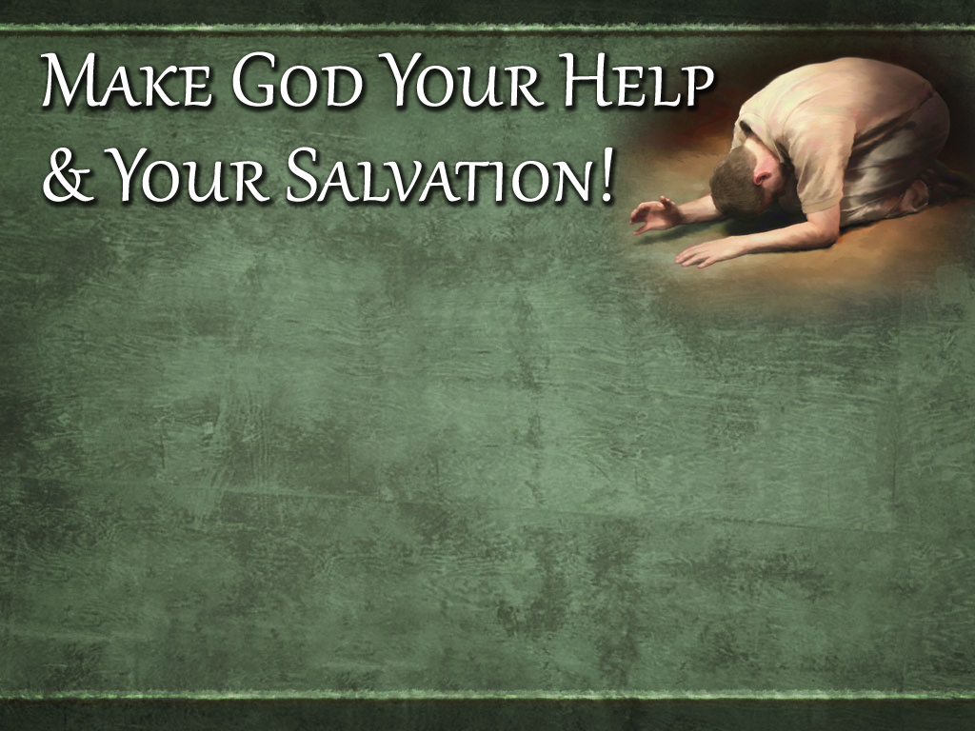
Believe that Jesus is God’s Son – Mark 16:16
Repent from your sinful living – Acts 3:19
Confess your faith in Jesus – Matthew 10:32
Be immersed into Christ – Acts 2:38
God will wash away your sins – Acts 22:16
God will add you to His church – Acts 2:47
God will write your name in heaven – Hebrews 12:23
Trust and obey God faithfully for life – 1 Corinthians 15:58

