Slide 2
The Feast
“Great Supper” = the abundant blessings of the gospel
Gospel of Christ is a sumptuous banquet for hungry souls
Nothing compares to its abundance, fellowship, joy or hope

Slide 3
The Invitations -The 1st One (v. 16-21a)
He “Invited many” (v. 16)
Shows great breadth of God’s love for all mankind
Invites all (Rev. 22:17), wants all (1 Tim. 2:4), offers to all (Tit. 2:11)
He made all the necessary preparations
“Come, for all things are now ready” (v. 17)
All Those Invited Made Flimsy Excuses (v. 18-20)
Bought land = refused because of possessions (cf. Lk. 18:18-23)
Bought oxen = refused because of ambition (cf. John 12:42-43)
Married = refused because of family ties (cf. Luke 14:26)
Excuses are not reasons!
They did not want to come because they loved other things too much!
Christ must take priority over all earthly matters!

Slide 4
The Invitations -The 2nd One (v. 21b-22)
“Go out into streets and lanes” to lower classes
Shows great impartiality of God’s love for mankind
“Bring in here”
Outcasts rarely make excuses when invited to a great banquet
“Still there is room”
God always has room for more at His table!

Slide 5
The Invitations -The 3rd One (v. 23-24)
“Go out into the highways and hedges” to those without opportunity
Shows great length of God’s love to reach the uttermost
“Compel them to come in”
Persuade them that people of their class are wanted
“That My house may be filled”
God wants His house full; man’s stubbornness cannot stop Him

Slide 6
The Applications
God has done all the preparations for the great salvation (cf. Heb. 2:3-4)
God has invited all to come to Him (cf. Matt. 11:28-30)
God has sent us, His servants, to extend His invitation (cf. Mark 16:15)
Some of those invited will make excuses, reject His invitation & be rejected.
Some of those sent will make excuses, reject His command & be rejected.
NO excuse for not accepting His invitation & obeying Him!
Christ must take priority over every earthly matter!

Slide 7
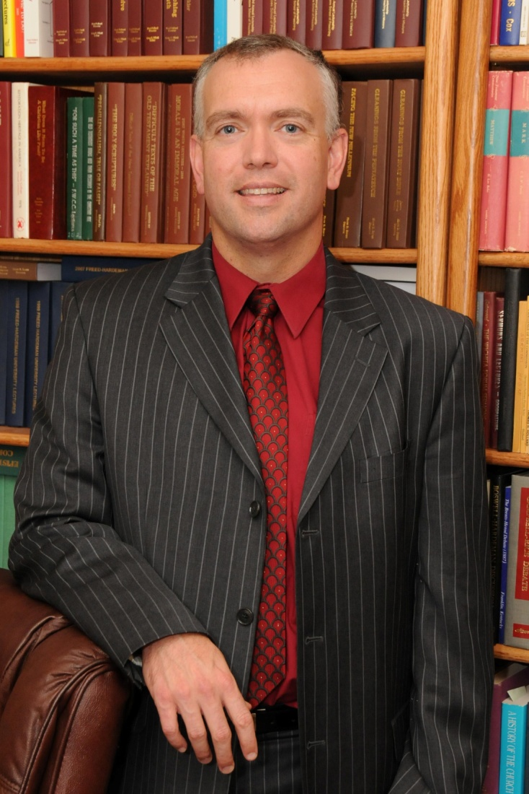
Immediate Opportunity: The Feast

Slide 8
Immediate Opportunity: The Invitations

Slide 9
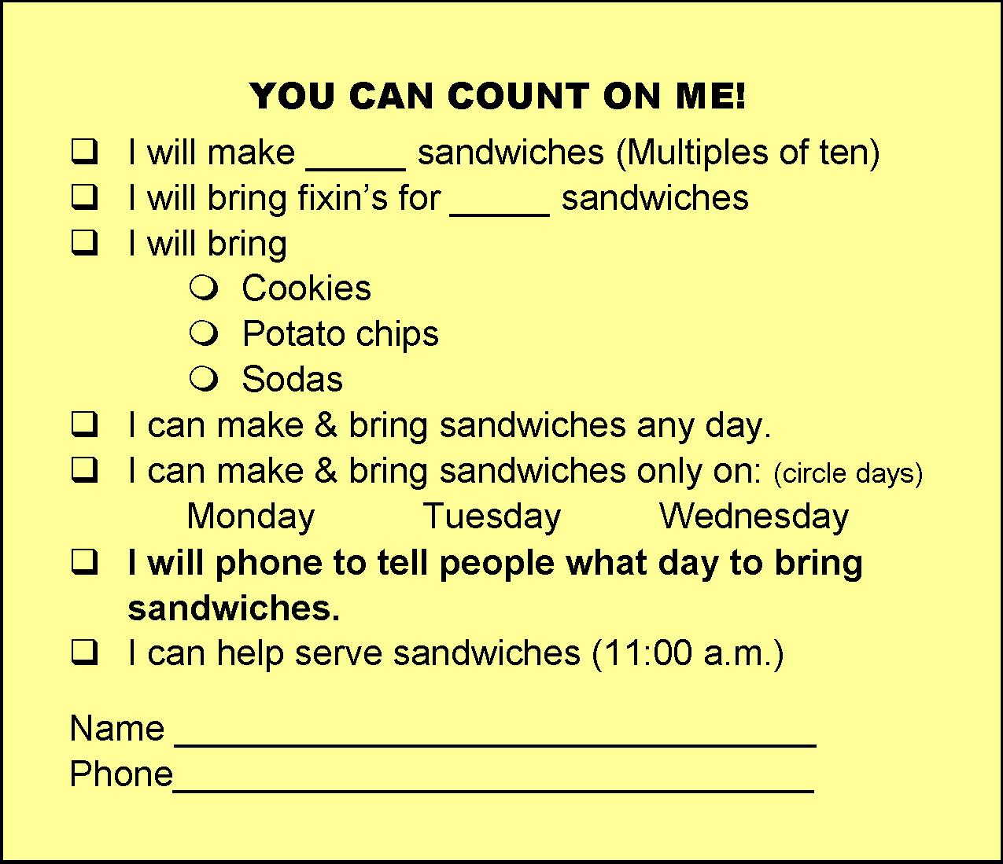
Immediate Opportunity: The Applications
Your full participation in & attendance at the Meeting
Your prayers
Your help with & presence at meals
Your assistance with lunchtime sandwiches
Your encouragement of Neal Pollard
Mr. Neal Pollard
2414 S. Cody Court
Lakewood, CO 80227

Slide 10
Jesus’ Invitation to the Feast in Heaven
Believe Jesus is God’s Son – Mark 16:16
Repent of your sins – Luke 13:3
Confess your faith in Jesus – Matthew 10:32
Be immersed in water – John 3:5
Your sins will be washed away – Acts 22:16
God will add you to His church – Acts 2:47
God will write your name in heaven – Hebrews 12:23
Serve at His table faithfully for life – 1 John 1:7

