Slide 1
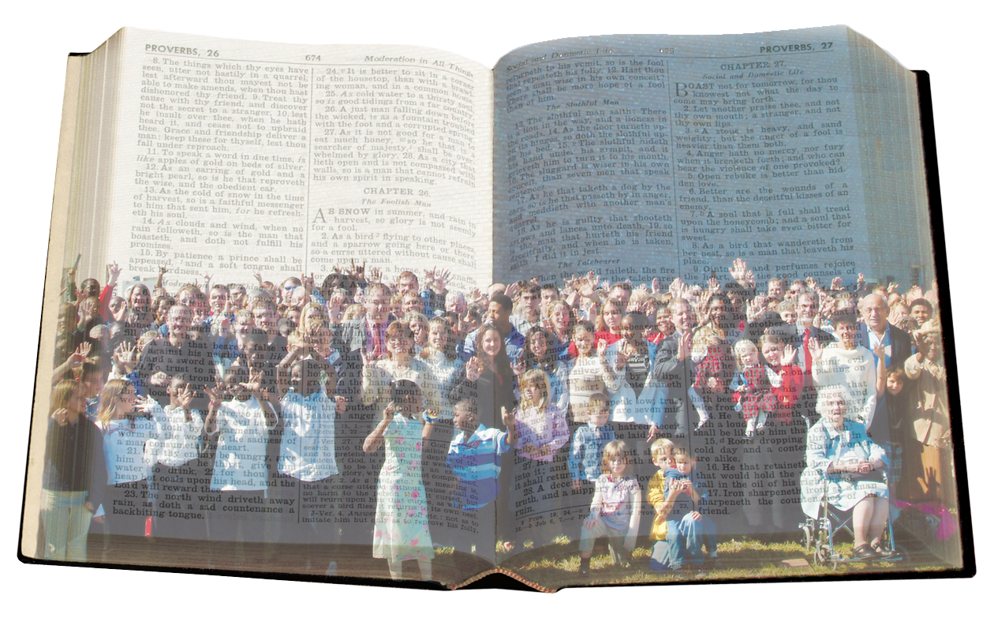
Bear
One Another’s
Burdens
Galatians 6:1-5

Slide 2
Brotherly Problem:
Trespasses & Burdens
We All Have Burdens!
Galatians 6:2 – others
Galatians 6:1, 5 – we ourselves
We All Have Different Burdens!
Verse 2 – “burden” (baros) – heaviness, weight, something that is particularly oppressive
These are burdens we need help in order to bear.
Verse 5 – “load/burden” (phortion) – a load for transport which is carried; used for the soldier’s pack he carried
These burdens/loads are more manageable and/or cannot possibly be shared (cf. Matt. 11:30).

Slide 3
Brotherly Problem:
Trespasses & Burdens
We All Have the Same Burden!
1 Brethren, if a man is overtaken in any trespass, you who are spiritual restore such a one in a spirit of gentleness, considering yourself lest you also be tempted.
2 Bear one another's burdens, and so fulfill the law of Christ.
Our most devastating burden weighing us down = SIN!
Can enslave us (John 8:34) & lead to death (Rom. 6:23)
Deceives us that all is good & safe (cf. Gal. 6:3-4, 7-8)
Can overtake us & catch us off guard (Gal. 6:1)
Can cause even a Christian to be lost (2 Pet. 2:20-22)
The works of the flesh are in this same context (5:19-21)

Slide 4
Brotherly Responsibility:
Restore & Bear
Restore Such a One!
“Restore” (katartizo)
“Put again into order; restore to former condition; make complete; put into a condition to function well”
Translated: “mending nets” (Matt. 4:21); “perfectly joined together” (1 Cor. 1:10)
Medical term – surgeon setting a fractured bone
Present tense imperative – urgent, continuous, repeated efforts
A soul is at stake (James 5:19-20 ~ Gal. 6:1)!
If we restore, we “gain our brother” (Matt. 18:15).

Slide 5
Brotherly Responsibility:
Restore & Bear
Bear His Burdens!
“Bear” (bastazo)
“pick up, carry, endure” – present tense imperative
“Restore & Bear”
These words have special meaning to a body
Broken bone receives immediate & careful attention
Rest of the body picks up, carries, supports, compensates
What if the body of Christ was as concerned for the body as one broken arm is for another broken arm?
One overtaken in sin experiences the guilt, pain, sorrow, stress & overload of sin.
Our Goal: Help relieve & bear the burden of our brother.

Slide 6
Brotherly Responsibility:
Restore & Bear
Bear His Burdens!
Keep your eyes open to situations! – Phil. 2:4
Go to them in private! – Matt. 18:15
Use Scripture to identify & convict of sin! – 2 Tim. 3:16
Encourage them to repent! – Acts 8:22
Pray with them! – James 5:16
Urge them to not give up! – Heb. 3:13; 1 Thess. 5:14
Warn them of consequences! – 2 Th. 3:15; 1 Th. 5:14
Compel to do right & prioritize! – Heb. 10:24; Mt. 6:33
Point them back to Jesus! – Heb. 12:1-2; Phil. 4:13
Refresh their appreciation for the cross! – Rom. 5:6-10

Slide 7
Brotherly Responsibility:
Restore & Bear
Bear His Burdens!
Remind them of heaven! – 1 Thess. 4:17-18; Phil. 3:20
Emphasize the riches of God’s love! – Eph. 2:4-5
Persuade to avoid temptations! – 1 Pe. 2:11; 1 Th. 5:22
Convince them to forgive themselves! – 1 Jn. 1:9
Be a Barnabas: Give for their good! – Acts 4:36-37
Be a Barnabas: Stand in the gap! – Acts 9:26-27
Be a Barnabas: Encourage to remain true! – Acts 11:23
Be a Barnabas: Be a steady companion! – Acts 11:30…
Put their needs even above your own! – Phil. 2:3-4
Always be there for them! – Ecc. 4:9-12

Slide 8
Brotherly Responsibility:
Restore & Bear
Whose Responsibility Is It?
“Brethren” – Gal. 6:1
“Ye” (plural) – Gal. 6:1
“Spiritual” – Gal. 6:1
“Walk in the Spirit…the Spirit [lusts] against the flesh… led by the Spirit….the fruit of the Spirit is love, joy, peace, longsuffering, kindness, goodness, faithfulness, gentleness, self-control…If we live in the Spirit, let us also walk in the Spirit…Brethren, if a man is overtaken in any trespass, you who are spiritual…he who sows to the Spirit will of the Spirit reap everlasting life” (Gal. 5:16, 17, 18, 22, 25; 6:1, 8).
“One Another” (reciprocal pronoun) – Gal. 6:2
Each one helping every one – mutual responsibility

Slide 9
Brotherly Attitude:
Love & Gentleness
The Wrong Attitude
“Let us not…
become conceited,
provoking one another,
envying one another” (Gal. 5:26).
“For if anyone thinks himself…
to be something,
when he is nothing,
he deceives himself” (Gal. 6:3).

Slide 10
Brotherly Attitude:
Love & Gentleness
Gentleness
“Restore such a one in a spirit of gentleness.”
The gentleness of a surgeon setting a broken bone
Sympathetically pick them up, gently help to move them, put them back in the right position, surround them with protection so they can heal
2 Timothy 2:24-26

Slide 11
Brotherly Attitude:
Love & Gentleness
Humility & Caution
“Considering yourself lest you also be tempted.”
No Christian is above temptation
Take heed to your own life & susceptibility to temptation (cf. 1 Cor. 10:12; 2 Pet. 3:17)
You are just as susceptible to sin as your brother is; thus, you need to treat your brother accordingly.
“If anyone thinks himself to be something, when he is nothing, he deceives himself.”
Must not compare ourselves to others (cf. 2 Cor. 10:12)
“Let each one examine his own work, and then he will have rejoicing in himself alone, and not in another” (Gal. 6:4).
Compare ourselves only to Christ (2 Cor. 3:18; 10:18)

Slide 12
Brotherly Attitude:
Love & Gentleness
Devotion to Law & Love
“Bear one another's burdens, and so fulfill the law of Christ” (Gal. 6:2).
We are under the law of Christ
“…Through love serve one another” (Gal. 5:13).
“For all the law is fulfilled in one word, even in this: ‘You shall love your neighbor as yourself’” (Gal. 5:14).

Slide 13
Bearing One Another’s Burdens:
A Function of a Healthy Body
We’re part of a family, a body
What a glorious & unique relationship we share!
As “members of one another,” we need each other!
What a blessed privilege that we have each other!
Thank God for His church, the body of Christ!

Slide 14
God’s Plan to Forgive
Man’s Burden of Sin
Believe Jesus is God’s Son – Acts 16:31
Repent of sinful living – Acts 3:19
Confess faith in Jesus – Acts 8:36-38
Be baptized into Christ – Acts 2:38
Sins are forgiven – Acts 22:16
Added to His church – Acts 2:47
Registered in heaven – Hebrews 12:23
Serve Him faithfully until death – 1 Cor. 15:58

