Slide 1
An Overview of
Haggai, Zechariah & Malachi

Slide 2
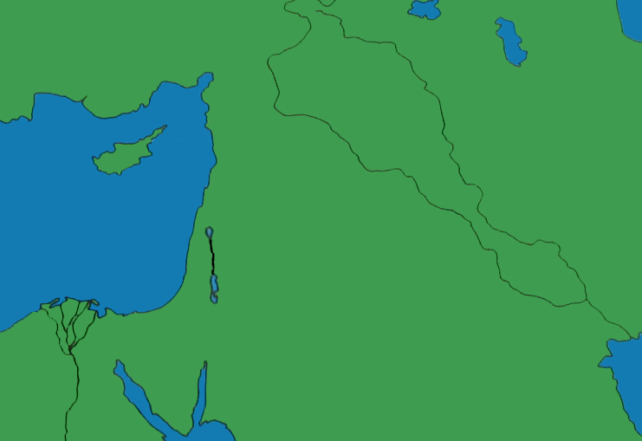
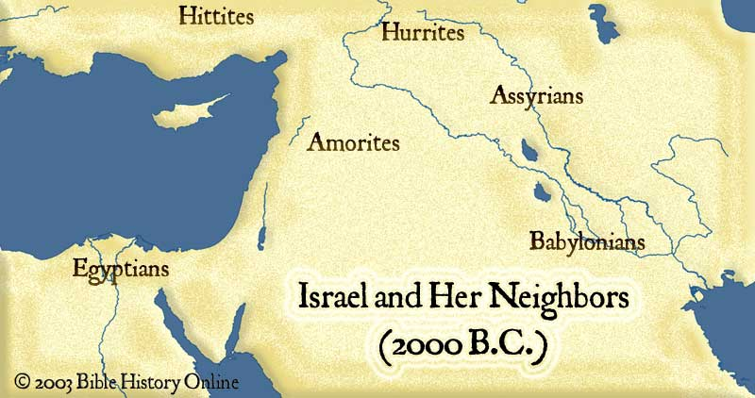
Haggai, Zechariah & Malachi
Nineveh
Jonah
Prophets to North
Hosea, Amos & Jonah
north
Hosea & Amos
Babylon
Daniel &
Ezekiel
South b/f North Fell
Isaiah & Micah
South b/f Fall
Nahum
Habakkuk
Zephaniah
Jeremiah
Unknown Time: Joel & Obadiah

Slide 3
An Overview of
Haggai, Zechariah & Malachi
Last 3 Books of History
Last 3 Books of Prophecy
Ezra
Nehemiah
Esther
Haggai
Zechariah
Malachi
Same Period of History

Slide 4
An Overview of
Haggai
Older prophet, likely returned with Zerubbabel
Prophesied for four months in 520 B.C.
The construction of the temple was idle for 16 yrs
But the people had taken care of their homes
Haggai & Zechariah prophesied (Ezra 5:1; 6:14)
Message of Haggai to the people of Israel:
Reorder your priorities!
“Consider your ways!” (1:1-7)
Rebuild the temple now!
“It is time!” (1:8-9, 12)
Completed in 4 years

Slide 5
An Overview of
Zechariah
Prophesied for two years (520-518 B.C.)
With Haggai, charged Israel to finish the temple
Haggai – more focused on practical side
Zechariah – more focused on spiritual side
Zechariah was a prophet & a priest (12:4)
Focused on two temples
The physical one that Israel needed to build
The spiritual one that God would build
8 Visions – Illustrating God’s providential care
Highly Messianic prophet, second only to Isaiah

Slide 6
An Overview of
Zechariah
8 Visions – Illustrating God’s providential care
The rider and the horses – 1:7-17
The four horns and four craftsmen – 1:18-21
The man with the measuring line – 2:1-13
The high priest, Joshua – 3:1-10
The gold lampstand & two olive trees – 4:1-14
The flying scroll – 5:1-4
The woman in a basket – 5:5-11
The four chariots – 6:1-8

Slide 7
An Overview of
Zechariah
Highly Messianic prophet, second only to Isaiah
Christ will be God’s servant, the Branch – 3:8
He will remove iniquity – 3:9
He will build the temple/church – 6:12
He will be King & Priest on His throne – 6:13
He will ride into Jerusalem on a donkey – 9:9
He will be a king who reigns from sea to sea – 9:10
He will be a shepherd – 9:16; 11:11
He will be a smitten shepherd – 13:7
He will be betrayed for 30 pcs of silver – 11:12-13
He will be pierced – 12:20
He will be a fountain of salvation – 13:1
He will be wounded in the house of friends – 13:6

Slide 8
An Overview of
Zechariah
Message of Zechariah to the people of Israel:
You rebuild the temple!
God will build His temple!
And, He shall rule! (14:9)

Slide 9
An Overview of
Malachi
Contemporary with Nehemiah (440-420 B.C.)
Last of the prophets, before 400 years of silence
The people had grown to be spiritually indifferent and morally lax
Message of Malachi to the people of Israel:
Return to holy living!
God expects and demands the very best!
The Messiah is coming!

Slide 10
An Overview of
Malachi
Main highlights found at “yet you say”:
God still loves His people (1:2-3)
God expects His name to be honored (1:6-8)
God expects faithfulness in marriage (2:13-16)
God expects a proper view of evil/son (2:17)
God expects repentance from straying (3:7)
God expects sacrificial giving (3:8-10)
God expects true service for His profit (3:13-15)
God would send Elijah & the Messiah (3:1; 4:5)
Lest He strike the earth with a curse – 4:6

Slide 11
An Overview of
God’s Plan of Salvation
Believe Jesus is God’s Son – Mark 16:16
Repent of sinful living – 2 Peter 3:9
Confess your faith in Jesus – Romans 10:9-10
Be immersed into Christ – Galatians 3:26-27
Sins are washed away – Acts 22:16
Added to the Lord’s church – Acts 2:47
Name is written in heaven – Hebrews 12:23
Serve the Lord faithfully – 1 Corinthians 15:58

