Slide 1
The End of Judah
Fall of Samaria—Fall of Jerusalem
2 Chron. 36:15-21

Slide 2
15 And the LORD God of their fathers sent warnings to them by His messengers, rising up early and sending them, because He had compassion on His people and on His dwelling place.
16 But they mocked the messengers of God, despised His words, and scoffed at His prophets, until the wrath of the LORD arose against His people, till there was no remedy.
17 Therefore He brought against them the king of the Chaldeans, who killed their young men with the sword in the house of their sanctuary, and had no compassion on young man or virgin, on the aged or the weak; He gave them all into his hand.
18 And all the articles from the house of God, great and small, the treasures of the house of the LORD,

Slide 3
and the treasures of the king and of his leaders, all these he took to Babylon.
19 Then they burned the house of God, broke down the wall of Jerusalem, burned all its palaces with fire, and destroyed all its precious possessions.
20 And those who escaped from the sword he carried away to Babylon, where they became servants to him and his sons until the rule of the kingdom of Persia,
21 to fulfill the word of the LORD by the mouth of Jeremiah, until the land had enjoyed her Sabbaths. As long as she lay desolate she kept Sabbath, to fulfill seventy years.
2 Chron . 36:15-21

Slide 4
  Historical Background
    Exodus—Moses

Slide 5
  Historical Background
    Exodus—Moses
    Capturing Promised Land—Joshua

Slide 6
  Historical Background
    Exodus—Moses
    Capturing Promised Land—Joshua
    Judges—Ehud, Deborah, Gideon, Jephthah, Samson, Eli, Samuel

Slide 7
  Historical Background
    Exodus—Moses
    Capturing Promised Land—Joshua
    Judges—Ehud, Deborah, Gideon, Jephthah, Samson, Eli, Samuel
    United Kingdom—Saul, David & Solomon

Slide 8
  Historical Background
    Exodus—Moses
    Capturing Promised Land—Joshua
    Judges—Ehud, Deborah, Gideon, Jephthah, Samson, Eli, Samuel
    United Kingdom—Saul, David & Solomon
    Fall of Israel/Samaria—722 B.C.

Slide 9
  Historical Background
    Exodus—Moses
    Capturing Promised Land—Joshua
    Judges—Ehud, Deborah, Gideon, Jephthah, Samson, Eli, Samuel
    United Kingdom—Saul, David & Solomon
    Fall of Israel/Samaria—722 B.C.
    Hezekiah. king of Judah when Samaria Fell

Slide 10

Joshua
2 Kings Tells About
The Fall of Israel & Judah

Slide 11
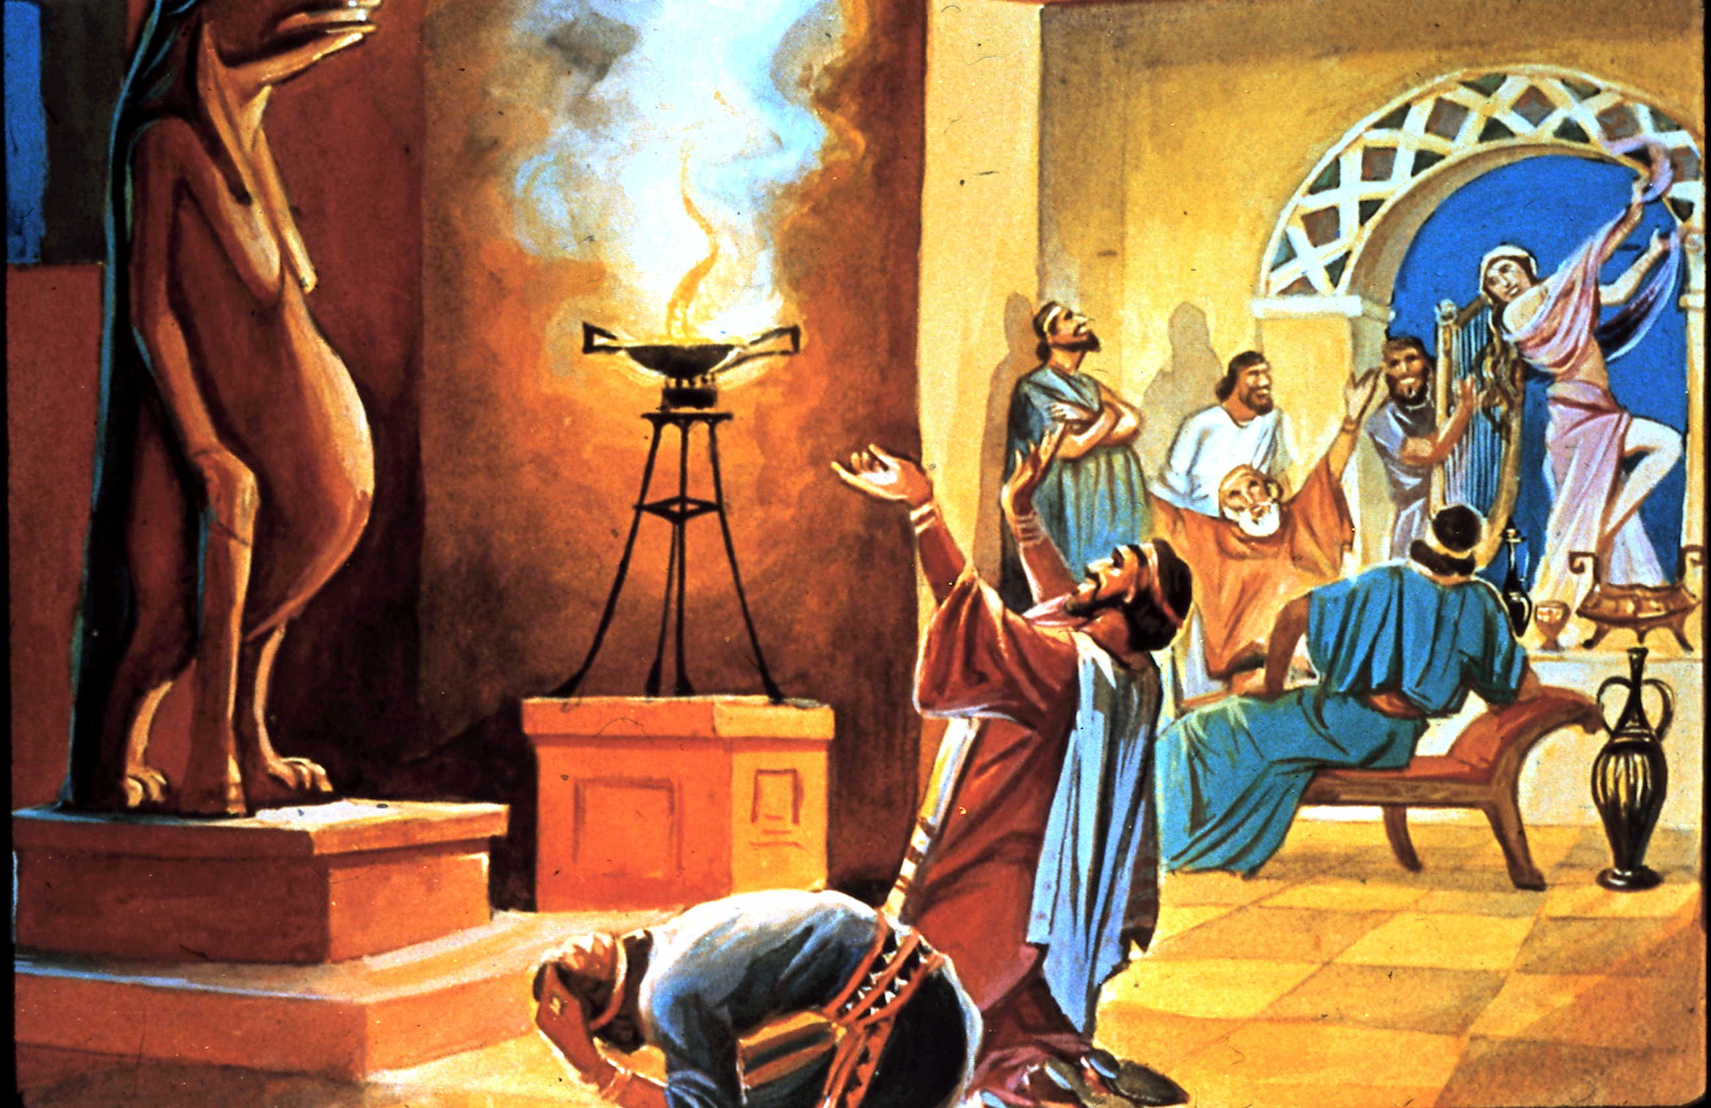
Reason God Gave That His
People (in Israel) Would Be
Taken Captive
Leaving the Commandments of God & Turning to Idolatry

Slide 12
  From Hezekiah to Fall of Jerusalem
    Hezekiah—Life extended 15 years

Slide 13
  From Hezekiah to Fall of Jerusalem
    Hezekiah—Life extended 15 years
    Manasseh—reigned 55 evil years

Slide 14
  From Hezekiah to Fall of Jerusalem
    Hezekiah—Life extended 15 years
    Manasseh—reigned 55 evil years
    Amon—reigned 2 evil years

Slide 15
  From Hezekiah to Fall of Jerusalem
    Hezekiah—Life extended 15 years
    Manasseh—reigned 55 evil years
    Amon—reigned 2 evil years
    Josiah—reigned 31 good years

Slide 16
  From Hezekiah to Fall of Jerusalem
    Hezekiah—Life extended 15 years
    Manasseh—reigned 55 evil years
    Amon—reigned 2 evil years
    Josiah—reigned 31 good years
      Discovery of the Bible—8th year of his reign

Slide 17
  From Hezekiah to Fall of Jerusalem
    Hezekiah—Life extended 15 years
    Manasseh—reigned 55 evil years
    Amon—reigned 2 evil years
    Josiah—reigned 31 good years
      Discovery of the Bible—8th year of his reign
      Restoration of Judaism

Slide 18
  From Hezekiah to Fall of Jerusalem
    Hezekiah—Life extended 15 years
    Manasseh—reigned 55 evil years
    Amon—reigned 2 evil years
    Josiah—reigned 31 good years
    Jehoahaz—3 evil months

Slide 19
  From Hezekiah to Fall of Jerusalem
    Hezekiah—Life extended 15 years
    Manasseh—reigned 55 evil years
    Amon—reigned 2 evil years
    Josiah—reigned 31 good years
    Jehoahaz—3 evil months
    Jehoiakim—(Egypt)—11 evil years

Slide 20
  From Hezekiah to Fall of Jerusalem
    Hezekiah—Life extended 15 years
    Manasseh—reigned 55 evil years
    Amon—reigned 2 evil years
    Josiah—reigned 31 good years
    Jehoahaz—3 evil months
    Jehoiakim—(Egypt)—11 evil years
      Daniel, S. M. & A. taken to Babylon

Slide 21
  From Hezekiah to Fall of Jerusalem
    Hezekiah—Life extended 15 years
    Manasseh—reigned 55 evil years
    Amon—reigned 2 evil years
    Josiah—reigned 31 good years
    Jehoahaz—3 evil months
    Jehoiakim—(Egypt)—11 evil years
      Daniel, S. M. & A. taken to Babylon
      Burned the Bible—Jeremiah 36

Slide 22
  From Hezekiah to Fall of Jerusalem
    Hezekiah—Life extended 15 years
    Manasseh—reigned 55 evil years
    Amon—reigned 2 evil years
    Josiah—reigned 31 good years
    Jehoahaz—3 evil months
    Jehoiakim—(Egypt)—11 evil years
    Jehoiachin—(Neb.)—3 evil months

Slide 23
  From Hezekiah to Fall of Jerusalem
    Hezekiah—Life extended 15 years
    Manasseh—reigned 55 evil years
    Amon—reigned 2 evil years
    Josiah—reigned 31 good years
    Jehoahaz—3 evil months
    Jehoiakim—(Egypt)—11 evil years
    Jehoiachin—(Neb.)—3 evil months
      Also named Coniah-- Jer. 22:28-30 & Matt. 1:11

Slide 24
  From Hezekiah to Fall of Jerusalem
    Hezekiah—Life extended 15 years
    Manasseh—reigned 55 evil years
    Amon—reigned 2 evil years
    Josiah—reigned 31 good years
    Jehoahaz—3 evil months
    Jehoiakim—(Egypt)—11 evil years
    Jehoiachin—(Neb.)—3 evil months
      Also named Coniah-- Jer. 22:28-30 & Matt. 1:11
      Ezekiel to Babylon 5th year of his exile

Slide 25
  From Hezekiah to Fall of Jerusalem
    Hezekiah—Life extended 15 years
    Manasseh—reigned 55 evil years
    Amon—reigned 2 evil years
    Josiah—reigned 31 good years
    Jehoahaz—3 evil months
    Jehoiakim—(Egypt)—11 evil years
    Jehoiachin—(Neb.)—3 evil months
    Zedekiah—11 evil years

Slide 26
  From Hezekiah to Fall of Jerusalem
    Hezekiah—Life extended 15 years
    Manasseh—reigned 55 evil years
    Amon—reigned 2 evil years
    Josiah—reigned 31 good years
    Jehoahaz—3 evil months
    Jehoiakim—(Egypt)—11 evil years
    Jehoiachin—(Neb.)—3 evil months
    Zedekiah—11 evil years
    Fall of Jerusalem—586 B.C.

Slide 27
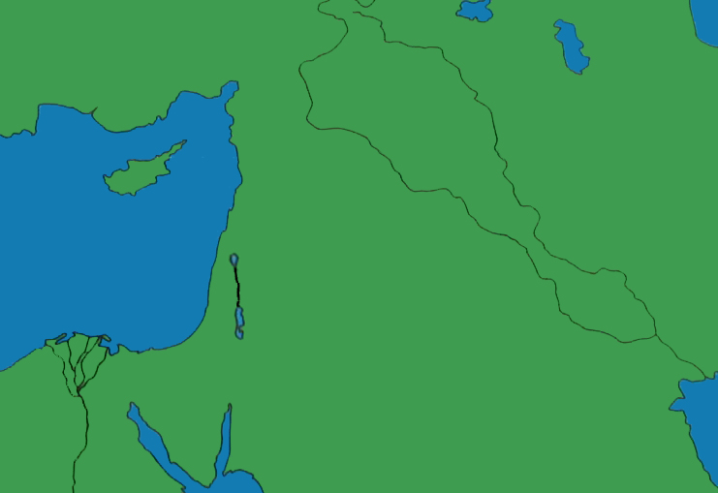
Nation That Destroyed & Took Captive the Southern Kingdom, Judah
Babylon

Slide 28
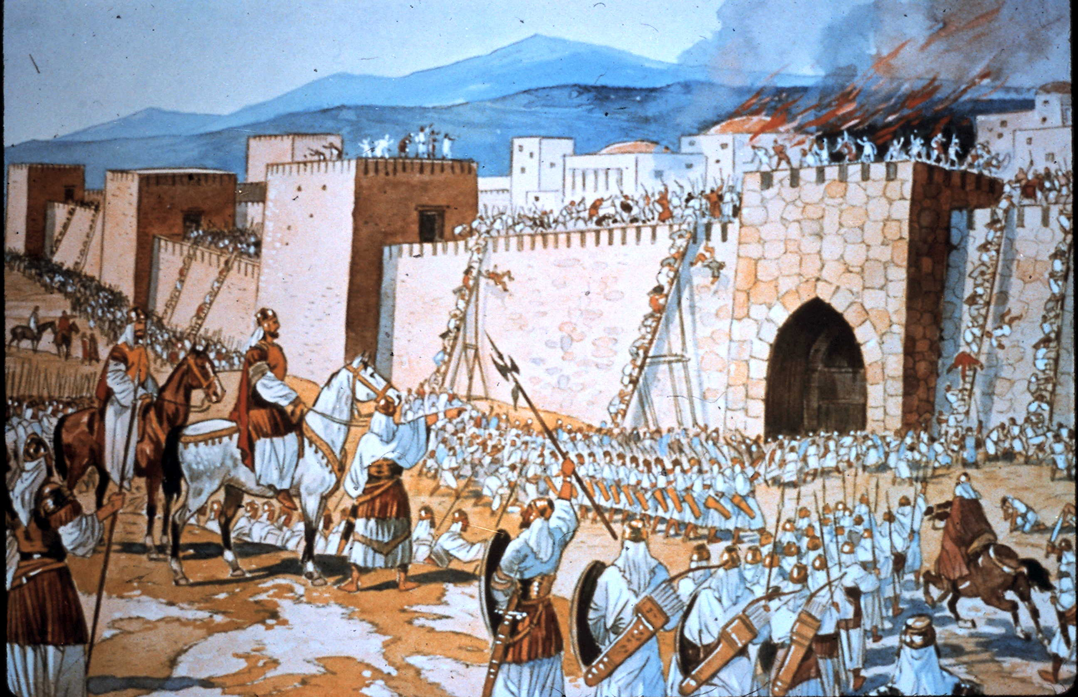

Slide 29
The King of Babylon
Who Conquered
Judah & Jerusalem
Nebuchadnezzar
(carried away three waves of captives in 606, 596 & 586 B.C.)

Slide 30
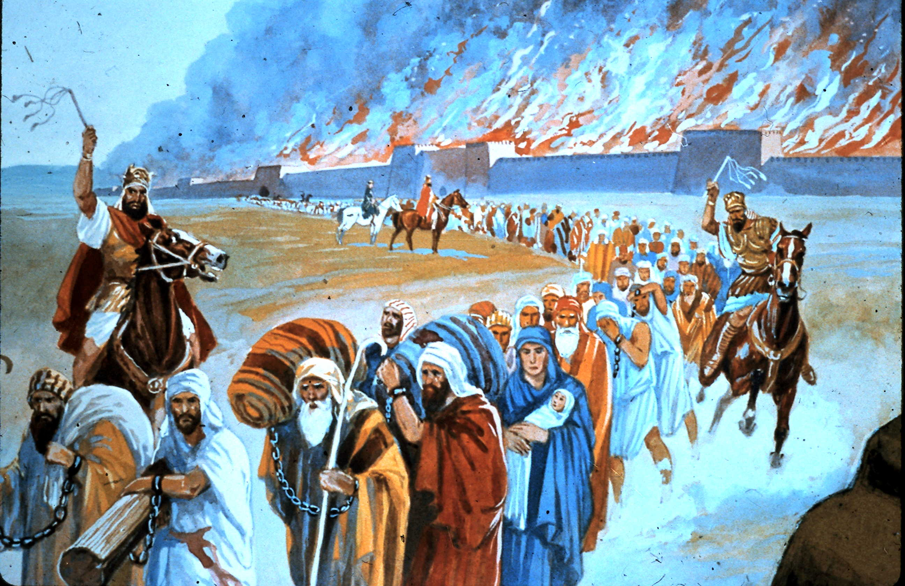
Taken By Nebuchadnezzar
(In Addition to Captives)
All of the Articles from the House of God, Great & Small

Slide 31
Date the Southern Kingdom Captured
606 B.C.
(Destroyed in 586 B.C.)

Slide 32
Leaving the Commandments of God & Turning to Idolatry
Reason the Southern Kingdom Fell

Slide 33
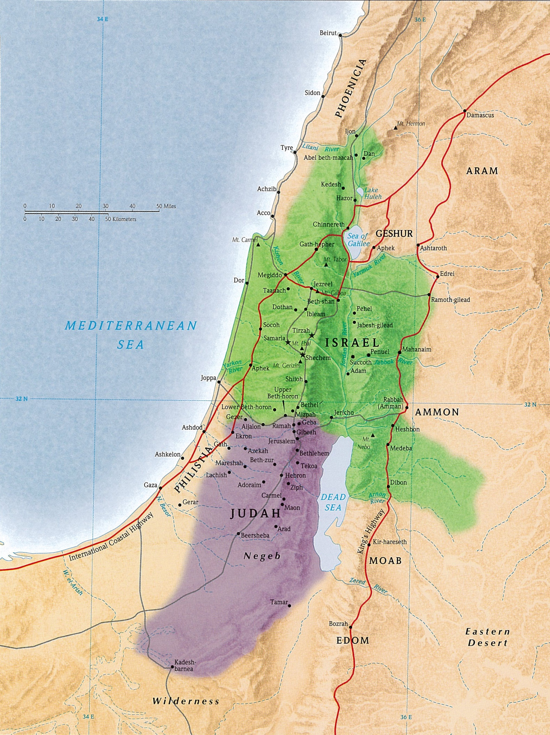
Writing Prophets to the Southern Kingdom Before the Northern Kingdom Fell
Isaiah & Micah
Writing Prophets to the Southern Kingdom Before It Fell
Nahum, Habakkuk, Zephaniah, Jeremiah
Writing Prophets of Unknown Time
Joel & Obadiah

Slide 34
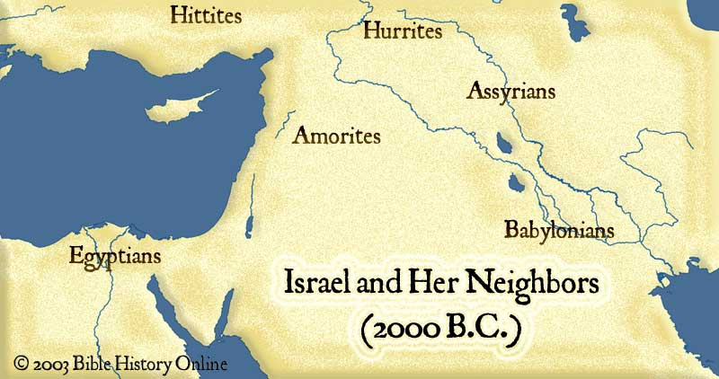
Haggai, Zechariah & Malachi
Nineveh
Jonah
Prophets to North
Hosea, Amos & Jonah
north
Hosea & Amos
Babylon
Daniel &
Ezekiel
South b/f North Fell
Isaiah & Micah
South b/f Fall
Nahum
Habakkuk
Zephaniah
Jeremiah
Unknown Time: Joel & Obadiah

Slide 35
His Plan for Your Salvation
  Believe in Him John 8:24
  Repent (yield to Him) Luke 13:3
  Confess Christ Matt. 10:32
  Baptized to be saved Acts 22:16
Added to His Kingdom, His Church
  Be faithful until death Rev. 2:10

