Slide 1
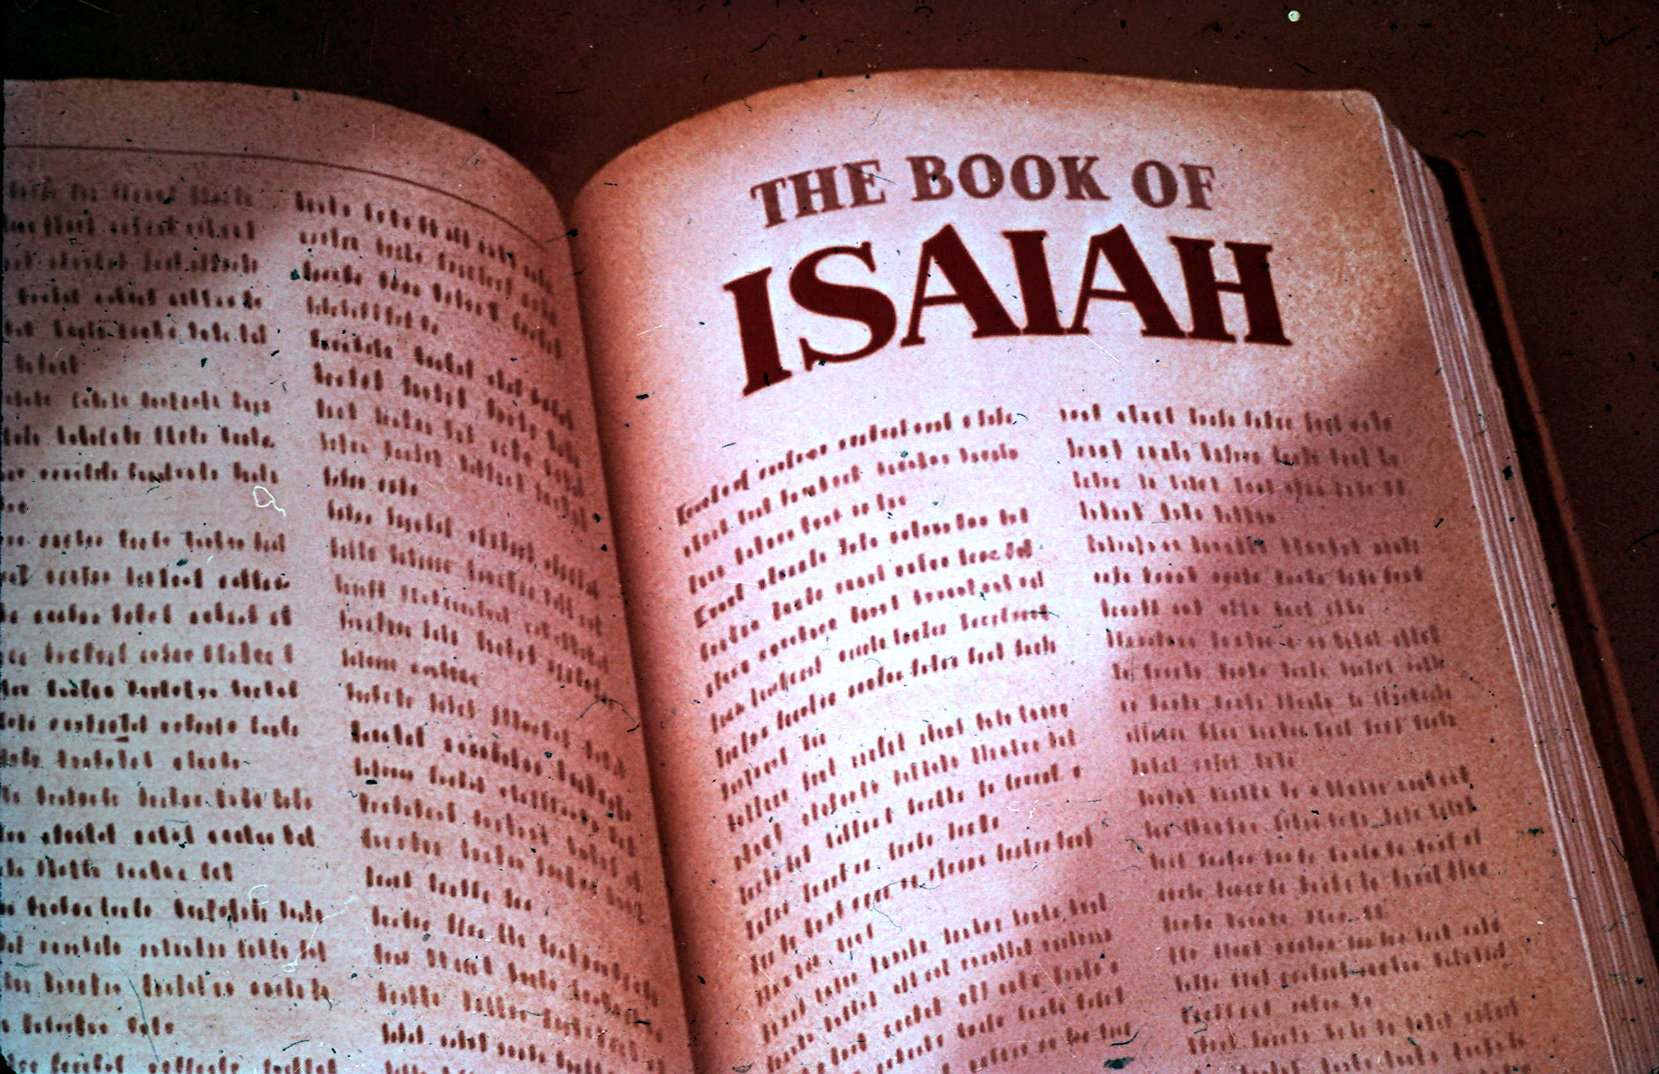
Messianic Prophet
Isaiah

Slide 2
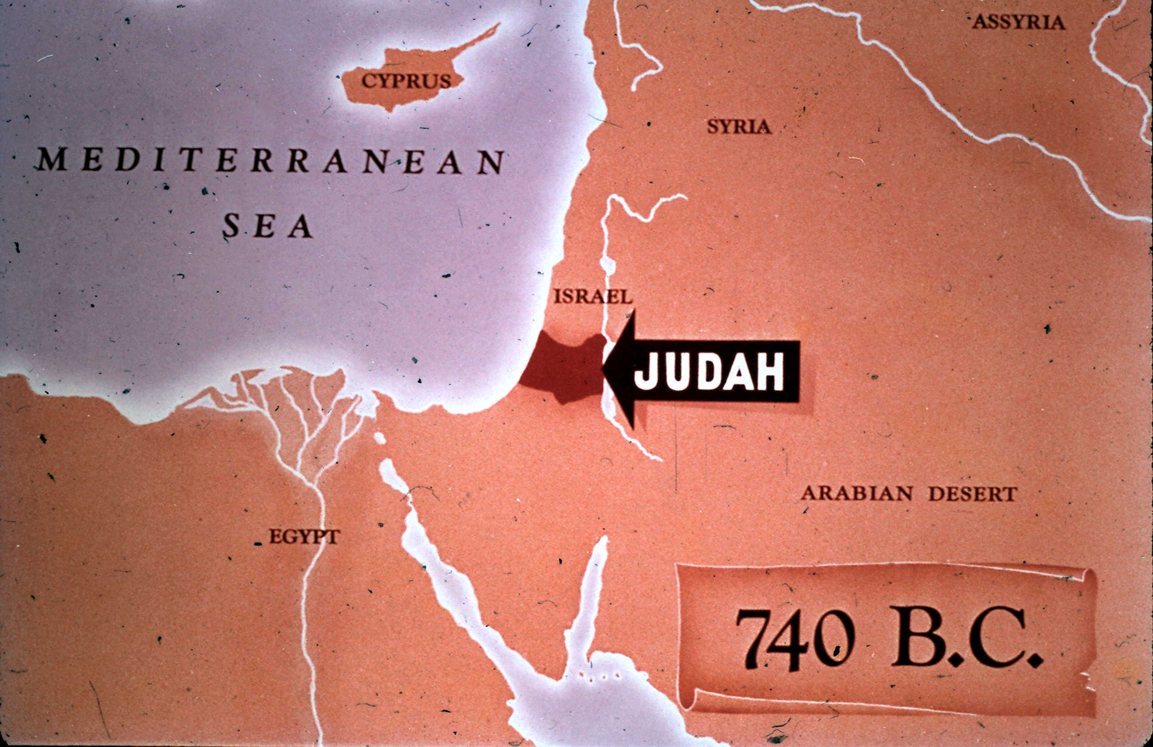
Isaiah Prophesied To
The Southern Kingdom, Judah (Before the Northern Kingdom Fell)

Slide 3
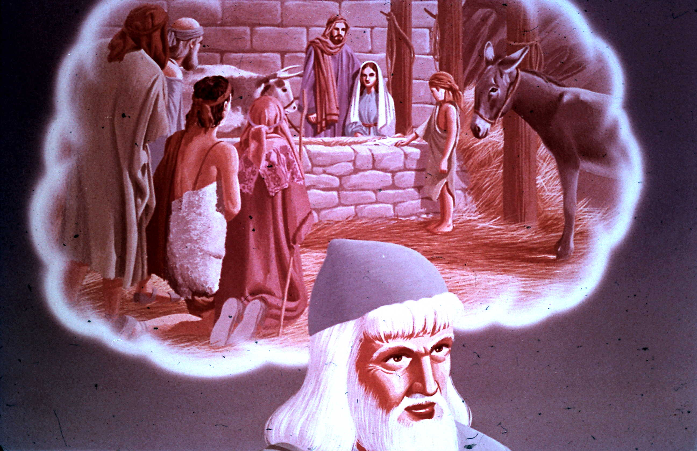
Four Names Given to Immanuel By Isaiah
"Wonderful Counselor, Mighty God, Everlasting Father, Prince of Peace"

Slide 4
Isaiah's Two Important Messianic Chapters
Isaiah 35 & 53

Slide 5
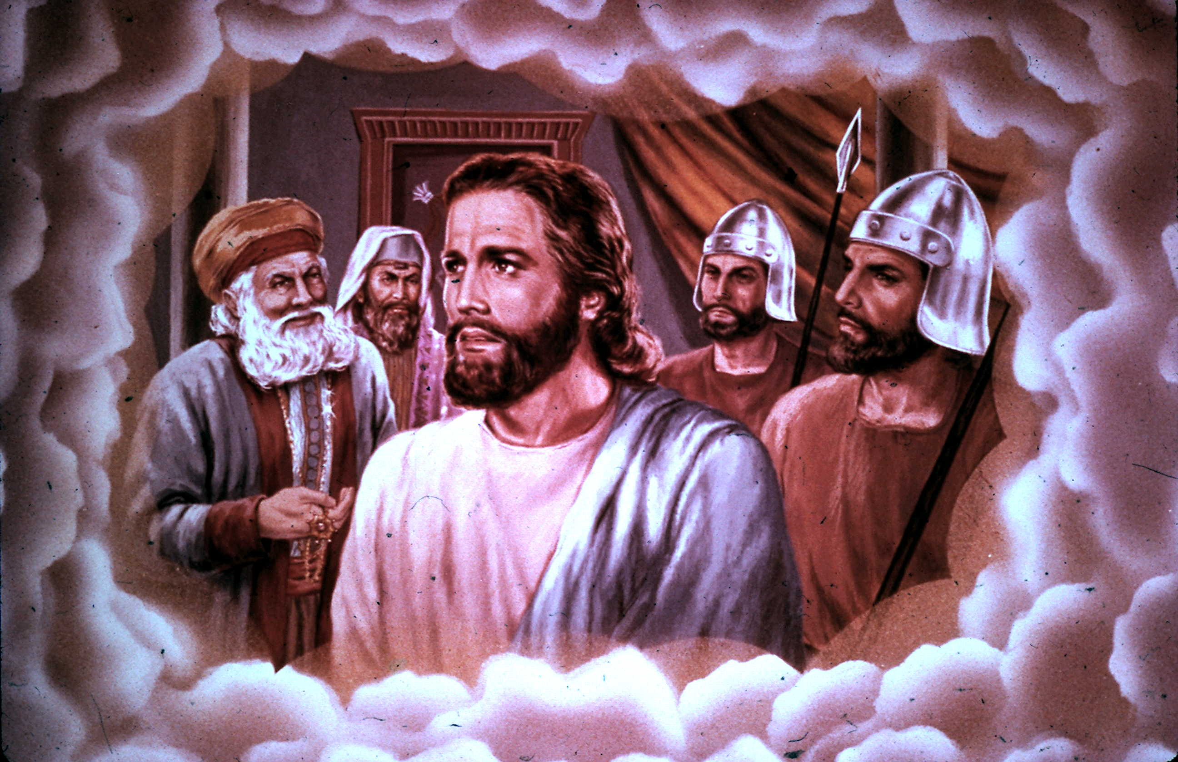
Isaiah 53:
The Suffering Messiah
Isaiah's Prophecy About the Suffering of Christ
Isaiah 53:1-12

Slide 6
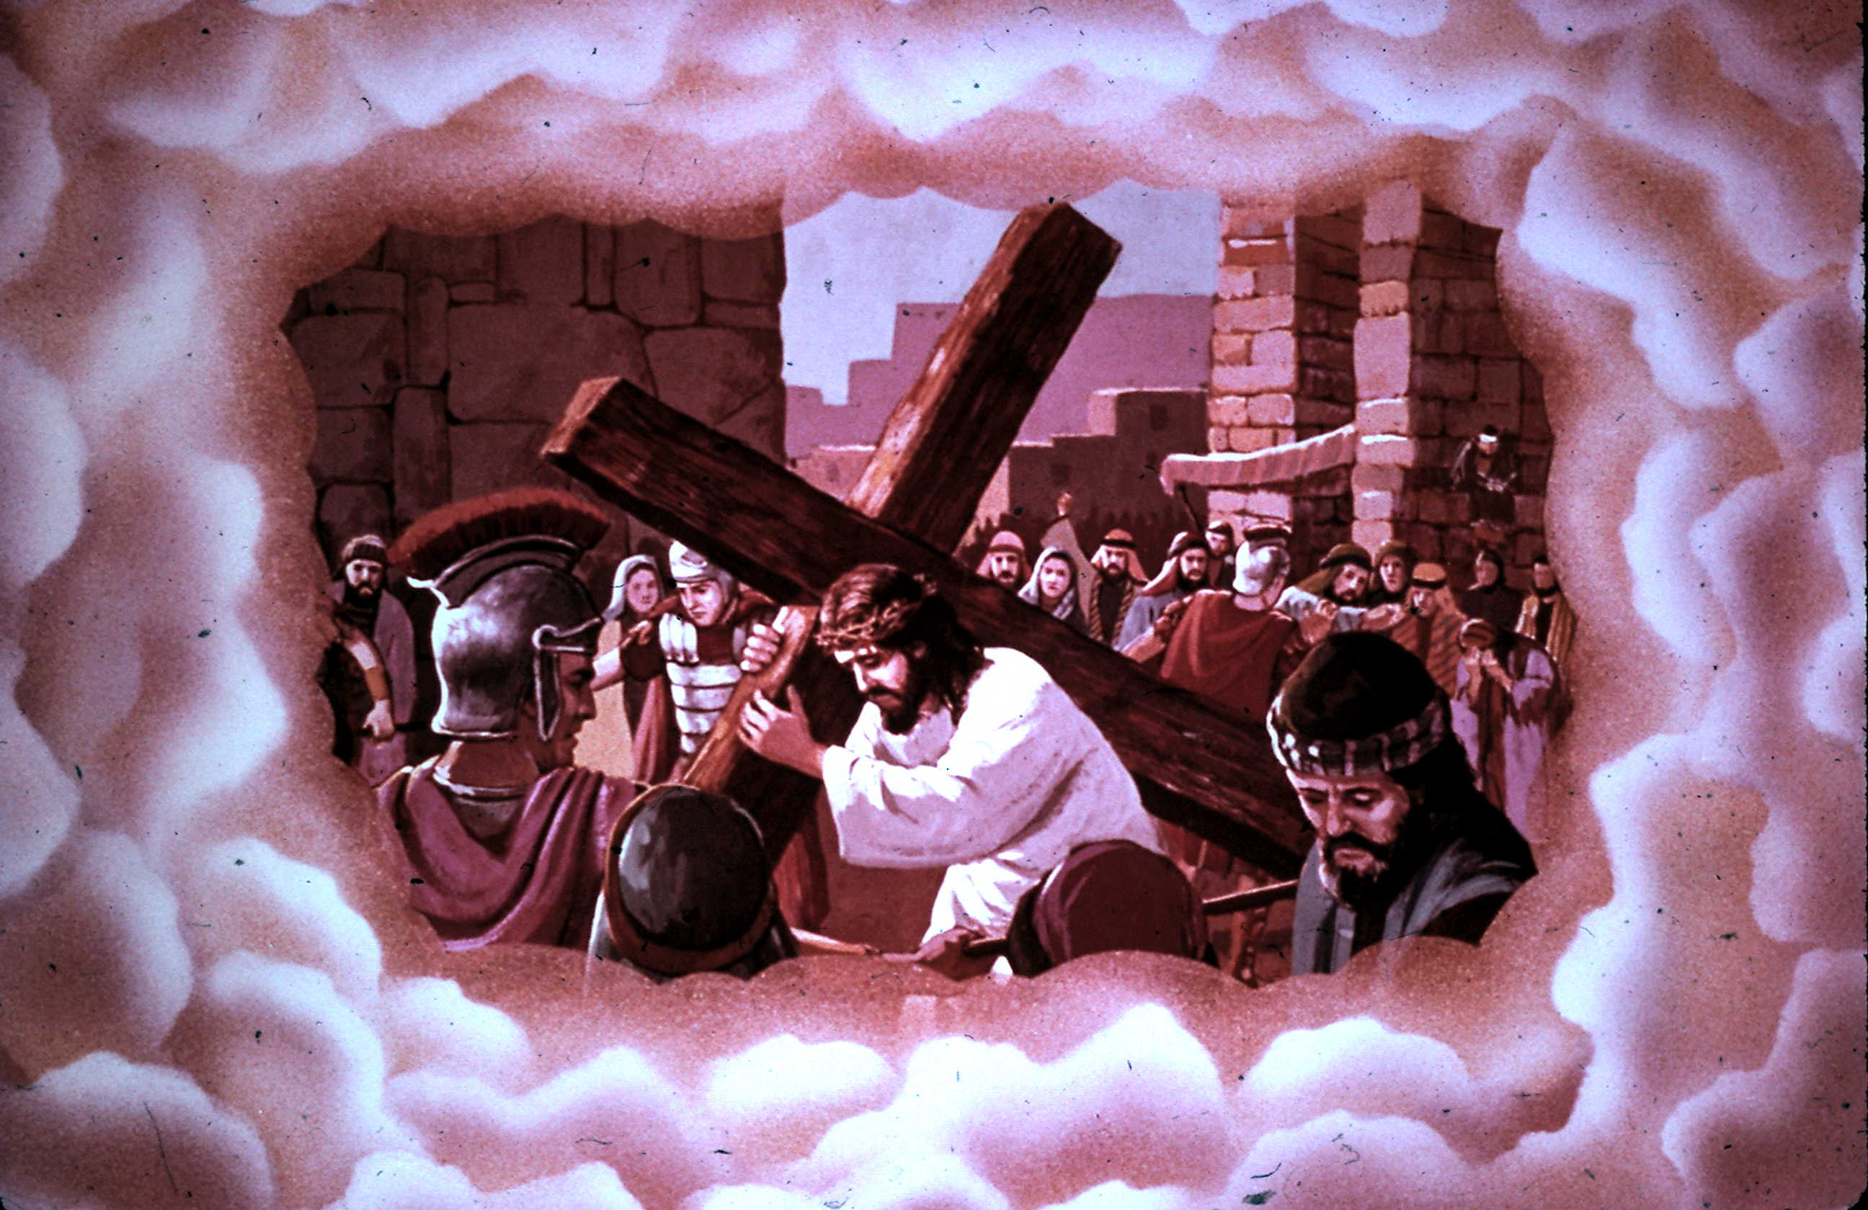
Three-Fold Description of Jesus in Isaiah 53
Man of Sorrows, Lamb of God,
Bearer of Man's Sins

Slide 7
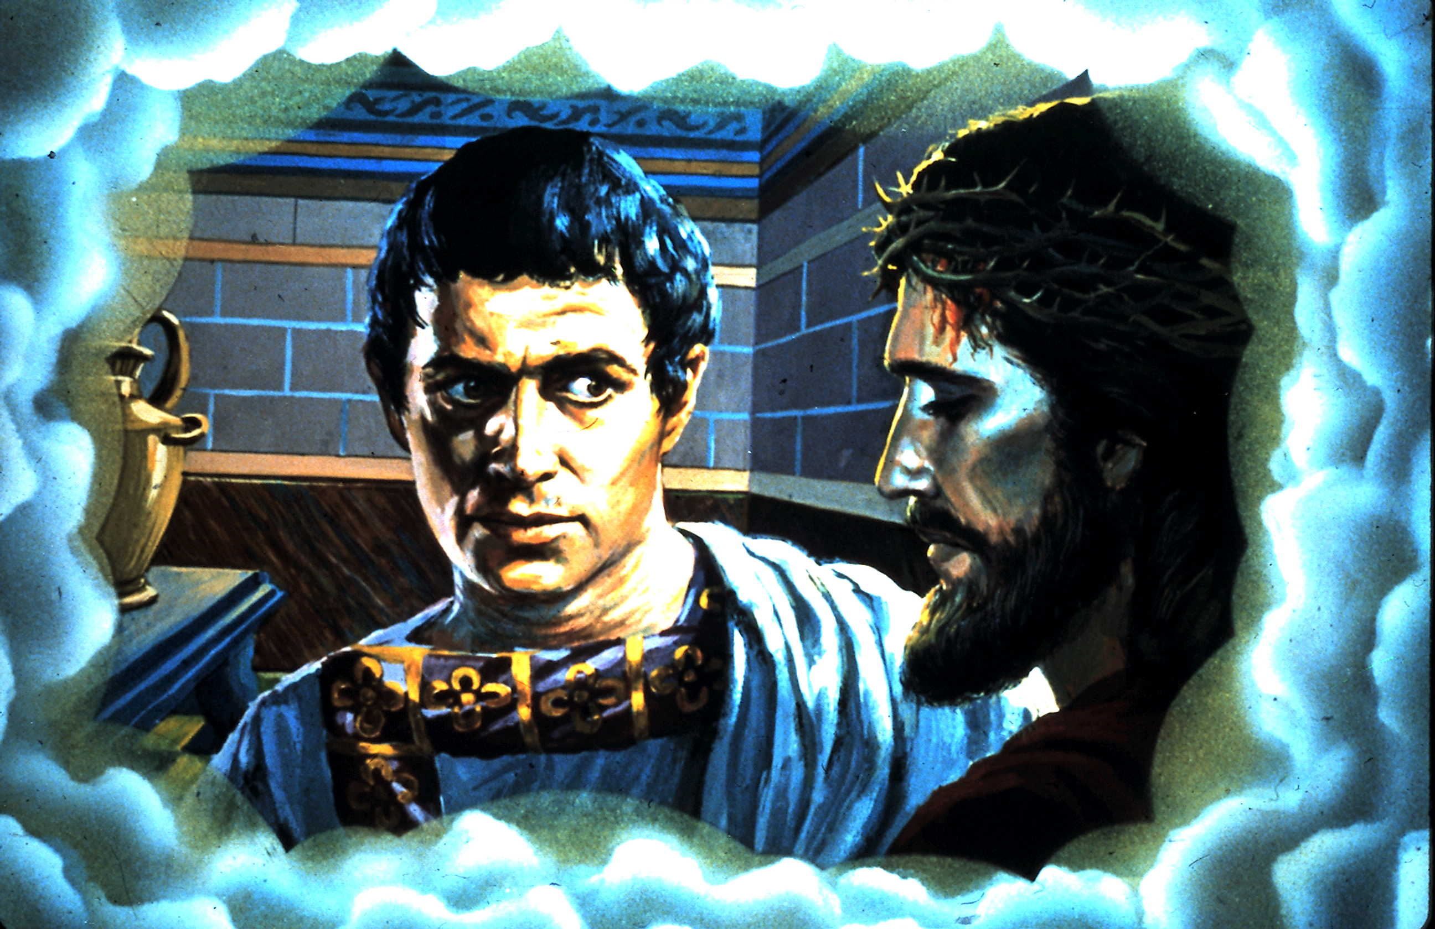
Isaiah 53:3-4:
“He is despised and rejected by men, A Man of sorrows and acquainted with grief. And we hid, as it were, our faces from Him; He was despised, and we did not esteem Him. Surely He has borne our griefs And carried our sorrows; Yet we esteemed Him stricken, Smitten by God, and afflicted.”

Slide 8
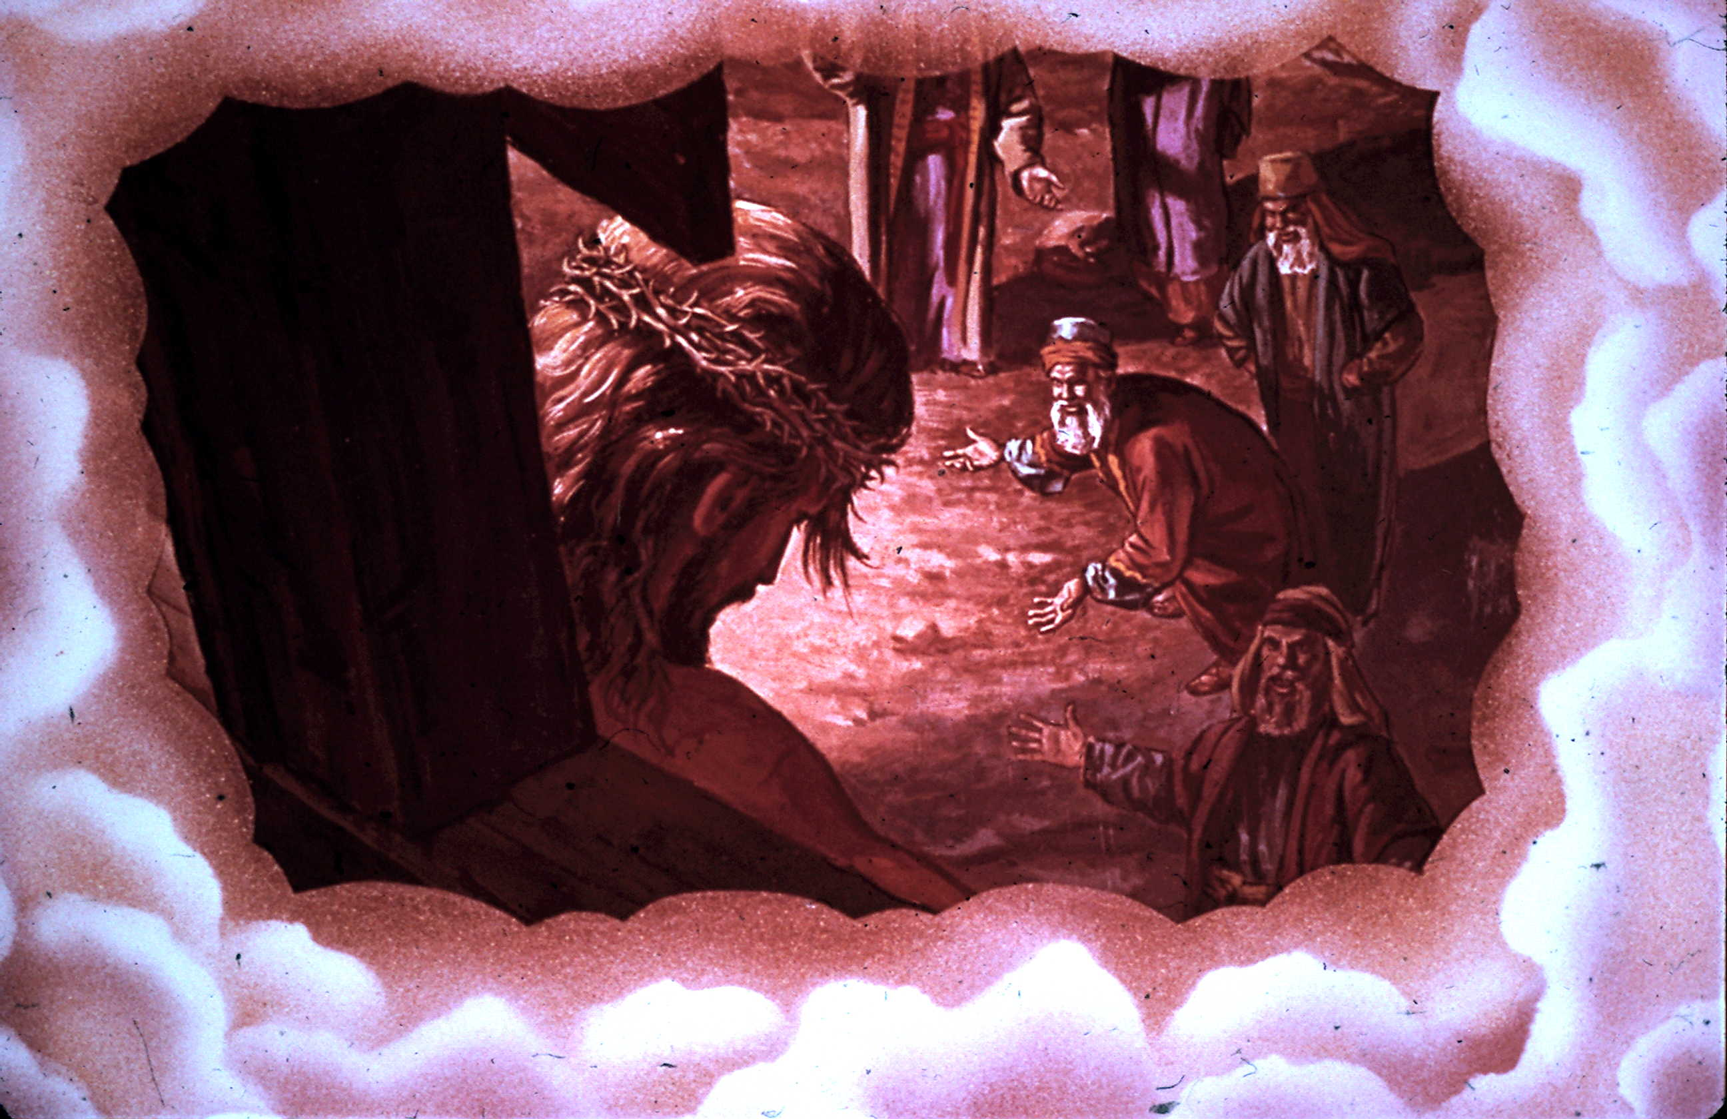
Isaiah 53:5-6:
“But He was wounded for our transgressions, He was bruised for our iniquities; The chastisement for our peace was upon Him, And by His stripes we are healed. All we like sheep have gone astray; We have turned, every one, to his own way; And the LORD has laid on Him the iniquity of us all.”

Slide 9
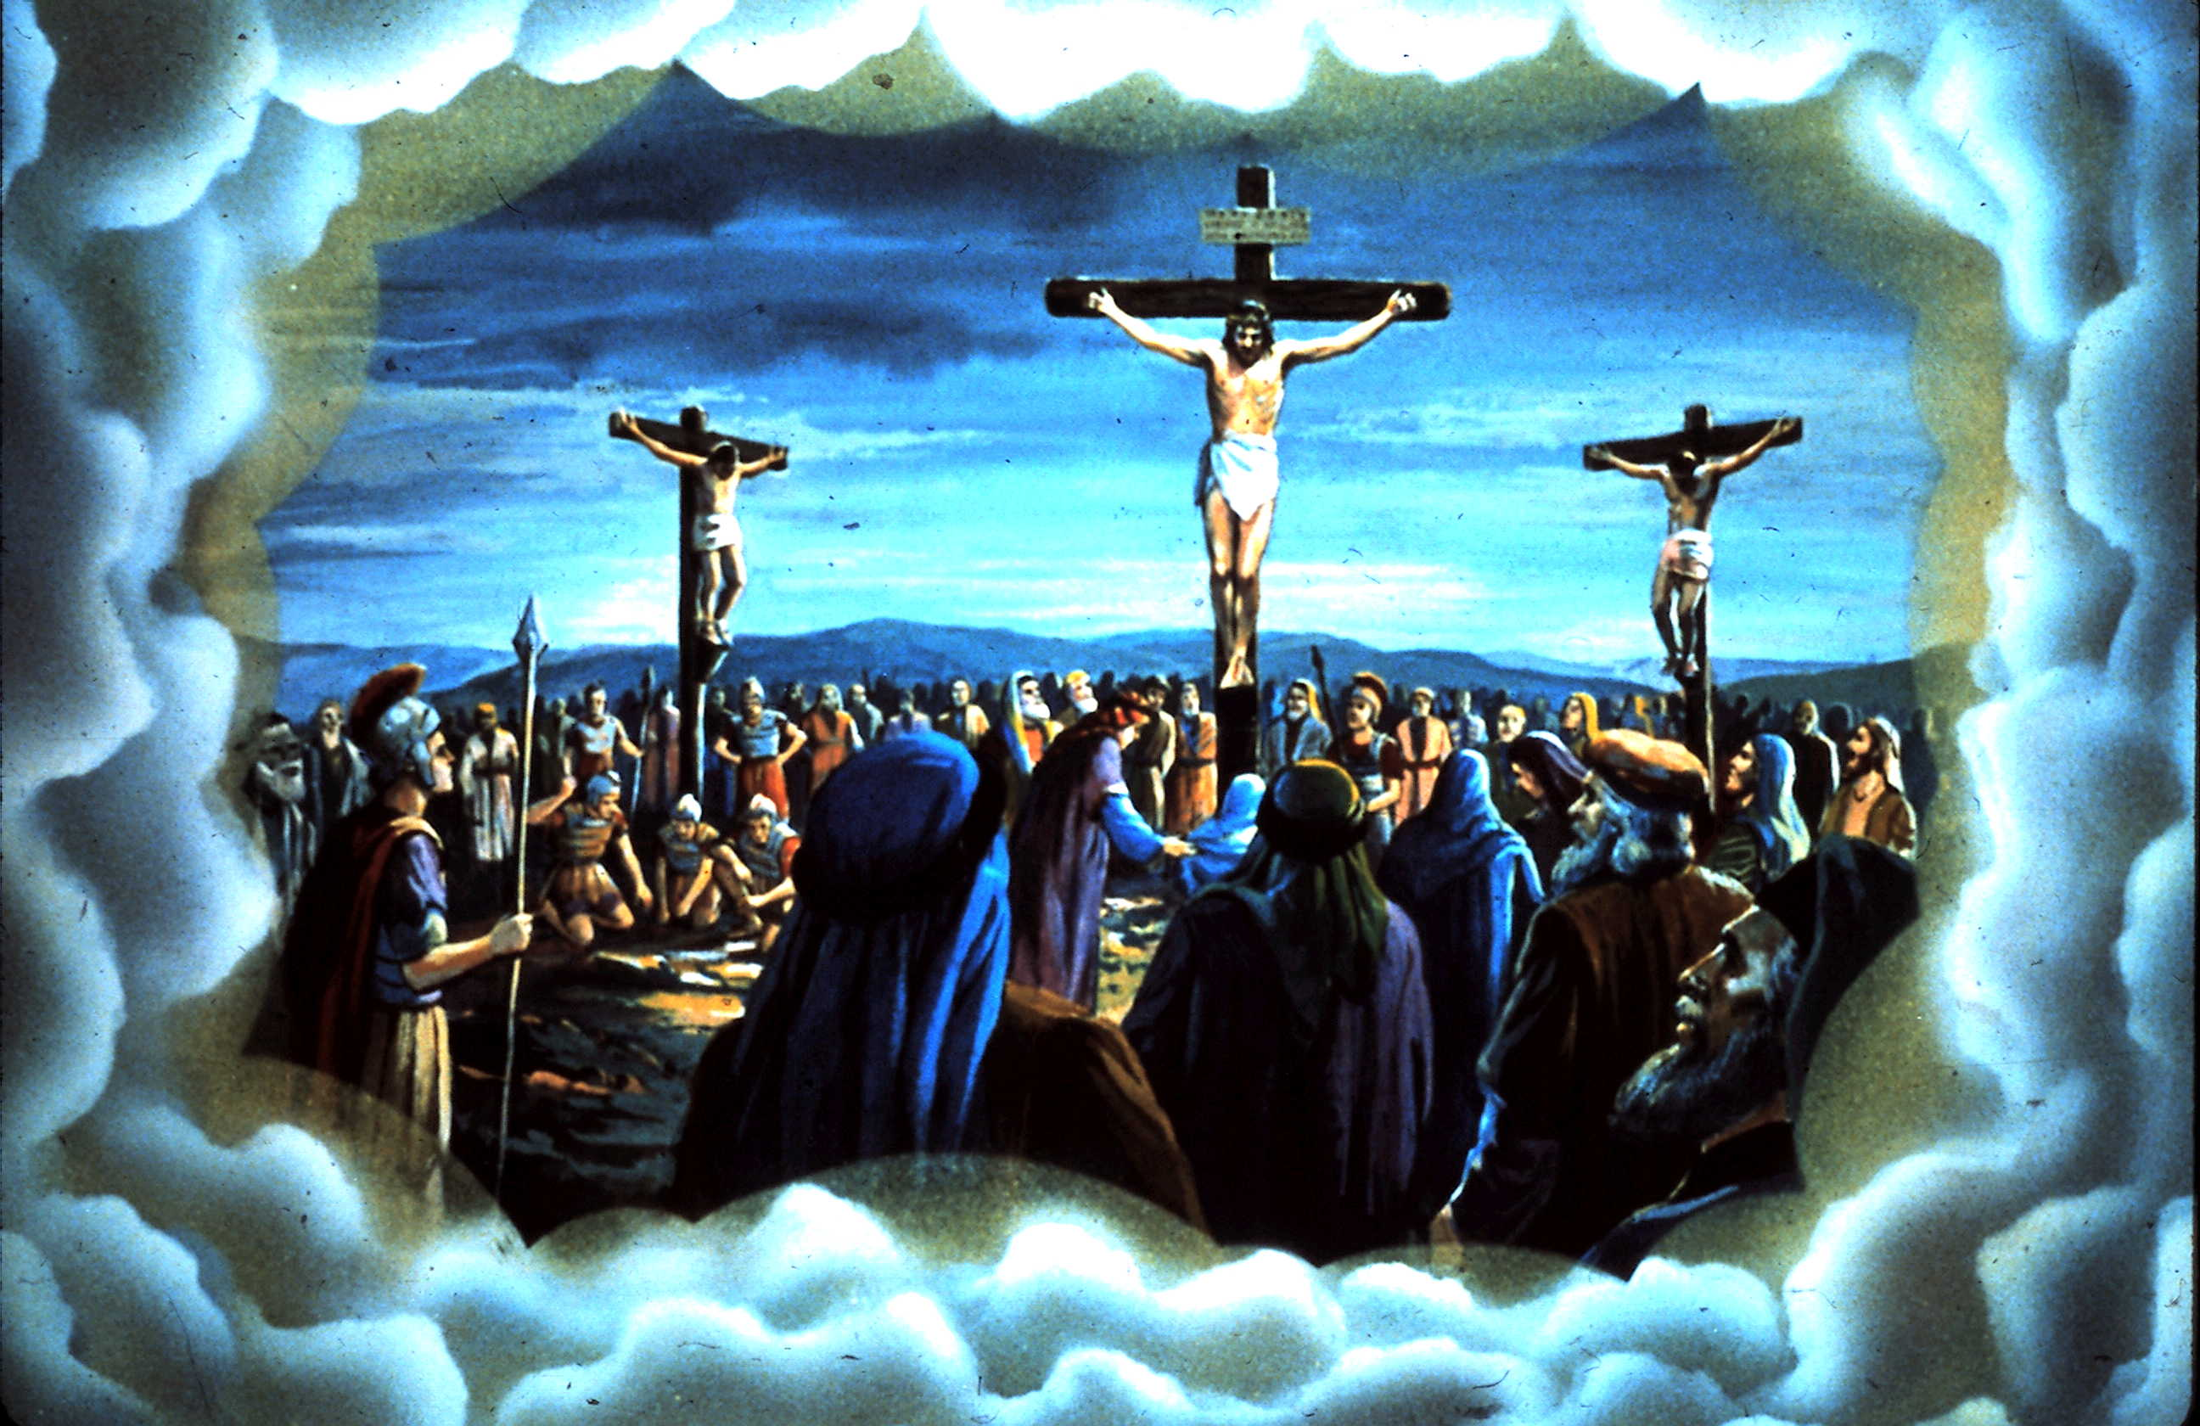
Isaiah 53:7:
“He was oppressed and He was afflicted, Yet He opened not His mouth; He was led as a lamb to the slaughter, And as a sheep before its shearers is silent, So He opened not His mouth.”

Slide 10
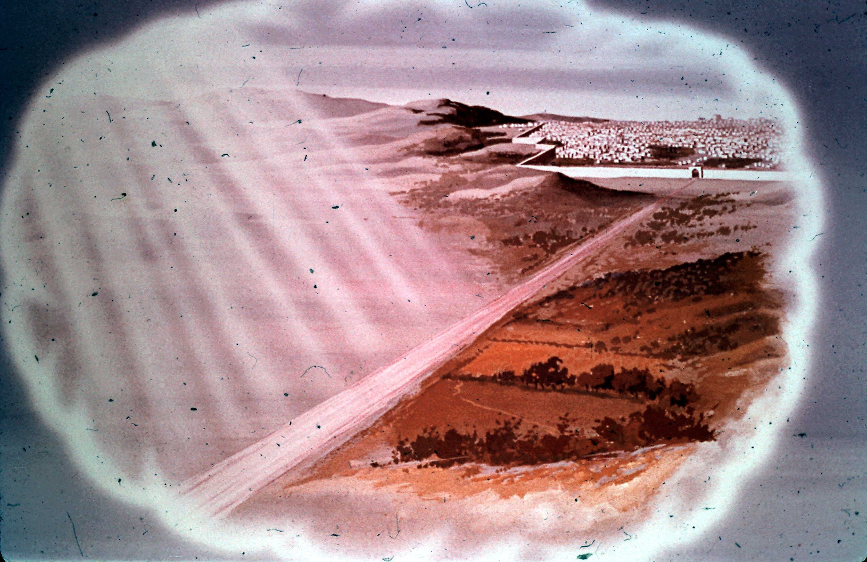
How Much Higher God's Thoughts & God's Ways Are Than Man's
As the Heavens Are Higher Than the Earth

Slide 11
Isaiah 55:8-9:
“For My thoughts are not your thoughts, Nor are your ways My ways," says the LORD. For as the heavens are higher than the earth, So are My ways higher than your ways, And My thoughts than your thoughts.”

Slide 12
Isaiah Prophesied That God's Word Would Not
Return unto Him Void

Slide 13
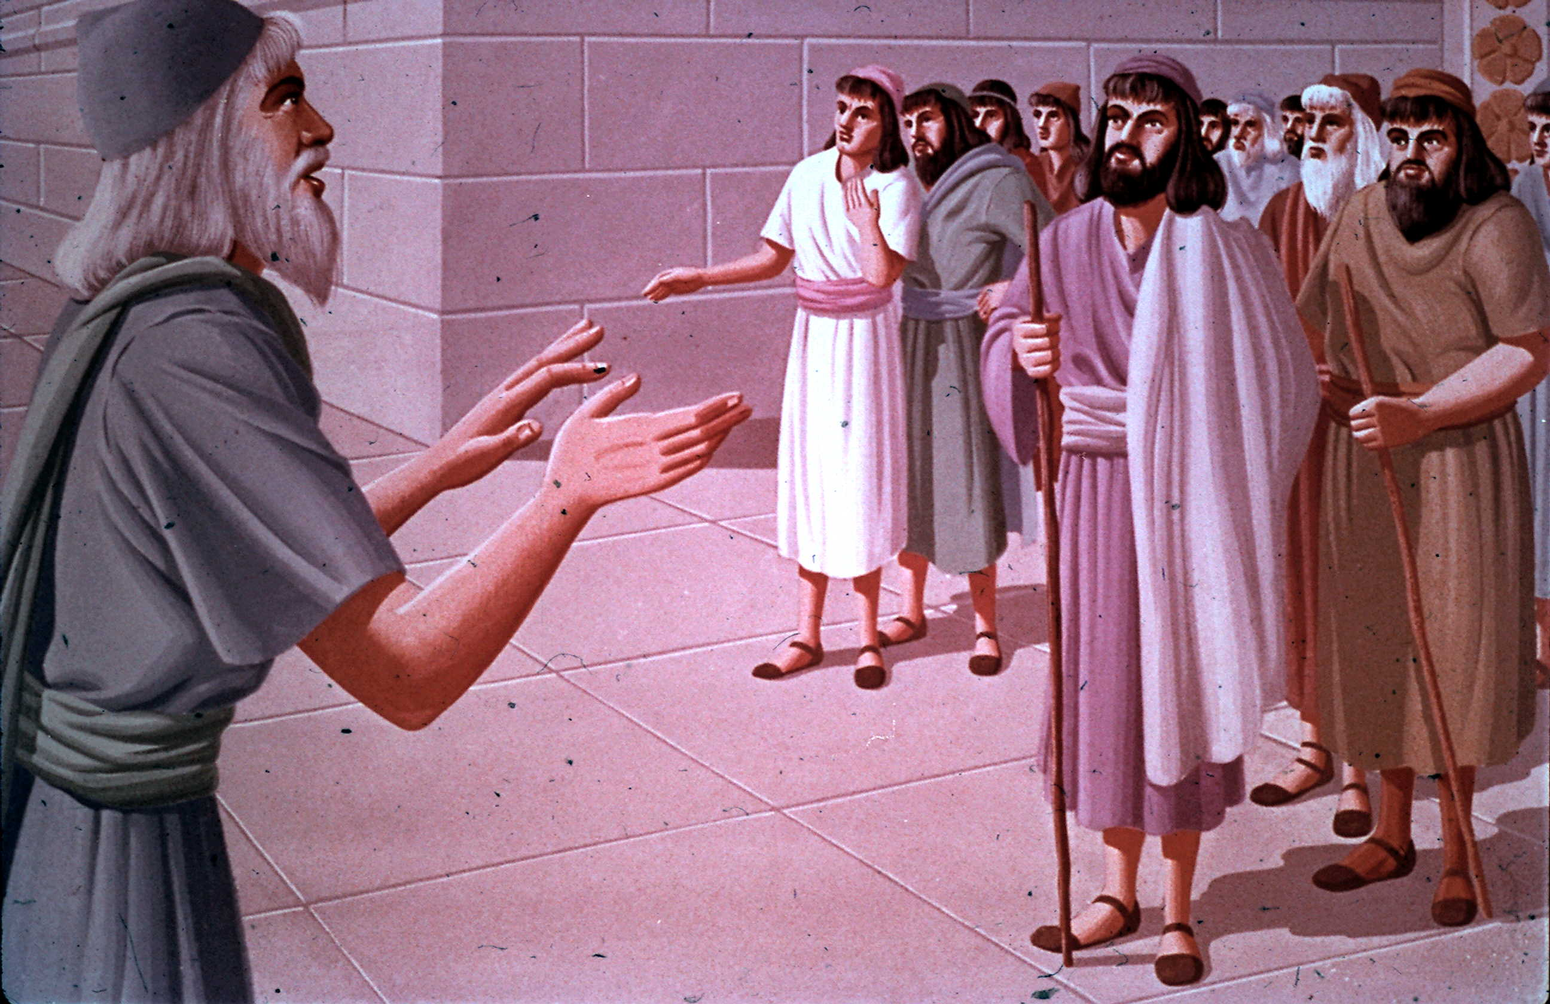
Isaiah's Prophecy About the Consequences of Sin
Isaiah 59:1-2
Isaiah's Description of the Consequences of Sin
"Your iniquities have separated you from your God"

Slide 14
Isaiah 59:2:
“But your iniquities have separated you from your God; And your sins have hidden His face from you, So that He will not hear.”

Slide 15
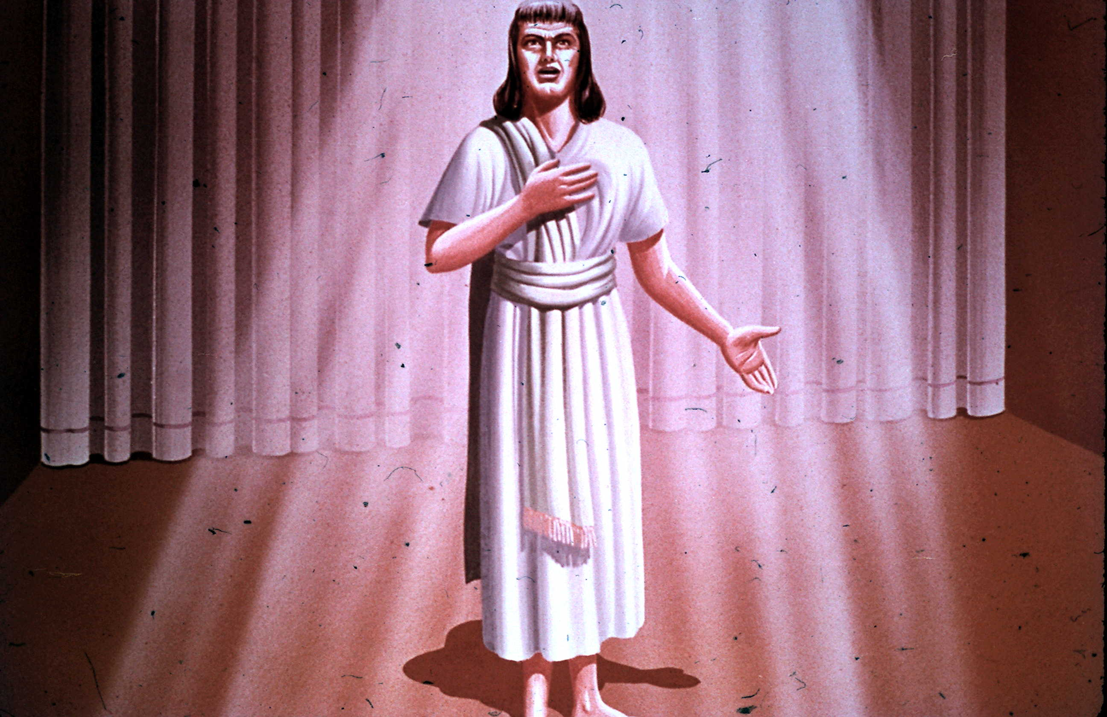
God Promised to Give a New Name to His People When
The Gentiles Were Saved (When the Church Started)

Slide 16
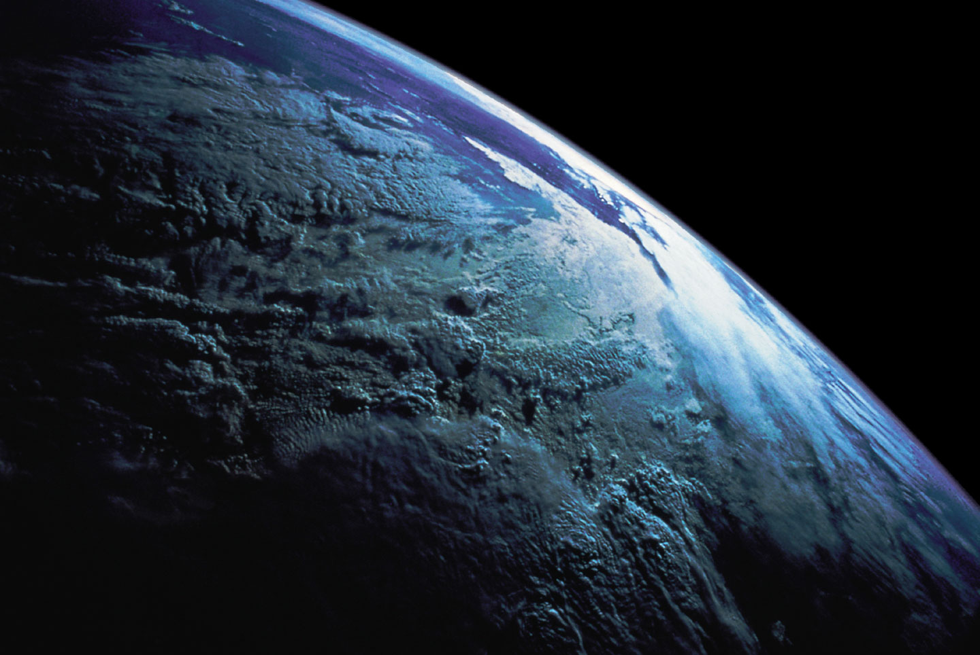
Scientific Foreknowledge in the Book of Isaiah
The Sphere of the Earth;
Earth Grow Old Like Garment

Slide 17
Three Main Themes of the Book of Isaiah
Fall of Nations; Captivity of Judah; Coming of the Messiah

