Slide 1
We Can Know!
Helpful chapters you might mark for this morning’s lesson:
Matthew 24
Mark 13
Matthew 24:42-44

Slide 2
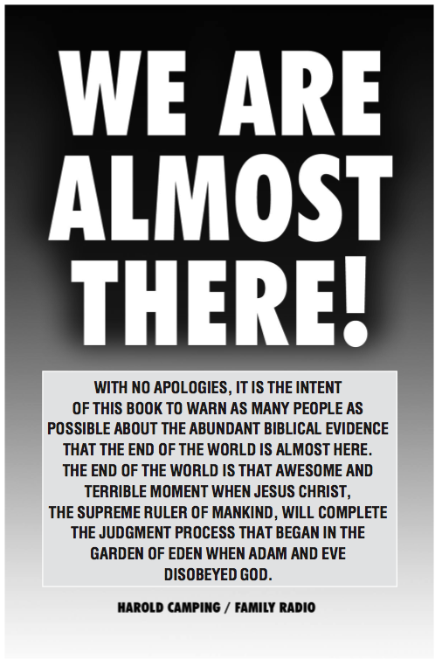
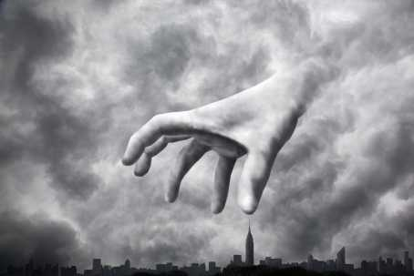

Slide 3
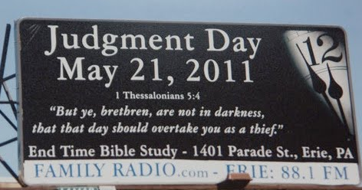
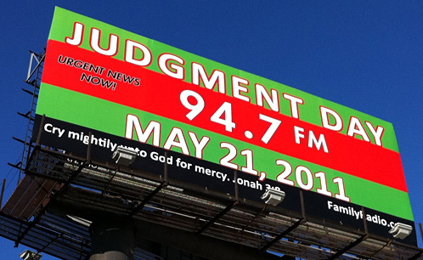
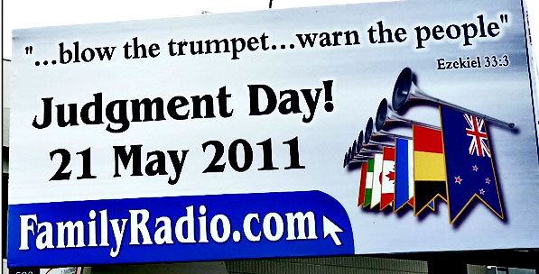
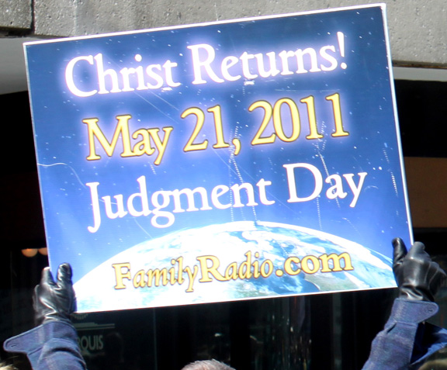

Slide 4
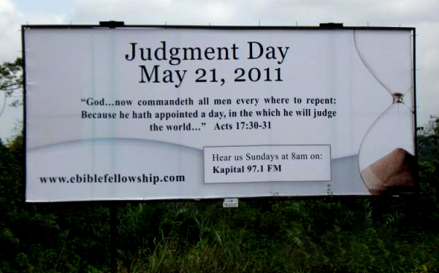

Slide 5
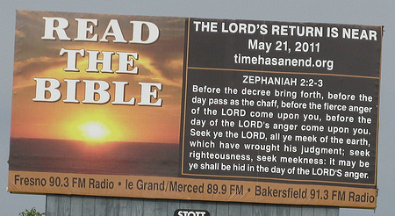

Slide 6
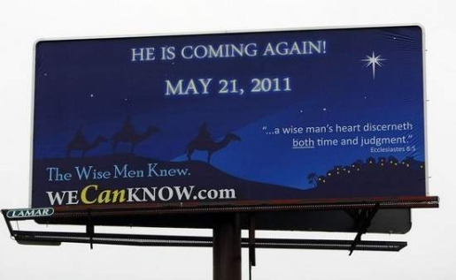
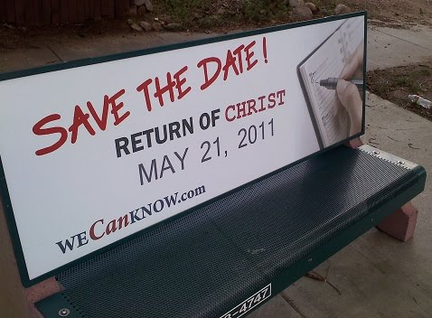

Slide 7
We Can Know!
We can know that we cannot know!
“of that day and hour no one knows” – Matt. 24:36
“you do not know what hour” – Matt. 24:42
“you know neither the day nor the hour” – Matt. 25:13
“you do not know when the time is” – Mark 13:33
“not even the angels of heaven” – Matt. 24:36
“nor the Son” – Mark 13:32
“but only the Father” – Mark 13:32
“coming at an hour you do not expect” – Matt. 24:44
“you do not know when” – Mark 13:35
“in the evening, at midnight, at the crowing of the rooster, or in the morning” – Mark 13:35
“coming suddenly” – Mark 13:36

Slide 8
We Can Know!
We can know that we cannot know!
Jesus said no one knows when He’ll return! – Mk. 13:32
It is not for us to know, only the Father! – Acts 1:7
We can know that life on earth will end!
Death is certain! – Heb. 9:27; Ecc. 9:5
The coming of Christ is certain! – Acts 1:11; 2 Pet. 3:10
We can know that the timing is uncertain!
Life is a vapor that appears & vanishes! – James 4:14
Jesus will return as a thief in the night! – 1 Thess. 5:2
We can know that judgment will certainly follow!
God has appointed that day! – Acts 17:31; Heb. 9:27
All shall stand before Christ in judgment! – Rom. 14:10

Slide 9
We Can Know!
We can know that we must prepare and be ready!
Prepare to give an account – Rom. 14:10-12; Jn. 12:48
Be in a constant state of readiness – Mt. 24:42-44
We can know that God is not kidding around about…
His Word being our only guide! – Col. 3:17; Gal. 1:8-9
Not following man’s doctrine! – Mt. 15:9; 2 Jn. 9-11
Obedience and faithful living! – Mt. 7:21; 1 Cor. 15:58
Genuine repentance being required! – Acts 17:30-31
Baptism being absolutely essential! – Acts 2:38; 22:16
Everlasting joy & rest in heaven! – Mt. 25:23; Rev. 21
Eternal fire & punishment in hell! – Mt. 25:30, 41, 46
Knowing if we’re saved or not! – 2 Th. 1:7-9; 1 Jn. 5:13

