Slide 1
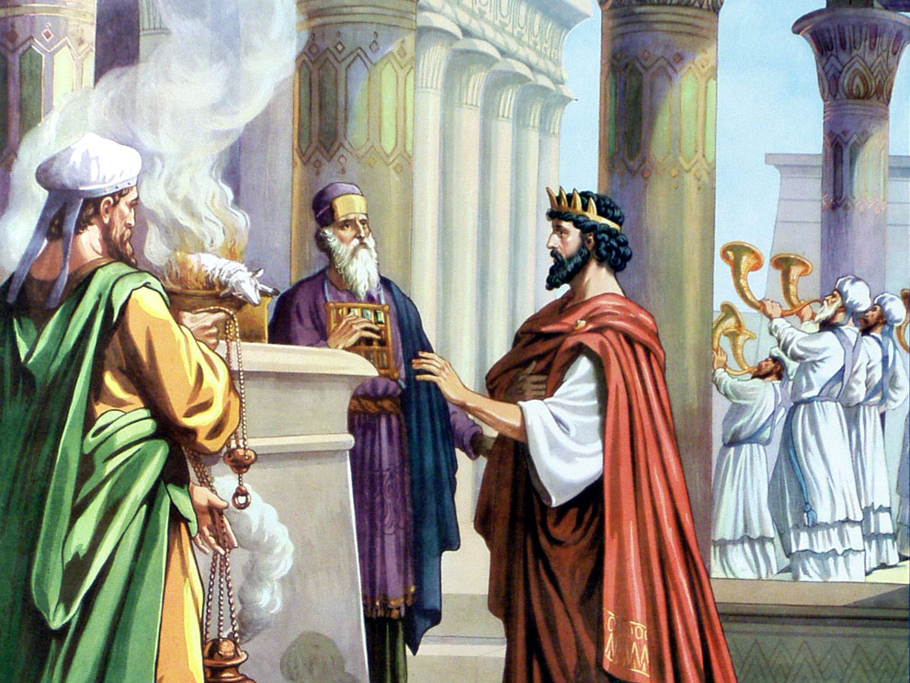
Valuable Lessons from
King Hezekiah
Helpful chapters you might mark for tonight’s lesson:
2 Chronicles 29
2 Kings 18
Isaiah 39

Slide 2
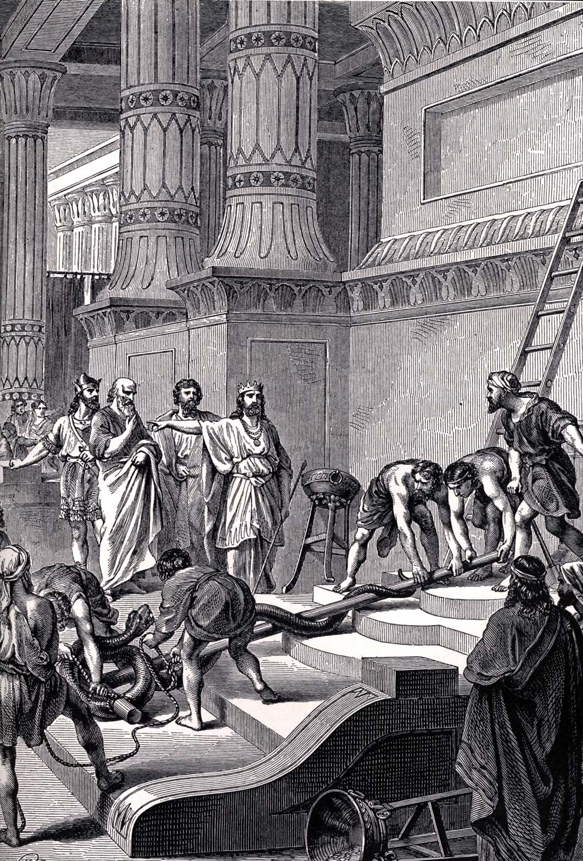
Hezekiah Was A Restorer – 2 Chr. 29-31
He Restored the Order of Acceptable Worship
The place & the priests
The practice & Passover
The pattern
He Restored the Object of Acceptable Worship
Eliminated every idol
Exalted the true God
Result
Great gladness & joy

Slide 3
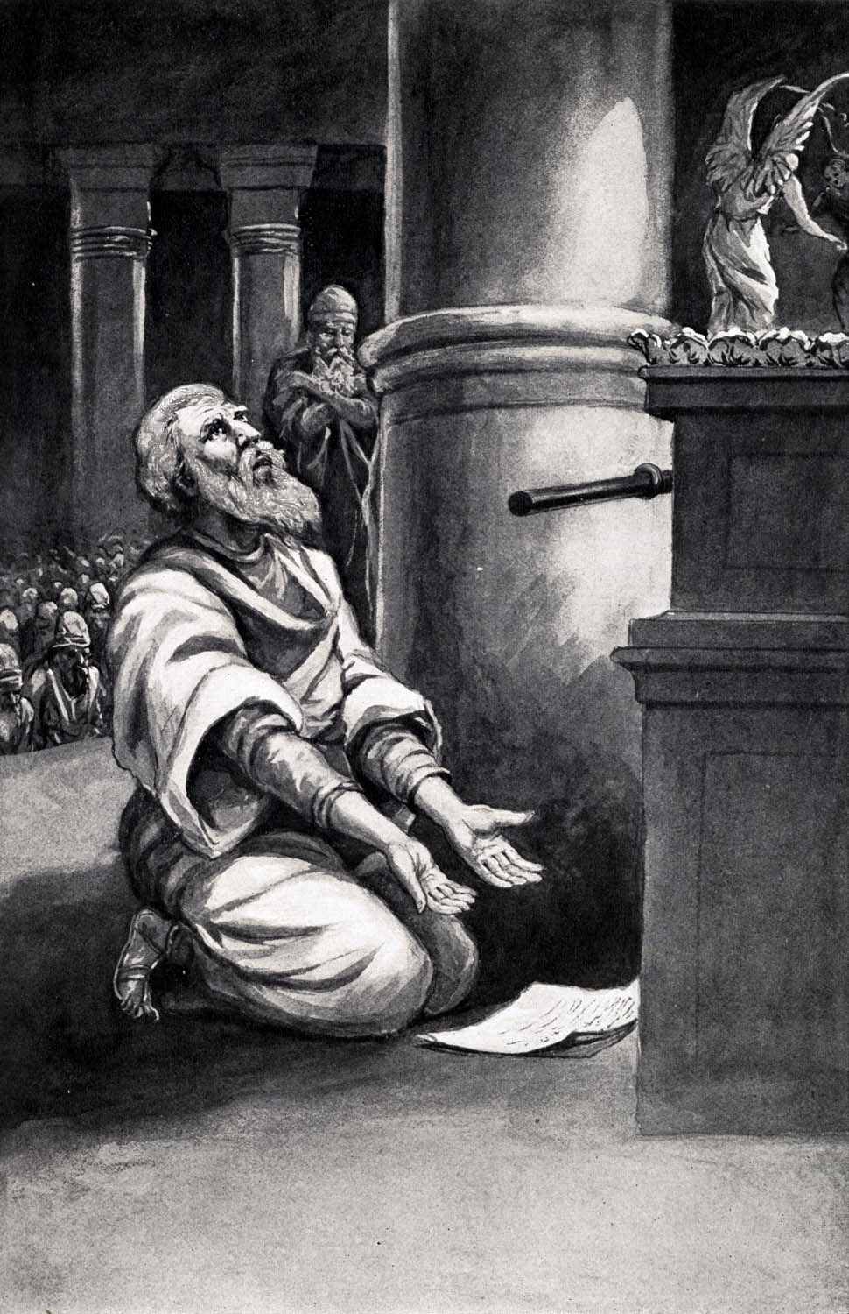
Hezekiah Was A Pray-er – 2 Kings 18-20
He Prayed When Surrounded & Near Defeat
Assyria had taken Israel
Assyria terrorized Judah
Hezekiah spread letter
Hezekiah prayed to God
Result: Angel of the Lord
He Prayed When Sick & Near Death
God’s answer conditional
Result: 15 years added

Slide 4
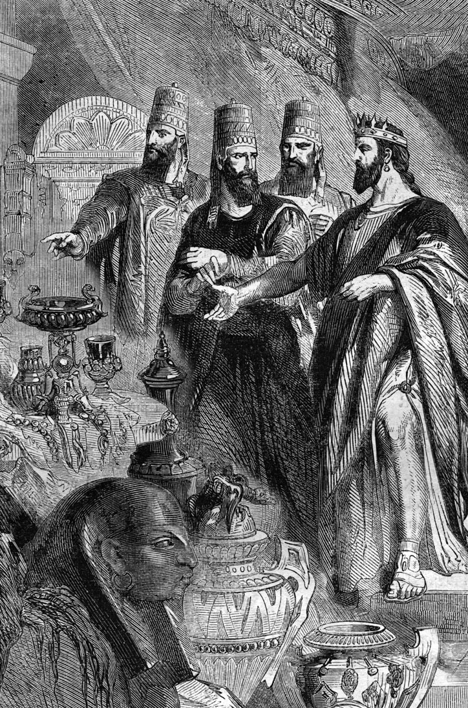
Hezekiah Was A Human – 2 Chr. 32; Isa. 39
His Heart Was Lifted Up
His House Was Filled Up
His Head Was Messed Up
His Heirs Were Broken Up
Eventually & Thankfully, He Humbled Himself

Slide 5
King of Judah Around the Time the Northern Kingdom Fell
Hezekiah
What Hezekiah Did with Sennacherib's Threatening Letter
He Spread
It Before the
Lord & Prayed
The Prophet Who Told Hezekiah That He Was Going to Die
Isaiah
Number of Years That Hezekiah's Life Was Extended
15 Years

