Slide 3
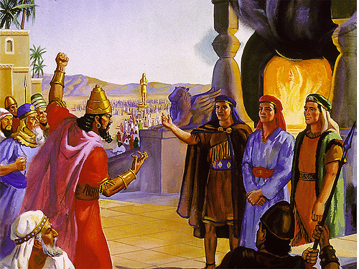
Daniel 3:1-30

Slide 4
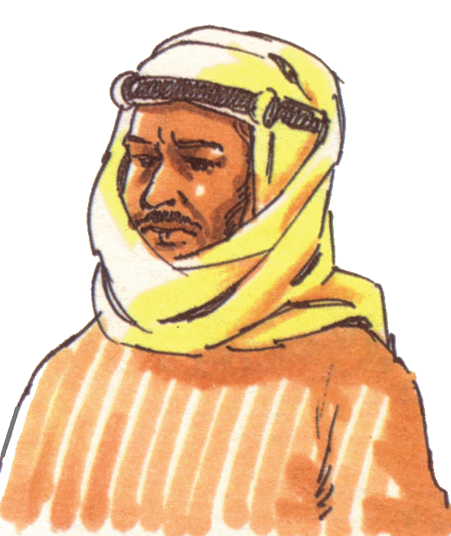

Slide 6
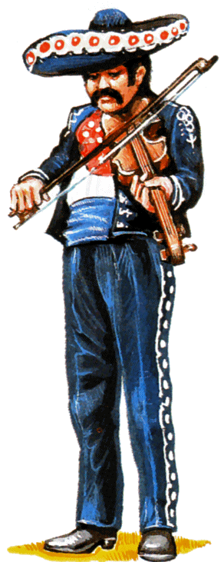

Slide 8
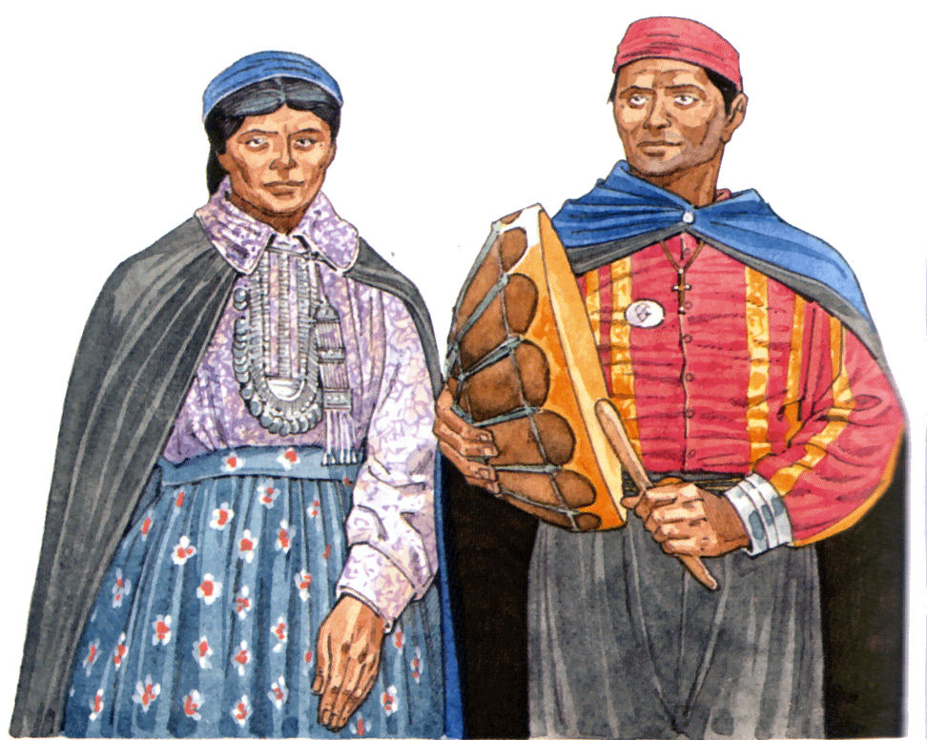

Slide 9
Which one of these
is a Christian?

Slide 10
CITIZENSHIP No Longer Strangers or Foreigners, We are Citizens of Heaven
Ephesians 2:19
Philippians 3:20

Slide 11
What is “Citizenship in Heaven?”

Slide 12
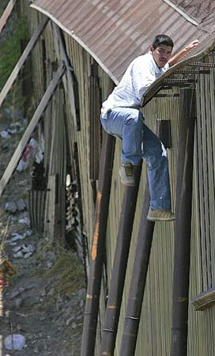
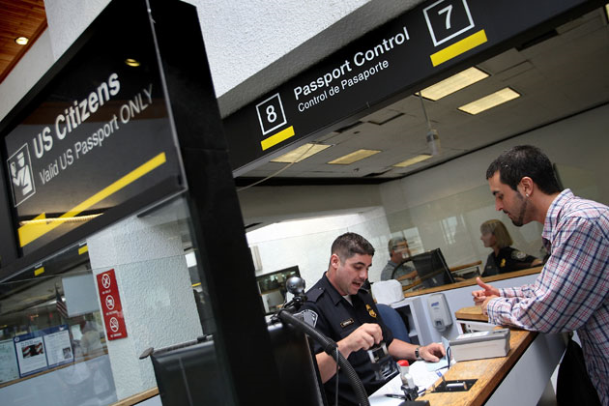
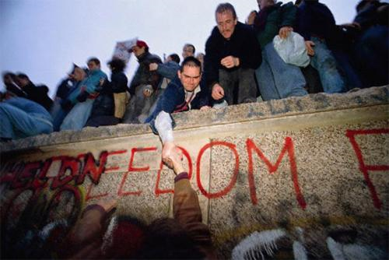
What is “Citizenship in Heaven?”

Slide 13
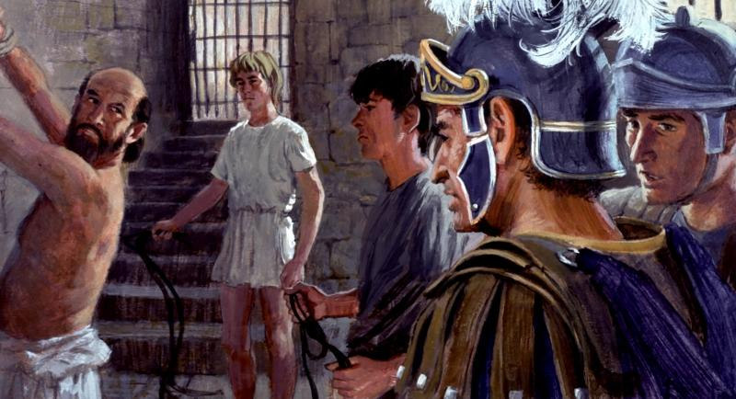
What is “Citizenship in Heaven?”
Acts 22:25-28

Slide 14
What is “Citizenship in Heaven?”

Slide 15
What is “Citizenship in Heaven?”
Philippians 3:19
Your heart seeks “earthly” things
World’s goals = your goals
Speak your own language
Your own appetite
You worry

Slide 16
What is “Citizenship in Heaven?”
Colossians 3:2
Heart seeks heavenly things
God’s purposes
Your own language
An expectation
You have hope

Slide 17
Where is Your Citizenship?
?
or
?

Slide 18
Ephesians 2:19
No longer strangers or foreigners,

Slide 19
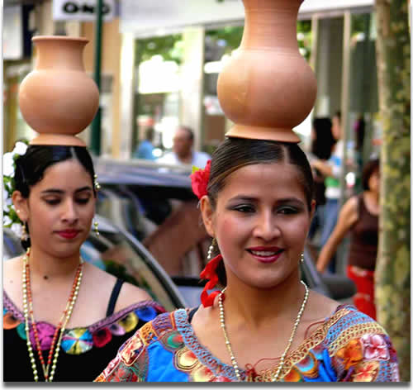
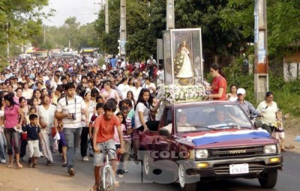

Slide 20
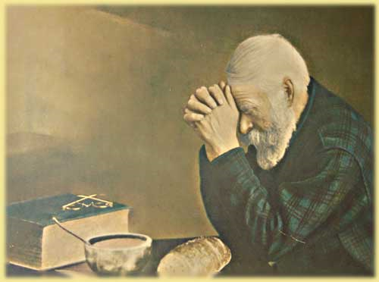

Slide 21
Ephesians 2:19
No longer strangers or foreigners,
But fellow citizens with the saints

Slide 24
Ephesians 2:19
No longer strangers or foreigners,
But fellow citizens with the saints
Members of the household of God

Slide 25
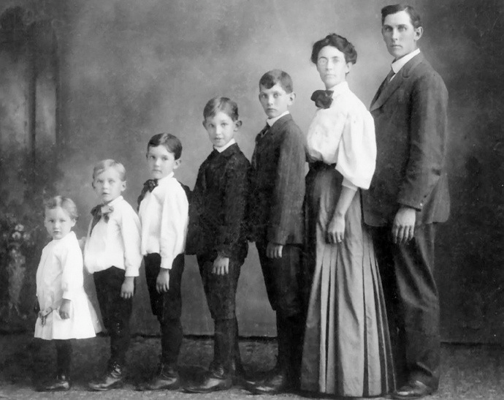
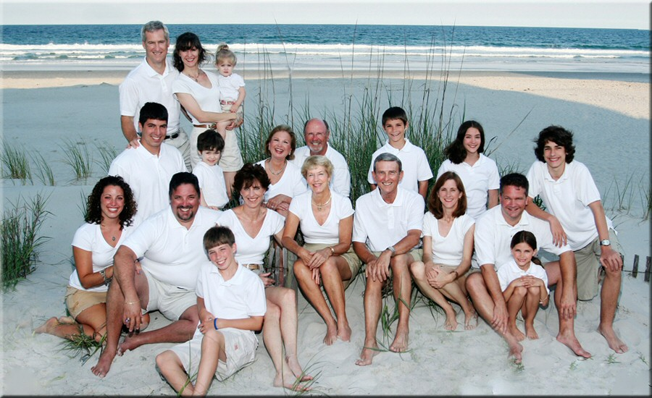

Slide 26
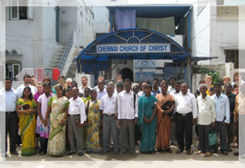
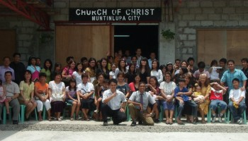
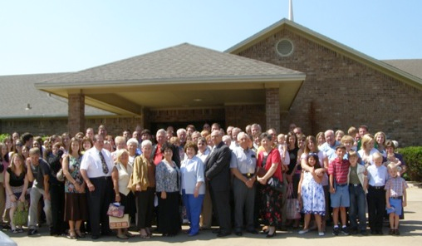
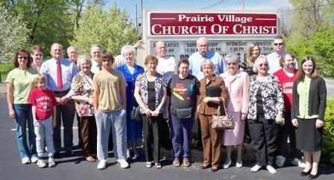
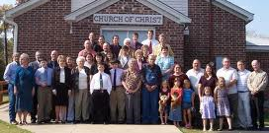

Slide 27
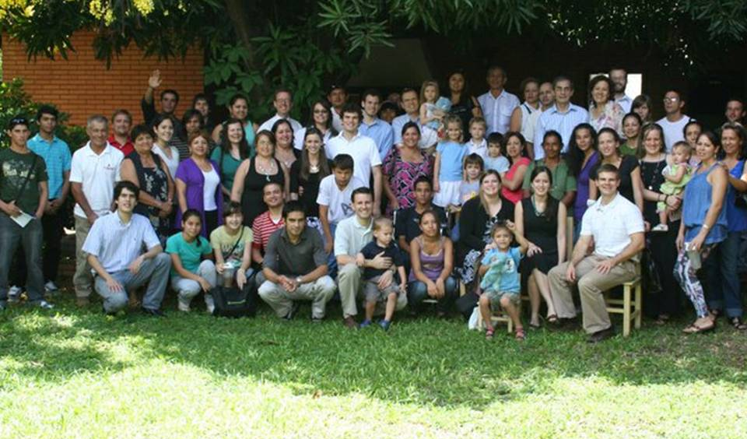

Slide 28
Where is Your Citizenship?

Slide 29
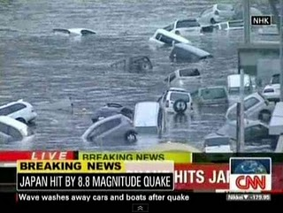
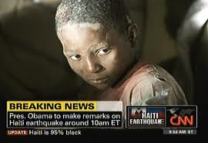
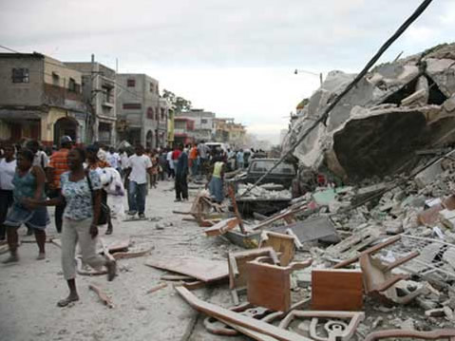
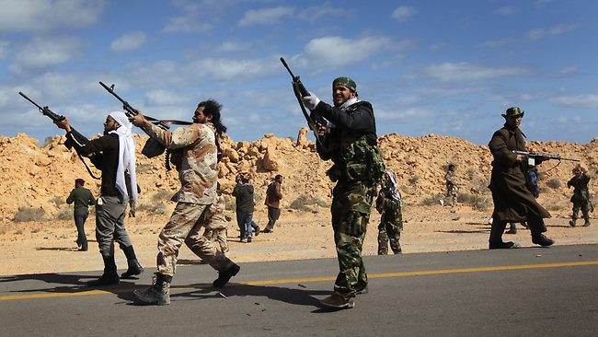

Slide 31
Where is Your Citizenship?

