Slide 1
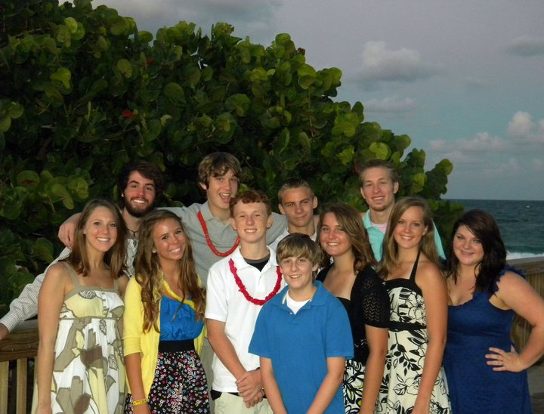
2011 Youth Report
Palm Beach Lakes church of Christ

Slide 2

Challenge Youth Conference
Location: Gatlinburg, TN
Over 8,000 youth in attendance
22 of us altogether, 19 kids

Slide 3
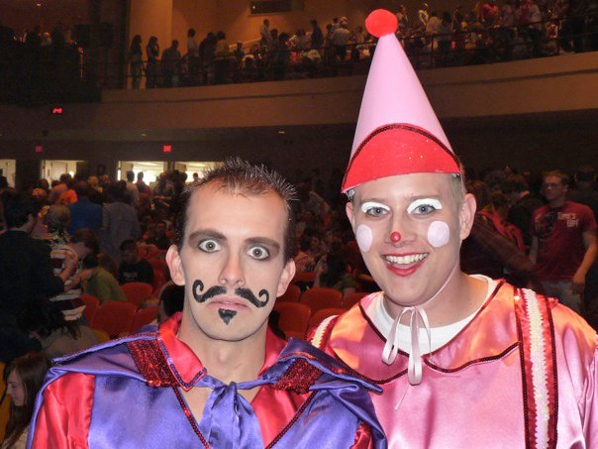
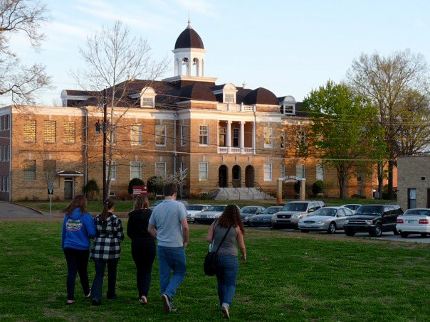
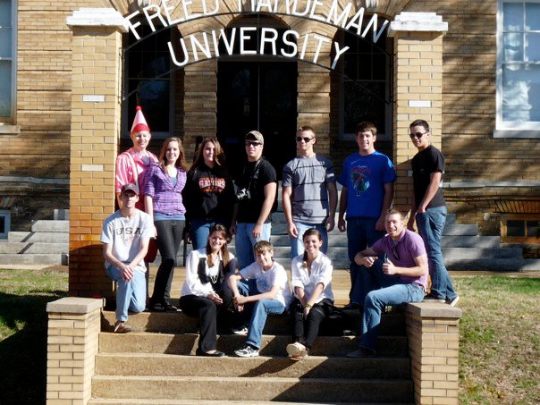
FHU Trip to Makin’ Music
9 kids, 2 adults
Kids enjoyed it and wanted more time on campus.

Slide 4
Youth UPreach
Emphasis on young men getting to teach and lead.
Weekly devotionals in class given by one of the young men.
Next month, the youth will be doing everything in worship.
Young women will be giving devotionals during split devotionals.
Monthly classes preparing them to be the leaders in the future

Slide 5
Reoccurring Monthly Events
Singing on Sunday
Sunday Night Out
Wednesday Night Dinner and Games
DEVO
Classes on Wednesdays teaching them how to conduct a Bible study.

Slide 6
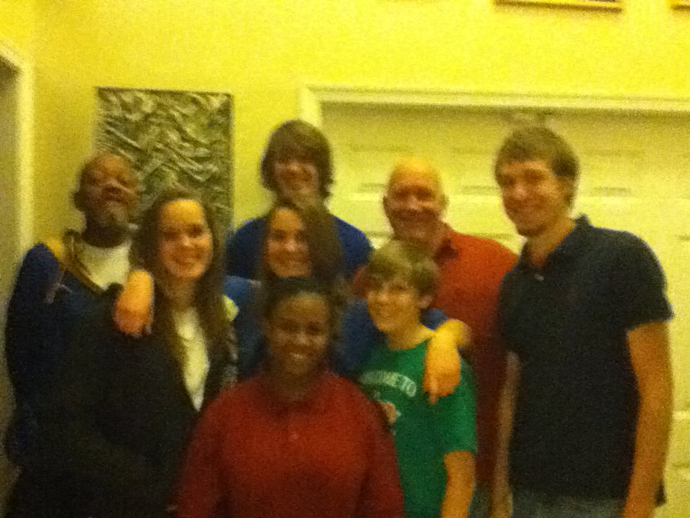
Service Projects
Went to visit the Allen family while Flo was struggling and after she passed.
Participated in Work Day
Cookies for Shut-ins and Widows
Egg Hunt
Many young men helped with Ladies’ Day

Slide 7
Focus on Evangelism
Over 60 visitors in the 20 months I have been here
Several Bible Studies
One Baptism of visitor
Teens have a great understanding of their purpose

Slide 8
What Can I Do To Help?
Keep the youth in your prayers
If you know of some service projects we can do, let me know.
Parents, encourage your kids to become an active part of the youth group.
Teach them what you know

