Slide 1
With God…
There Is Nothing Too Hard!
Jeremiah 32:17-24

Slide 2
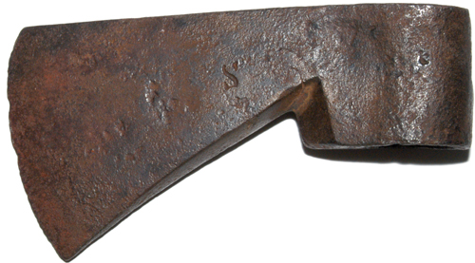
With God…
Sticks float
2 Kings 6:1-7

Slide 3
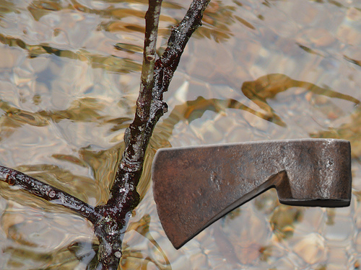
With God…
Sticks float & so does iron
2 Kings 6:1-7

Slide 4
With God…
Secrets are not secret
2 Kings 6:8-12

Slide 5
With God…
Seeing it may be missing it
2 Kings 6:13-23

Slide 6
With God…
“Surrounders”
2 Kings 6:13-23

Slide 7
With God…
“Surrounders”
…may be the surrounded

Slide 8
With God…
Scarcity
2 Kings 7:1-20

Slide 9
With God…
Scarcity can have plenty
2 Kings 7:1-20

