Slide 1

ARGENTINA MISSIONS

Slide 2
“Every man has more right
To hear the Gospel once, than
Any man has to hear it twice.”
Avon Malone

Slide 3

Why Do We Want to be Missionaries?
Because Jesus has commissioned us to go and preach His Gospel (Matt. 28:18-20).
Because we have a passion to save lost souls and are aware of their true value (Luke 15).
Because the Gospel has not reached the lost living in San Juan, Argentina (Mark 16:15-16). “Every man has more right to hear the Gospel once, than any man has to hear it twice.”
Because we feel there are people crying out for help and craving for the truth (cf. Acts 16:9-10).
Because the harvest is truly plentiful, but the laborers are few (Matt. 9:37-38).
Because the fields are already white for harvest (John 4:35). And…
Because here we are, send us! (cf. Isaiah 6:8).

Slide 4
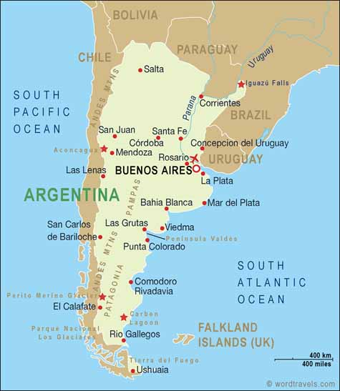
Argentina
Population: 40,913,584 (July 2009 est.)
Language: Castilian, others: Italian, English & German
People: 86.4% European descent, 8% Mestizo, 4% Arab and Asian, 1.6% Amerindians.
Literacy: 97.6%
Government: Democrat
Climate: 4 seasons

Slide 5
Religious Background in Argentina
76.5% of argentines are Roman Catholic.
11.3% are religiously indifferent.
9% are protestant (with 7.9% in Pentecostal denominations).
1.2% are Jehovah’s Witness
0.9% are Mormons.
The church of Christ has never been established in San Juan, Argentina.
Missionary efforts have been made by members of the Church of Christ in the following argentine provinces: Buenos Aires (east), Chubut (south), Mendoza (west), and Córdoba (central).

Slide 6
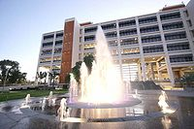
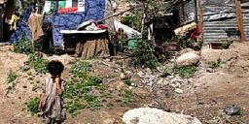
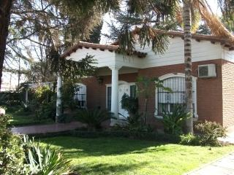
San Juan, Argentina
Population: 705,378 (1.75% of Argentina’s population).
Poverty & Prosperity
Income: Comes from Agriculture, Mine industry & cattle.

Slide 7
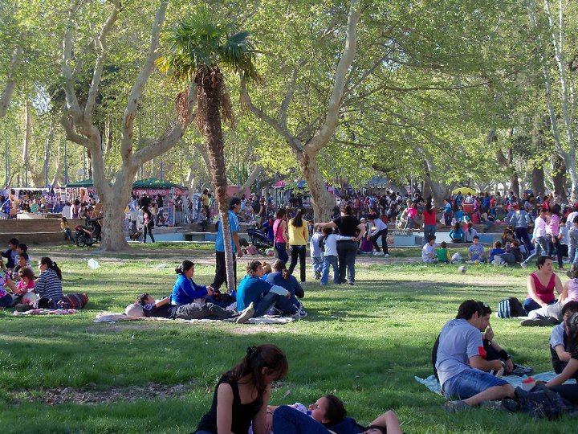
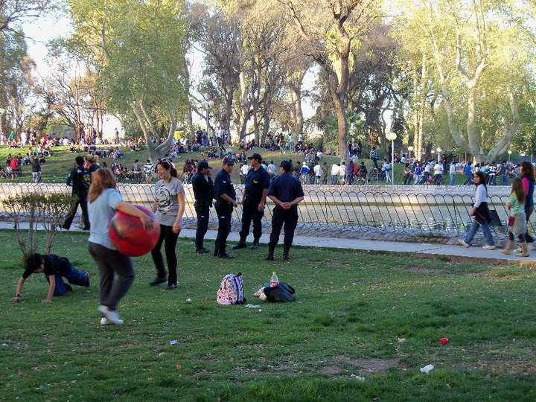
Lost Souls = Great Spiritual Need

Slide 8
How can we fill this
spiritual need?

Slide 9


Our Part
Go to San Juan to evangelize the lost & establish the church there.
Advantages:
  The Lord will be with us (Matt. 28:18-20).
  Sandra is from San Juan, AR.
  She has contacts there.
  We both speak the language.

Slide 10
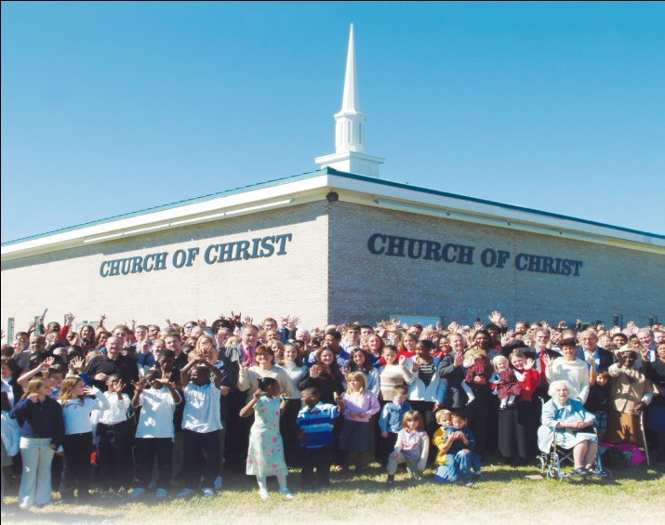

Your Part
Get involved in the work in San Juan, AR.
Ways to do so:
  Praying for us & the work in San Juan, AR.
  Encouraging us.
  Visiting the work when we’re down there.
  Assisting us financially.

Slide 11
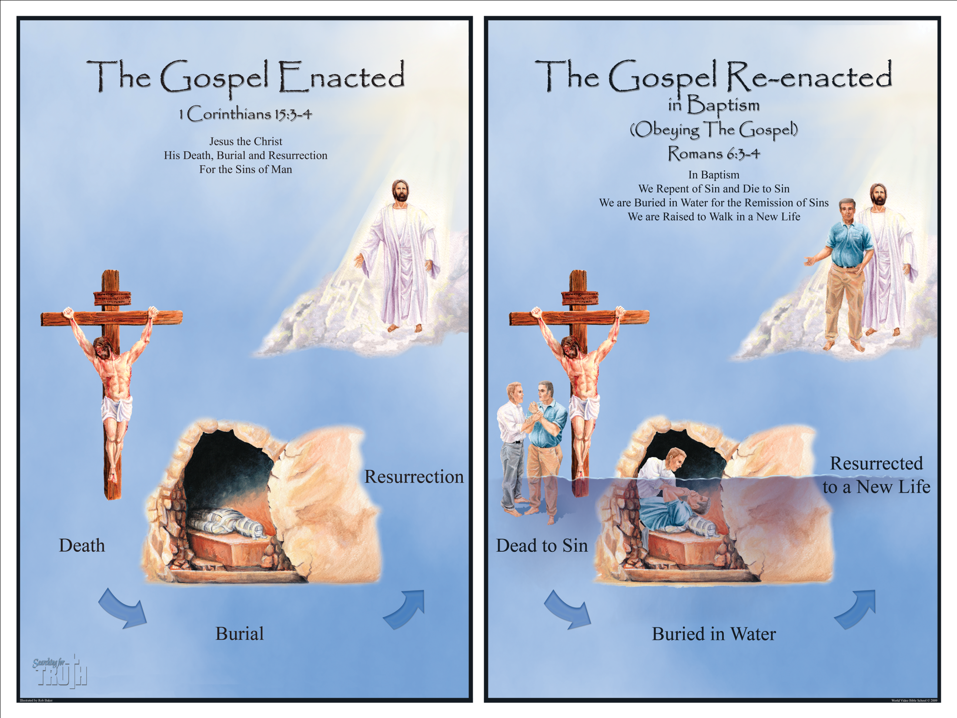
The Gospel
Christ died for our sins according to the Scriptures (Isa. 53:4-6).
He was buried and resurrected on the third day according to the Scriptures (Acts 2:27; cf. Psalm 16:10; Hos. 6:2; Mat. 12:39-40; 16:21).

Slide 12
Obeying the Gospel
After you learn/hear it, you must:
Believe it (Heb. 11:6).
Repent of your sins (Acts 17:30).
Confess Jesus as Lord and Son of God (Rom. 10:10; Matt. 10:32-33).
Be baptized to wash away your sins (Acts 22:16)

Slide 13
