Slide 1
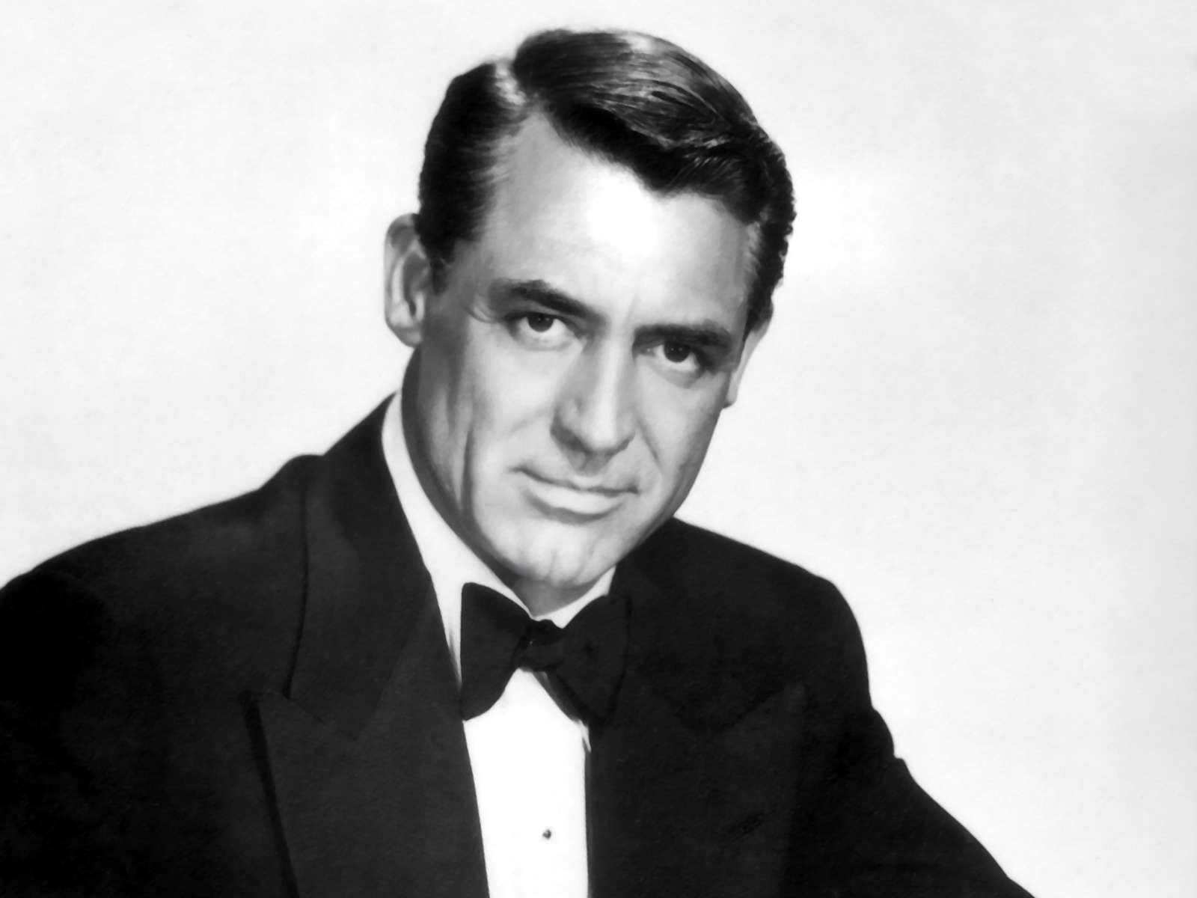
1. The Cary Grant Category

Slide 2
2. The Mr. Clean Category

Slide 3
3. The Santa Clause Category

Slide 4
4. The Michael
Bolton Category

Slide 5
5. The Superman Category

