Slide 1
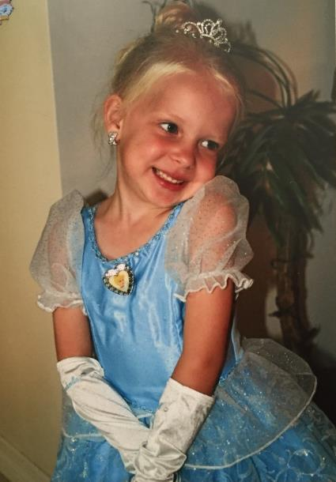
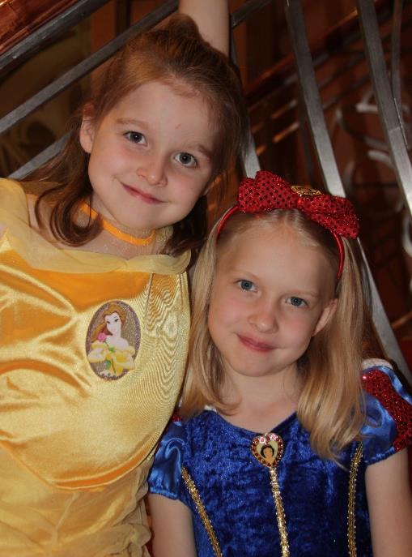
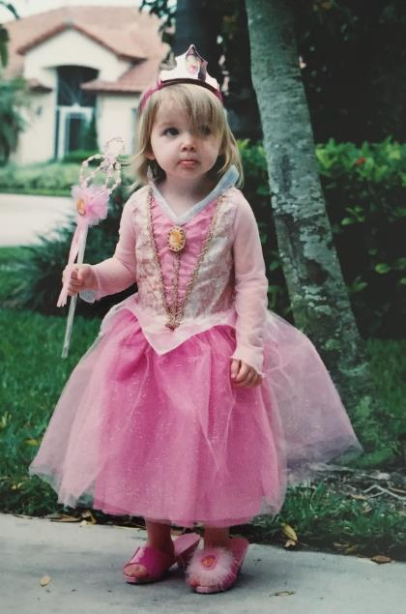
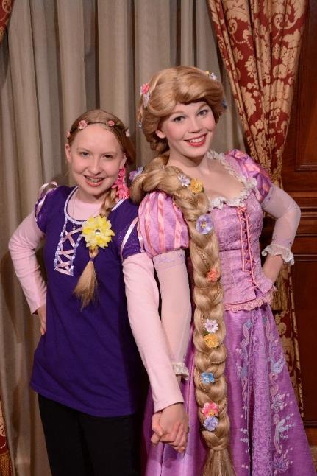
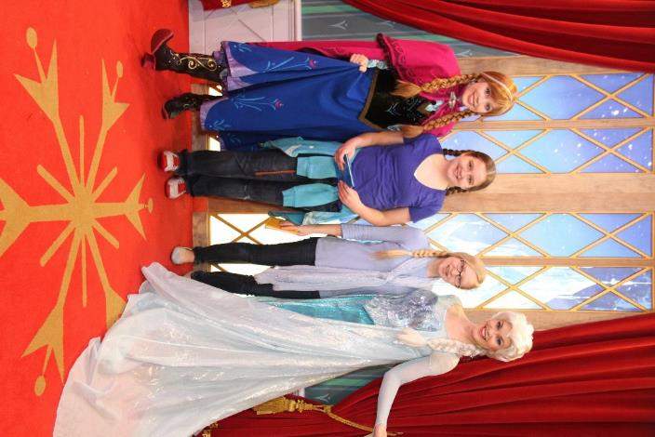
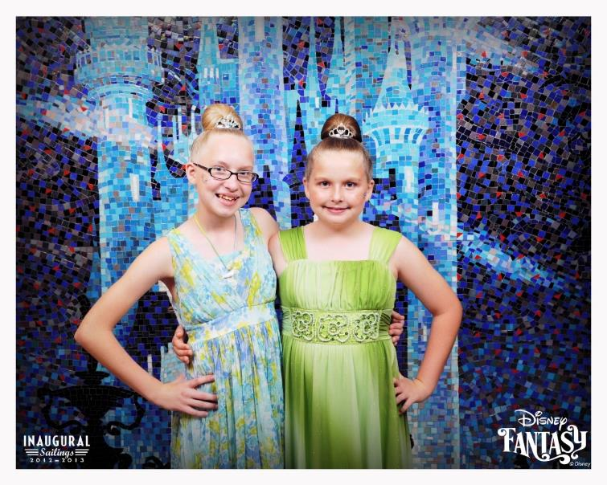

Slide 2
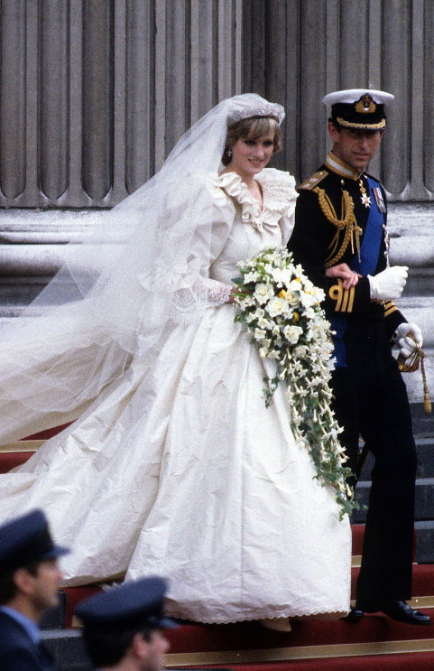
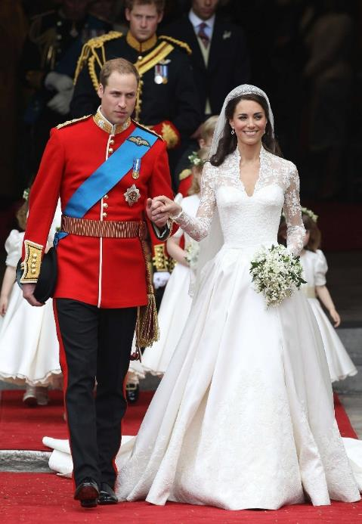

Slide 3
Daughters
KING
of the
2 Corinthians 6:18

Slide 4
A Daughter of the KING Is…
PRIVILEGED
She is an HEIR
Heir to the hope of eternal life (Titus 3:7)
She inherits a home in heaven (1 Peter 1:4)
A home specifically prepared for her (John 14:1-4)
A place of life eternal (John 3:16)
A place of everlasting comfort (Rev. 21:4)
Where God dwells, and His light continues forever (Rev. 22:1-5)

Slide 5
A Daughter of the KING Is…
PRIVILEGED
She is an HEIR
A joint heir with Christ (Rom. 8:16-17)
He calls us “brethren” (Hebrews 2:11)
She is one of God’s children (1 John 3:1-2)
She is a part of His “household” (Eph. 2:19-21)
She inherits a family in the church (Rom. 12:4)
She becomes an “adopted daughter” (Eph. 1:5)

Slide 6
A Daughter of the KING Is…
PRIVILEGED
She is an HEIR
Heir to His blessings in Christ (Eph. 1:7-13)
Redemption through His blood (Eph. 1:7)
Forgiveness of sins (Eph. 1:7, Heb. 8:12)
Revelation of His will (Eph. 1:9, Jude 1:3, 2 Pet. 1:3)
Riches of His grace (Eph. 1:7; Rom. 5:8, 15)
Hope in Him (Eph. 1:18; Heb. 6:17)

Slide 7
A Daughter of the KING Is…
PROTECTED
By the blood of Christ (Rom. 3:25)
It cleanses us from all sin (1 Jn. 1:7)
It justifies us, giving us access to God (1 Cor. 6:11)
It brings us near to God (Eph. 2:13)
It redeems us (1 Pet. 1:18-20)
It saves us (Rom. 5:9)
It provides forgiveness (Col. 1:14)
It reconciles us to Him (Col. 1:20)
It purchased us (Acts 20:28)

Slide 8
A Daughter of the KING Is…
PROTECTED
By God’s Love and Concern (Deut. 6:24)
If she lets Him direct her steps (Jer. 10:23)
If she submits to His ways (Is. 55:8)
If she follows His teaching (2 Tim. 3:16)
If she accepts His abundant offer of life (Jn. 10:10)

Slide 9
A Daughter of the KING Is…
PRESENTED
She is presented to God
As part of His glorious church (Eph. 5:27)
As a living sacrifice (Rom. 12:1)
As an instrument of righteousness (Rom. 6:13)
As a slave for holiness (Rom. 6:16-19)
For God’s approval, a worker for Him who is not ashamed (2 Tim. 2:15)

Slide 10
A Daughter of the KING Is…
PRESENTED
She represents God to the world
She is the light of the world (Matt. 5:14-16)
Her speech betrays her relationship to God (Matt. 26:73)
She cultivates a modest appearance (1 Tim. 2:9-10)
She has no communion with darkness (2 Cor. 6:14)
She shares the gospel (Rom. 1:16)

Slide 11
A Daughter of the KING Is…
PREPARED
She believes in Him (John 8:24)
She repents of her sins (Luke 13:3)
She confesses her faith (Matt. 10:32)
She is baptized into Christ (Acts 22:16)
God cleanses her of all sin (1 Jn. 1:7)
God adds her to His church (Acts 2:47)
God enrolls her in heaven (Heb. 12:23)
She serves Him faithfully (Rev. 2:10)
“Be faithful until death, and I will give you the crown of LIFE.”
“Be faithful until death, and I will give you the crown of LIFE.”

