Slide 1
Mission Report

Slide 2
Cuba
APRIL 1 - 2

Slide 6
Paraguay
JULY 1-17

Slide 29
Bahamas
AUGUST 16-21

Slide 32
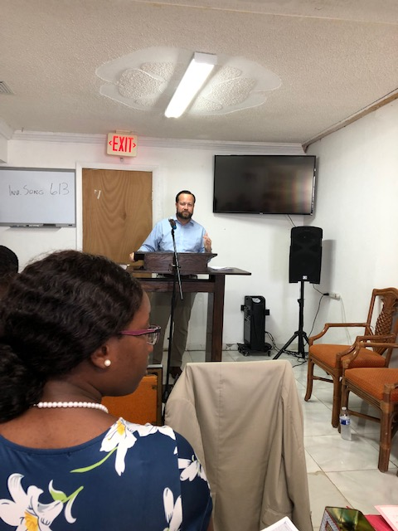

Slide 33
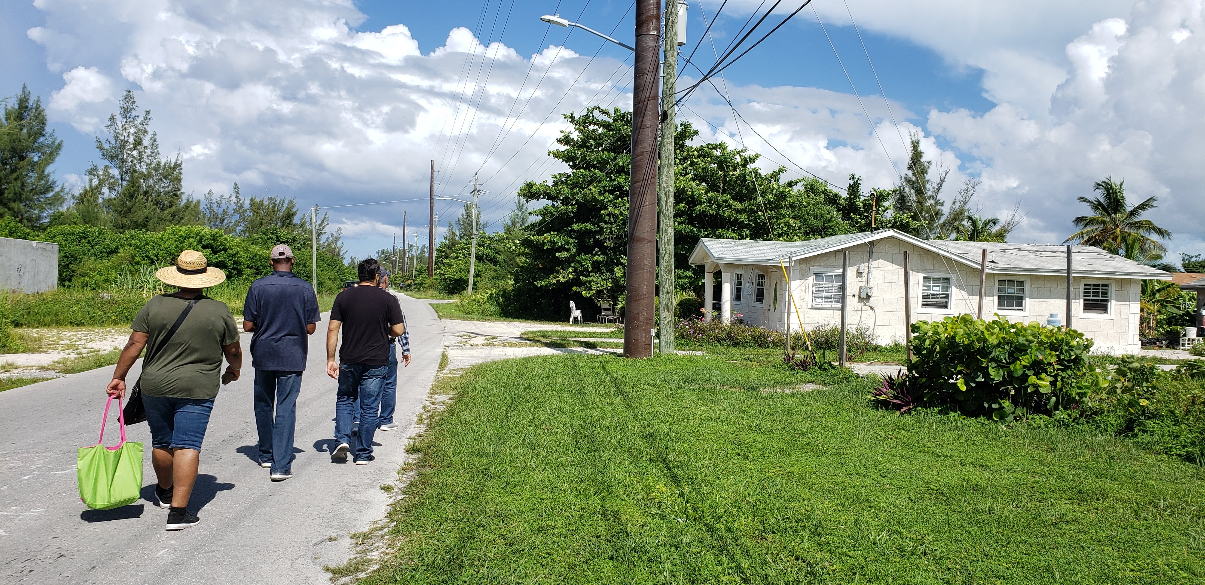

Slide 34
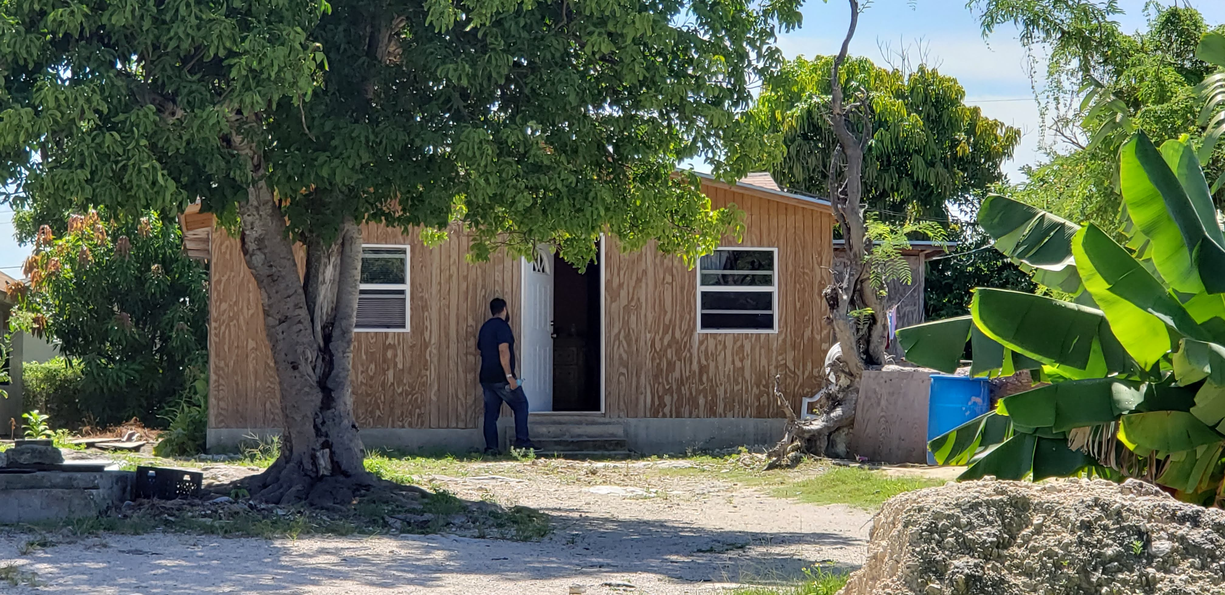

Slide 36
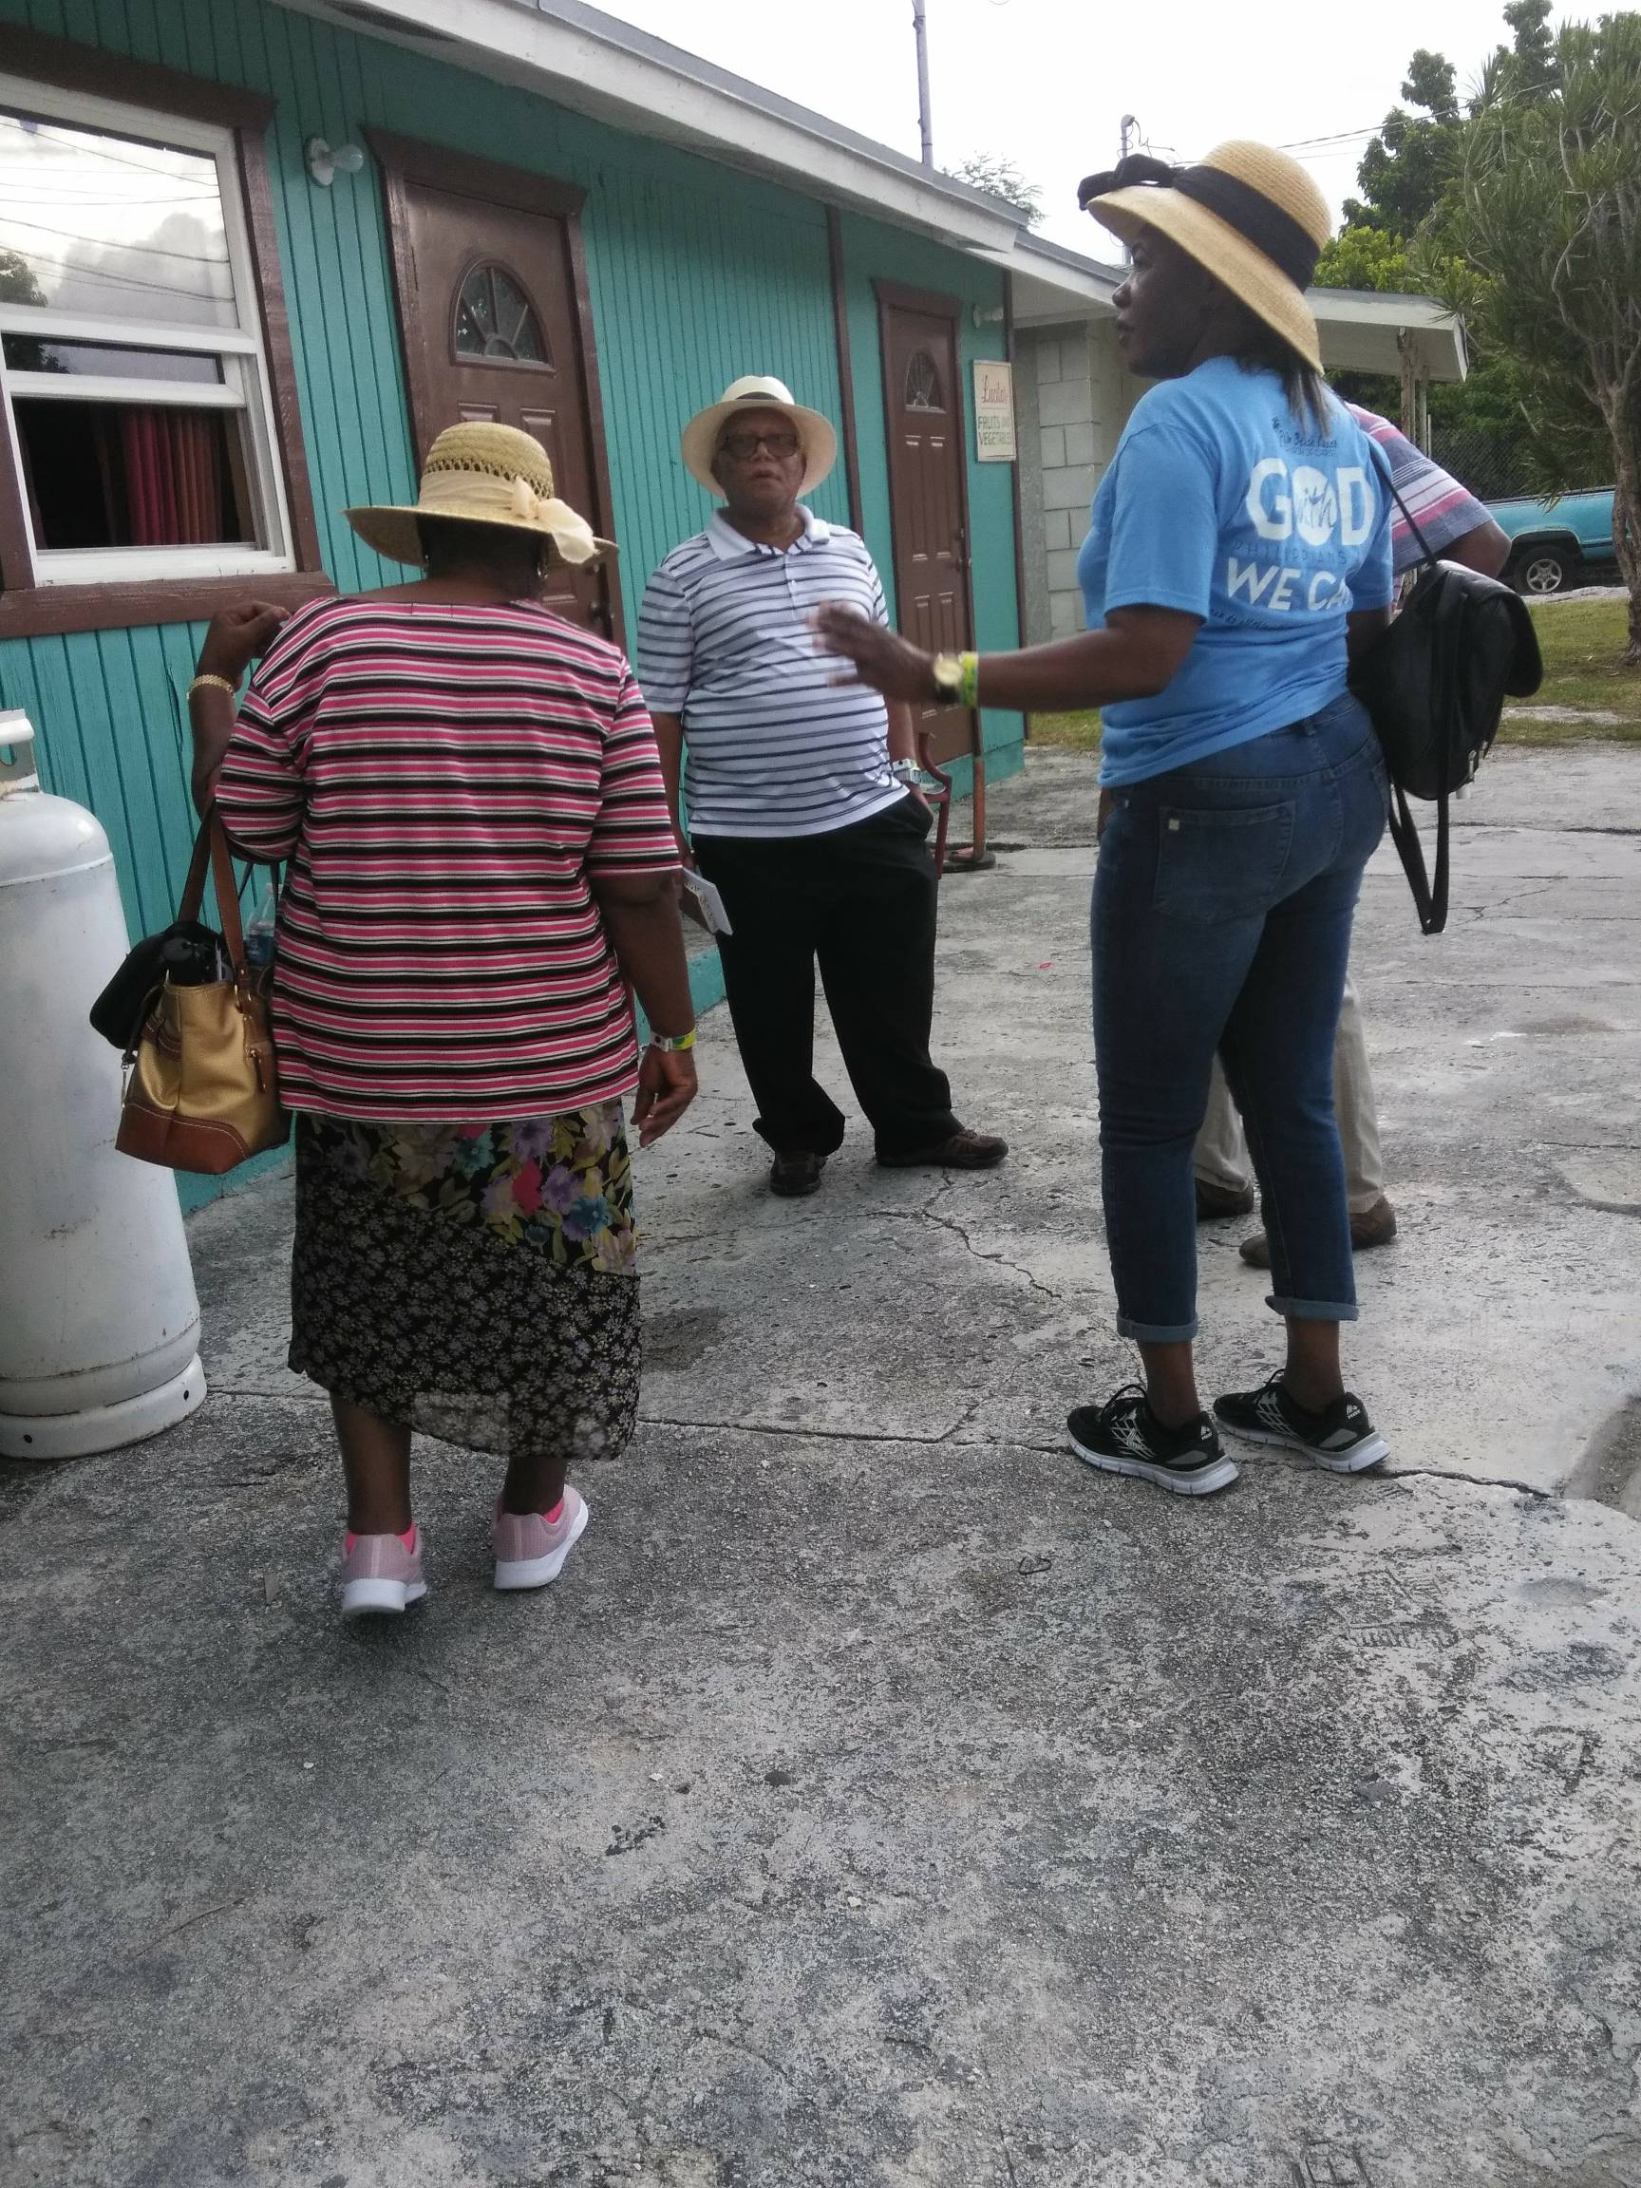

Slide 37
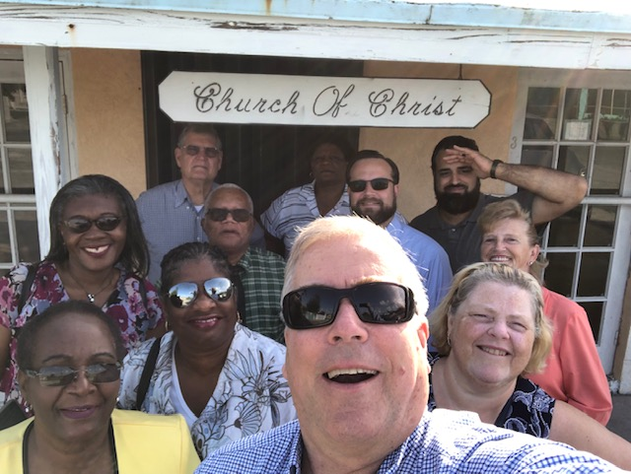

Slide 38
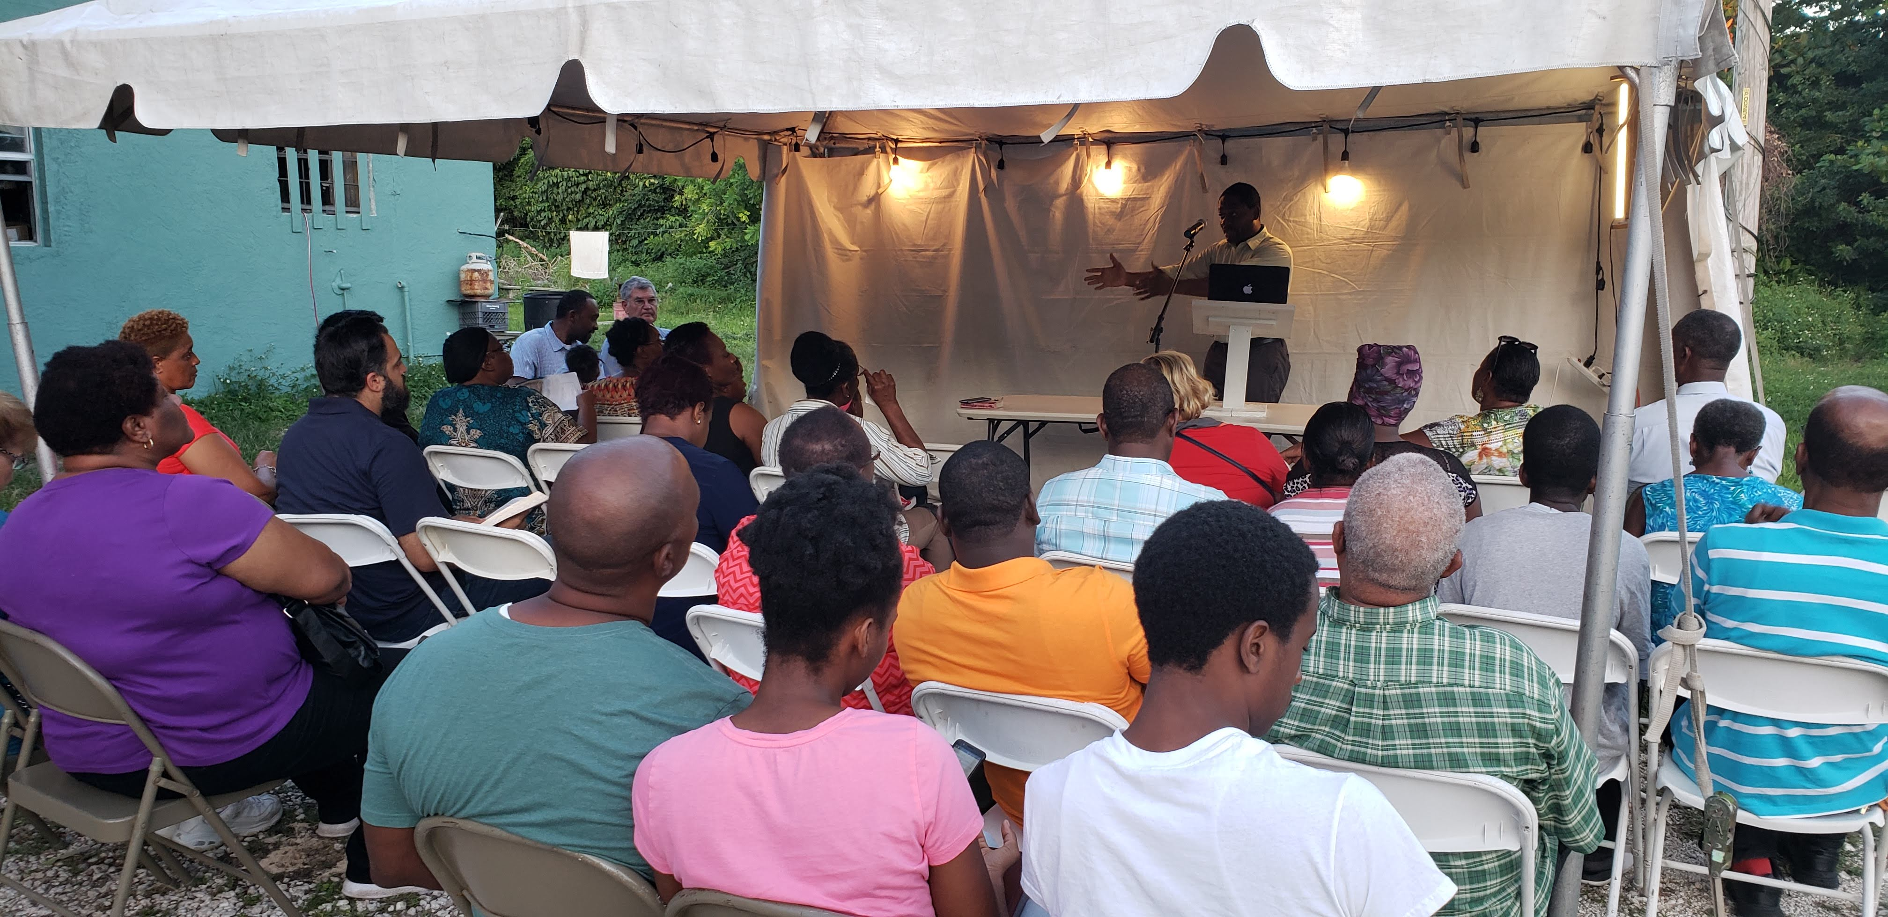

Slide 39
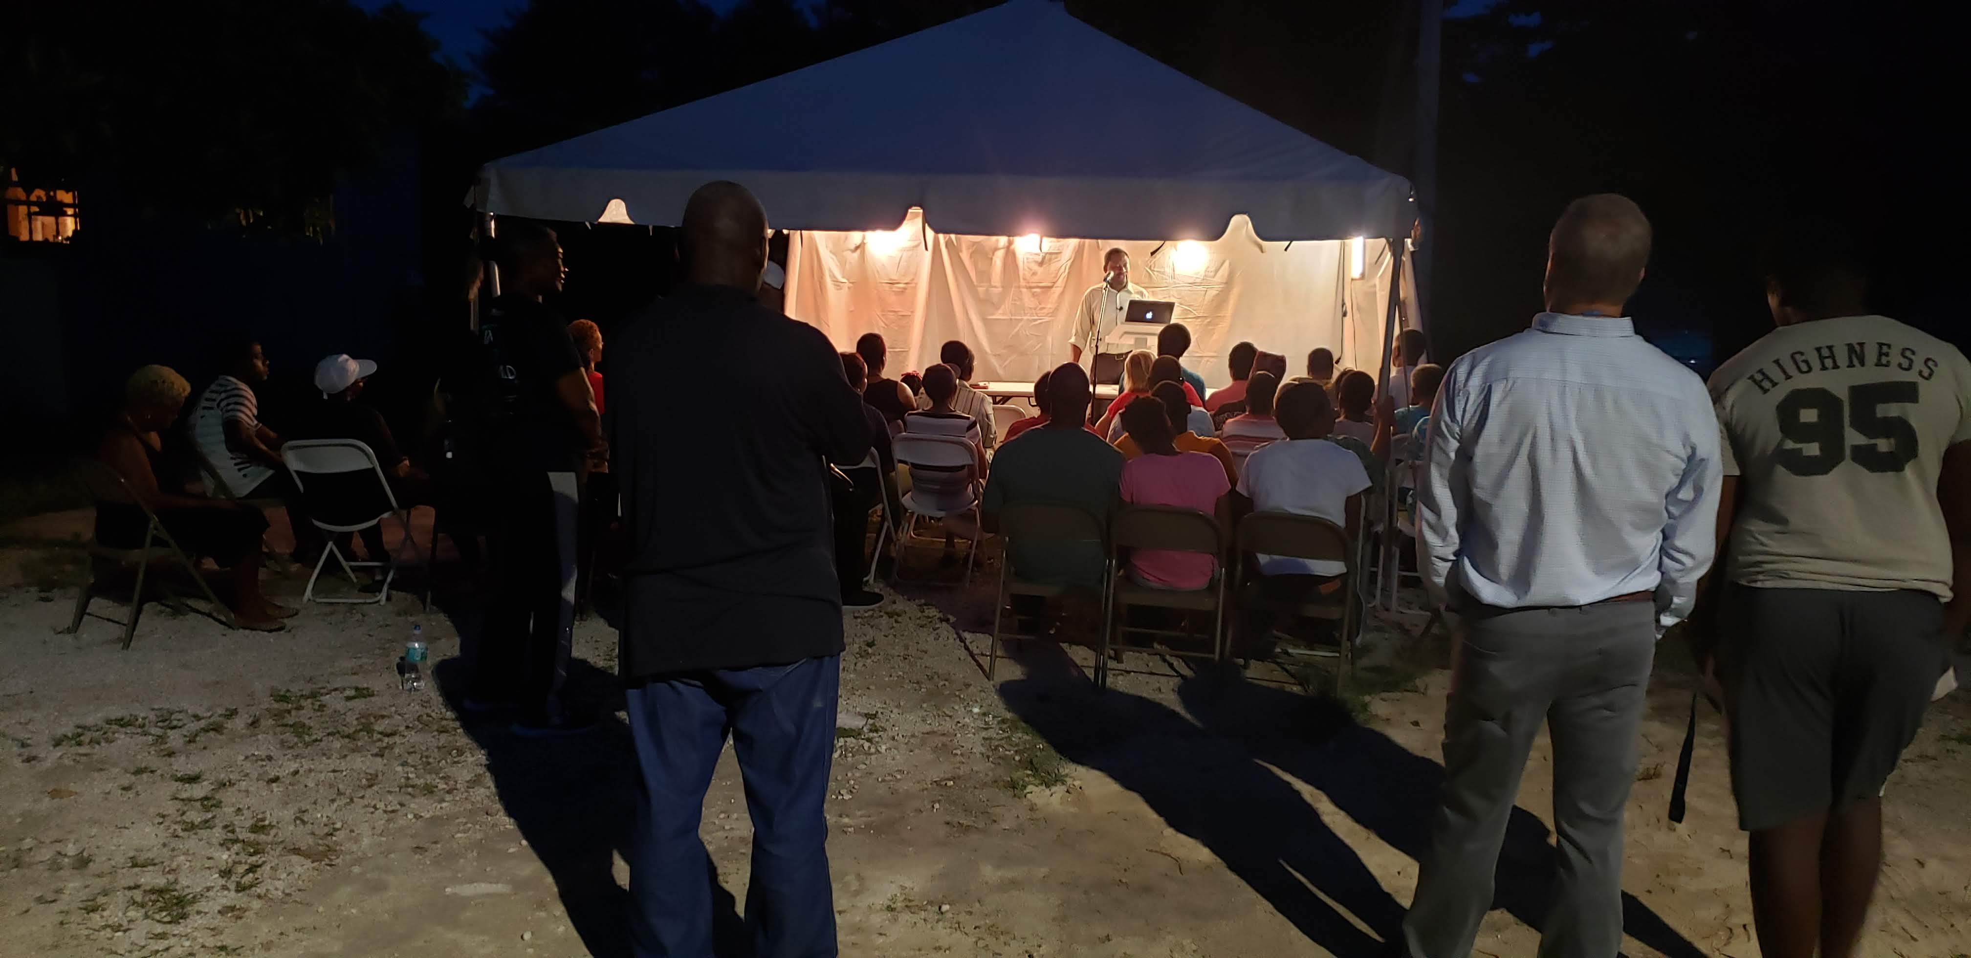

Slide 40
Easter Island
MARCH 14 -24

Slide 43
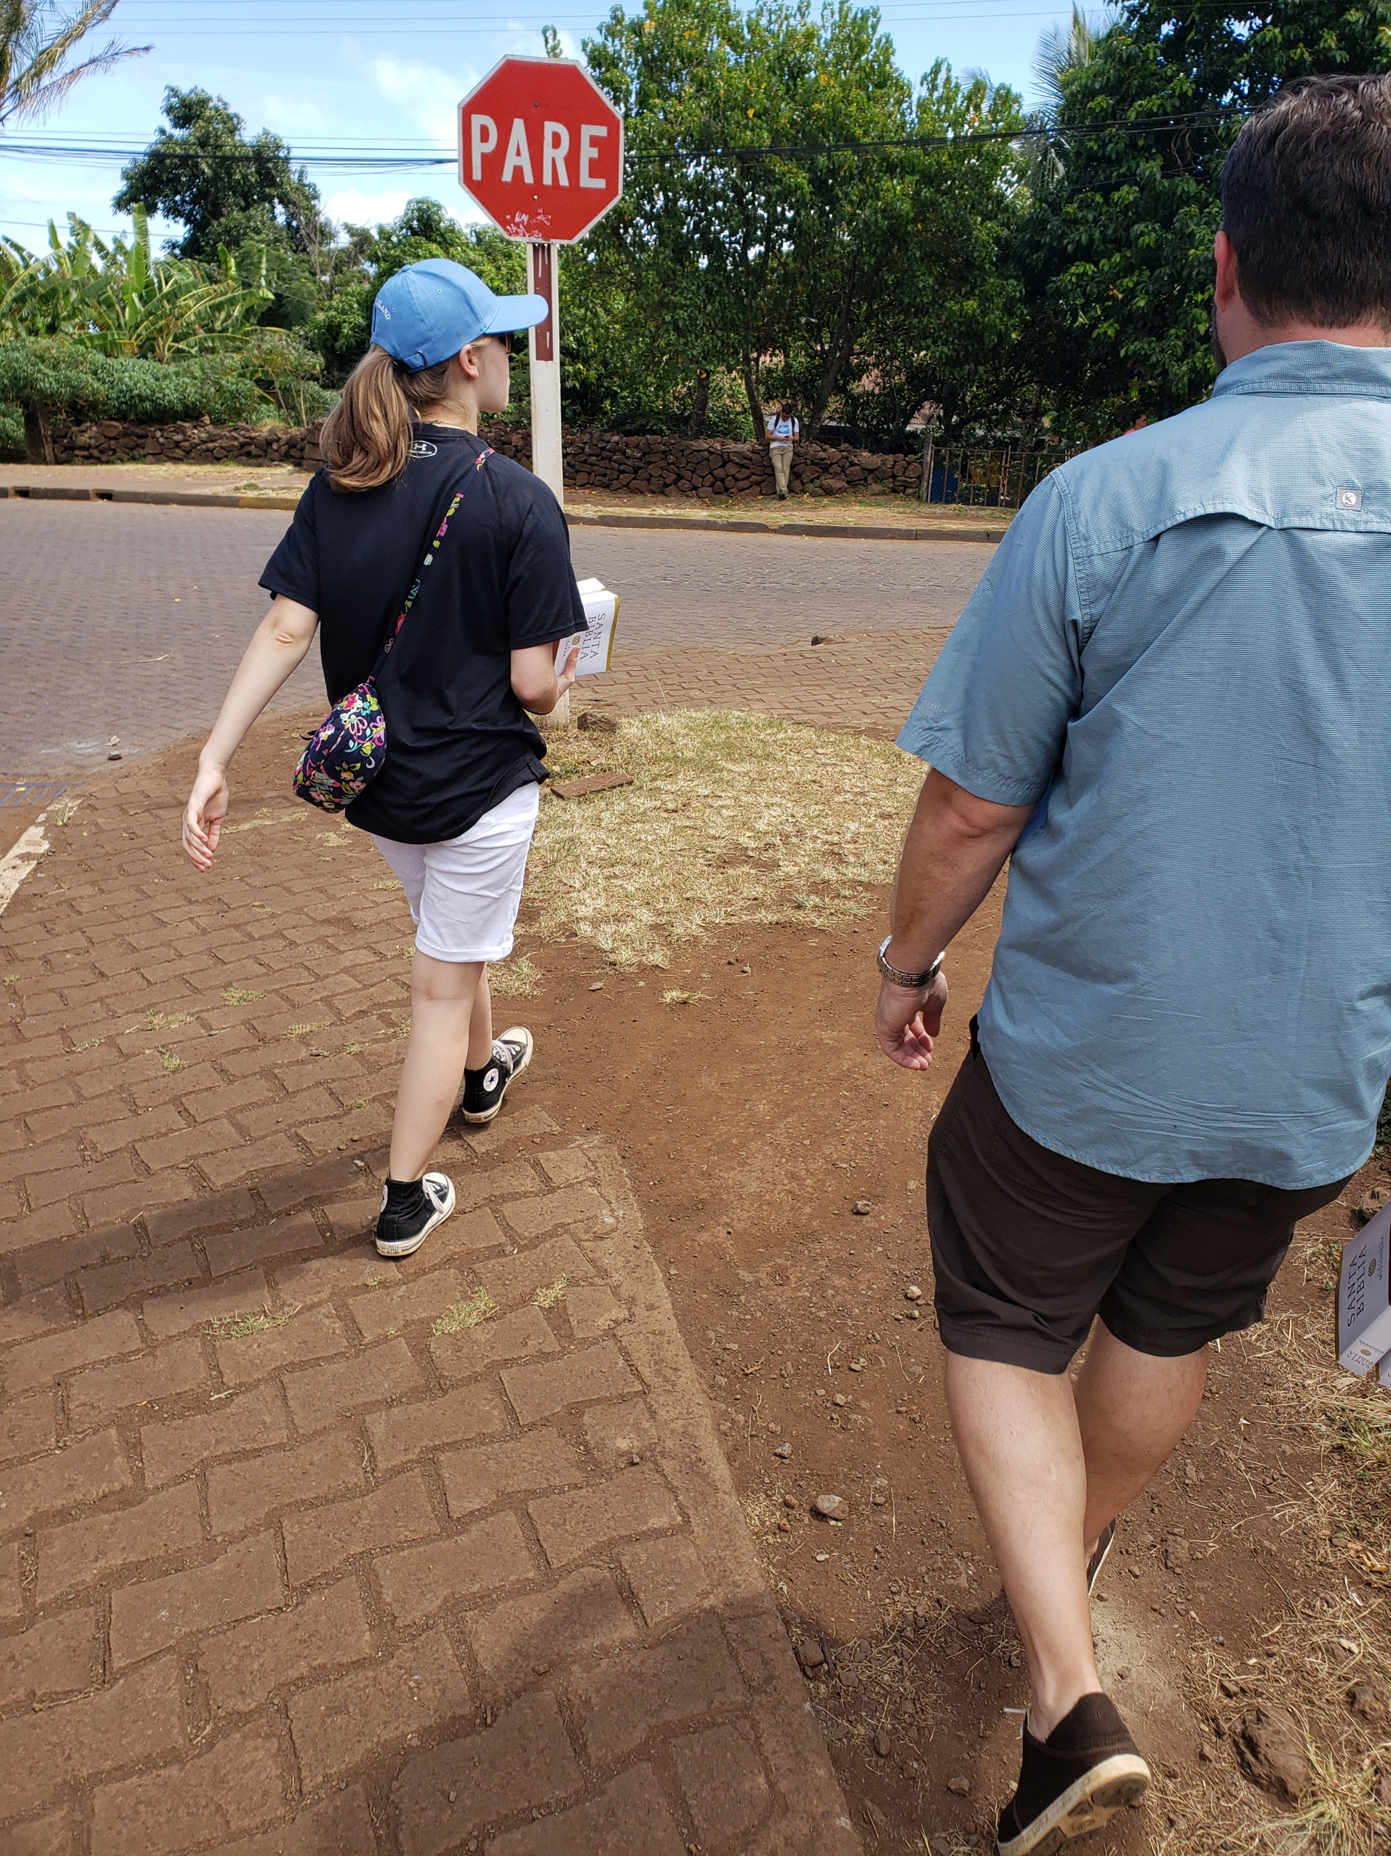

Slide 44
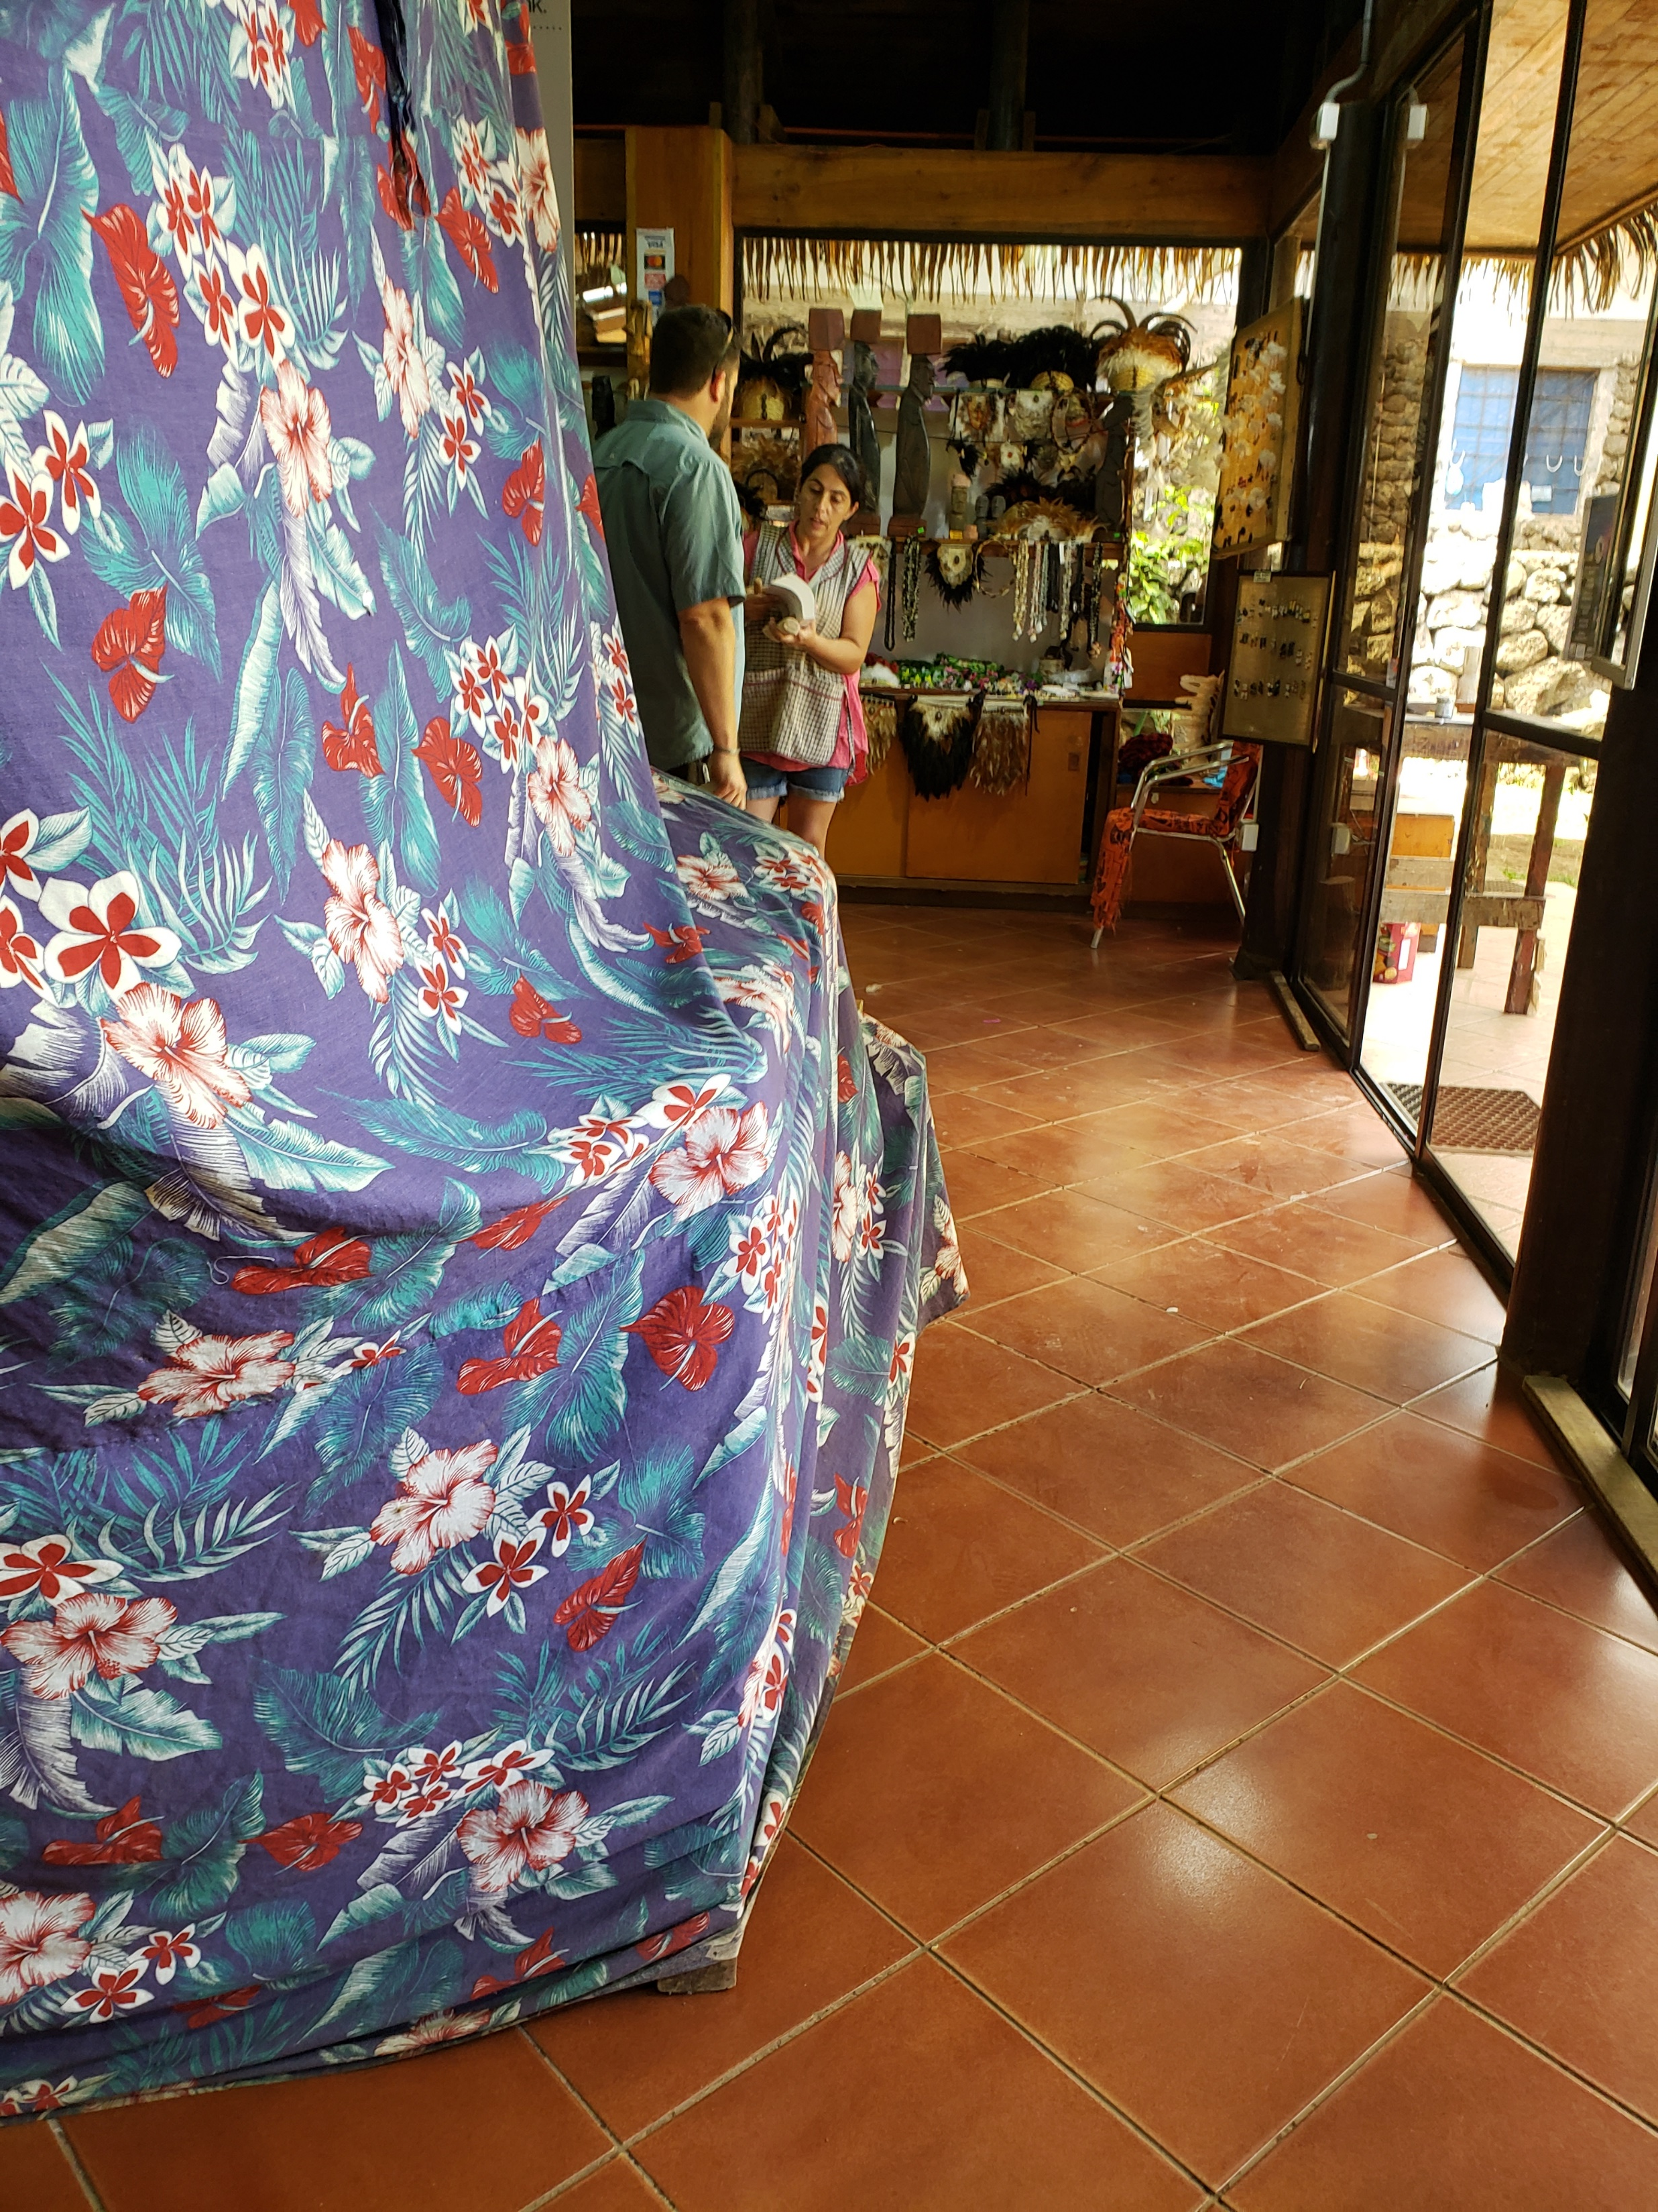

Slide 45
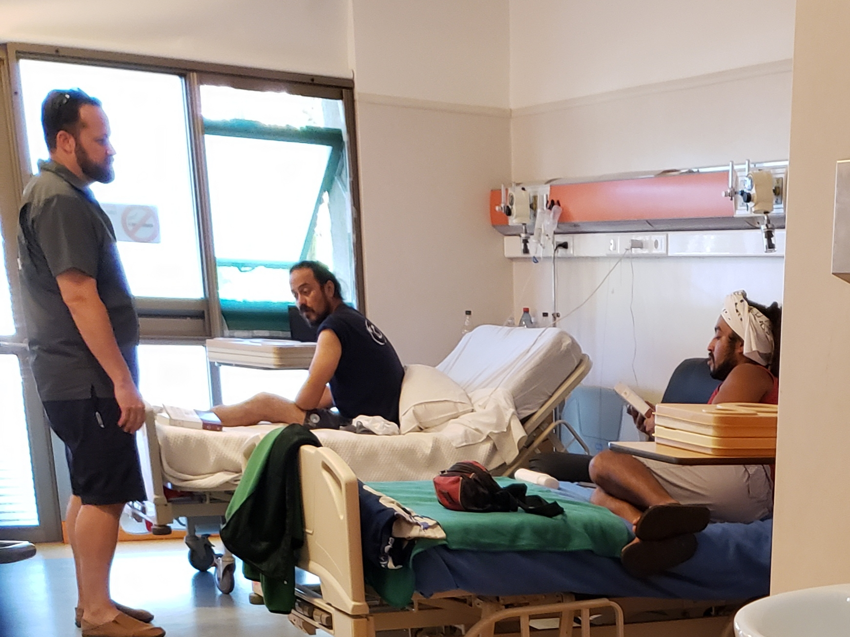

Slide 46
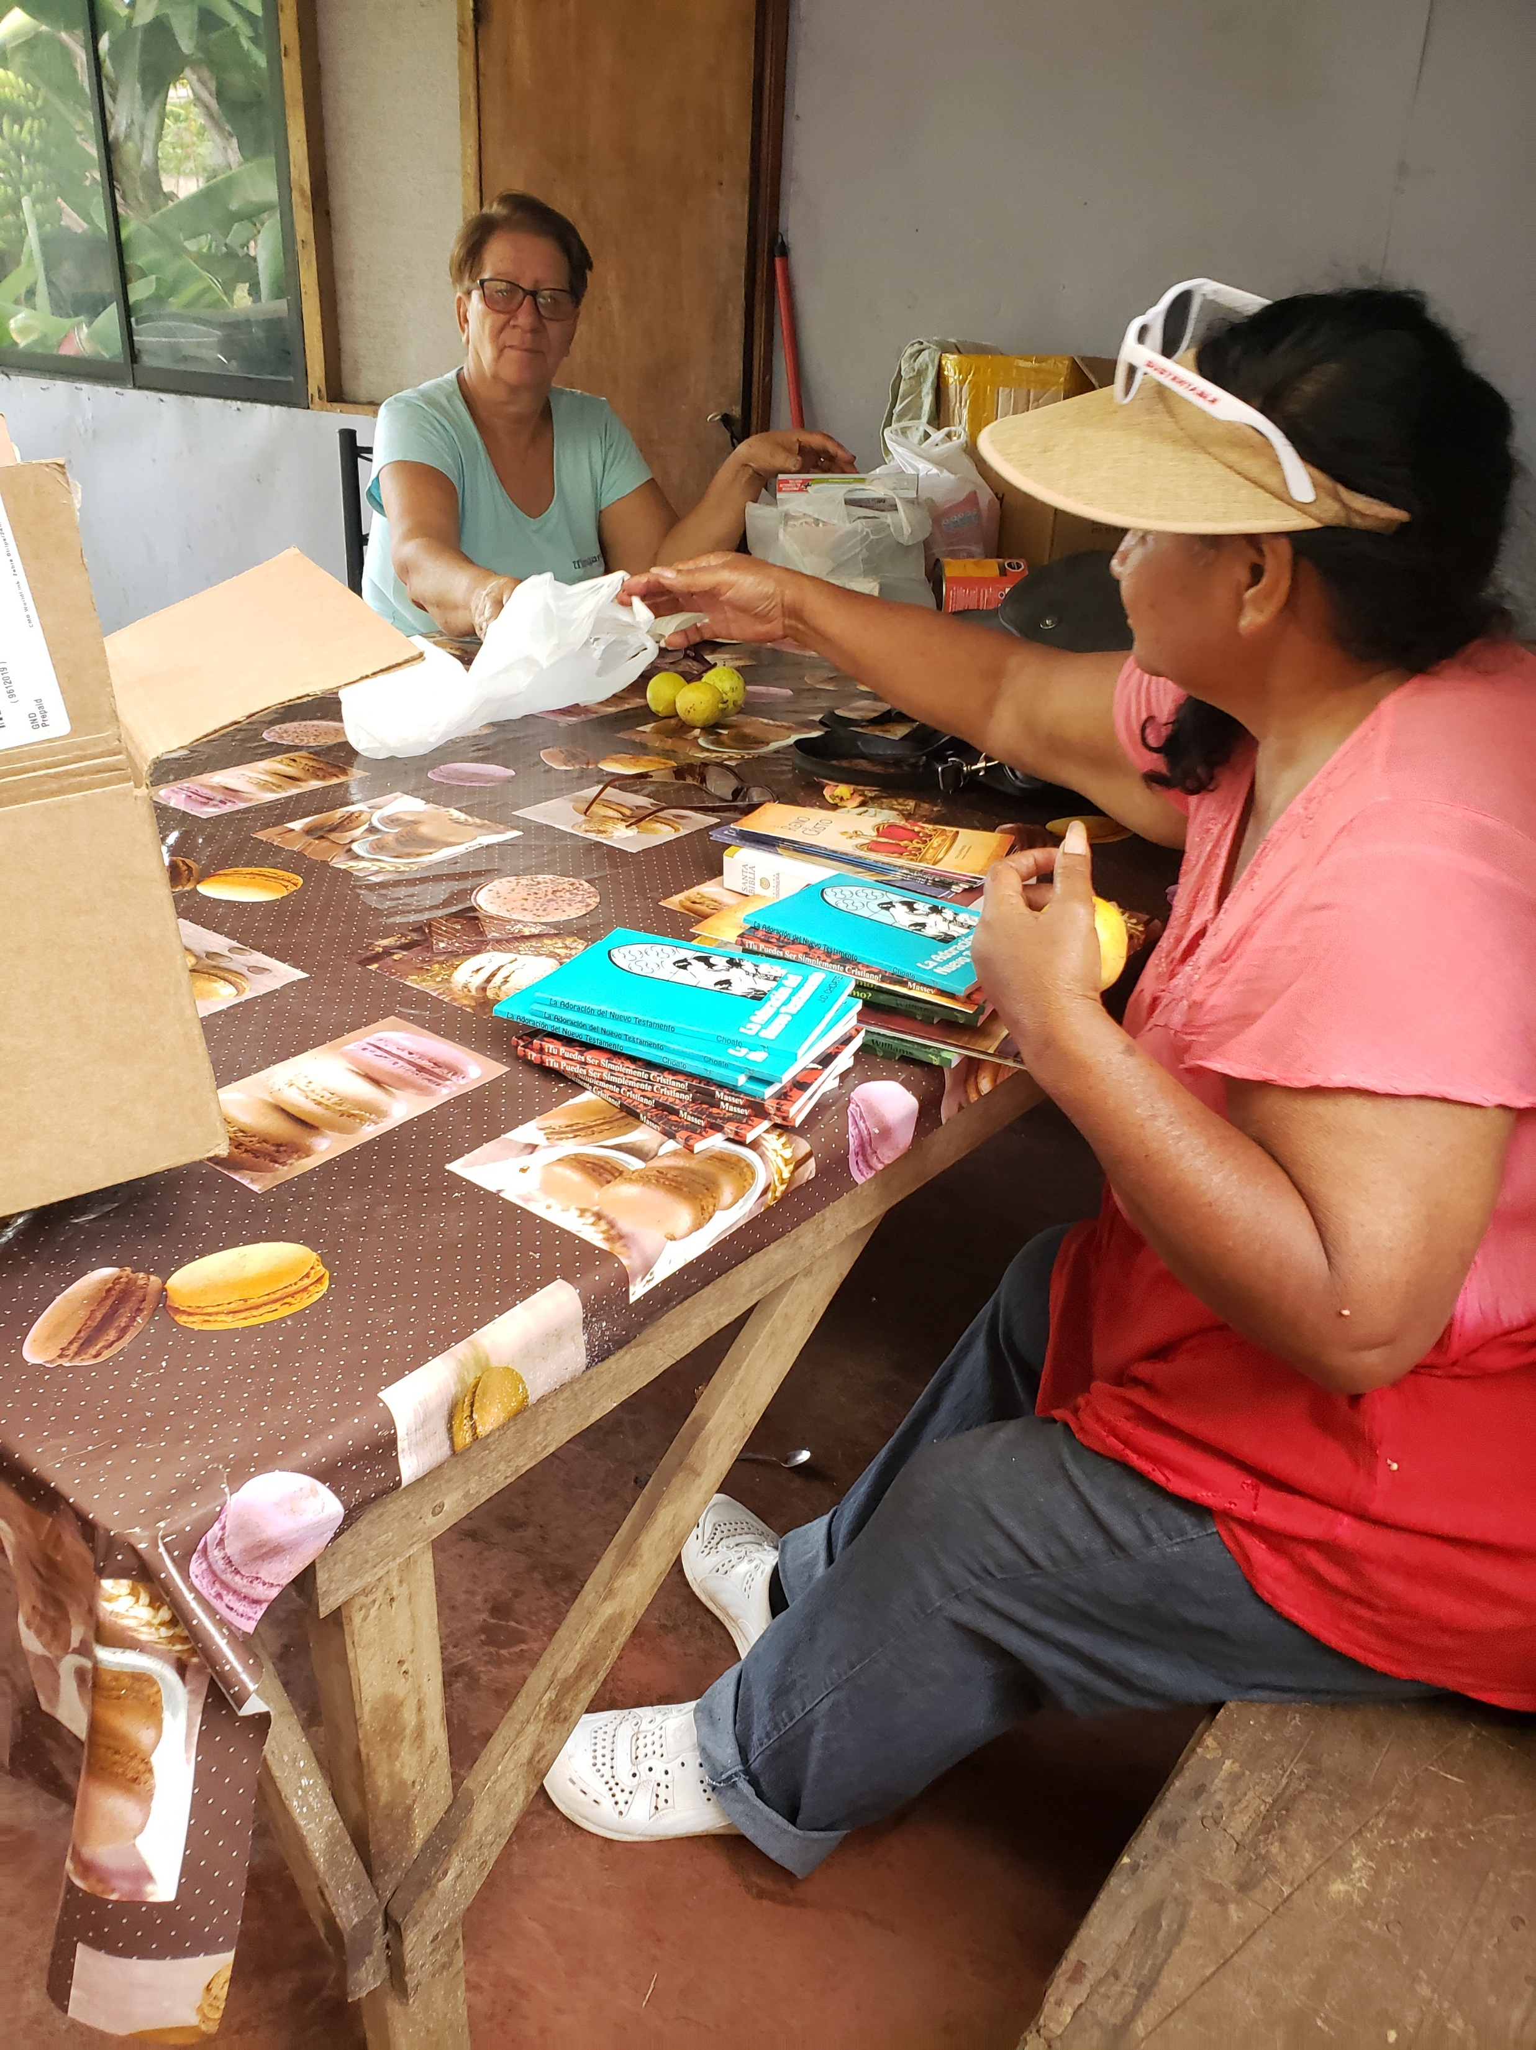

Slide 48
Easter Island
SEPTEMBER 6-15

Slide 55
Hear: Romans 10:17
Believe: Acts 8:37-38
Repent: Acts 2:38
Confess: Romans 10:10
Be Baptized: Mark 16:15-16
Live Faithfully: Revelation 2:10

