Slide 1
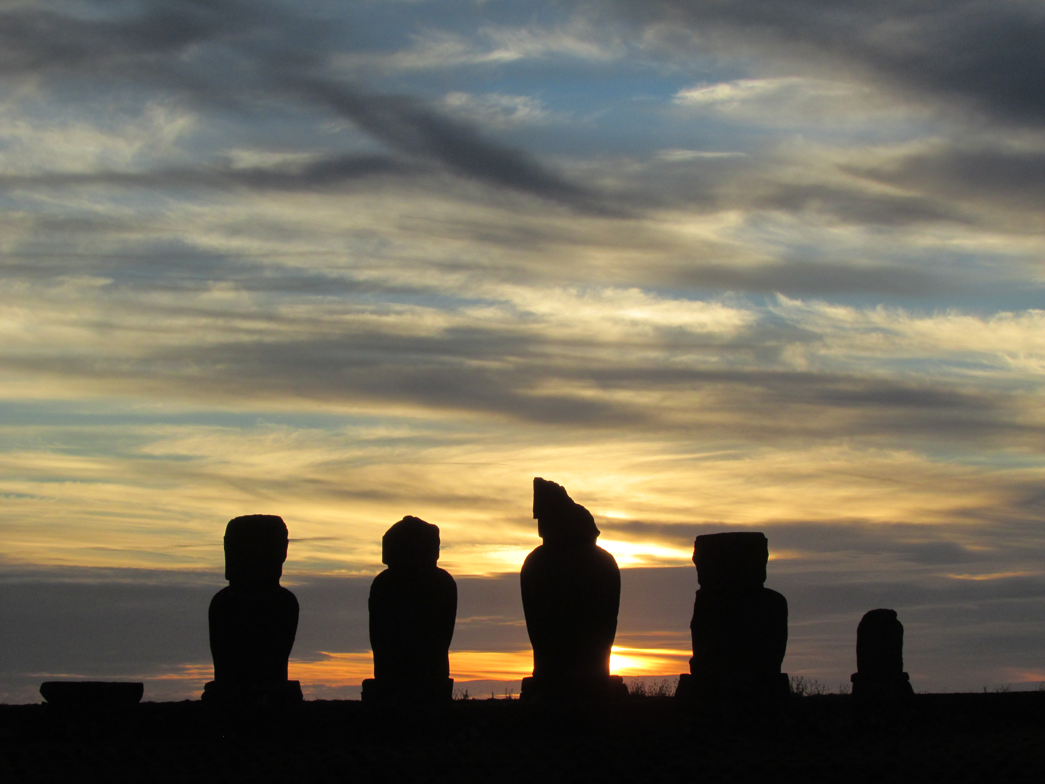
Rapa Nui
Report

Slide 2
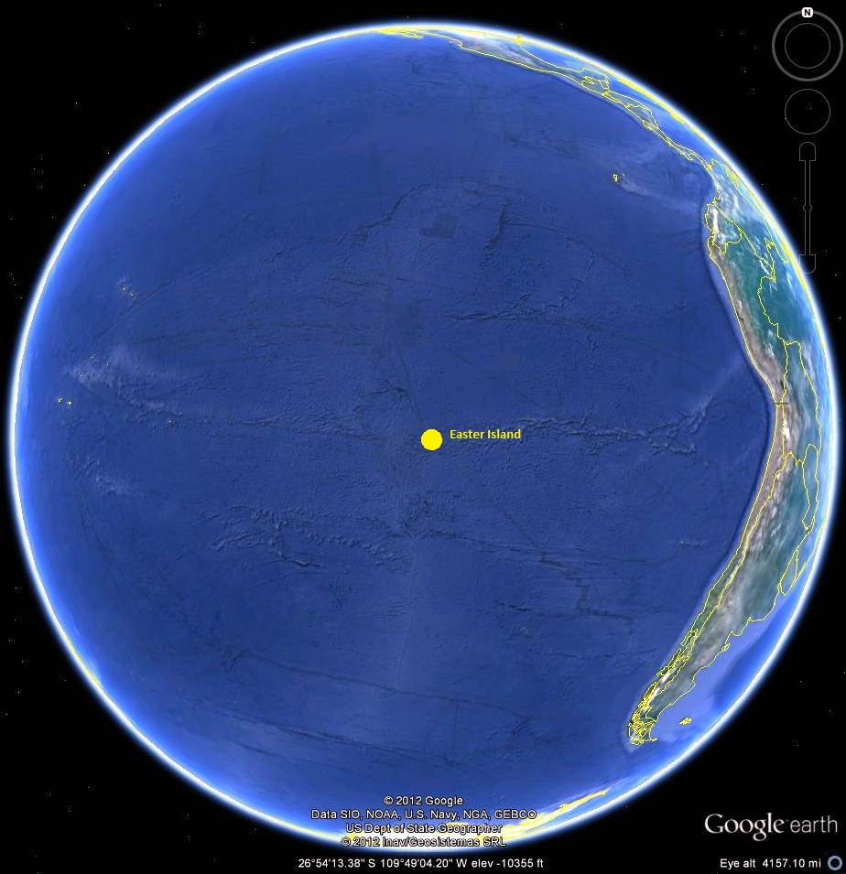
The Island

Slide 3
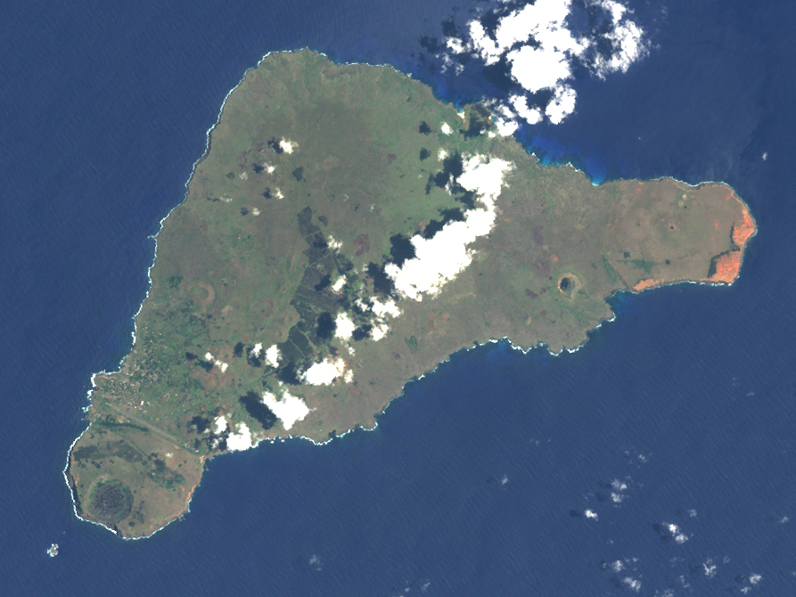

Slide 4
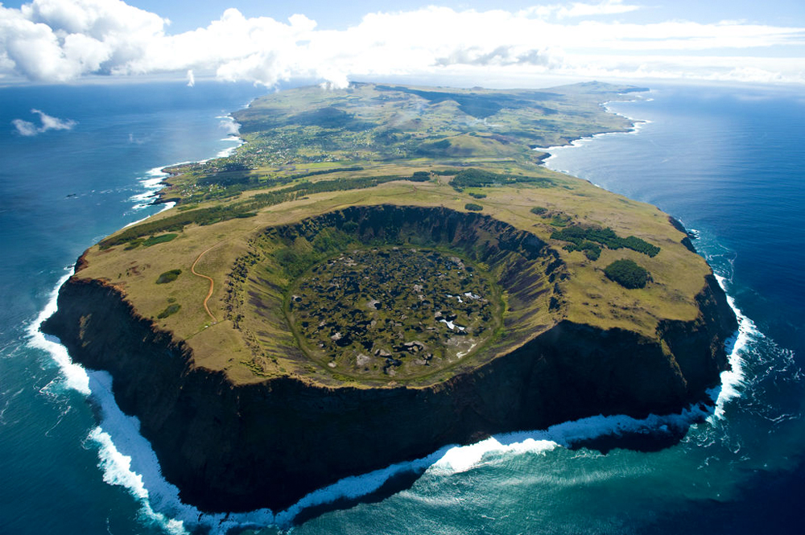

Slide 5
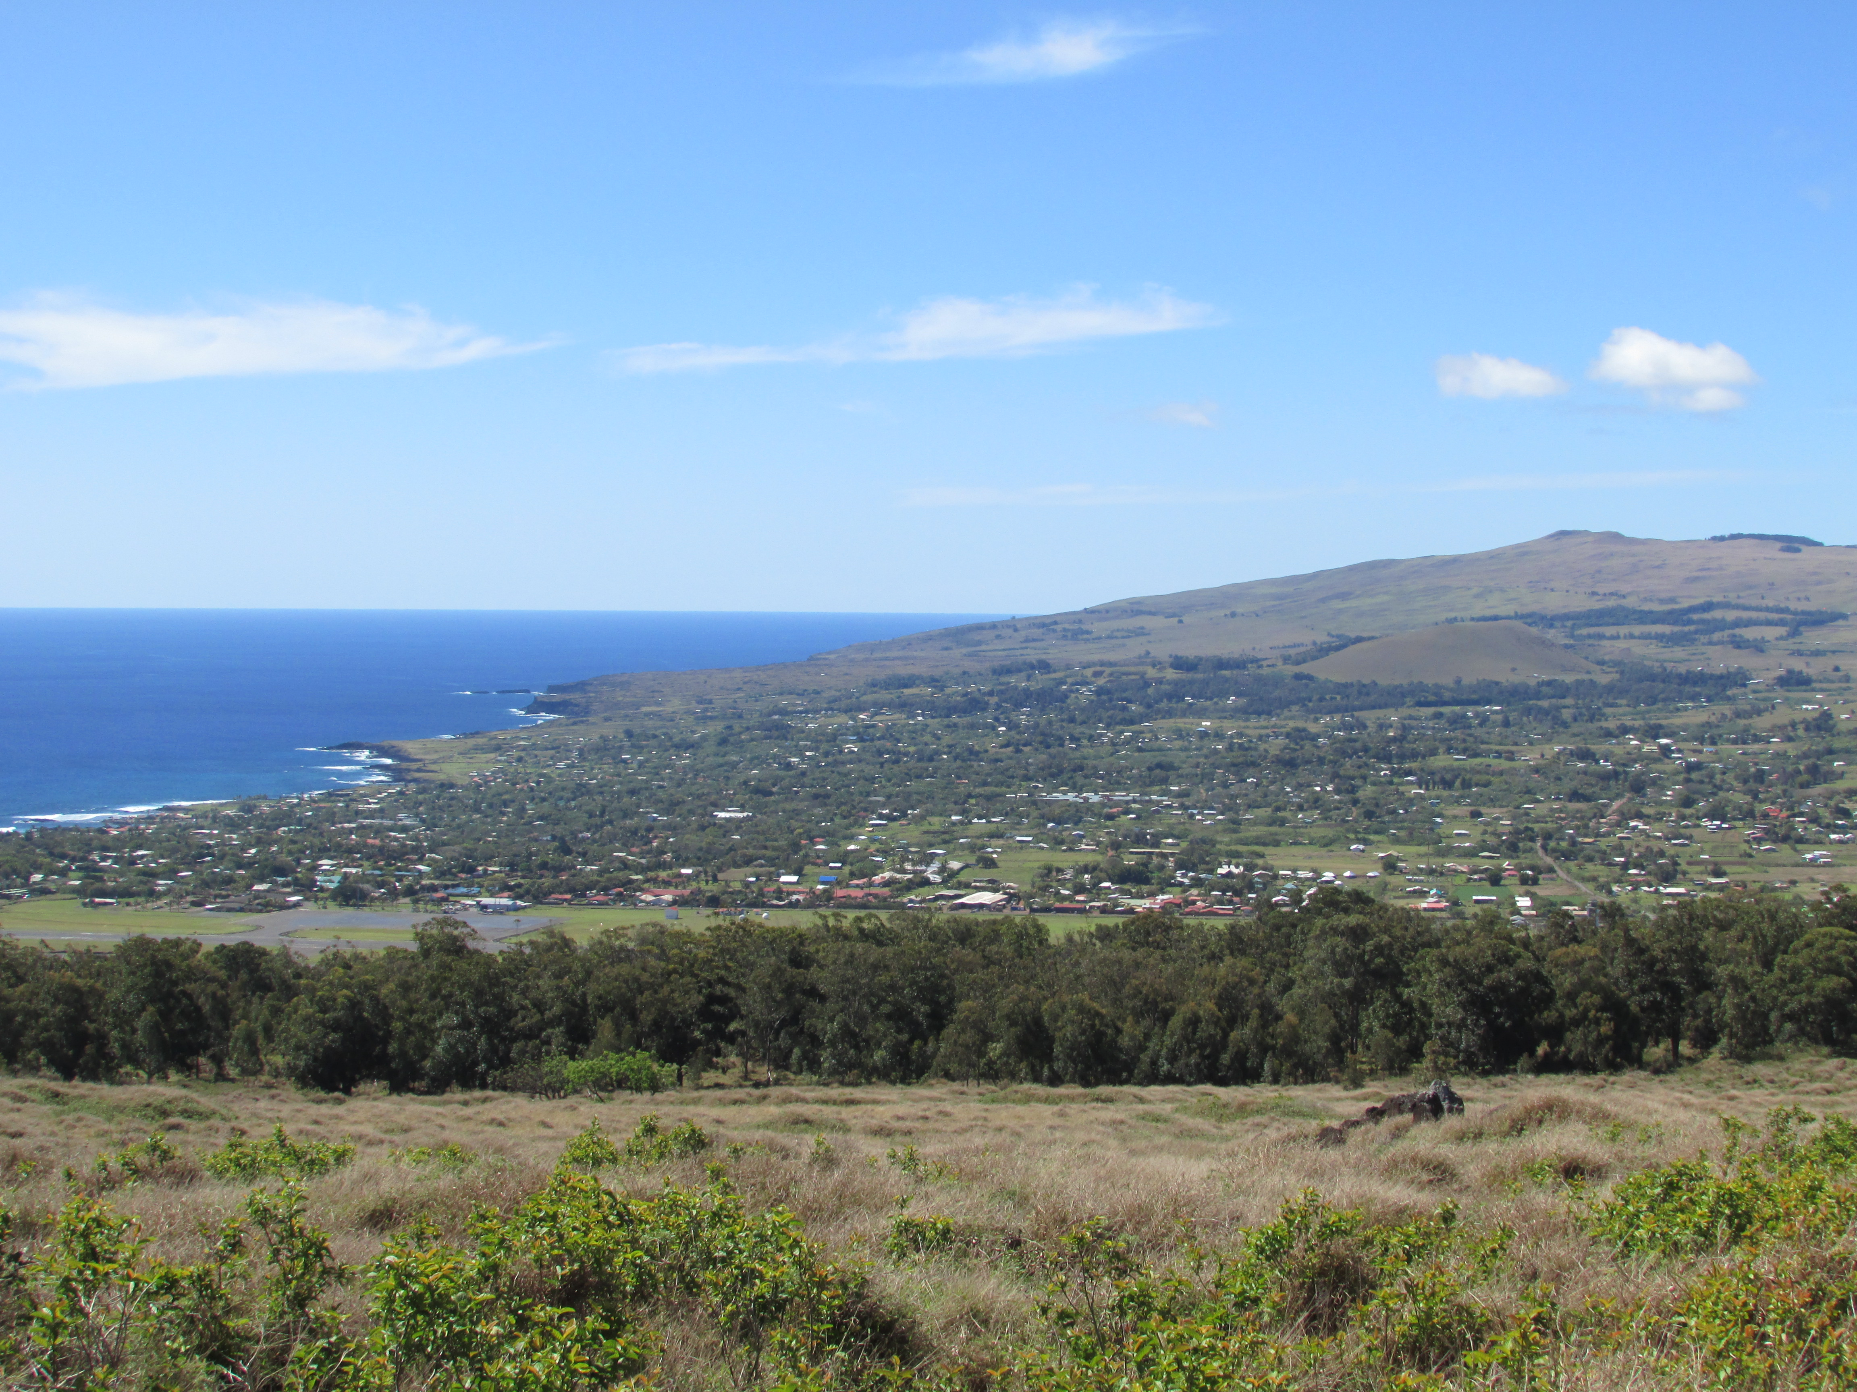

Slide 6
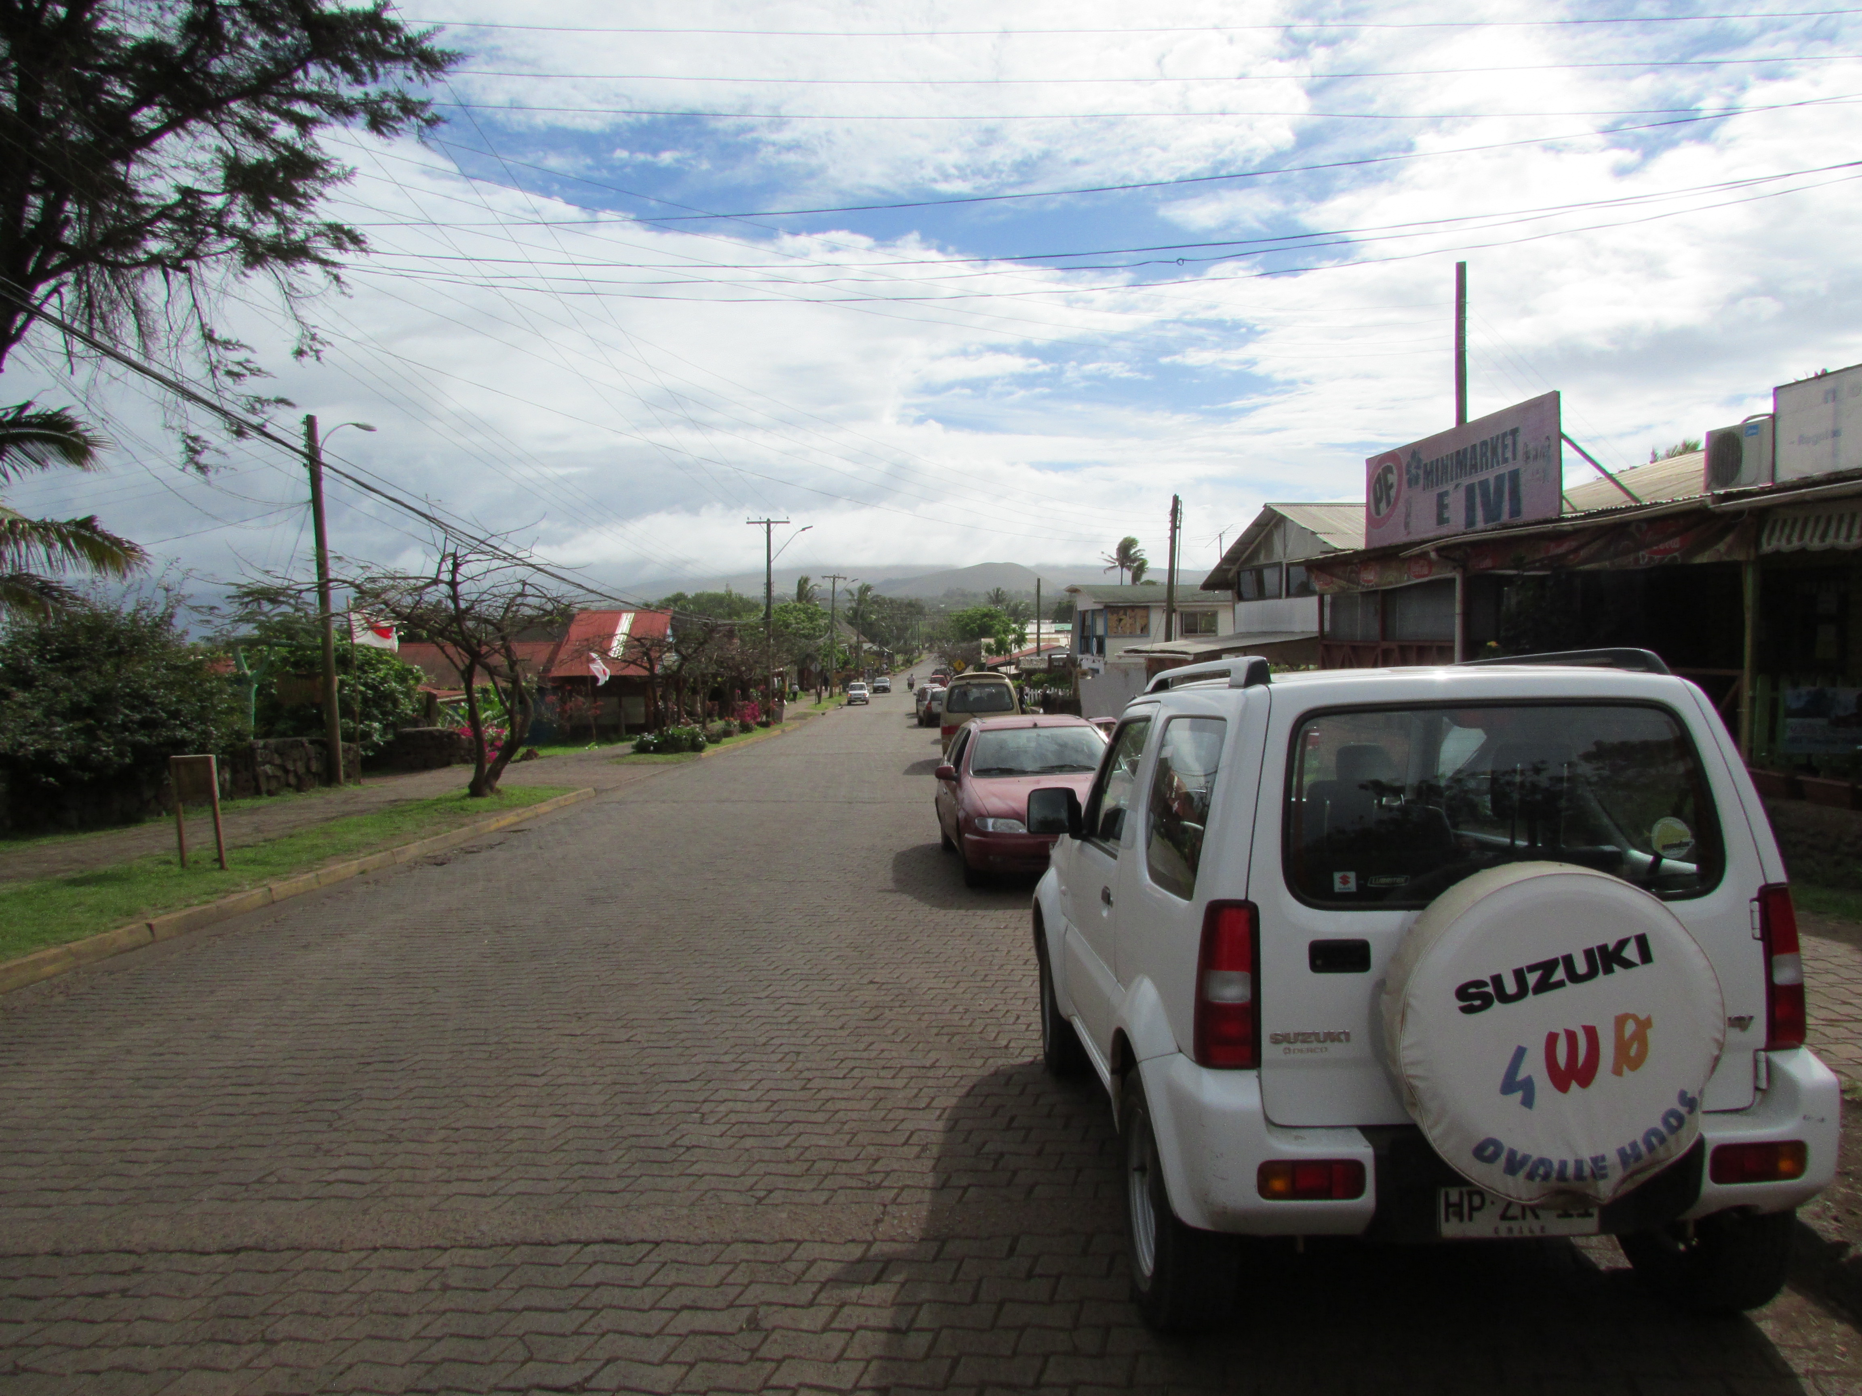

Slide 7
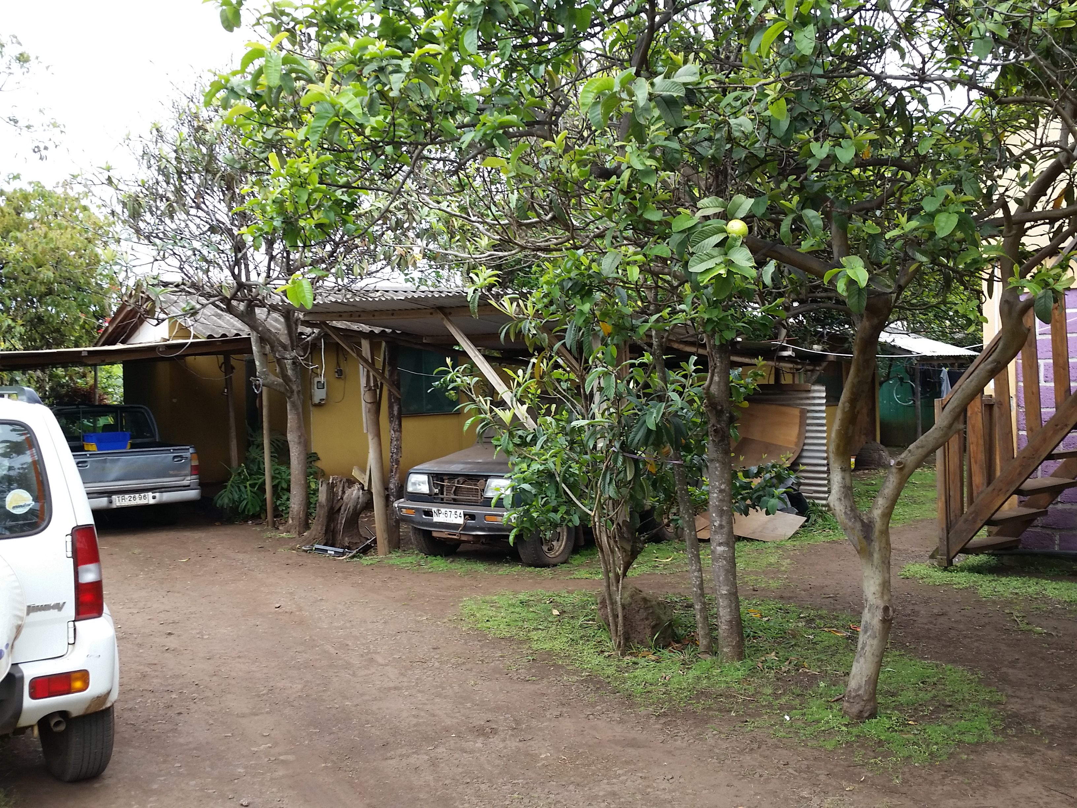

Slide 8
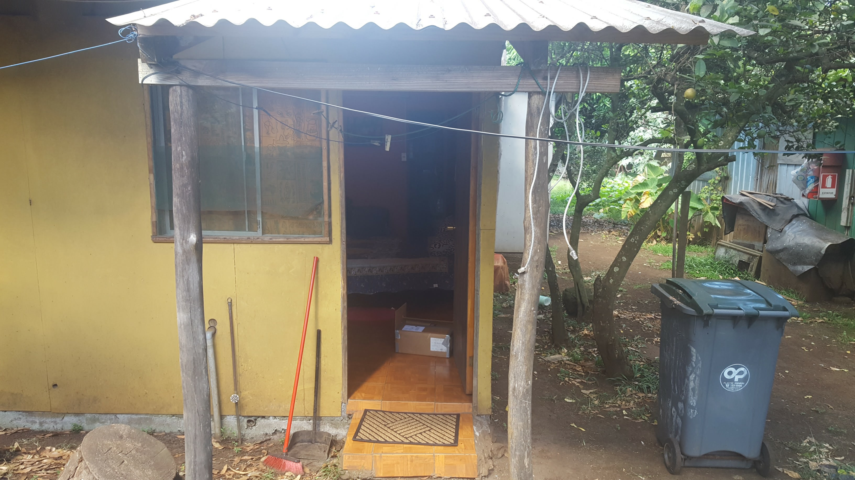

Slide 9
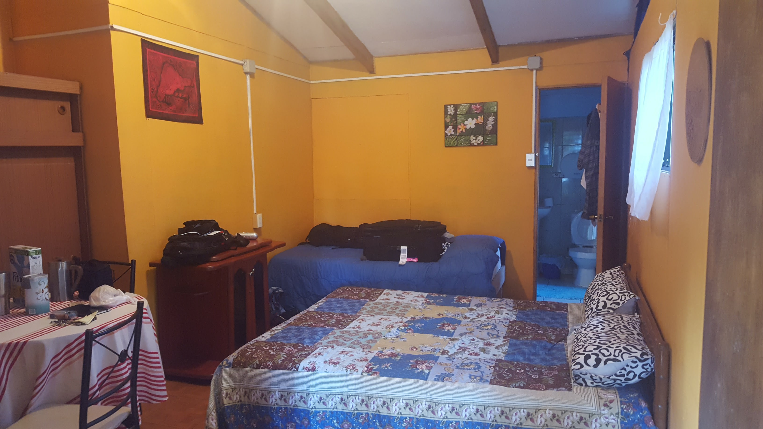

Slide 10
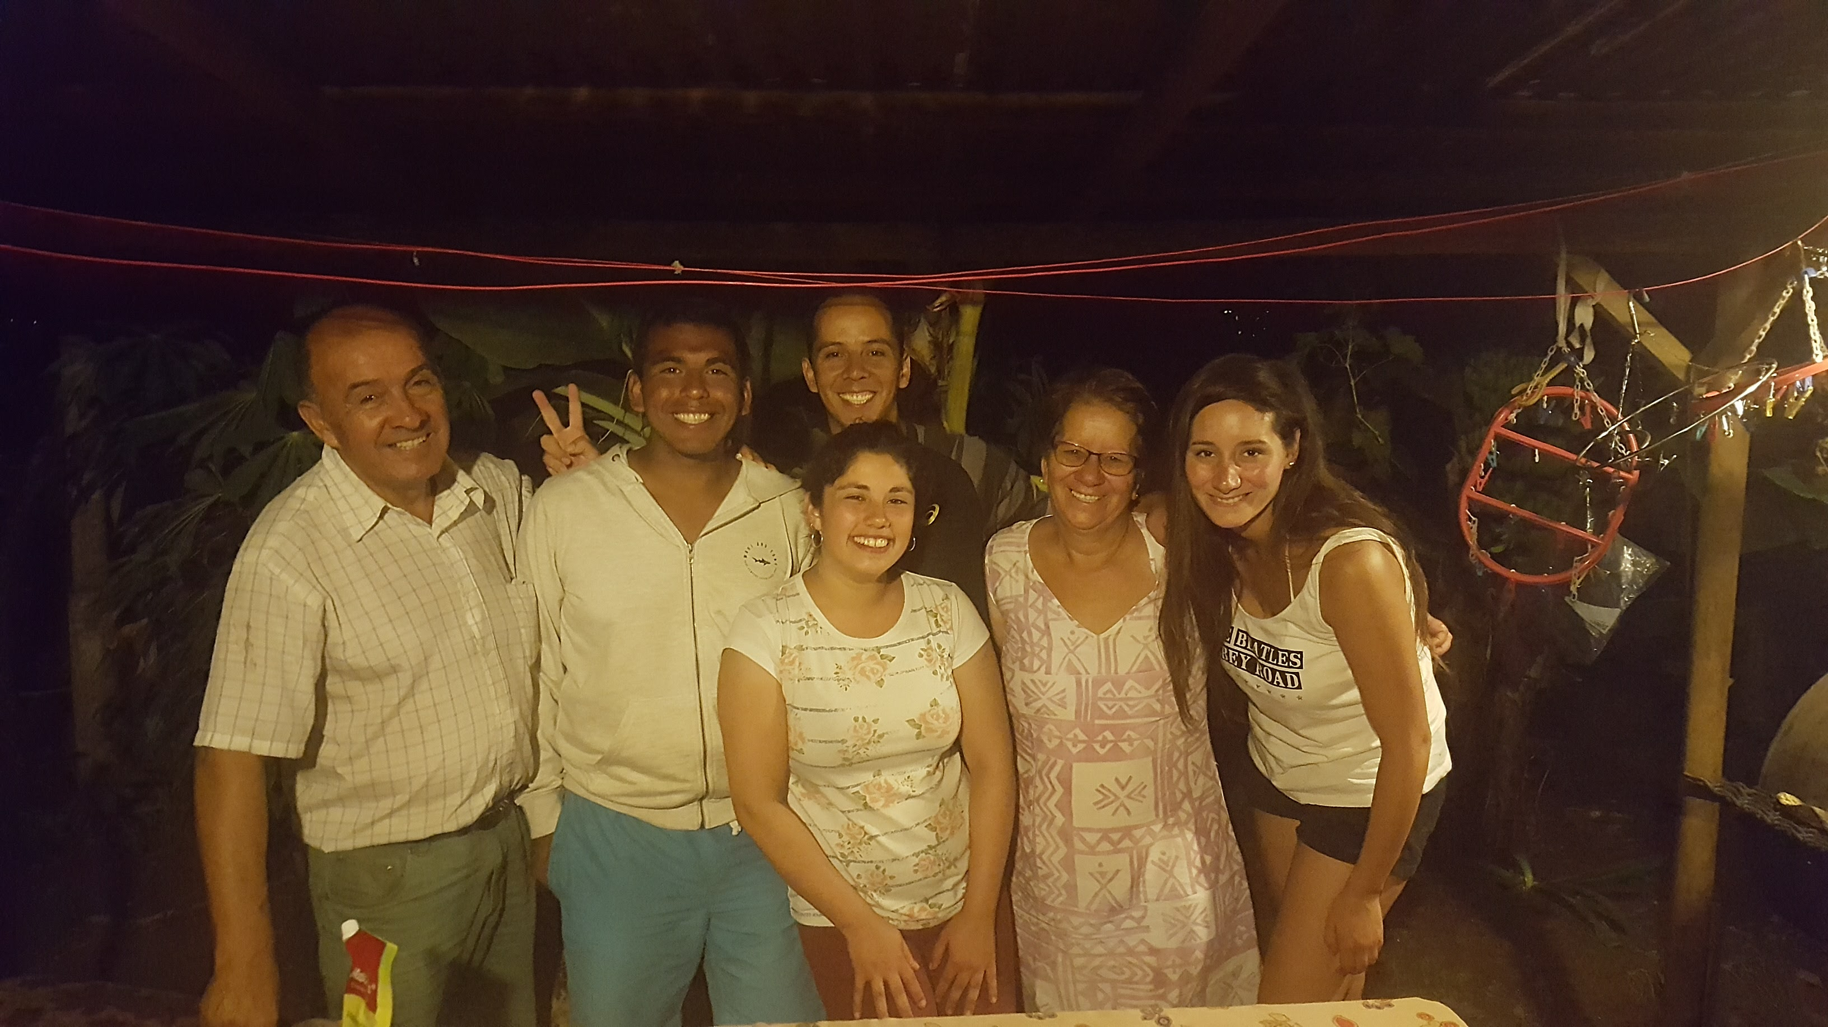

Slide 11
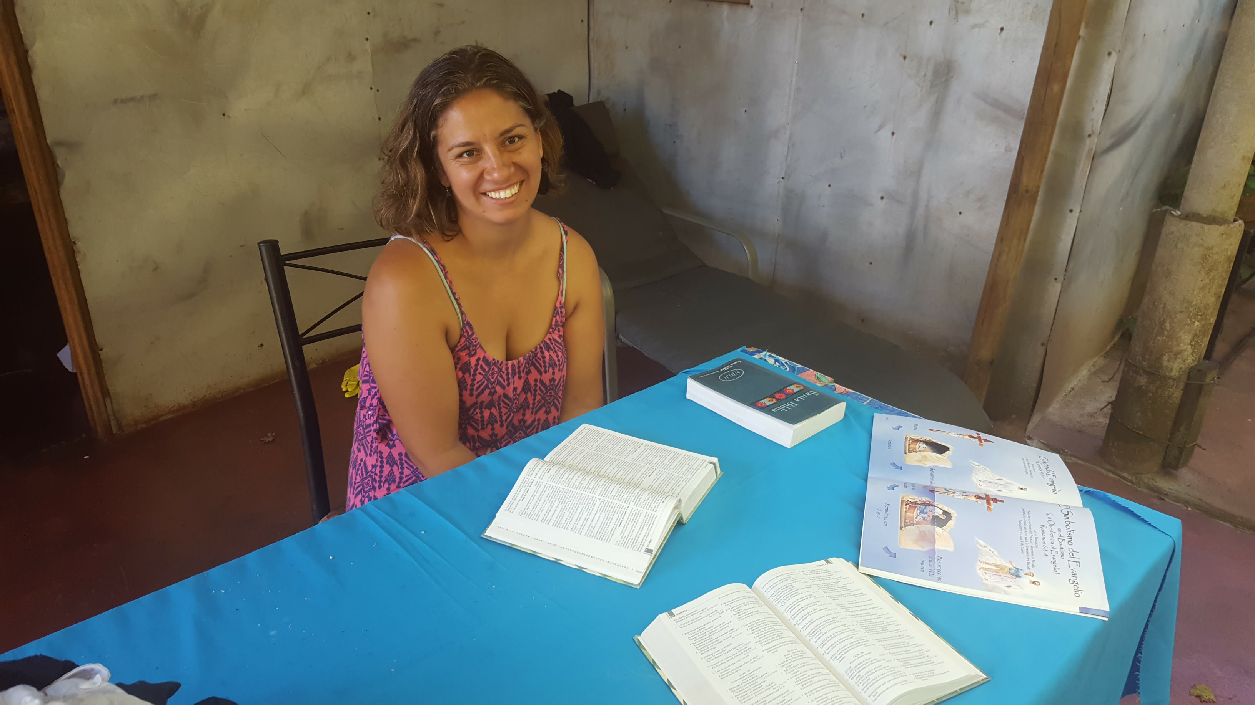

Slide 12
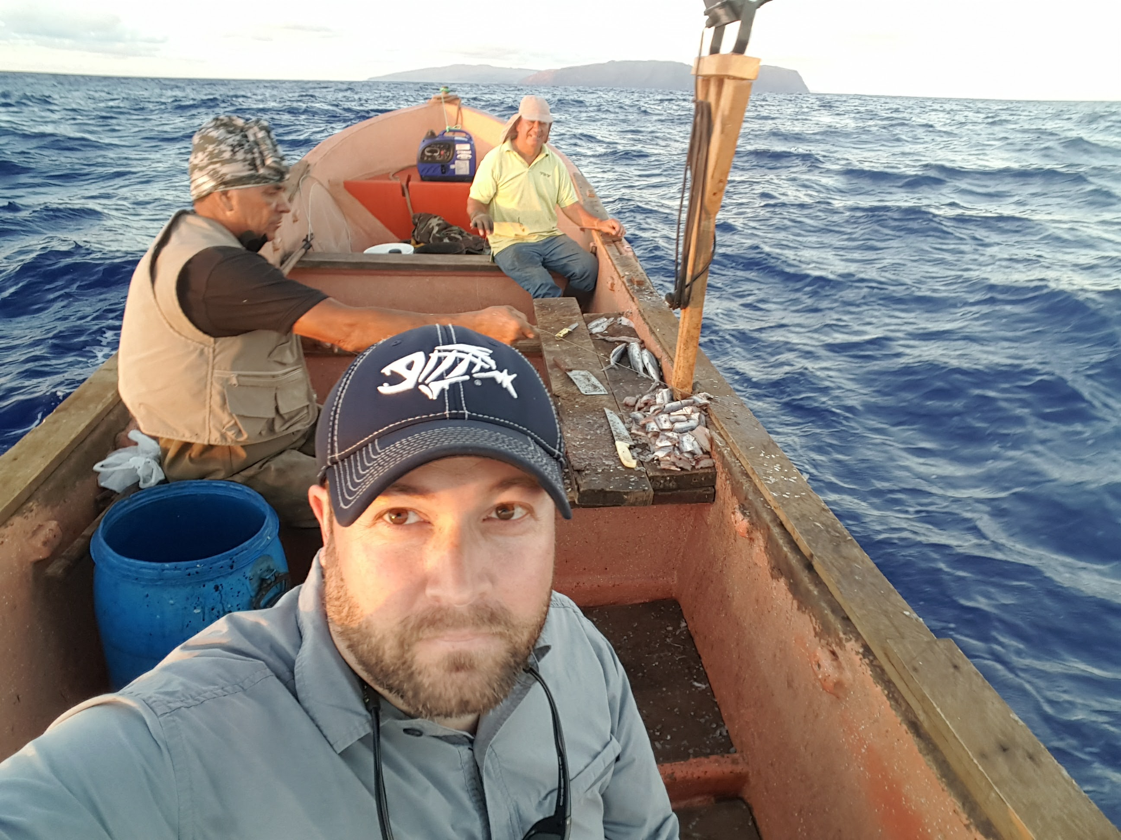

Slide 13
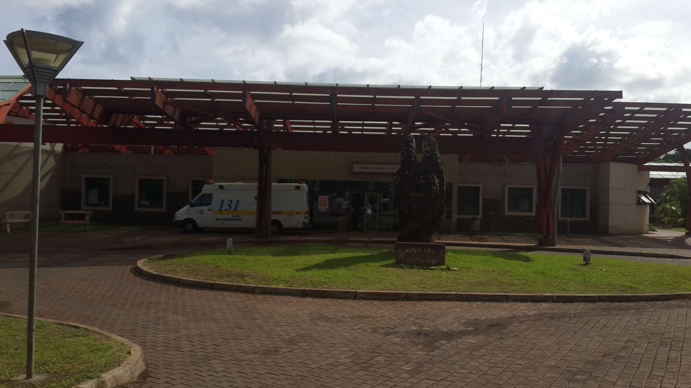

Slide 14
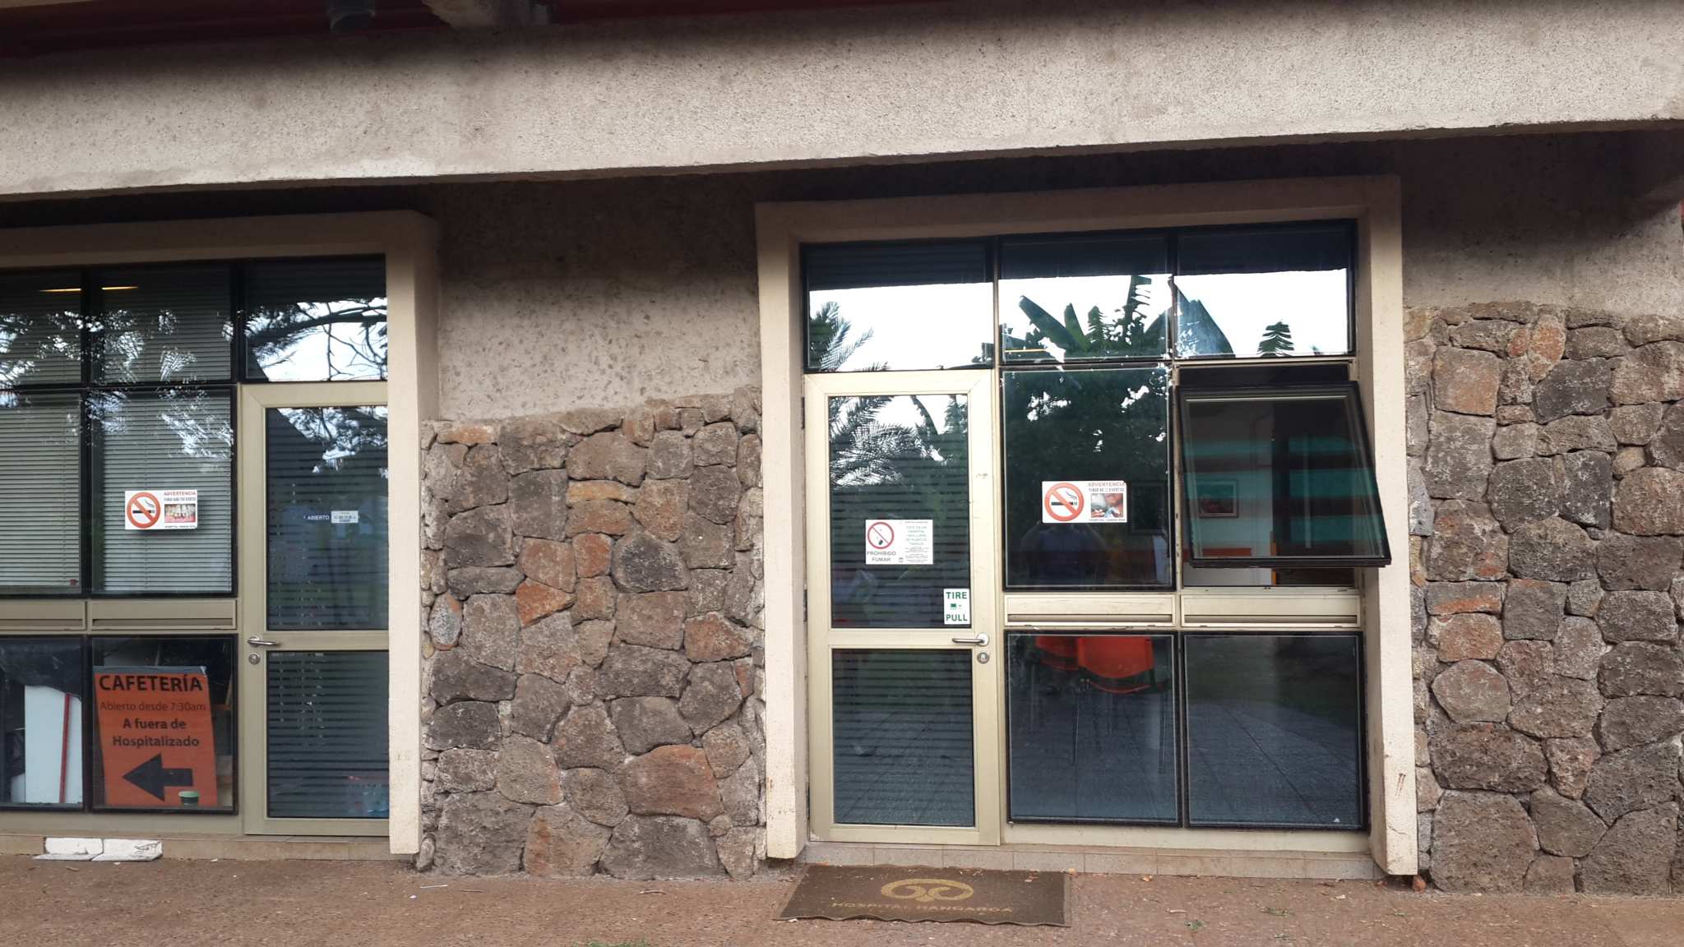

Slide 15
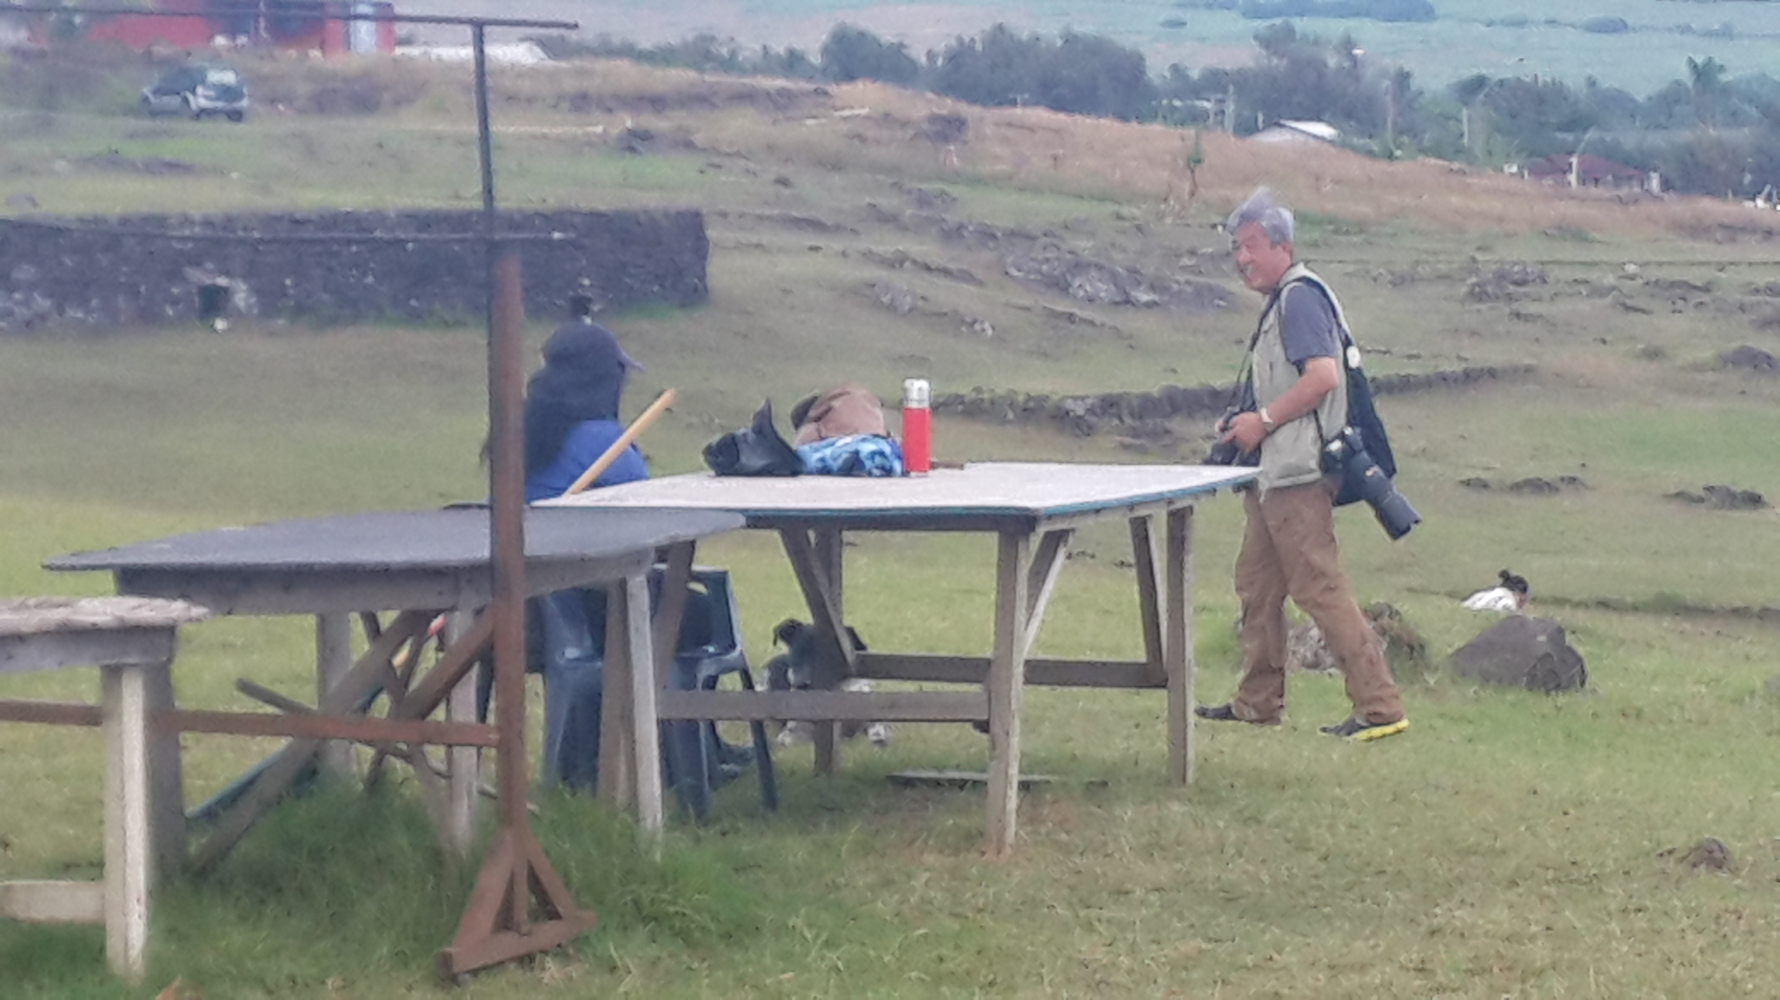

Slide 16
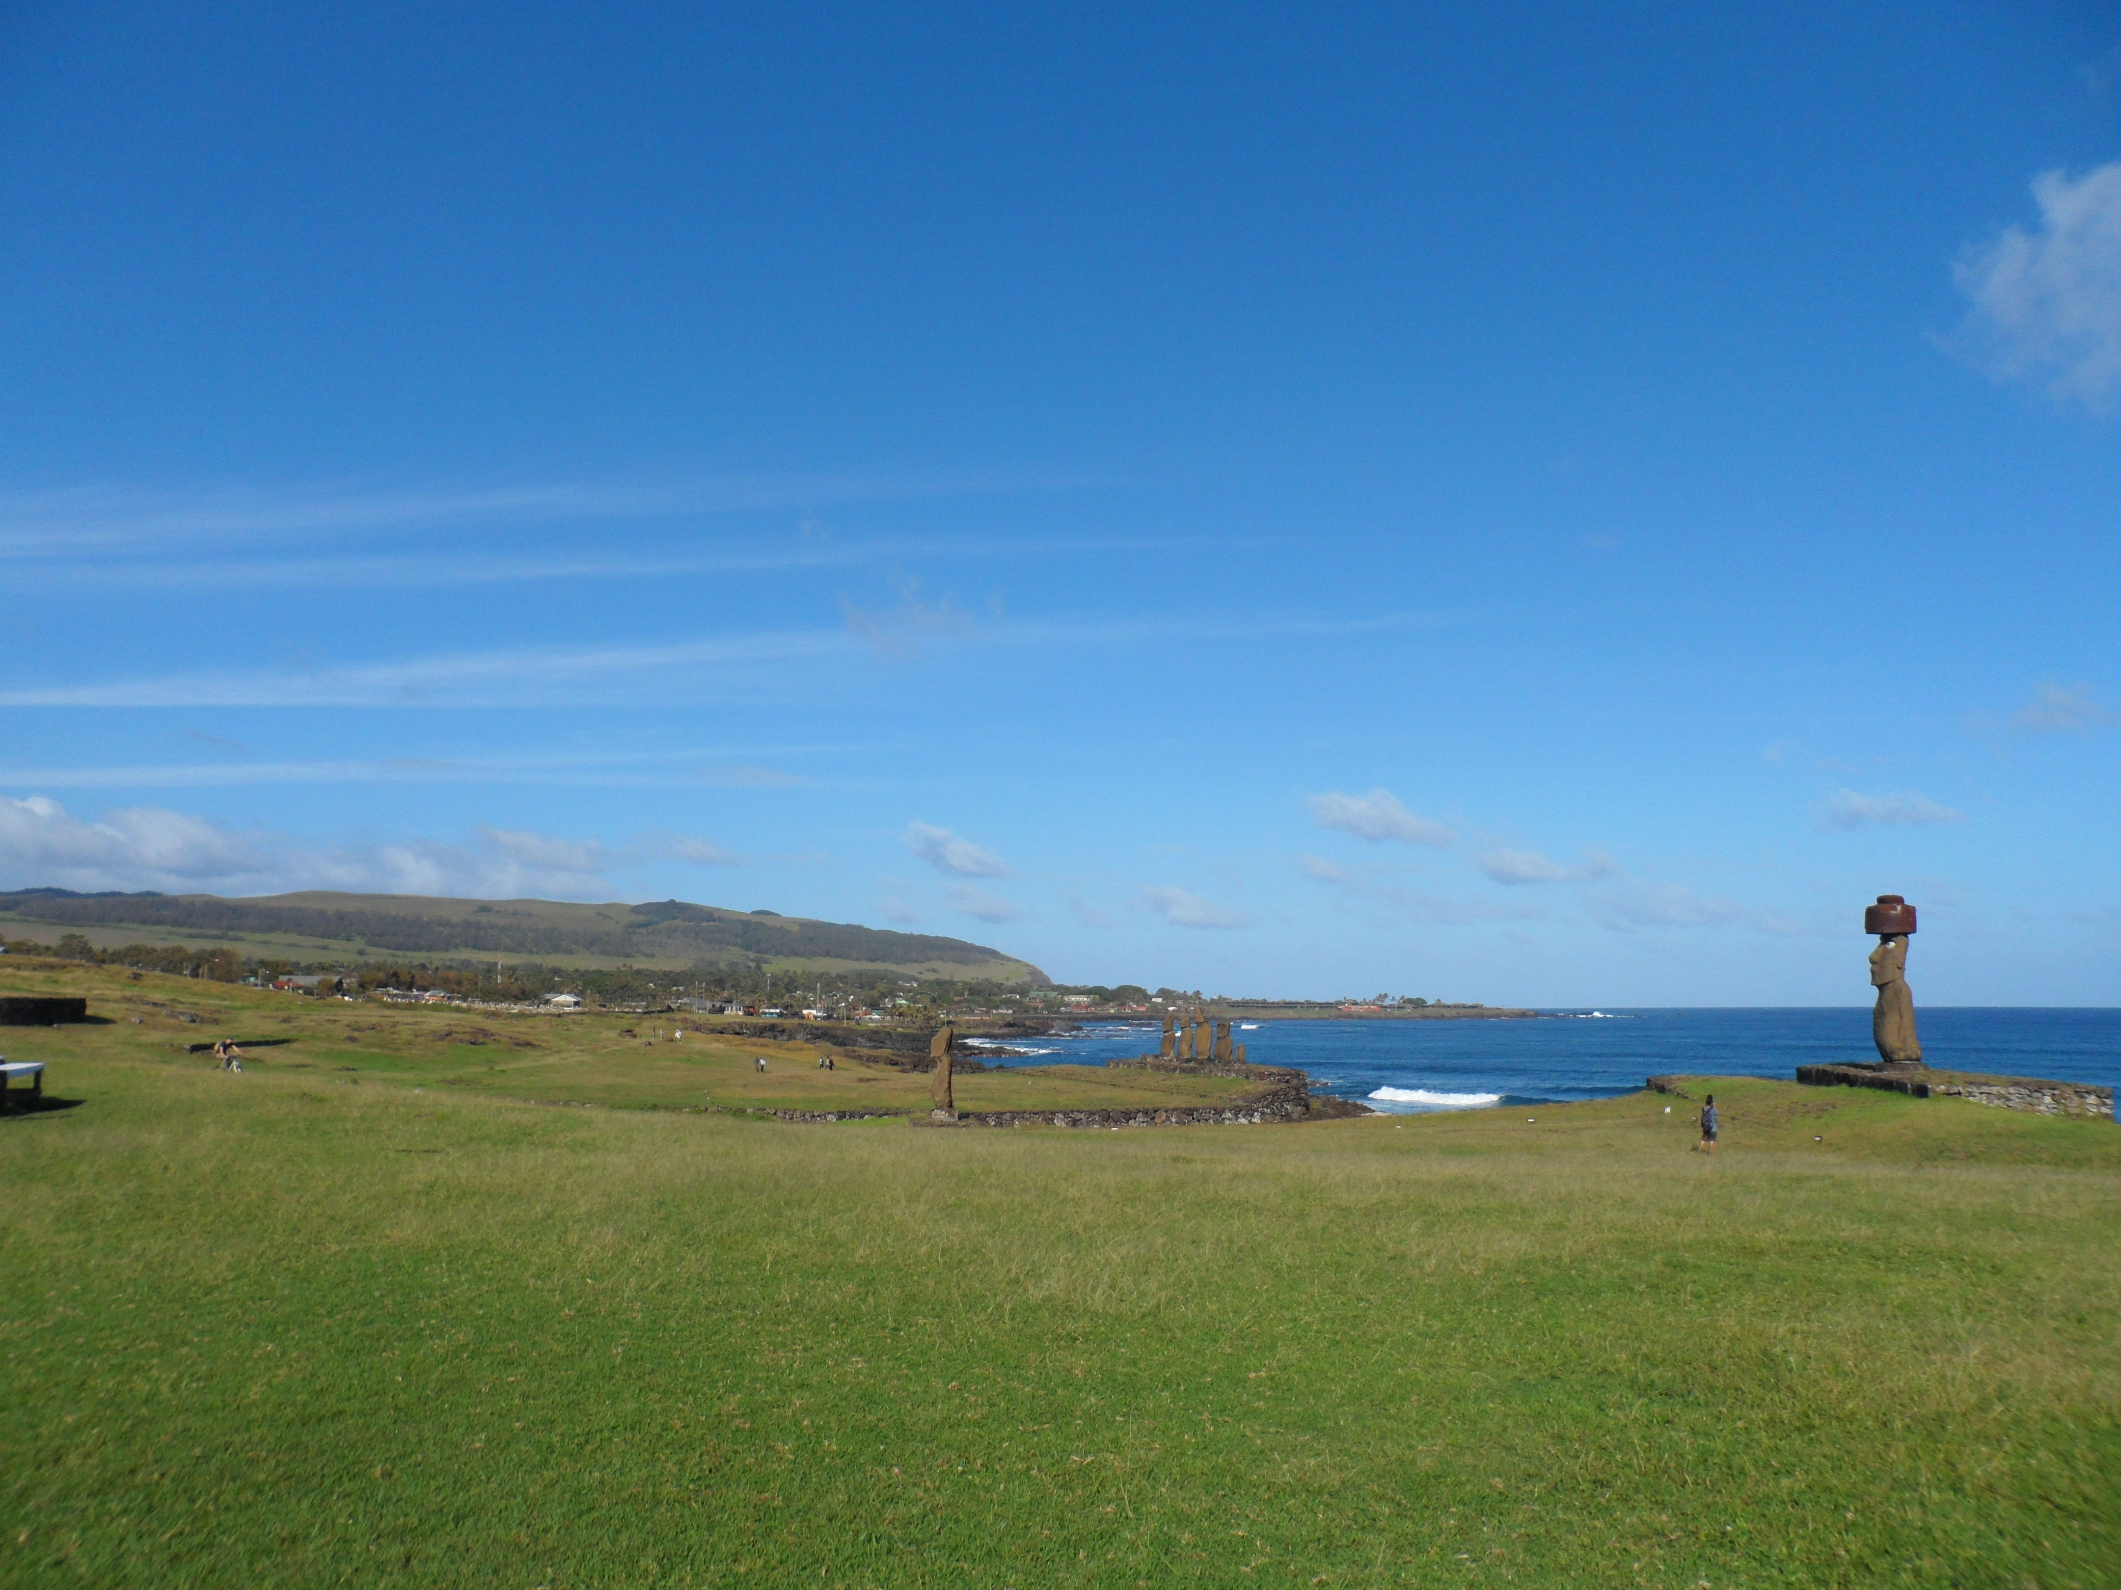

Slide 17
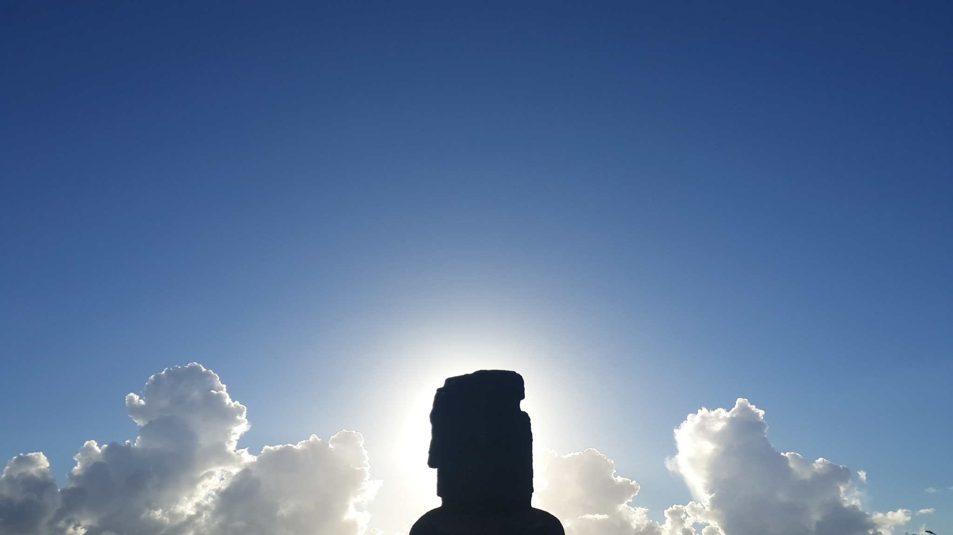
Some Things to Consider
Seeing the people, He felt compassion for them, because they were distressed and dispirited like sheep without a shepherd. Then He said to His disciples, "The harvest is plentiful, but the workers are few. Therefore beseech the Lord of the harvest to send out workers into His harvest.”
(Mat. 9:36-38)

Slide 18
Some Things to Consider
"Behold, I send you out as sheep in the midst of wolves; so be shrewd as serpents and innocent
as doves.”
(Mat. 10:16)

Slide 19
Some Things to Consider
"But when they hand you over, do not worry about how or what you are to say; for it will be given you in that hour what you are to say. For it is not you who speak, but it is the Spirit of your Father who speaks in you.”
(Mat. 10:19-20)

Slide 20
Some Things to Consider
"Therefore do not fear them, for there is nothing concealed that will not be revealed, or hidden that will not be known… Do not fear those who kill the body but are unable to kill the soul; but rather fear Him who is able to destroy both soul and body in hell…So do not fear; you are more valuable than many sparrows.” (Mat. 10:26, 28, 31)

Slide 21
Some Things to Consider
"He who loves father or mother more than Me is not worthy of Me; and he who loves son or daughter more than Me is not worthy of Me. And he who does not take his cross and follow after Me is not worthy of Me. He who has found his life will lose it, and he who has lost his life for My sake will find it.” (Mat. 10:37-39)

Slide 22

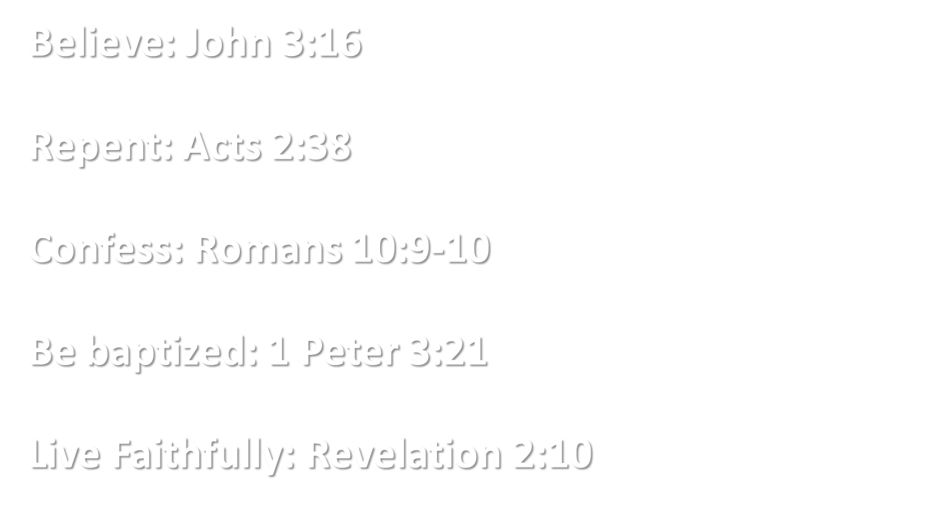
Would You Live For Him?

