Slide 1
Rapa Nui Report

Slide 2
The Island

Slide 15
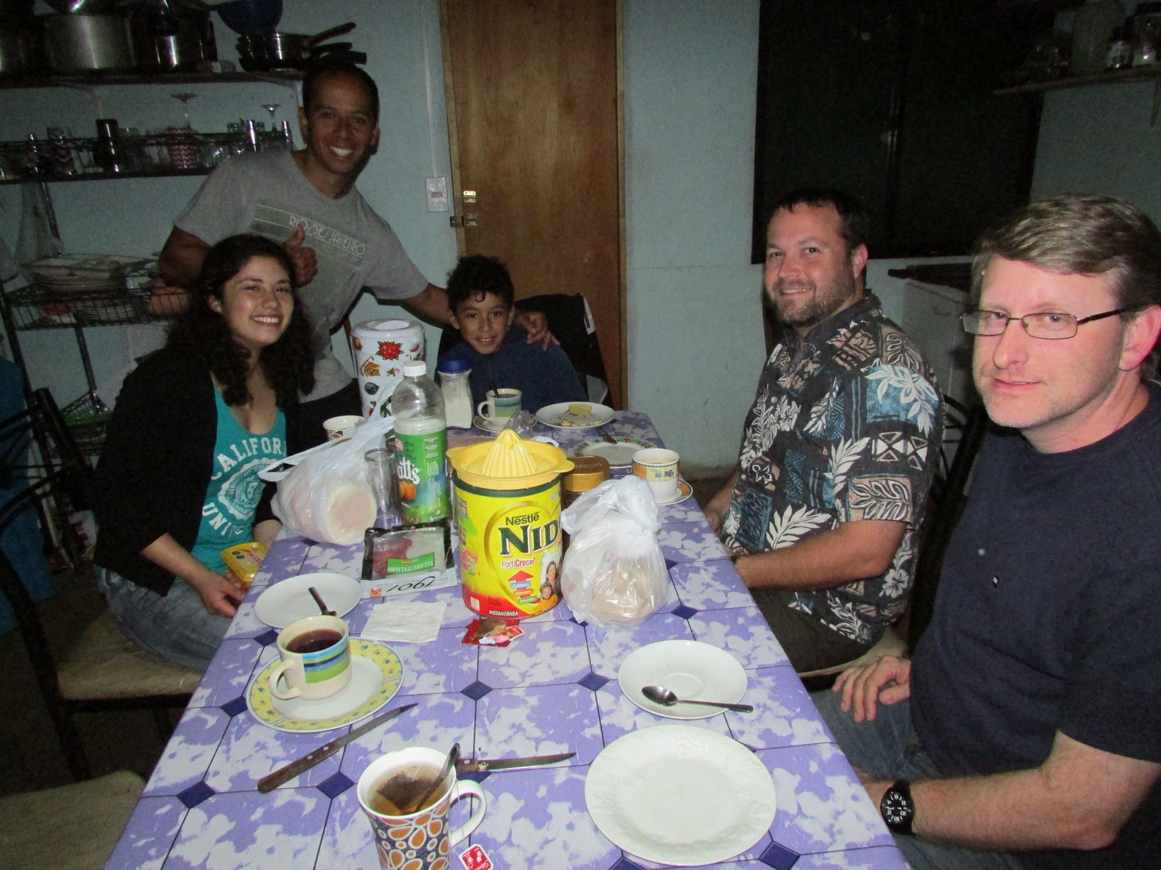

Slide 16
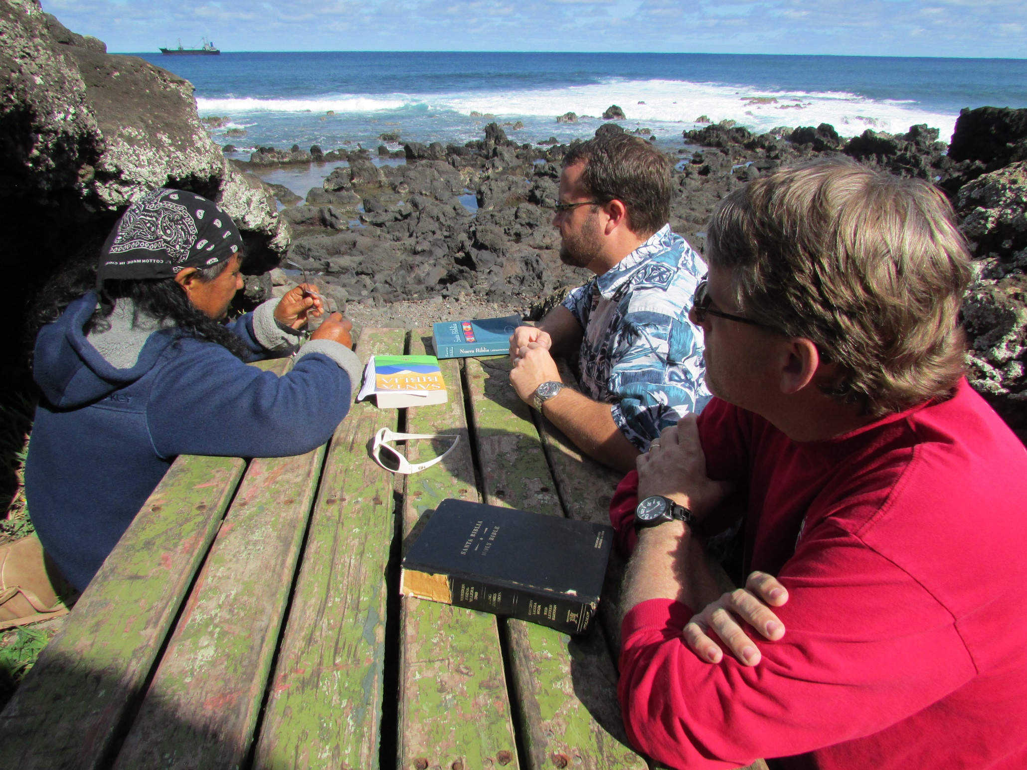

Slide 17
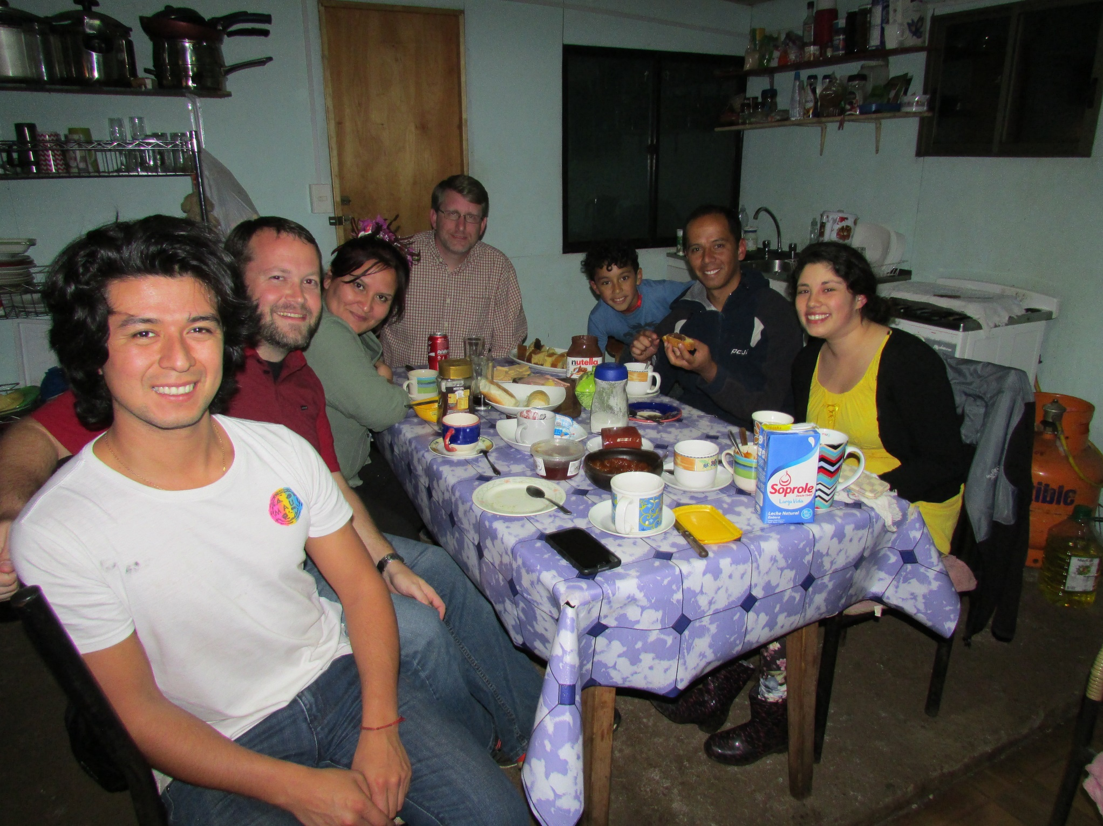

Slide 22
What does God ask of you?
Only let your manner of life be worthy of the gospel of Christ, so that whether I come and see you or am absent, I may hear of you that you are standing firm in one spirit, with one mind striving side by side for the faith of the gospel, and not frightened in anything by your opponents. This is a clear sign to them of their destruction, but of your salvation, and that from God. For it has been granted to you that for the sake of Christ you should not only believe in him but also suffer for his sake, engaged in the same conflict that you saw I had and now hear that I still have.
(Philippians 1:27-30)

Slide 23
What does God ask of you?
Only let your manner of life be worthy of the gospel of Christ, so that whether I come and see you or am absent, I may hear of you that you are standing firm in one spirit, with one mind striving side by side for the faith of the gospel, and not frightened in anything by your opponents. This is a clear sign to them of their destruction, but of your salvation, and that from God. For it has been granted to you that for the sake of Christ you should not only believe in him but also suffer for his sake, engaged in the same conflict that you saw I had and now hear that I still have.
(Philippians 1:27-30)

Slide 24
What does God ask of you?
Only let your manner of life be worthy of the gospel of Christ, so that whether I come and see you or am absent, I may hear of you that you are standing firm in one spirit, with one mind striving side by side for the faith of the gospel, and not frightened in anything by your opponents. This is a clear sign to them of their destruction, but of your salvation, and that from God. For it has been granted to you that for the sake of Christ you should not only believe in him but also suffer for his sake, engaged in the same conflict that you saw I had and now hear that I still have.
(Philippians 1:27-30)

Slide 25
What does God ask of you?
Only let your manner of life be worthy of the gospel of Christ, so that whether I come and see you or am absent, I may hear of you that you are standing firm in one spirit, with one mind striving side by side for the faith of the gospel, and not frightened in anything by your opponents. This is a clear sign to them of their destruction, but of your salvation, and that from God. For it has been granted to you that for the sake of Christ you should not only believe in him but also suffer for his sake, engaged in the same conflict that you saw I had and now hear that I still have.
(Philippians 1:27-30)

Slide 26
What does God ask of you?
Believe: John 3:16
Repent: Acts 2:38
Confess: Romans 10:9-10
Be baptized: 1 Peter 3:21
Live Faithfully: Revelation 2:10

