Slide 1
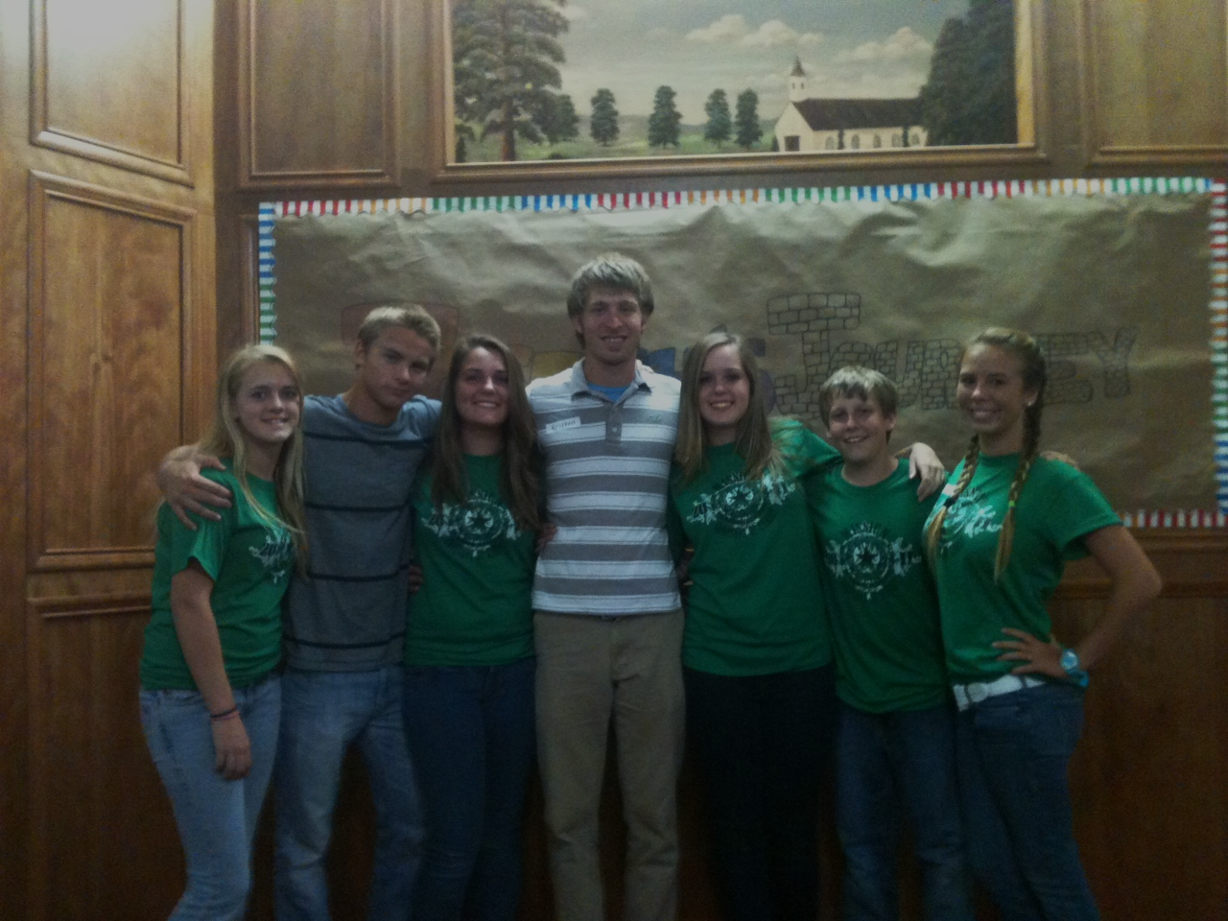
SR. HIGH MISSION REPORT 2011
Cross Plains, Texas

Slide 2
Trip Details
Mission Team: 17 altogether, 7 from PBL and 10 from Central in Moore, OK.
Location: Cross Plains, Texas (Aaron Austin’s Dad is the minister there) Population is 1068.
Flew out of Ft. Lauderdale into Dallas on the 24th. Central picked us up on the 25th and we got to Cross Plains around 2 pm. Got home July 1st around 7:30 pm.
What We Did: Knocked on doors, put on a VBS, service work, worked with their youth.

Slide 3
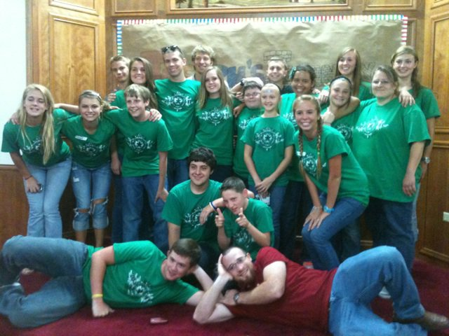

Slide 4
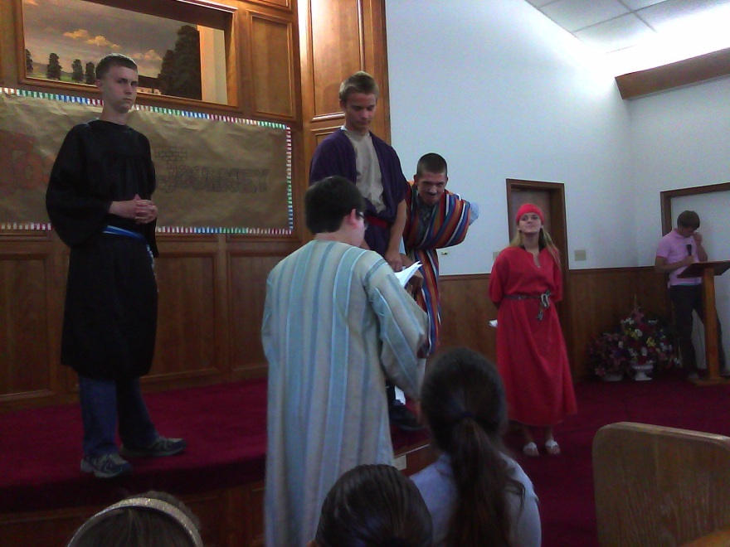
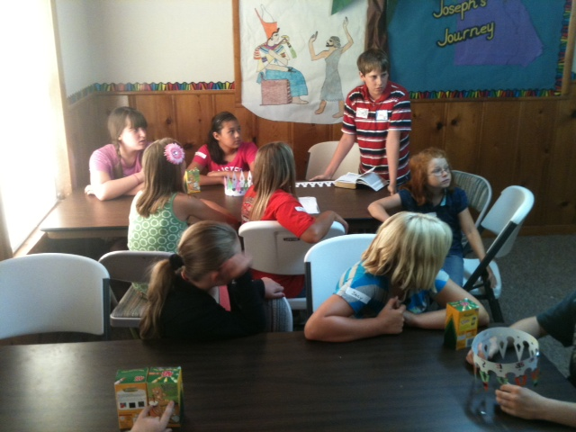
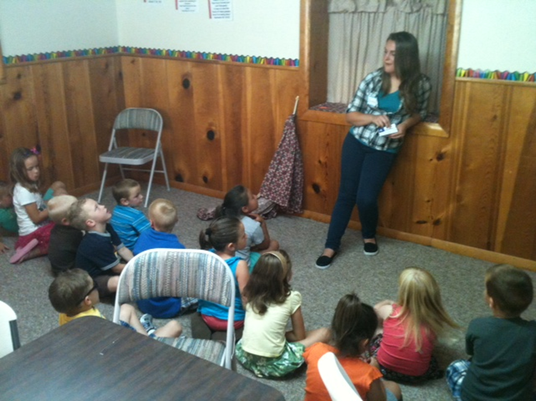
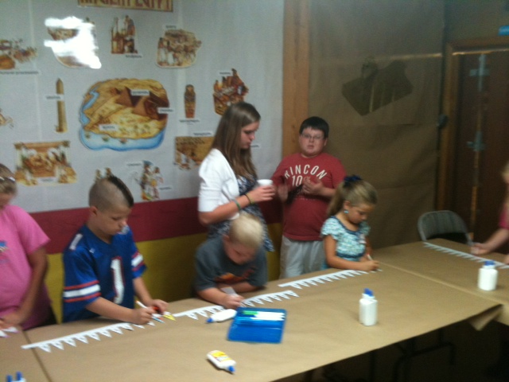
Vacation Bible School

Slide 5
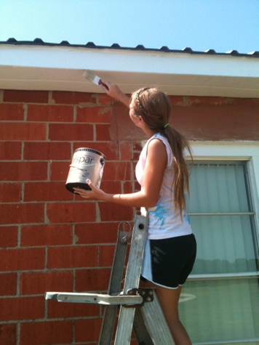
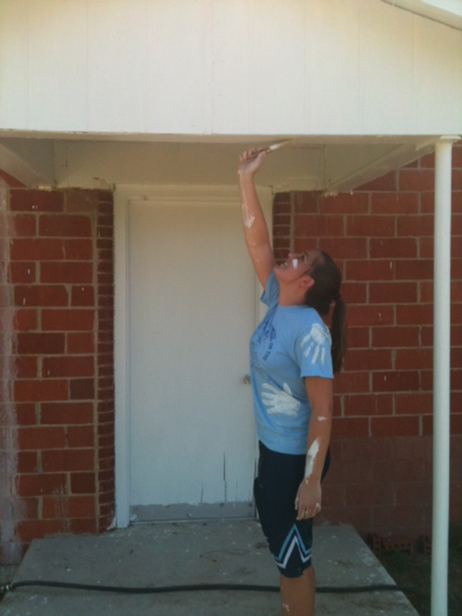
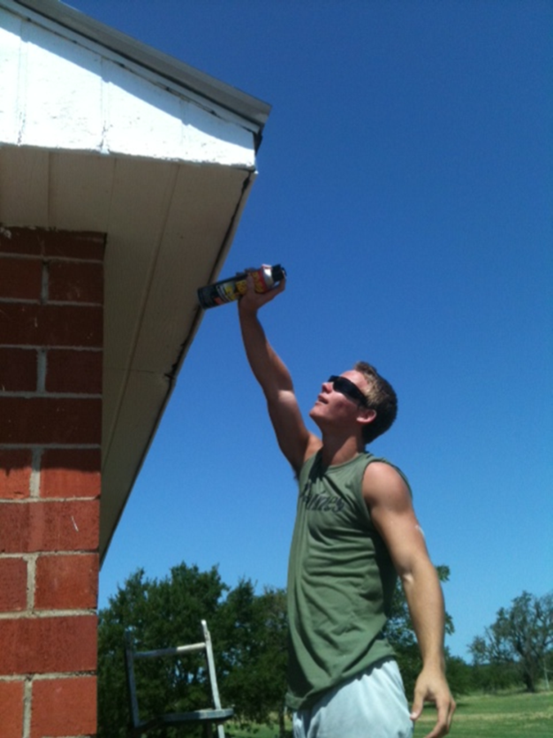
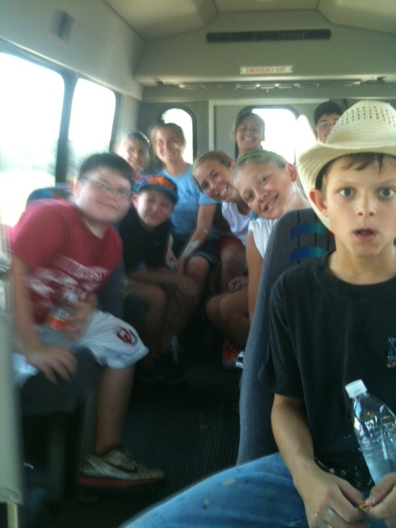
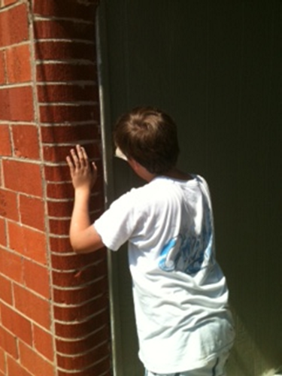
Service Work
Painted a building
Laid a sidewalk and worked for a man with a immobile wife.
Knocked Doors

Slide 6
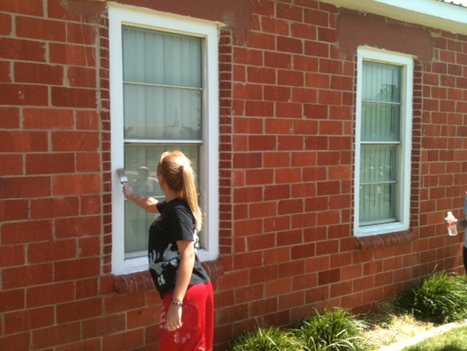
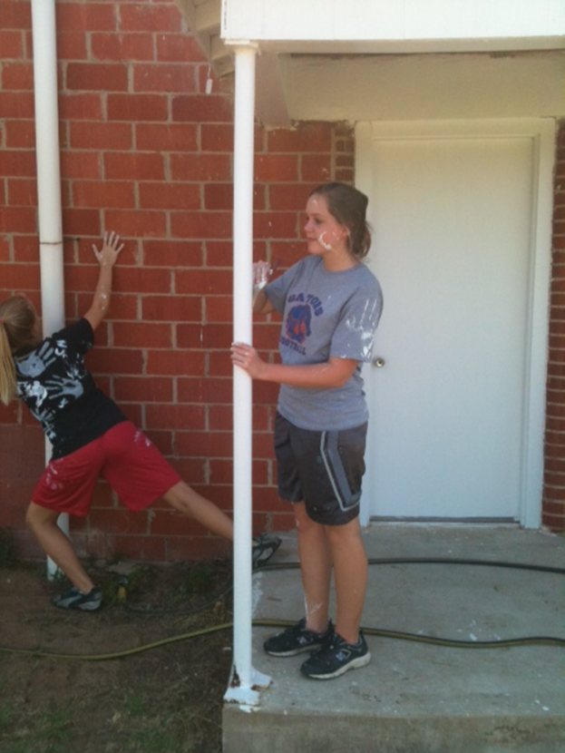
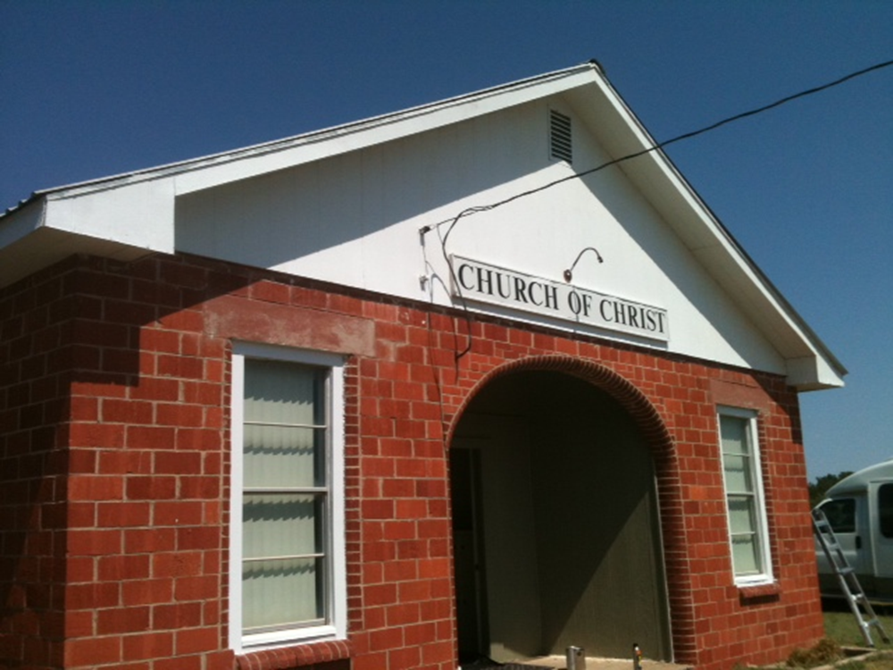
Service Work

Slide 7
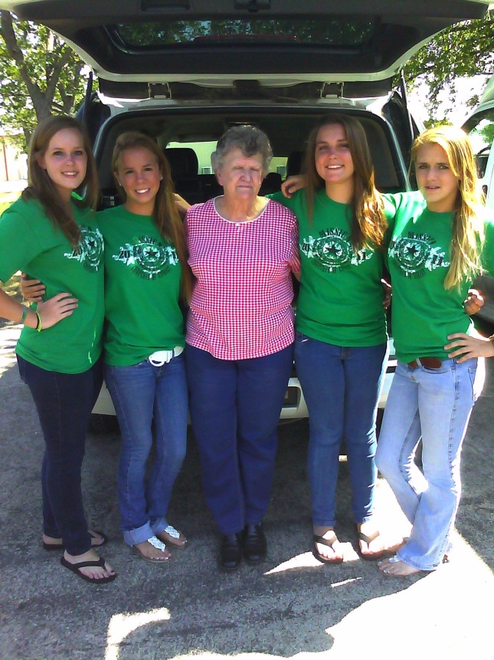
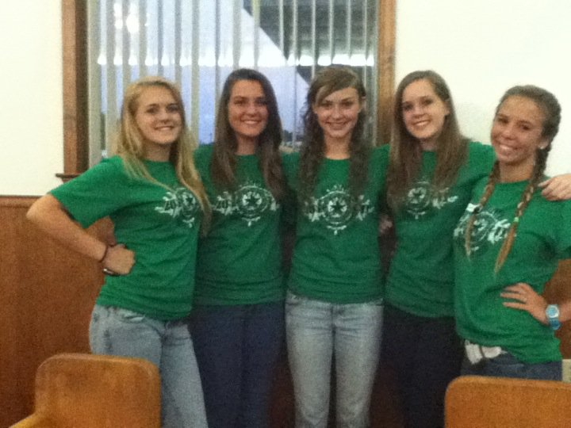
Relationships
Built a close bond to two families with teens. The Goode and the Lawrence family.
Built a close relationship with their host families.

Slide 8
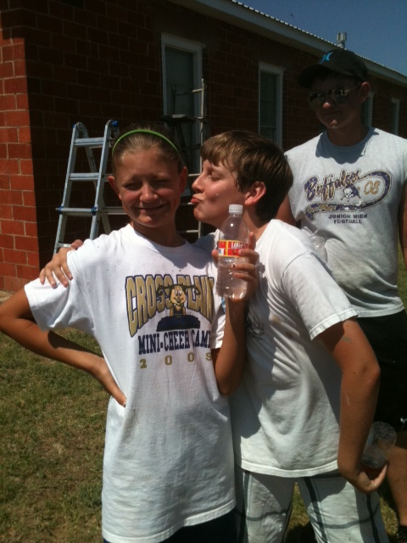
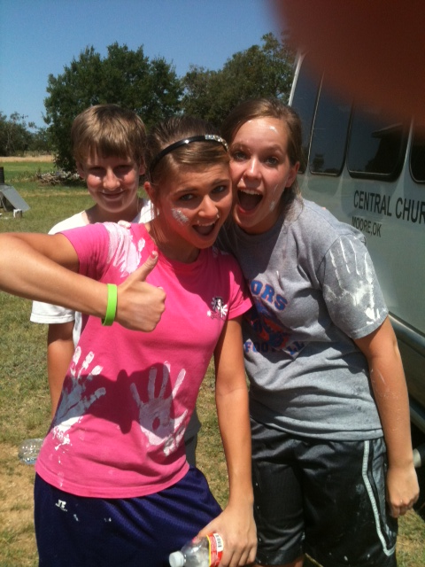
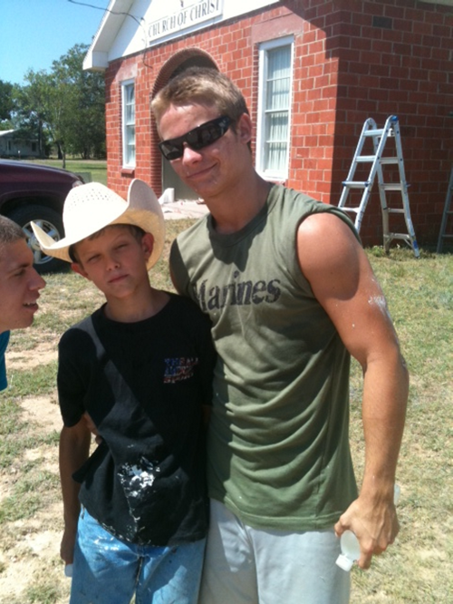
Relationships

Slide 9
Some Comments Made About Our Teens
“I have never seen our kids this excited about the Bible.”
“You guys have shown our teens what a youth group looks like and how they should act.”
“You have inspired our youth because they now know that there are other teens that are trying to live a good life.”
“It is good to see young people who have a heart to serve.”

Slide 10
What Is A Mission Trip For?
To help the church in other areas.
To help us become better people.
To glorify God.
To impact the lives of those who are not members.

