Slide 1
GENERATION
AN INTRODUCTION

Slide 2
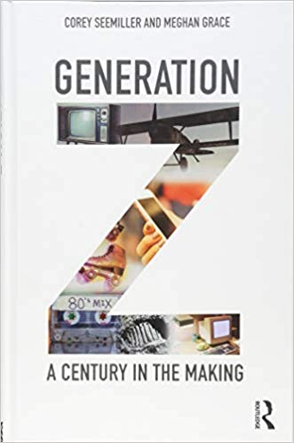
Generational Studies
Generation Z: A Century In the Making
By Seemiller & Grace

Slide 3
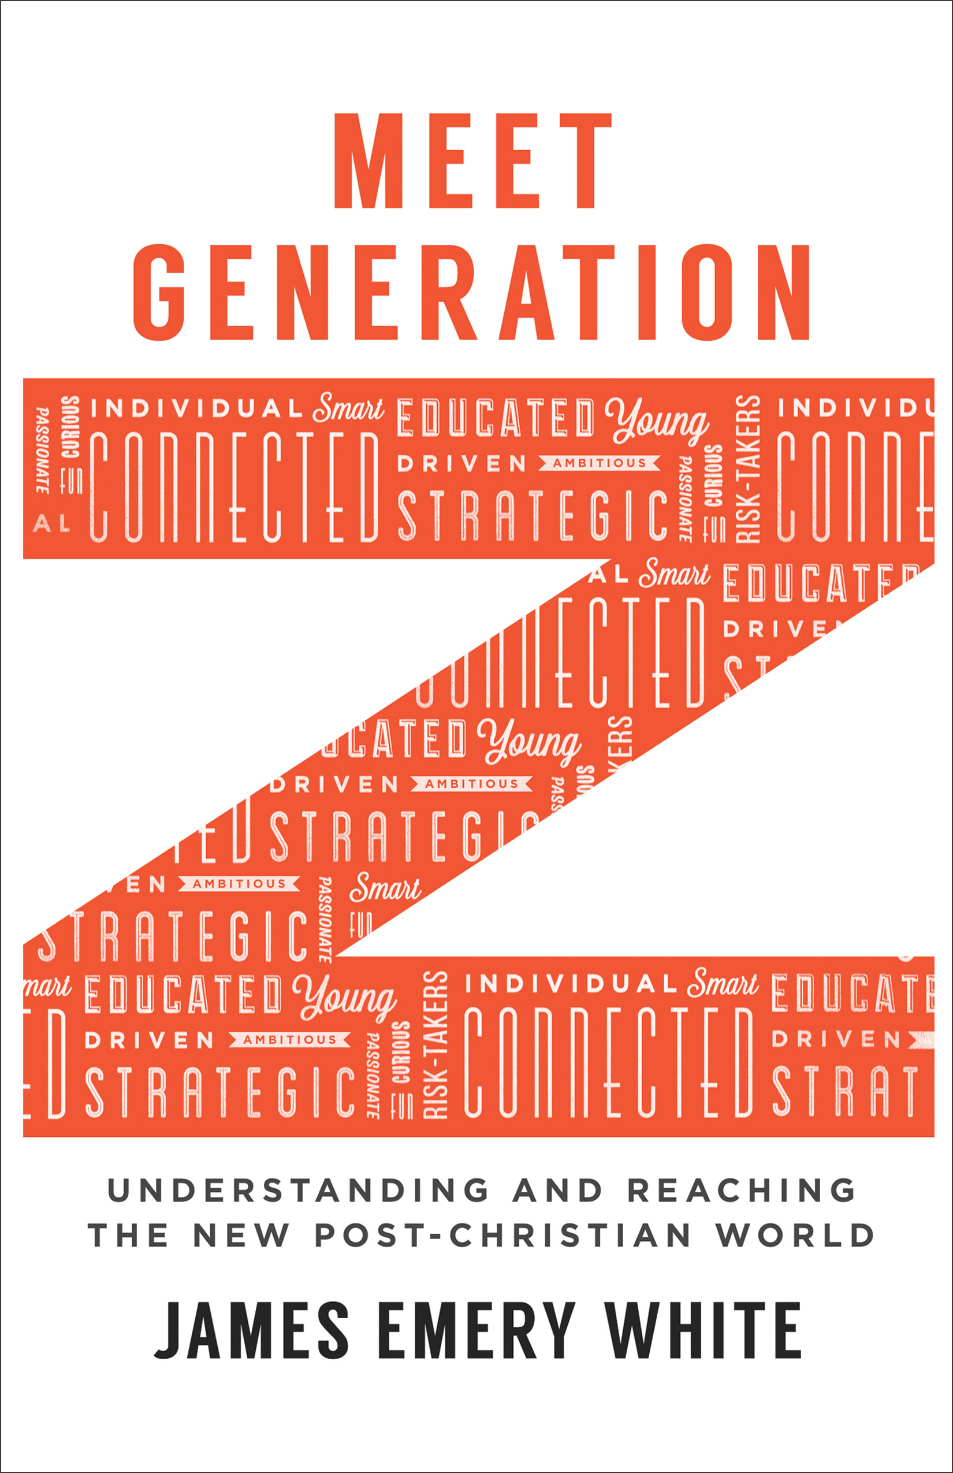
Generational Studies
Meet Generation Z
By James White

Slide 4
Generational Studies
Gen Z: The Culture, Beliefs and Motivations Shaping the Next Generation
By Barna Group & Impact 360

Slide 5
Why Study Generations?
They are studied for…
All that generation also were gathered to their fathers; and there arose another generation after them who did not know the LORD, nor yet the work which He had done for Israel. Judges 2:10
You shall teach them diligently to your sons and shall talk of them when you sit in your house and when you walk by the way and when you lie down and when you rise up. Deuteronomy 6:7
Older men, older women, young women, young women… Titus 2:1-8
Marketing
Political trends
Education
Health care
Insurance
Social Trends
Workforce
Religion

Slide 6
Gen Z (Born 1995-2010; age 9 to 24)
A lot of debate about the actual date range.
iGen, Digital Natives, The Founders, Homeland Generation, Post-Millennials, and the Plurals are all names they have been given.
They constitute 25.9% of the US population (GenY 24.5%, Gen X 15.4%, Boomers 23.6%)
By 2020 they will constitute 40% of all consumers.
Possibly the last generation we will ever talk about.

Slide 7
Who I Am & What Matters to Gen Z
Self Perceptions
43% see personal achievement and 42% see hobbies as most important to their sense of self.
Only 1 in 3 see family background or religion as an identifier.
Even so more than half see their parents as role models.
Those with different ethnic backgrounds see those as identifiers.
Those engaged Christians see their faith as something to identify with.

Slide 8
Who I Am & What Matters to Gen Z
Sexuality and Gender
Sexuality is central to their sense of personal identity.
48% believe gender is based on what a person was born as while 33% believe it has to do with how you feel.
7 out of 10 feel it is definitely or probably acceptable to be born one gender and feel like another.
3 in 10 report knowing a friend or peer who has changed their sexual identity.
45% would feel neutral if their friend was questioning their sexuality.

Slide 9
Who I Am & What Matters to Gen Z
Goals and Priorities
Less likely to want to drive more that 25% of seniors in high school do not have their drivers license.
41% are looking forward to the freedoms and responsibilities of adulthood.
There is a higher priority on career and education and less of a focus marriage and family.
Of those that are engaged Christians 46% say spiritual maturity is a goal compared to 16% of the unchurched.
Of engaged Christians only 29% percent want to be married before 30 and only 16% want to have children.
Most of GenZ cite parents or other family members as role model. 6 out of the top 10 reasons have to do with career of financial success.

Slide 10
Who I Am & What Matters to Gen Z
Morality and Values
24% believe that morality changes with culture.
21% believe it depends on the individual.
34% of unchurched while 77% of engaged Christians believe lying is morally wrong.
29% of unchurched while 80% of engaged Christians believe abortion is wrong.
38% of unchurched while 91% of engaged Christians view marriage as a life long commitment.
21% of unchurched while 76% of engaged Christians believe sex before marriage is morally wrong.
20% of unchurched while 77% of engaged Christians believe homosexuality is morally wrong.
This polarity will only get worse.

Slide 11
Who I Am & What Matters to Gen Z
Truth
37% of Gen Z believe it is impossible to know if God is real.
58% of teens and 68% of adults say there is no one true religion.
66% believe that a person can be wrong about something they sincerely believe, down from the 85% of Boomers. There are a growing number of people that think believing in something makes it true.
46% say they need factual evidence to support beliefs.
Gen Z has a hard time balancing what the Bible says with science.

Slide 12
Who I Am & What Matters to Gen Z
Church
Among church goers (1 time in the last month) 82% say yes, it is the place to find the answers to a meaningful life.
82% say yes, it is relevant to their lives.
81% say that a sense of community in the church is important.
Only 35% believed traditional coat and tie is important.
Among all Gen Z 59% say church is not relevant.
Those that do come want to belong.
Irrelevance is a word used a lot in relation to church, faith, and truth.
What are we doing to encourage grit and spiritual resilience?

Slide 13
Passing Faith On to Gen Z
Many in Gen Z are hesitant to hold firm beliefs.
They don’t want to be seen as judgmental.
Hard to argue truth or faith with people that only be believe in “scientism”.
They need reasons for faith.
Apologetics is not an optional class for Gen Z.
We need to raise them up into a Biblical world view not just through coloring books and crayons at them in the pew.

Slide 14
Passing Faith On to Gen Z
They need wise relationships with their parents and others walking in the faith.
They need to be shown how to create healthy spiritual habits and disciplines, things disciples do.
Important topics for Gen Z
Truth
Sex
Money
Technology
Diversity
Empathy
Openness
Emptiness

