Slide 1
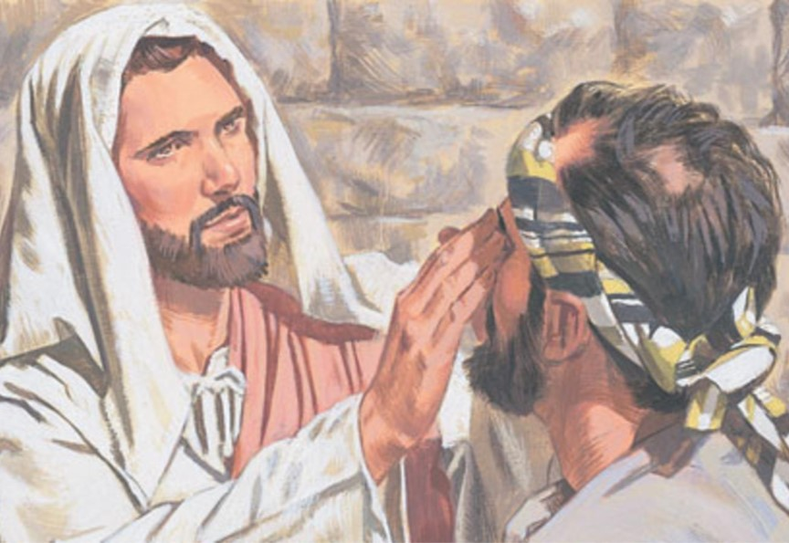
The Man Born Blind
John Chapter Nine

Slide 2
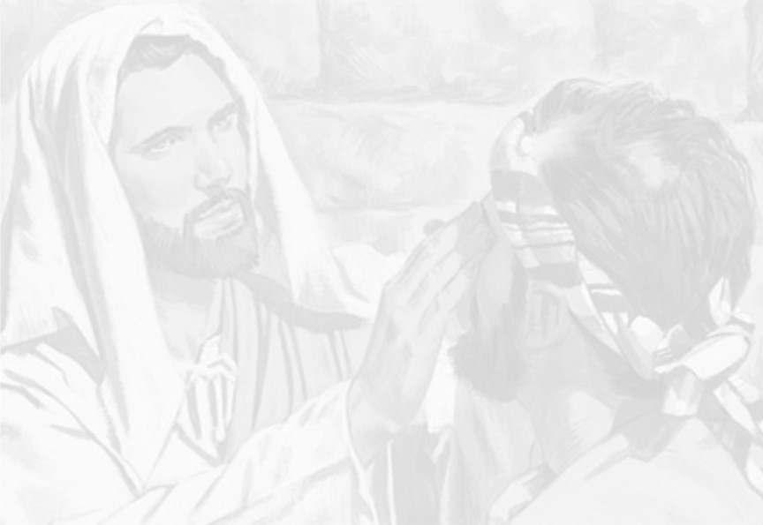
The Context
It is the Sabbath day. 9:14
Jesus was teaching in the temple after being in Gethsemane all night. 8:1
Jesus had been discussing with the Jews about…
  Being His disciple 8:31-32
  Who He was 8:41-42
  Them being the children of the devil 8:44-47
  Abraham rejoicing to see His day 8:56
  “I AM” 8:58
They try to stone Him 8:59

Slide 3
The Curing
The disciples ask the question 9:1-2
  Ezekiel 18:20
  2 Corinthians 5:10
Jesus answered the question 9:3-5
Jesus heals the blind man 9:6-7
  Matthew 9:27-30; 20:30-34
  Did He need the clay?
Neighbors question him 9:8-12

Slide 4
The Controversy
The Pharisees question him 9:13-15
Not of God! But the signs! 9:16-17
  He healed on the Sabbath
  But how does He do these signs?
  What do you think?
Call in the parents 9:18-23
  Is this your son?
  Yeah but he can answer for himself
  Put out of the synagogue

Slide 5
The Controversy
They question him…again 9:24-34
  Give God the glory 9:24
  An honest answer 9:25
  Coached answer 9:26
  Stirred the pot 9:27
  Disciples of Moses 9:28-29
  His defense 9:30-34

Slide 6
The Confession
Jesus found him and questioned him 9:35
  He found him
  The most important question
The answer 9:36-38
  Belief
  Worship
The lesson 9:39-41
  John 12:48-50
  2 Corinthians 5:7

Slide 7
The Conclusion
When you washed you could see. (1 Cor. 6:11)
You have had to defend the changes in your life and your faith even though you have never seen Him. (John 20:29)
You will see him face to face. (Rev. 7:15-17)

