Slide 1
"Let us trust God, and our better judgment to set us right hereafter. United we stand, divided we fall. Let us not split into factions which must destroy that union upon which our existence hangs.“
- Patrick Henry, 1799

Slide 2
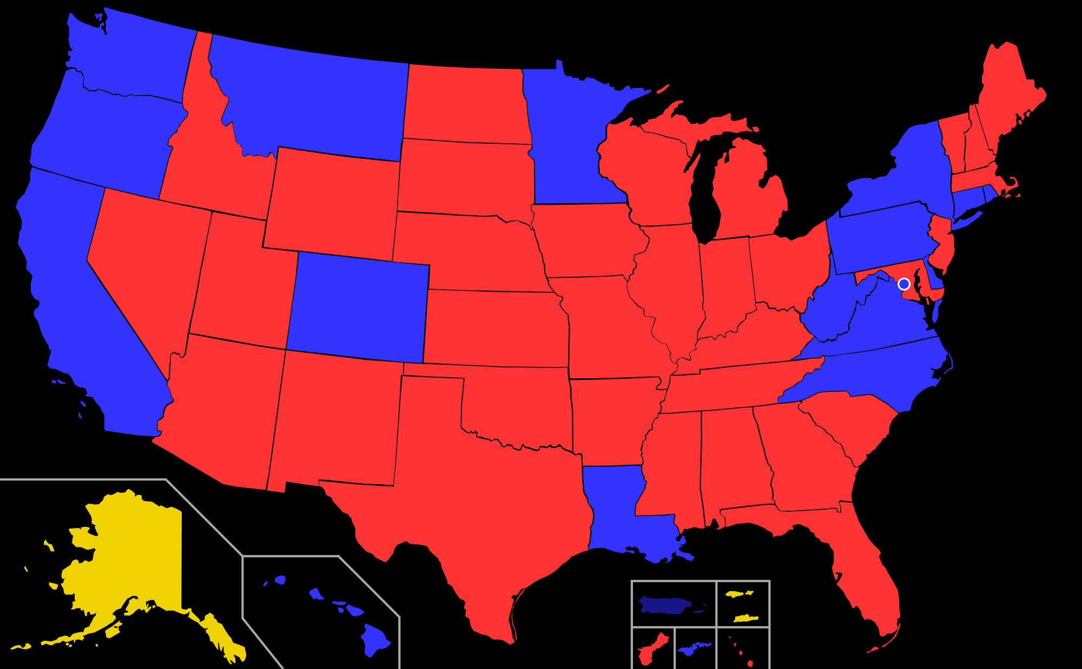

Slide 4
Behold, how good and how pleasant it is For brothers
to dwell together in unity!
Psalm 133:1

Slide 5
Divisions In the Church
Social Divisions
For you are all sons of God through faith in Christ Jesus. For all of you who were baptized into Christ have clothed yourselves with Christ. There is neither Jew nor Greek, there is neither slave nor free man, there is neither male nor female; for you are all one in Christ Jesus.
Galatians 3:26-28

Slide 6
Divisions In the Church
Theological Divisions
Judaizing: Acts 15:1-5, Philippians 3:2; Galatians 2:3-14
Docetism: 2 John 1:7-11; 1 John 4:2-3
Gnosticism: 1 Corinthians 8:1-3

Slide 7
Divisions In the Church
Corinthian Division
Quarrels over leadership (1 Co 1:10–4:21)
Dealing with the church’s lack of judgment on sex and legal disputes (1 Co 5–6)
Marriage and divorce (1 Co 7)
Eating meat used for idol worship (1 Co 8–10)
The Lord’s Supper (1 Co 11:17–34)
Using spiritual gifts (1 Co 12–14)
Understanding the resurrection (1 Co 15)

Slide 8
"I do not ask on behalf of these alone, but for those also who believe in Me through their word; that they may all be one; even as You, Father, are in Me and I in You, that they also may be in Us, so that the world may believe that You sent Me. "The glory which You have given Me I have given to them, that they may be one, just as We are one; I in them and You in Me, that they may be perfected in unity, so that the world may know that You sent Me, and loved them, even as You have loved Me.
John 17:20-23

Slide 9
Now I urge you, brethren, keep your eye on those who cause dissensions and hindrances contrary to the teaching which you learned, and turn away from them. For such men are slaves, not of our Lord Christ but of their own appetites; and by their smooth and flattering speech they deceive the hearts of the unsuspecting.
Romans 16:17-18

Slide 10
whereas our more presentable members have no need of it. But God has so composed the body, giving more abundant honor to that member which lacked, so that there may be no division in the body, but that the members may have the same care for one another. And if one member suffers, all the members suffer with it; if one member is honored, all the members rejoice with it. Now you are Christ's body, and individually members of it.
1 Corinthians 12:24-27

Slide 11
But you, beloved, ought to remember the words that were spoken beforehand by the apostles of our Lord Jesus Christ, that they were saying to you, "In the last time there will be mockers, following after their own ungodly lusts." These are the ones who cause divisions, worldly-minded, devoid of the Spirit.
Jude 1:17-19

Slide 12
How Has God Made Unity Possible?
By conquering sin. Eph. 2:1-3
By showing us a goodness we do not deserve. Eph. 2:4-5
1 John 3:1 “Se how great a love…”
John 3:16 “For God so loved the world…”
Romans 3:23 “For all have sinned
Romans 5:8 “But God demonstrates His love toward us…”
By raising us up in Christ. Eph. 2:6-7
John 10:10 “I came that they may have life, and have it abundantly.”
Galatians 2:20 “I have been crucified with Christ, and It is no longer I who live…”

Slide 13
How Has God Made Unity Possible?
By recreating us. Eph. 2:8-10
Romans 12:2 “And do not be conformed to this world, but be transformed by the renewing of your mind…”
John 14:27 “Peace I leave with you; My peace I give to you…”
Philippians 4:6-7 Be anxious for nothing…”
Romans 6:4 “…so we too might walk in newness of life.”
By placing a great value on unity. Eph. 2:11-13
Galatians 3:26-28 “…for you are all one in Christ Jesus.”
Romans 12:16 “Be of the same mind toward one another; do not be haughty in mind, but associate with the lowly.”

Slide 14
How Has God Made Unity Possible?
By removing every obstacle of unity. Eph. 2:14-15
By illustrating unity in three forms. Eph. 2:16-22
Body: 1 Corinthians 12:12-27
God’s household: 1 Timothy 3:15
Holy temple: 1 Corinthians 3:16

