Slide 2
“A disciple is someone who is committed to following Jesus and becoming like Him. Being a disciple is more than merely going to church or being religious. It is a commitment to being transformed to be just like Jesus.” –David Young

Slide 3
“Christianity without discipleship is always Christianity without Christ.”
–Dietrich Bonhoeffer

Slide 4
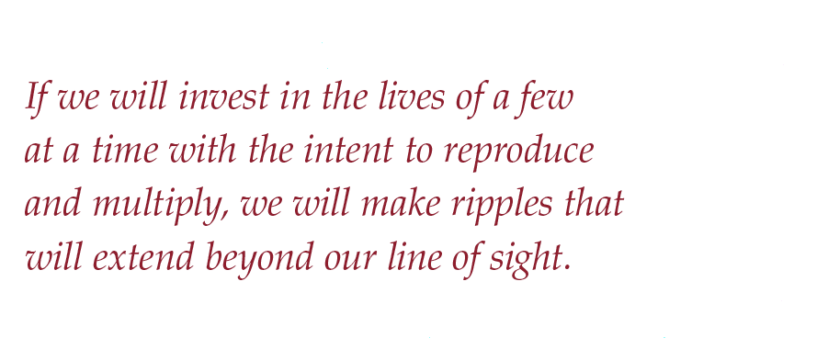

Slide 5
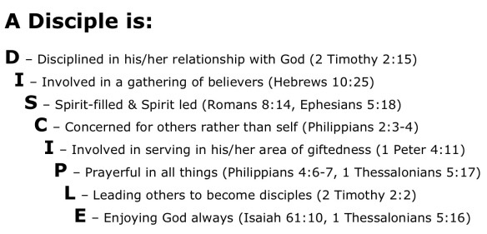

Slide 6
Matthew 28:18-20 “Then Jesus came to them and said, “All authority on heaven and earth has been given to me. Go therefore and make disciples of all nations, baptizing them in the name of the Father, and of the Son, and of the Holy Spirit, teaching them to observe all of the things that I have commanded you and surely I am with you always even to the end of the age.”

Slide 7
Jesus Lead Himself
Jesus Confided in Three
Jesus Trained Twelve
Jesus Mobilized Seventy
Jesus Taught the Multitude

Slide 8
How do we make disciples?

Slide 9
1. KNOW Jesus
Mark 3:14 “Then He appointed the twelve, that they might be with Him and that He might send them out to preach…”

Slide 10
Acts 4:14 “…And they realized that they had been with Jesus.”

Slide 11
John 6:66-69: “From that time many of His disciples went back and walked with Him no more. Then Jesus said to the twelve, “Do you also want to go away?”
But Simon Peter answered Him, “Lord to whom shall we go? You have the words of eternal life.”
Also we have come to believe and know that you are the Christ, the Son of the living God.”

Slide 12
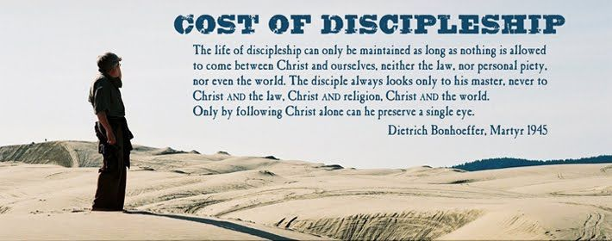
2. FOLLOW Jesus

Slide 13
2 Peter 1:3-4: “ By his divine power, God has given us everything we need for living a godly life. We have received all of this by coming to know him, the one who called us to himself by means of his marvelous glory and excellence. 4 And because of his glory and excellence, he has given us great and precious promises. These are the promises that enable you to share his divine nature and escape the world’s corruption caused by human desires.”

Slide 14
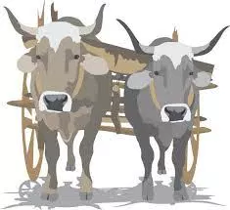
Matthew 11:28-30: “Come to Me, all you who labor and are heavy laden, and I will give you rest. 29 Take My yoke upon you and learn from Me, for I am gentle and lowly in heart, and you will find rest for your souls. 30 For My yoke is easy and My burden is light.”

Slide 15
Sweetly, Lord, have we heard Thee calling,
Come, follow Me!
And we see where Thy footprints falling
Lead us to Thee.
Refrain:
Footprints of Jesus,
That make the pathway glow;
We will follow the steps of Jesus
Where’er they go.
Though they lead o’er the cold, dark mountains,
Seeking His sheep;
Or along by Siloam’s fountains,
Helping the weak.
If they lead through the temple holy,
Preaching the Word;
Or in homes of the poor and lowly,
Serving the Lord.

Slide 16
Though, dear Lord, in Thy pathway keeping,
We follow Thee;
Through the gloom of that place of weeping,
Gethsemane!
If Thy way and its sorrows bearing,
We go again,
Up the slope of the hillside, bearing
Our cross of pain.
By and by, through the shining portals,
Turning our feet,
We shall walk, with the glad immortals,
Heav’n’s golden street.
Then, at last, when on high He sees us,
Our journey done,
We will rest where the steps of Jesus
End at His throne.

Slide 17
3. MAKE Disciples
How do we do it?
“Do everything in the church except make disciples, you have failed. Make disciples, and you have succeeded, even if you have done nothing else.”
–David Young

Slide 18
Matthew 28:18-20 “Then Jesus came to them and said, “All authority on heaven and earth has been given to me. GO therefore and make disciples of all nations, baptizing them in the name of the Father, and of the Son, and of the Holy Spirit, teaching them to observe all of the things that I have commanded you and surely I am with you always even to the end of the age.”

Slide 19
Colossians 1:28-29: “Him we preach, warning every man and teaching every man in all wisdom, that we may present every man perfect in Christ Jesus. 29 To this end I also labor, striving according to His working which works in me mightily.”
“The Great Commission is not just another good idea- though it is that- it is the church’s marching order!”

Slide 20
How do we do it? Like Jesus did!
“Jesus entered into the lives of a handful of people, spent several years training and mentoring them, then sent them out to make more disciples. Programs, ministries, worship services, sermons, books, etc., can all help; but Jesus’ method was one-on-one, and there is no substitute for this.”

Slide 21
2 Timothy 3:10-11: “But you have carefully followed my doctrine, manner of life, purpose faith, longsuffering, love, perseverance, persecutions, afflictions, which happened to me at Antioch, at Iconium, at Lystra- what persecutions I endured. And out of them all the Lord delivered me.”

Slide 22
Paul’s exhortations to Timothy in 2 Timothy 2:
-Be strong in the grace in Jesus Christ
-Teach the things you have heard to others so that they make teach others (discipleship)
-Endure Hardship
-Don’t be entangled with affairs of this life
-Takes hardwork/discipline! (Endure Hardship)
-Consider what the Lord says to gain understanding
-Remember: Jesus is RISEN!
-The Word of God is not chained!
-Endure Hardship
-If we die, we live
-Even when we are faithless, He remains faithFUL

