Slide 1
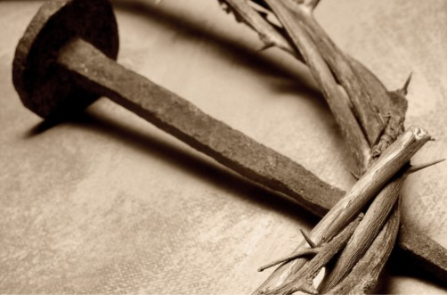
11 Things
About Jesus
(Part 3)
John 20:31

Slide 2

“But these are written…”
John 20:31
The Events Recorded
In All of the Gospels

Slide 3
Therefore many other signs Jesus also performed in the presence of the disciples, which are not written in this book; but these have been written so that you may believe that Jesus is the Christ, the Son of God; and that believing you may have life in His name.
John 20:30-31

Slide 4

The Events
Baptism of Jesus: Mt. 3:1-17; Mk. 1:1-11; Lk. 3:1-22; Jn. 1:15-34.
Feeding of 5,000: Mt. 14:13-21; Mk. 6:30-44; Lk. 9:10-17; Jn. 6:1-15.
Triumphal Entry: Mt. 21:1-11; Mk. 11:1-10; Lk. 19:29-44; Jn. 12:12-19.
Last Supper: Mt. 26:17-35; Mk. 14:12-31; Lk. 22:7-39; Jn. 13:1-38.
Gethsemane: Mt. 26:36-56; Mk. 14:32-42; Lk. 22:40-46; Jn. 18:1.

Slide 5
The Events
The Betrayal: Mt. 26:47-56; Mk. 14:43-53; Lk. 22:47-53; Jn. 18:1-11.
Peter’s Denial: Mt. 26:69-75; Mk. 14:66-72; Lk. 22:54-62; Jn. 18:25-27
Before Pilate: Mt. 27:11-14; Mk. 15:2-5; Lk. 23:1-5; Jn. 18:28-38
The Crucifixion: Mt. 27:32-56; Mk. 15:21-41; Lk. 23:26-49; Jn. 19:17-37.
The Burial: Mt. 27:57-66; Mk. 15:42-47; Lk. 23:50-56; Jn. 19:38-42.
The Resurrection: Mt. 28:1-7; Mk. 16:1-8; Lk. 24:1-12; Jn. 20:1-10.

Slide 6
The gospel preached to Cornelius and his house.
Acts 10:36-43

Slide 7
For I am not ashamed of the gospel, for it is the power of God for salvation to everyone who believes, to the Jew first and also to the Greek.
Romans 1:16

Slide 8

The Baptism of Jesus
Matthew 3:1-17 | Mark 1:1-11 | Luke 3:1-23 | John 1:15-34
They all…
Testify to the ministry of John the Baptizer.
Mention the prophecy concerning John.
  Isaiah 40:1-6
  Malachi 3:1; 4:5-6
Speak about the baptism of Jesus.

Slide 9
The Baptism of Jesus
Matthew 3:1-17
Emphasizes…
Repentance v.1 (Lk 3:3)
The person of John and his situation v.5,6 (Mk 1:6)
He mentions specifically the Pharisees and Sadducees v.7
Baptism of the Holy Spirit and fire v.11 (Lk 3:16)
To fulfill all righteousness v.15

Slide 10
The Baptism of Jesus
Mark 1:1-11
Emphasizes…
As it is written… v.2
He preached v.7-8
In those days v.9
Immediately v.10

Slide 11
The Baptism of Jesus
Luke 3:1-23
Emphasizes…
Time stamp v.1-2
Forgiveness of sins v.3 (Mk 1:4)
The message of John v.7-14 (Mt 3:7-10)
Image of the Messiah v.15-18
Jesus teaching and his age v.23

Slide 12
The Baptism of Jesus
John 1:15-34
Emphasizes…
The person of the Messiah v.15-18
The conflict of who John was v.19-26
The Lamb of God v.29
God’s signal to John v.33

Slide 13

Lessons from John
What it means to be the lone voice.
Devotion to the message.
Humility
Luke 7:24-28

Slide 14
The Feeding of 5,000
Matthew 14:13-21 | Mark 6:30-44 | Luke 9:10-17 | John 6:1-15
They all mention…
The persistence of the multitude.
The disciples' concern of the physical needs.
“Give them what you have.”
The disciples’ lack of faith.
The Prayer
The 12 baskets.
That the people ate until they were full.

Slide 15
The Feeding of 5,000
Matthew 14:13-21
Emphasizes…
Jesus’ response to the events.
Jesus healing the sick v.14
Women and children v.21

Slide 16
The Feeding of 5,000
Mark 6:30-44
Emphasizes…
The work of the apostles work and rest v.30-32
Compassion on the people v.34 (Mt 14:14)
Doubt v.37 (Jon 6:7)
Green grass v.39

Slide 17
The Feeding of 5,000
Luke 9:10-17
Emphasizes…
Jesus welcomed them v.11
The kingdom v.11
Sit in groups v.14 (Mark 6:40)
Looking up v.16 (Mt 14:19; Mk 6:41)

Slide 18
The Feeding of 5,000
John 6:1-15
Emphasizes…
Why the people followed v.2
Passover was near v.4
Jesus asked about where to buy bread v.5
John names the apostles v.7,8
The source of the bread and fish v.9
“As much as they wanted” v.11
Why they gathered up the left overs v.12
The response of the people v.14

Slide 19
Lessons from the 5,000
God can shatter your expectations (1 Cor. 1:27)
The disciples did the work because this was a lesson they had to learn.
Nothing is too big for God.
Makes me to lie down in green pasture…

Slide 20
Triumphal Entry
Matthew 21:1-11 | Mark 11:1-10 | Luke 19:29-44 | John 12:12-19
They all mention…
Riding on a young donkey.
The branches in the road.
The reaction of the multitudes.

Slide 21
Triumphal Entry
Matthew 21:1-11
Emphasizes…
The prophecies v.4,5 (Zech. 9:9)
Son of David. v.9
The question, “Who is this?” v.10,11

Slide 22
Triumphal Entry
Mark 11:1-10
Emphasizes…
The details of how they got the young donkey v. 1-7
The people crying out Psalm 118:26. v.9
The people speaking of the kingdom of David. v.10

Slide 23
Triumphal Entry
Luke 19:29-44
Emphasizes…
They people were praising God for all the miracles they had seen. v.37
The rebuke of the Pharisees. v.39-40 (Isa 55:12; Ps 148:1-15)
Jesus weeping for the city. v.41-44

Slide 24
Triumphal Entry
John 12:12-19
Emphasizes…
The disciples did not understand these events until after Jesus was “glorified”. v.16
These people had been there when Lazarus was raised from the dead. v.17-18 (*The day before they had gathered to see Jesus and Lazarus 12:9-11)
The frustration of the Pharisees. v.19

Slide 25
Lessons from the triumphal entry.
Obedience to God’s instruction.
“The Lord has need” is that your attitude toward your possessions?
Jesus is worthy of praise.
He is the messiah the son of David.

Slide 26
Last Supper
Matthew 26:17-35 | Mark 14:12-31 | Luke 22:7-39 | John 13:1-38
They all mention…
The Passover.
The one who would betray Jesus.
Peter’s statement of allegiance.
(*John is the only one to not mention the Lord’s Supper.)

Slide 27
Last Supper
Matthew 26:17-35
Emphasizes…
Matthew and Mark are almost mirror accounts on this event.
Matthew is more concise about these events.
“In My Father’s Kingdom” v.29
He does mention the sheep being scattered. v.31 (Mk. 14:27; Zech. 13:7)

Slide 28
Last Supper
Mark 14:12-31
Emphasizes…
The man carrying the pitcher of water v.13 (Lk. 22:10)
Furnished upper room. v.15 (Lk. 22:12)
“Kingdom of God” v.25 (Lk. 22:16)
“Peter kept saying insistently” v.31

Slide 29
Last Supper
Luke 22:7-39
Emphasizes…
Jesus tells the disciples to prepare. v.8
Jesus desired to eat this with them. v.15
“New covenant in My blood.” v.20
Discussion about who is the greatest. v.24-30
“Simon, Simon…” v.31,32
“Numbered with the transgressors” v.37 (Isa. 53:12)
“When I sent you out…” v.35-38 (Mt. 10:1-10)
“As was His custom” v.39

Slide 30
Last Supper
*Chapters 14 – 17 took place in the upper room or on the way through the city.
John 13:1-38
Emphasizes…
Love v.1, 34-35
The devil v.2, 27
Jesus “knowing” v.3
Washing feet v.4-17
“Lifts up his heal against me” v.18 (Ps 41:9)
Why Jesus was telling them these things v.19
More detail about Judas v.22-30
Son of Man is glorified v.31-32

Slide 31
Lessons from the last supper.
Love
Service
The heart of the Savior
The cost of betrayal
The nature of the relationship between God the Father and God the Son.
The covenant

Slide 32
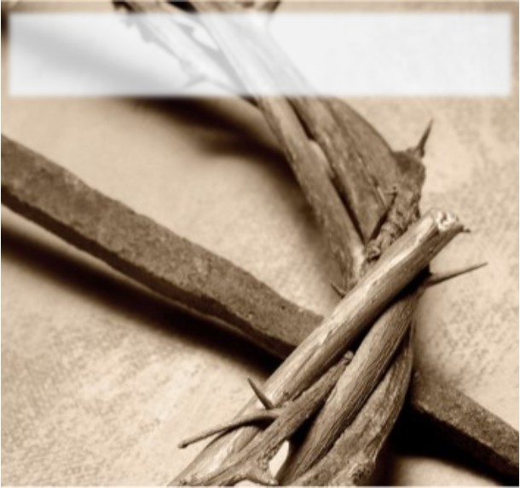
Gethsemane
Matthew 26:36-46 | Mark 14:32-42 | Luke 22:40-46 | John 18:1
They all mention…
Going to a certain place.
They all leave out just enough information.

Slide 33
Gethsemane
Matthew 26:36-46
Ephasizes…
“The two sons of Zebedee. v.37
“Fell on His face” v.39
What Jesus prayed for the second time v.42
Prayed the same words the third time v.44

Slide 34
Gethsemane
Mark 14:32-42
Ephasizes…
The disciples by name v.33
The theme of Jesus’ prayer v.35
“Abba! Father”v.36
One hour v.37 (Mt.26:40)
The reason the disciples did not answer Him the second time v. 40

Slide 35
Gethsemane
Luke 22:40-46
Ephasizes…
Does not mention the name of the place v.40
Does not mention the placement of the disciples, only “a stones throw” v.41
The help of an angel v.43
Sweat like drops of blood v.44
Sleeping from sorrow v.45

Slide 36
Gethsemane
John 18:1
Ephasizes…
The location over the Kidron.
That it was a garden place.

Slide 37
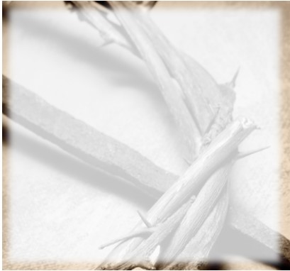
Lessons from Gethsemane.
The importance of prayer.
The need for companionship.
Obedience
Submission

Slide 38
The Betrayal
Matthew 26:47-56 | Mark 14:43-53 | Luke 22:47-53 | John 18:2-11
They all mention…
Judas as the betrayer
The multitude of people
Peter drawing the sword.

Slide 39
The Betrayal
Matthew 26:47-56
Emphasizes…
“Friend, do what you have come for v. 50
Take up the sword and die by the sword v.52
More than 12 legion of angels v.53
Fulfill scripture v.54

Slide 40
The Betrayal
Mark 14:43-53
Emphasizes…
They came with swords and clubs v.43 (Mt 26:55)
Every day I was with you v.49 (Mt 26:55)
One disciple escaped naked v.52

Slide 41
The Betrayal
Luke 22:47-53
Emphasizes…
More abbreviated
“Are you betraying the Son of Man with a kiss?” v.48
Shall we strike? v.49
Stop! v.51
Jesus healed the ear v.51
This hour and the power of darkness are yours v.53

Slide 42
The Betrayal
John 18:2-11
Emphasizes…
Judas knew where to go v.2
Romans were involved v.3
Lanterns torches and weapons v.3
Whom do you seek v.4
I am He v.5-8
Let these go their way v.8
I lost not one v.9
Slave of the high priest called Malchus v.10
Drink the cup v.11

Slide 43
Lessons from the betrayal.
The love of money.
The meekness of the Savior.
The misuse of the sword.
He didn’t lose one of the disciples but one of them lost Him.

