Slide 1
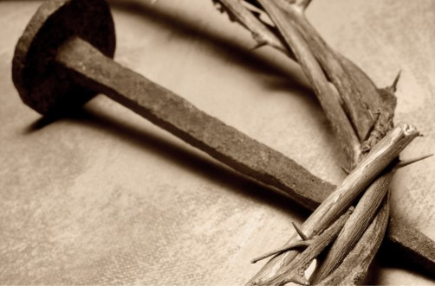
11 Things
About Jesus
John 20:31

Slide 2

“But these are written…”
John 20:31
The Events Recorded
in All of the Gospels

Slide 3
Therefore many other signs Jesus also performed in the presence of the disciples, which are not written in this book; but these have been written so that you may believe that Jesus is the Christ, the Son of God; and that believing you may have life in His name.
John 20:30-31

Slide 4

The Events
Baptism of Jesus: Mt. 3:1-17; Mk. 1:1-11; Lk. 3:1-22; Jn. 1:15-34.
Feeding of 5,000: Mt. 14:13-21; Mk. 6:30-44; Lk. 9:10-17; Jn. 6:1-15.
Peter's Profession: Mt. 16:13-19; Mk. 8:27-29; Lk. 9:18-20; Jn. 6:66-71.
Anointing by Mary: Mt. 26:6-13; Mk. 14:3-9; Lk. 7:36-50; Jn. 12:1-11.
Triumphal Entry: Mt. 21:1-11; Mk. 11:1-10; Lk. 19:29-44; Jn. 12:12-19.
Last Supper: Mt. 26:17-30; Mk. 14:12-26; Lk. 22:7-23; Jn. 13:1-35.

Slide 5
The Events
Gethsemane: Mt. 26:36-56; Mk. 14:32-52 Lk. 22:40-53; Jn. 18:1.
The Trials: Mt. 26:57-27:31; Mk. 14:43-15:20; Lk. 22:47-23:37; Jn. 18:2-19:3.
The Crucifixion: Mt. 27:32-56; Mk. 15:21-41; Lk. 23:26-56; Jn. 19:1-37.
His Burial: Mt. 27:57-28:15; Mk. 15:42-47; Lk. 23:50-56; Jn. 19:38-42.
The Resurrection: Mt. 28:1-10; Mk. 16:1-11; Lk. 24:1-12; Jn. 20:1-18.

Slide 6
The gospel preached to Cornelius and his house.
Acts 10:36-43

Slide 7
For I am not ashamed of the gospel, for it is the power of God for salvation to everyone who believes, to the Jew first and also to the Greek.
Romans 1:16

Slide 8

The Baptism of Jesus
Matthew 3:1-17 | Mark 1:1-11 | Luke 3:1-23 | John 1:15-34
They all…
Testify to the ministry of John the Baptizer.
Mention the prophecy concerning John.
  Isaiah 40:1-6
  Malachi 3:1; 4:5-6
Speak about the baptism of Jesus.

Slide 9
The Baptism of Jesus
Matthew 3:1-17
Emphasizes…
Repentance v.1 (Lk 3:3)
The person of John and his situation v.5,6 (Mk 1:6)
He mentions specifically the Pharisees and Sadducees v.7
Baptism of the Holy Spirit and fire v.11 (Lk 3:16)
To fulfill all righteousness v.15

Slide 10
The Baptism of Jesus
Mark 1:1-11
Emphasizes…
As it is written… v.2
He preached v.7-8
In those days v.9
Immediately v.10

Slide 11
The Baptism of Jesus
Luke 3:1-23
Emphasizes…
Time stamp v.1-2
Forgiveness of sins v.3 (Mk 1:4)
The message of John v.7-14 (Mt 3:7-10)
Image of the Messiah v.15-18
Jesus teaching and his age v.23

Slide 12
The Baptism of Jesus
John 1:15-34
Emphasizes…
The person of the Messiah v.15-18
The conflict of who John was v.19-26
The Lamb of God v.29
God’s signal to John v.33

Slide 13

Lessons from John
What it means to be the lone voice.
Devotion to the message.
Humility
Luke 7:24-28

Slide 14
The Feeding of 5,000
Matthew 14:13-21 | Mark 6:30-44 | Luke 9:10-17 | John 6:1-15
They all mention…
The persistence of the multitude.
The disciples' concern of the physical needs.
“Give them what you have.”
The disciples’ lack of faith.
The Prayer
The 12 baskets.
That the people ate until they were full.

