Slide 1
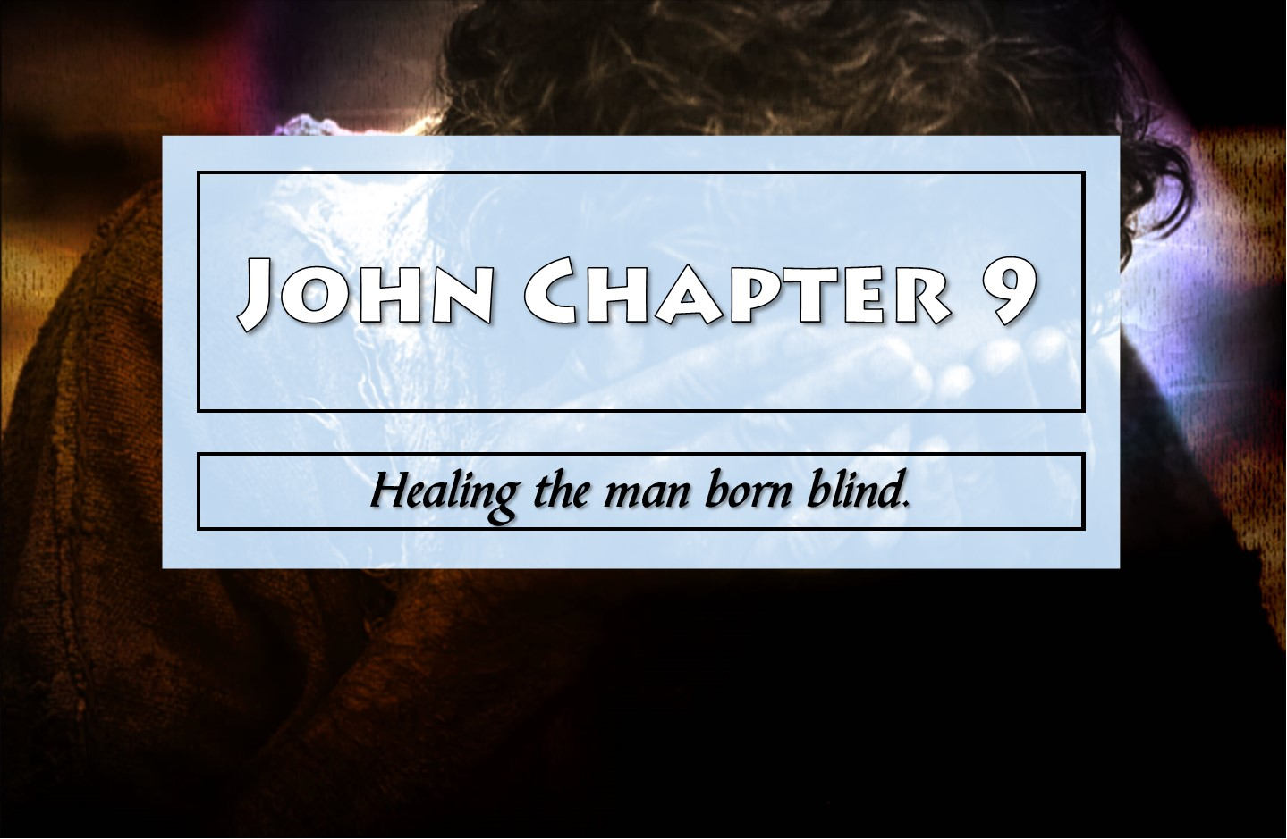

Slide 2
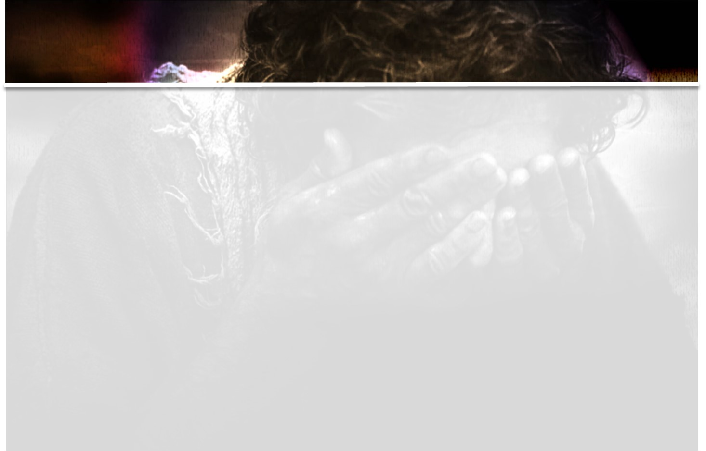
Context
Chapter 8 They couldn’t hear v.43-47
Chapter 9 They couldn’t see v.39-41
Chapter 10 The sheep hear and see v.24-28

Slide 3
Outline of chapter 9
1-7: The blind man and Jesus
8-12: This man and the people
13-34: This man and the Pharisees
35-41: A sheep with his Shepherd

Slide 4

1-7: The blind man and Jesus
“Who sinned?”
(Ezekiel 18:20; Luke 13:1-5; Romans 3:23)
“That the works of God…”
(John 6:28-29, 11:4)
“I am the light of the world”
(John 1:4-5; 8:12, 11:9; 2 Corinthians 4:4)
He spat
(Mark 7:33; 8:23; Malachi 4:2)

Slide 5
8-12: This man and the people
Dispute about the man born blind
“I am he!”
He tells the story

Slide 6
13-34: This man and the Pharisees
They brought him to the Pharisees
It was Sabbath
(Mark 2:28 “Lord even of the Sabbath”)
(Other Sabbath miracles John 5:1-18; Mark 1:24-28; 1:29-31; 3:1-6; Luke 6:6-11; 13:10-17; 14:1-6)
“What do you say about Him?”
Call in the parents
“Give glory to God”
“If this man…”

Slide 7
35-41: A sheep with his Shepherd
Jesus heard
(John 9:31; Psalm 4:3; 34:17; 69:33; 116:1)
“Do you believe in the Son of Man?”
(Daniel 7:12-13; Luke 21:27)
“seen Him…talking with you”
The lesson for those listening
(Mark 7:6-8; Malachi 4:5-6; Luke 1:17; Mark 2:16-17; Luke 18:9-14)

Slide 8
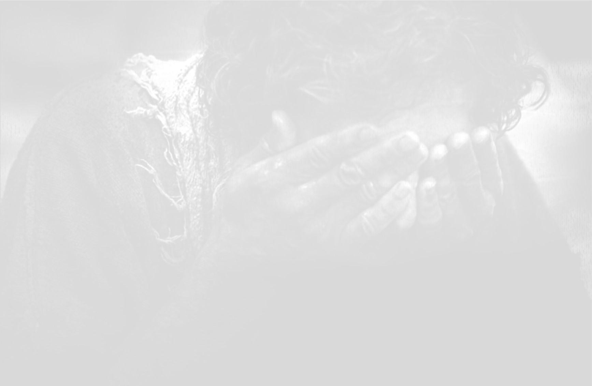
Take Away
Everybody else is blind.
People will believe what they want to, despite evidence.
Jesus hears His sheep.
Do not trust in your own righteousness.
Beware of the “leaven” of the Pharisees and Sadducees.

