Slide 1
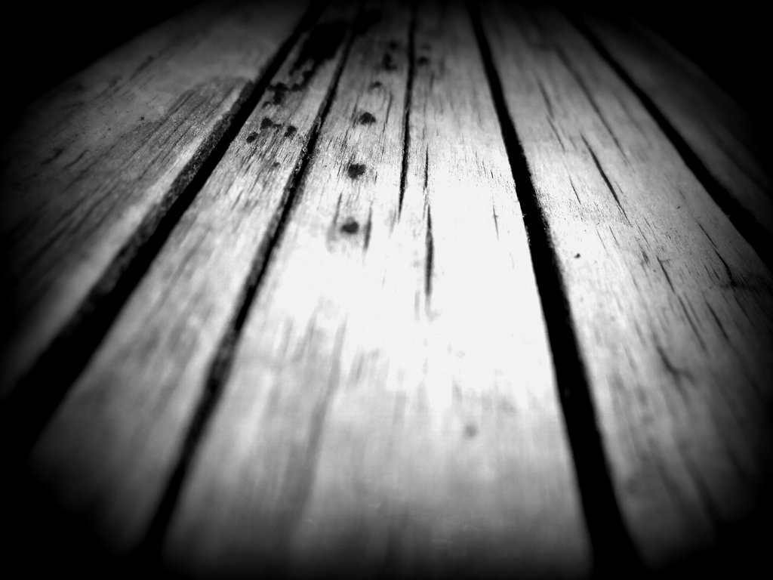
The Surrendered Life

Slide 2
Galatians 2:19-20
"For through the Law I died to the Law, so that I might live to God. "I have been crucified with Christ; and it is no longer I who live, but Christ lives in me; and the life which I now live in the flesh I live by faith in the Son of God, who loved me and gave Himself up for me.

Slide 3
Ecclesiastes 9:10
Whatever your hand finds to do, do it with all your might; for there is no activity or planning or knowledge or wisdom in Sheol where you are going.

Slide 4
Ezra 7:23
"Whatever is commanded by the God of heaven, let it be done with zeal for the house of the God of heaven, so that there will not be wrath against the kingdom of the king and his sons.

Slide 5
Colosians 3:17
Whatever you do in word or deed, do all in the name of the Lord Jesus, giving thanks through Him to God the Father.

Slide 6
2 Peter 3:14
Therefore, beloved, since you look for these things, be diligent to be found by Him in peace, spotless and blameless.

Slide 7
Matthew 6:33
"But seek first His kingdom and His righteousness, and all these things will be added to you.”

Slide 8
James 4:7-8
Submit therefore to God. Resist the devil and he will flee from you. Draw near to God and He will draw near to you. Cleanse your hands, you sinners; and purify your hearts, you double-minded.

Slide 9
What do these passages have in common?
Diligence, Devotion and Dedication

Slide 10
Consider King David
1 Chronicles 29:1-5
1. Recognized that the “work was great” v1
2. Stated that the work “was not for man,
but for the Lord God.” v1
3. Prepared for this work “with all his might.” v2
4. The house of the Lord was the focus of his
devotion. v3
5. Raised a question, “Who, then, is willing to
consecrate his service this day unto the Lord?”
v5

Slide 11
What is the surrendered life?

Slide 12
The surrendered life is… a surrounded life.
Job and the hedge about him. (Job 1:10, 1 Peter 1:5)
We are surrounded by God today. (Romans 5:20, 1:17, 1 John 4:4, Psalm 119:11)
We are surrounded by sin. (1 Peter 5:8)
We are kept buy the power of God. (1 Peter 1:5)
If we remain faithful God will keep us. (2 Timothe (2 Timothy 1:12)

