Slide 1
Building a Stronger Relationship with the Church

Slide 2
What is the Church? Meaning of the word “Church”
It is used to refer to a regularly summoned legislative body (Acts 19:39).
A casual gathering of people (Acts 19:32, 40).
People with shared belief. Used of Israel (Deut. 31:30; Judges 20:22) and Christians (Matt. 18:17; cf. 1 Cor. 11:18; 3 John 6).
Congregation or church as the totality of Christians living and meeting in a particular locality or larger geographical area, but not necessarily limited to one meeting place (Acts 5:11; 8:3; 9:31).
The global community of Christians (Matt. 16:18; Acts 9:31).

Slide 3
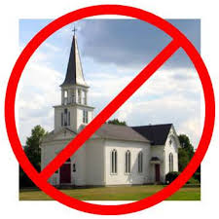
We Are The Church, Not The Building!

Slide 4
Essentials to Building a Stronger Relationship with the Church

Slide 5
We must understand that we are members of one another
Rom. 12:4-5; cf. 1 Cor. 12:12-27
The day you obeyed the gospel and you were added to the church by Jesus (Acts 2:47), you were added to the one big family of God (Eph. 2:19; cf. 1 Tim. 3:15).
If you preach Jesus, then by necessity, you must preach the church; since you cannot preach a head without a body or vice versa (Eph. 1:22-23; Col. 1:18, 24).

Slide 6
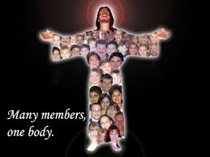
Members of One Another!

Slide 7
We Must

Slide 8
Why should we love one another?
Because it is a commandment (John 15:17; 1 John 4:21; cf. Rev. 22:14).
Because it is a badge of discipleship (John 13:34-35).
Because it is the fulfillment of the law (Rom. 13:8-10).
Because it helps us abide in the light and prevents us from stumbling (1 John 2:10).
Because we will be considered murderers if we don’t love one another (1 John 3:15).
Because God loved us (1 John 4:9-11).

Slide 9
How should we love one another?
We should love one another as Christ loved us (John 13:34-35; 1 Jn. 3:16).
We should love one another as we love ourselves (Matt. 22:39).
We should love one another genuinely and fervently (1 Pet. 1:22; 4:8).
We should love one another in deed and not word only (1 John 3:18).
We should love one another the 1 Corinthians 13:4-8 way!

Slide 10
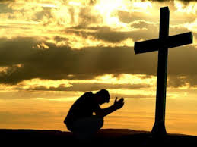
We must pray for one another (James 5:16)

Slide 11
Why should we pray for one another?
Because the Bible gives us examples for doing so: 1) Moses prayed for the children of Israel (Ex. 32:31-32), 2) Paul prayed for the brethren (Phil. 1:3-4, 9-11) and he requested prayers for himself too (Eph. 6:18-20), and 3) Jesus prayed for all of us (John 17:20-21).
Because it is a sin not to pray for one another (1 Sam. 12:23).

Slide 12
For whom should we pray specifically?
We should pray for the Elders (Heb. 13:17).
We should pray for the preachers (Acts 12:5; Eph. 6:18-20; 1 Thess. 5:25; 2 Thess. 3:1-2).
We should pray for the sick (James 5:13-16).
We should pray for the needs of each individual member!

Slide 13
We must confess our faults one to another (James 5:16)

Slide 14
What does it mean to confess our faults one to another?
It could mean confessing some weakness with the intent of receiving assistance from another brother in Christ to overcome such.
It could mean confessing some offense and asking for forgiveness (Luke 17:3-4).
It could mean making some public confession of some public offense and asking for the prayers of the church that one may be forgiven and receive strength.

Slide 15
Wrong View of Confession

Slide 16
Consider One Another

Slide 17
What are some of the things we must consider?
We must consider one another’s feelings (Phil. 2:4).
We must consider one another’s reputation (Matt. 5:13-16).
We must consider one another’s conscience (1 Cor. 8:13; cf. Rom. 15:1-3).

Slide 18
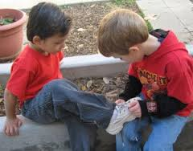
We must be hospitable and serve one another (Gal. 5:13)

Slide 19
Hospitality and Service Go Hand in Hand!
We must be hospitable to one another without grumbling (1 Pet. 4:9).
Service is a mark of true greatness and in serving one another we are serving the Lord (Matt. 20:26-28; 25:31-46).

Slide 20
We must encourage and comfort one another (Heb. 3:13; 1 Thess. 4:18)

Slide 21
Encouraging & Comforting
If someone is feeling discourage, we can encourage him or her.
If someone is shy and wants to get involved more in the church, we can encourage him or her (Acts 4:36; 9:26-28).
If someone lost a loved one, we can comfort them by being there for them during those difficult times; and thus, weep with those who weep (Rom. 12:15).

Slide 22
Conclusion
We must practice these essential principles in order for us to be able to build a stronger relationship with the church; otherwise, we will become stagnant in our spiritual growth and in our relationship with one another.

