Slide 1
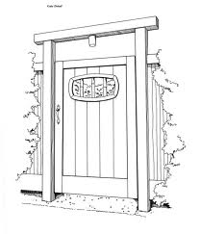
The Narrow Gate

Slide 2
Matthew 7: 13,14
“ Enter by the narrow gate; for wide is the gate
and broad is the way that leads to destruction, and there are many who go in by it.
Because narrow is the gate and difficult is the
way that leads to life, and there are few who find it.”
Palm Beach Lakes Bible study, Oct 27th

Slide 3

We all have choices

Slide 4
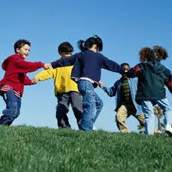
Those that have children at home, what choices are you giving them?

Slide 5
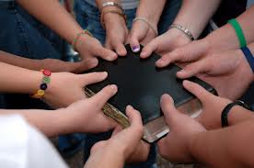
Hey teens & young adults,
what choices are you making?

Slide 6
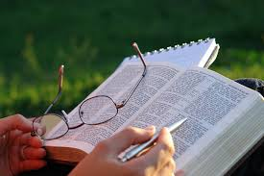
Choices
What about the rest of us?
What choices are we making?
What road are we taking?

Slide 7
Choices
Quotes on decision making :
“ a good decision is based on knowledge and not on numbers”. - Plato
“nothing is more difficult, and therefore more precious than to be able to decide”.
- Napoleon
“ in a moment of decision, the best thing you can do is the right thing you can do”.
- Theodore Roosevelt

Slide 8
Choices
Help at making good choices
from the book of Proverbs.
Proverbs 14: 12 the way that seems right
Proverbs 16: 3 success with God
Proverbs 16:9 let the Lord establish your way
Proverbs 19:21 the Lord has a purpose

Slide 9
Choices
Other instruction on making good choices.
Deuteronomy 31: 6 God will not leave us
Jeremiah 29:11 hope and a future
Ephesians 4: 32 forgiving others
Philippians 4: 13 Christ strengthens us

Slide 10
Decision Making Steps
1. Begin with prayer. Frame your mind with trust.
2. Define your decision. Moral or non- moral.
Remember Psalm 119: 105
3. Be ready to accept and obey God’s answer.
Look at Proverbs 3: 5-6
4. Exercise faith. Hebrews 11: 6
5. Seek concrete direction.
6. Obtain counsel. Proverbs 15:22
7. Choose your spiritual priorities.

Slide 11
Setting Spiritual Priorities
1. Attend every time the doors are open.
2. Make 9:00 AM Bible class a priority.
3. Read and study your Bible everyday.
4. Make your prayer life rich.
5. Choose spiritually minded friends.
6. Commit yourself in service to others.

Slide 12

Deciding on the right kind of fruit
Galatians 5: 22 – 23
Concentrate on these qualities along the difficult way.
Love Goodness
Joy Faithfulness
Peace Gentleness
Longsuffering Self – control
Kindness

Slide 13
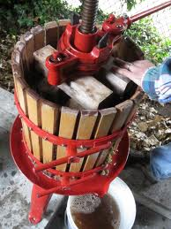
The way could be difficult
“ Difficult” is from the Greek word thlibo.
Which means : “To press (as grapes),press hard
upon; a compressed way; narrow straitened,
contracted”

Slide 14
Advice to would be followers
Jesus addresses “following Him”
Look at Luke 9: 57- 62

Slide 15
Putting God’s Kingdom First
“ But seek first the Kingdom of God, and His righteousness, and all these things will be added
to you”. Matthew 6: 33

Slide 16
More examples of the hard road
Luke 14:26 – desiring something less than something else.
If company comes in town, what do
you do on Sunday and Wednesday?
If you are out of town , do you seek to worship in spirit and in truth?

Slide 17

Bearing the cross
Luke 14: 27
“whoever does not bear his cross and
come after Me cannot be My disciple.”

Slide 18
Bearing the cross
Deny yourself- give up anything that would hinder us from following God and His will.
Matthew 6: 19-24, Romans 12:1,2 : 2 Cor. 5:14,15
Giving your whole self to God-
Romans 6:13, Philippians 3: 8- 10

Slide 19
Count the cost
Luke 14: 28 -30
There could be hardship & challenges.
Your relationships might need to change.
But your reward is great !!

Slide 20
Jesus does not just want numbers
John 6: 25-66
Jesus does not just want numbers, He
wants disciples.
Jesus purchased the church with His
blood. Acts 20: 28

Slide 21
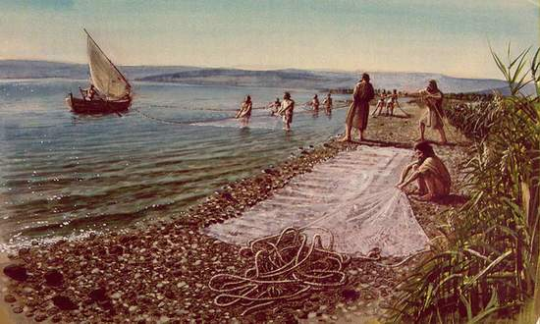
The Dragnet
Matthew 13: 47, 48
.. The kingdom of heaven is like a dragnet…..

Slide 22
Staying Focused
Keep your heart and mind focused on
Jesus Christ. He is the author of our salvation.
Colossians 3: 2 - things above.
Psalm 1: 1-6 - meditating day and night.
2 Timothy 2:15 - present yourself to God.
1 Peter 3:17 - suffering for doing good.
Proverbs 2: 2-5 - attentive to wisdom.

Slide 23
A Different Perspective
The wide gate and the broad way
in perspective of false teaching.

Slide 24
Taking another look at
Matthew chapter 7
Matthew 7 : 15 – 27
False prophets
Good and bad fruit
The will of My Father
The wise man built his house upon a rock.

Slide 25
Acts of worship
Singing - Ephesians 5:19, Colossians 3:16,
Hebrews 2:12
The Lord’s Supper – Acts 20: 7, 1 Cor. 11:20
Is God specific on how He wants to be
worshiped?

Slide 26
Types of worship
1. True worship – John 4:24
2. Vain worship - Matthew 15:9

Slide 27
One church
The concept of there is only one church
may be foreign to many people.
Ephesians 3: 21, Matt. 16:18
Ephesians 4: 4- 6 - List of “ones”
Ephesians 5: 23 – Christ is the head
Psalm 127:1 - Building in vain

Slide 28
Who is the audience?
Worship is not for our entertainment.
It is erroneous to think that we attend worship
to “get something out of worship”
Hebrews 13: 15 - sacrifice of praise.
Galatians 1:10 - do I seek to please men?

