Slide 1
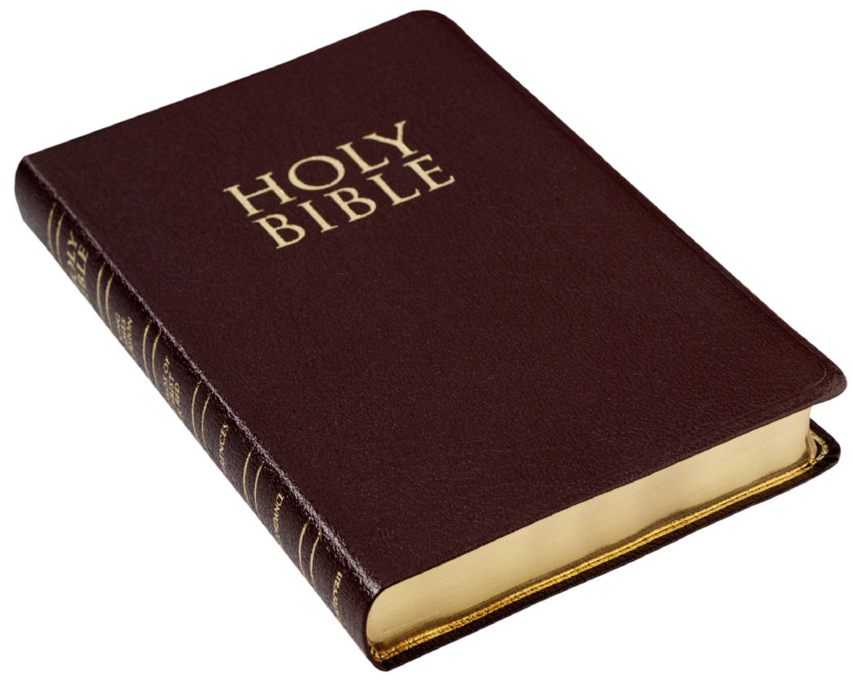
Bible Authority And Faith

Slide 2
Bible Authority
Bible authority is often questioned
or modified.

Slide 3
First Look
To believe that the Bible has authority we must
agree with Genesis 1:1
and Hebrews 11:6

Slide 4
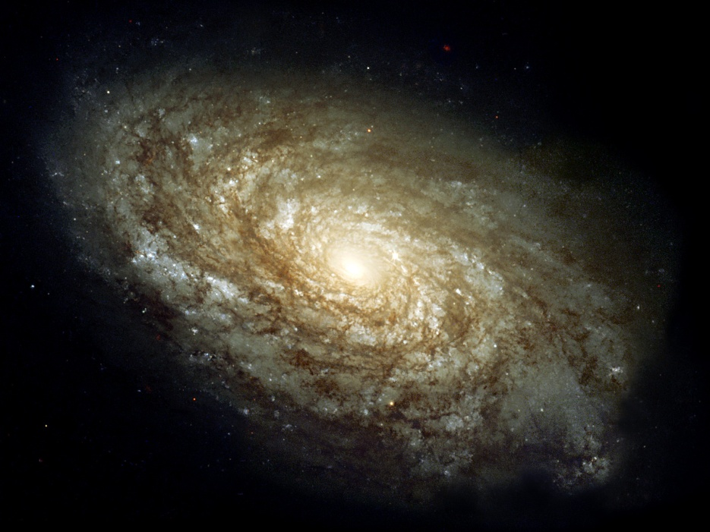
God Is Sovereign
God is sovereign over the universe. Romans 11:33-36

Slide 5
God Communicates
It is reasonable to assume that our sovereign creator would communicate to His creation.
2 Tim. 3:16-17
John 16:7, 13

Slide 6
God Gives Us The Bible
God gives us His word to guide us in this life and to prepare us for eternity.
Acts 20:32
Hebrews 12:2

Slide 7
God Sends The Messiah
God gives mankind a redeemer
to save him from his sins.
John 1:1
The words of Jesus will judge us.
John 12:48

Slide 8
Bible Characters And The Word Of God
Job Job 23:12
David Psalm 19:10
Isaiah Isaiah 40:8

Slide 9
Our Faith And The Word
God's word creates our faith.
Romans 10:17
2 Corinthians 5:7
Hebrews 11:6, 12:2
Romans 14:23

Slide 10
Our Faith And The Word
Where is faith in your life?
Where is the Word of God in
your life?
Psalm 119:11

Slide 11
Our Faith And The Word
A look at faith through Hebrews 11.
The Word of God presents us with
the faith of others.

Slide 12
Our Worship and God's Word
Our worship to God is tied into our acceptance of the authority of the Bible.
John 4:24
John 3:5

Slide 13
Our Worship and God's Word
Our worship to God is tied into our acceptance of the authority of the Bible.
Eph. 5:19 Col. 3:16

Slide 14
Our Worship and God's Word
Our worship to God is tied into our acceptance of the authority of the Bible.
I Cor. 11:23-26

Slide 15
Our Relationships And God's Word
With our spouse.
Eph. 5: 22-25
With our enemies.
Luke 6: 27-28

Slide 16
Our Relationships And God's Word
With our children.
Eph. 6:4
Deut. 11:18-19
Prov. 22:6

Slide 17
Our Relationships And God's Word
With employees/employers.
I Peter 2:18-20
Colossians 4:1

Slide 18
Our Stewardship And God's Word
Matt. 25:14-30
Mark 4:18-19
Luke 12:15, 23, 34

Slide 19
The World Around Us And God's Word
New York approves Gay marriage.
Romans 1:27
I Cor. 6:9-10

Slide 20
The World Around Us And God's Word
Roe Vs. Wade 1973
Abortion issue in the U.S.
Psalm 139:13
Jeremiah 1:5

Slide 21
Evolution vs. Bible Authority
Genesis 1 explicitly gives us the account of Creation.
Do we have the authority to believe anything differently?

Slide 22
Authority And The Silence Of The Scriptures
The silence of the scriptures is just as authoritative as written scripture.
Silence of the scripture is always
prohibitive.

Slide 23
Authority And The Silence Of The Scriptures
The silence of the scriptures is just as authoritative as written scripture.
Deut. 17:3
Hebrews 7:14

Slide 24
Authority And The Silence Of The Scriptures
The silence of the scriptures is just as authoritative as written scripture.
Matt. 26:26-28
Acts 20:7

Slide 25
Authority And The Silence Of The Scriptures
The silence of the scriptures is just as authoritative as written scripture.
I Samuel 15:1- 35

Slide 26
Authority And The Silence Of The Scriptures

