Slide 2
The church was established in Philippi on Paul’s Second Missionary Journey
Paul received the “Macedonian call” while in Troas (Acts 16:9-10)
Paul, Silas, Timothy and Luke traveled to Philippi (in Macedonia → in Europe)
Paul and Silas were imprisoned for casting out a demon (16:16-24)
Paul taught the gospel to Lydia (and her family) and the jailor (and his family)

Slide 3
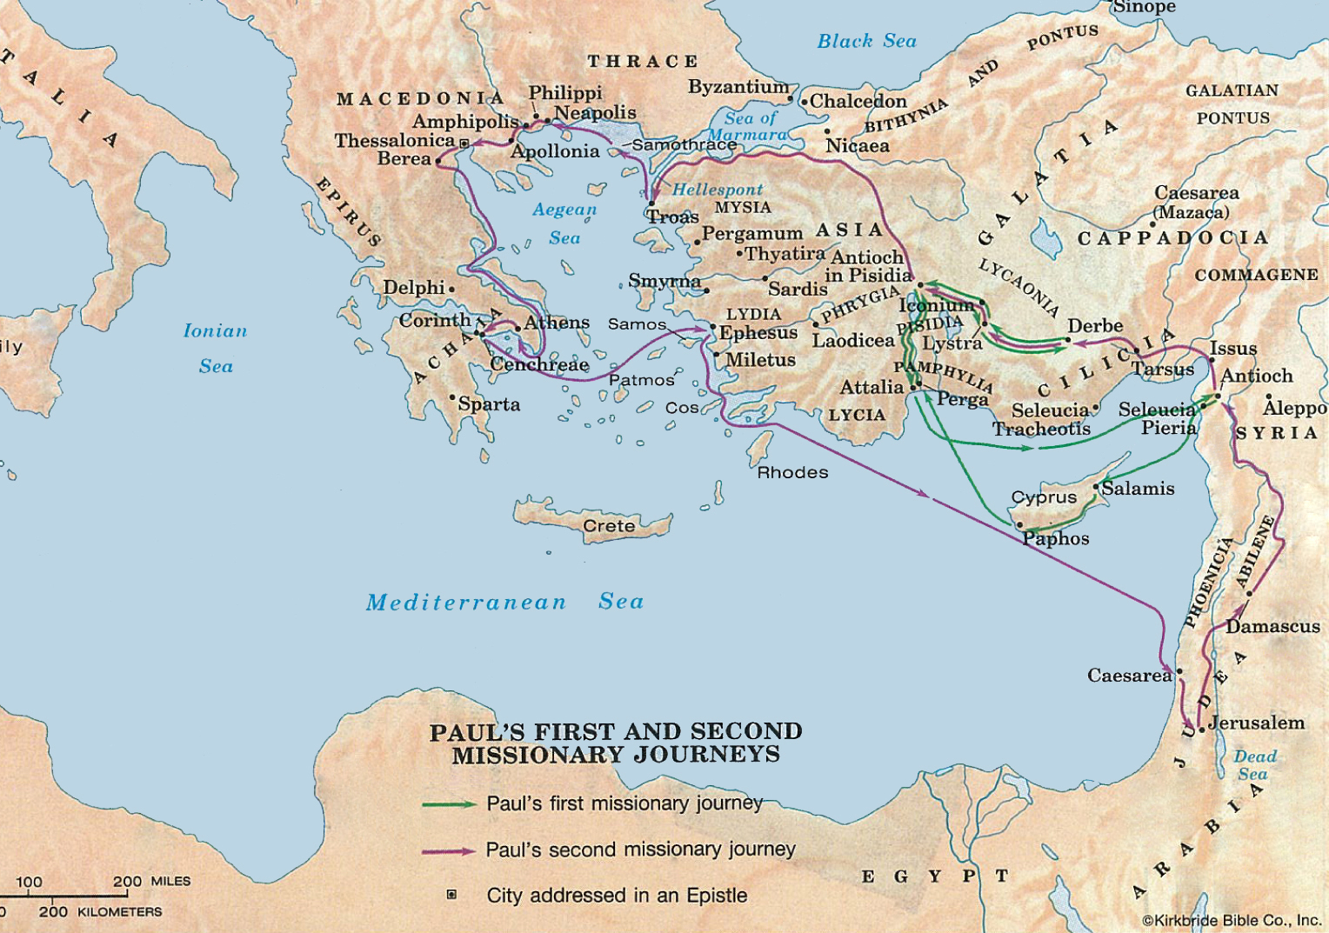

Slide 5
Period of Writing | Books | Description | Date | Theme
Second Missionary Journey | 1 Thessalonians 2 Thessalonians | The First Epistles | 51-52 A.D. | Eschatology: Last Things
Third Missionary Journey | Galatians 1 Corinthians 2 Corinthians Romans | The Impregnable Quartet | 53-57 A.D. | Soteriology: Salvation
First Roman Imprisonment | Colossians Philemon Ephesians Philippians | The Prison Epistles | 60-62 A.D. | Christology: Christ
Release & 2nd Roman Imprisonment | 1 Timothy Titus 2 Timothy | The Evangelist Epistles | 62-68 A.D. | Ecclesiology: The Church

Slide 6
The church was established in Philippi on Paul’s Second Missionary Journey
Paul received the “Macedonian call” while in Troas (Acts 16:9-10)
Paul, Silas, Timothy and Luke traveled to Philippi (in Macedonia → in Europe)
Paul and Silas were imprisoned for casting out a demon (16:16-24)
Paul taught the gospel to Lydia (and her family) and the jailor (and his family)
Paul wrote the letter of Philippians to one of his favorite congregations
He wrote the letter (1:1) from Roman prison (Acts 28:30-31; Phil. 1:7, 13, 14, 16)
The letter was written around 60-62 A.D. (10-12 years after church established)
The letter is very personal and affectionate (115 1st-person pronouns in 104 vss)
The letter is characterized by joy (“joy” and “rejoice” found 16 times)
The letter emphasizes viewing everything through the gospel (1:5, 7, 12, 27; 4:3)
The letter was written upon receipt of the brethren’s most recent gift (4:15-18)
The theme of the book: ____________________________________________

Slide 8
The Joy of
Prayerful Fellowship
(1:1-11)
#1

