Slide 1
A Study of Isaiah
Cyrus
September 18, 2019
Palm Beach Lakes
Dan Jenkins

Slide 2
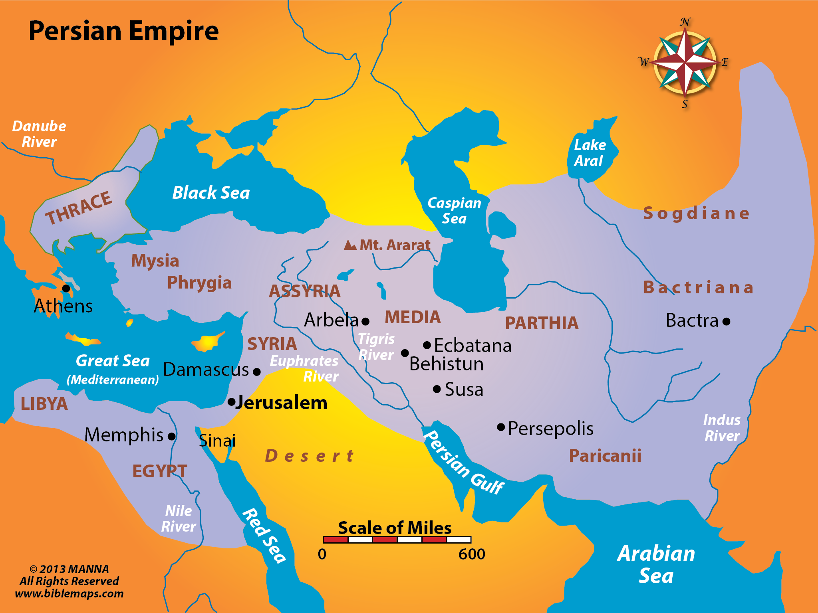
BABYLON

Slide 3
28
God’s Servant—Isaiah 42:1-9
sss
1 "Behold! My Servant whom I uphold, My Elect One in whom My soul delights! I have put My Spirit upon Him; He will bring forth justice to the Gentiles.
2 He will not cry out, nor raise His voice, Nor cause His voice to be heard in the street.
3 A bruised reed He will not break, And smoking flax He will not quench; He will bring forth justice for truth. (Look at Matt. 12:18-21)
4 He will not fail nor be discouraged, Till He has established justice in the earth; And the coastlands shall wait for His law."
5 Thus says God the LORD, Who created the heavens and stretched them out, Who spread forth the earth and that which comes from it, Who gives breath to the people on it, And spirit to those who walk on it:
6 "I, the LORD, have called You in righteousness, And will hold Your hand; I will keep You and give You as a covenant to the people, As a light to the Gentiles,
7 To open blind eyes, To bring out prisoners from the prison, Those who sit in darkness from the prison house.
8 I am the LORD, that is My name; And My glory I will not give to another, Nor My praise to carved images.
9 Behold, the former things have come to pass, And new things I declare; Before they spring forth I tell you of them."

Slide 4
28
God Punishes Rebellious Jews—Isaiah 42:21-25
sss
18 "Hear, you deaf; And look, you blind, that you may see.
19 Who is blind but My servant, Or deaf as My messenger whom I send? Who is blind as he who is perfect, And blind as the LORD's servant?
20 Seeing many things, but you do not observe; Opening the ears, but he does not hear."
21 The LORD is well pleased for His righteousness' sake; He will exalt the law and make it honorable.
22 But this is a people robbed and plundered; All of them are snared in holes, And they are hidden in prison houses; They are for prey, and no one delivers; For plunder, and no one says, "Restore!"
23 Who among you will give ear to this? Who will listen and hear for the time to come?
24 Who gave Jacob for plunder, and Israel to the robbers? Was it not the LORD, He against whom we have sinned? For they would not walk in His ways, Nor were they obedient to His law.
25 Therefore He has poured on him the fury of His anger And the strength of battle; It has set him on fire all around, Yet he did not know; And it burned him, Yet he did not take it to heart.

Slide 5
28
God Shows Folly of Idolatry—Isaiah 44:9-20
9 Those who make an image, all of them are useless, And their precious things shall not profit; They are their own witnesses; They neither see nor know, that they may be ashamed.
10 Who would form a god or mold an image That profits him nothing?
11 Surely all his companions would be ashamed; And the workmen, they are mere men. Let them all be gathered together, Let them stand up; Yet they shall fear, They shall be ashamed together.
12 The blacksmith with the tongs works one in the coals, Fashions it with hammers, And works it with the strength of his arms. Even so, he is hungry, and his strength fails; He drinks no water and is faint.
13 The craftsman stretches out his rule, He marks one out with chalk; He fashions it with a plane, He marks it out with the compass, And makes it like the figure of a man, According to the beauty of a man, that it may remain in the house.
14 He cuts down cedars for himself, And takes the cypress and the oak; He secures it for himself among the trees of the forest. He plants a pine, and the rain nourishes it.
15 Then it shall be for a man to burn, For he will take some of it and warm himself; Yes, he kindles it and bakes bread; Indeed he makes a god and worships it; He makes it a carved image, and falls down to it.

Slide 6
28
God Shows Folly of Idolatry—Isaiah 44:9-20
16 He burns half of it in the fire; With this half he eats meat; He roasts a roast, and is satisfied. He even warms himself and says, "Ah! I am warm, I have seen the fire."
17 And the rest of it he makes into a god, His carved image. He falls down before it and worships it, Prays to it and says, "Deliver me, for you are my god!"
18 They do not know nor understand; For He has shut their eyes, so that they cannot see, And their hearts, so that they cannot understand.
19 And no one considers in his heart, Nor is there knowledge nor understanding to say, "I have burned half of it in the fire, Yes, I have also baked bread on its coals; I have roasted meat and eaten it; And shall I make the rest of it an abomination? Shall I fall down before a block of wood?"
20 He feeds on ashes; A deceived heart has turned him aside; And he cannot deliver his soul, Nor say, "Is there not a lie in my right hand?"

Slide 7
28
God Pleads to His People—Isaiah 43:22-28
22 "But you have not called upon Me, O Jacob; And you have been weary of Me, O Israel.
23 You have not brought Me the sheep for your burnt offerings, Nor have you honored Me with your sacrifices. I have not caused you to serve with grain offerings, Nor wearied you with incense.
24 You have bought Me no sweet cane with money, Nor have you satisfied Me with the fat of your sacrifices; But you have burdened Me with your sins, You have wearied Me with your iniquities.
25 "I, even I, am He who blots out your transgressions for My own sake; And I will not remember your sins.
26 Put Me in remembrance; Let us contend together; State your case, that you may be acquitted.
27 Your first father sinned, And your mediators have transgressed against Me.
28 Therefore I will profane the princes of the sanctuary; I will give Jacob to the curse, And Israel to reproaches.

Slide 8
28
God Promise of Deliverance—Isaiah 44:21-45:7
21 "Remember these, O Jacob, And Israel, for you are My servant; I have formed you, you are My servant; O Israel, you will not be forgotten by Me!
22 I have blotted out, like a thick cloud, your transgressions, And like a cloud, your sins. Return to Me, for I have redeemed you."
23 Sing, O heavens, for the LORD has done it! Shout, you lower parts of the earth; Break forth into singing, you mountains, O forest, and every tree in it! For the LORD has redeemed Jacob, And glorified Himself in Israel.
24 Thus says the LORD, your Redeemer, And He who formed you from the womb: "I am the LORD, who makes all things, Who stretches out the heavens all alone, Who spreads abroad the earth by Myself;
25 Who frustrates the signs of the babblers, And drives diviners mad; Who turns wise men backward, And makes their knowledge foolishness;
26 Who confirms the word of His servant, And performs the counsel of His messengers; Who says to Jerusalem, 'You shall be inhabited,' To the cities of Judah, 'You shall be built,' And I will raise up her waste places;
27 Who says to the deep, 'Be dry! And I will dry up your rivers';
28 Who says of Cyrus, 'He is My shepherd, And he shall perform all My pleasure, Saying to Jerusalem, "You shall be built," And to the temple, "Your foundation shall be laid." '

Slide 9
28
God Promise of Deliverance—Isaiah 44:21-45:7
1 "Thus says the LORD to His anointed, To Cyrus, whose right hand I have held—To subdue nations before him And loose the armor of kings, To open before him the double doors, So that the gates will not be shut:
2 'I will go before you And make the crooked places straight; I will break in pieces the gates of bronze And cut the bars of iron.
3 I will give you the treasures of darkness And hidden riches of secret places, That you may know that I, the LORD, Who call you by your name, Am the God of Israel.
4 For Jacob My servant's sake, And Israel My elect, I have even called you by your name; I have named you, though you have not known Me.
5 I am the LORD, and there is no other; There is no God besides Me. I will gird you, though you have not known Me,
6 That they may know from the rising of the sun to its setting That there is none besides Me. I am the LORD, and there is no other;
7 I form the light and create darkness, I make peace and create calamity; I, the LORD, do all these things.'

Slide 10
28
Fulfillment of Isaiah 44:21-45:7
1 Now in the first year of Cyrus king of Persia, that the word of the LORD by the mouth of Jeremiah might be fulfilled, the LORD stirred up the spirit of Cyrus king of Persia, so that he made a proclamation throughout all his kingdom, and also put it in writing, saying,
2 Thus says Cyrus king of Persia: All the kingdoms of the earth the LORD God of heaven has given me. And He has commanded me to build Him a house at Jerusalem which is in Judah.
3 Who is among you of all His people? May his God be with him, and let him go up to Jerusalem which is in Judah, and build the house of the LORD God of Israel (He is God), which is in Jerusalem.
4 And whoever is left in any place where he dwells, let the men of his place help him with silver and gold, with goods and livestock, besides the freewill offerings for the house of God which is in Jerusalem.
5 Then the heads of the fathers' houses of Judah and Benjamin, and the priests and the Levites, with all whose spirits God had moved, arose to go up and build the house of the LORD which is in Jerusalem.
Ezra 1:1-5

